Slide 1
ML/DL Assignment MIMIC-IV : Mortality Prediction for Acute Respiratory Failure Patients
Ankita Savaliya

Slide 2
MIMIC-IV : Mortality Prediction for Acute Respiratory Failure Patients
Goal:
Load and preprocess MIMIC-IV EHR data related to Acute Respiratory Failure (ARF).
Analyze demographic and lab test indicators for ARF.
Construct a structured dataset for modeling.
Apply classification and deep learning models to EHR data.
Compare model performances.
Predict mortality in ARF patients.
Dataset: MIMIC-IV dataset.
GitHub and Google Colab Links:​
https://colab.research.google.com/github/AnkitaSavaliya/AIH/blob/main/MIMIC-IV_MORTALITY_PREDICTION_ARF.ipynb
https://github.com/AnkitaSavaliya/AIH/blob/main/MIMIC-IV_MORTALITY_PREDICTION_ARF.ipynb

Slide 3
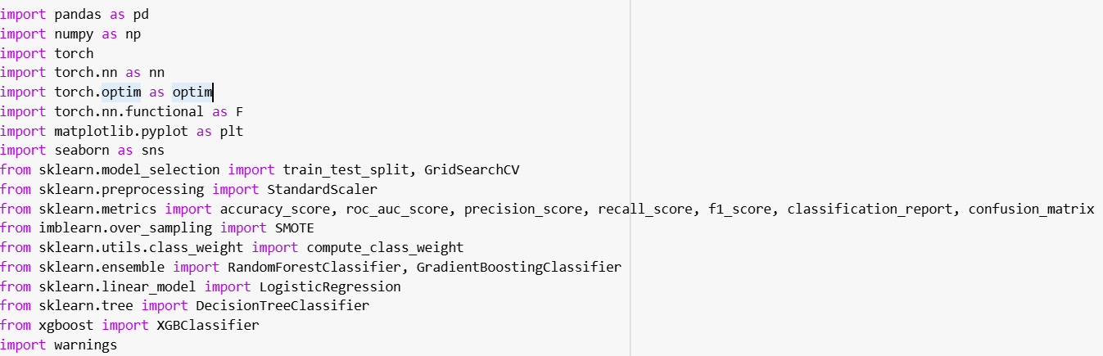

Step 1: Import required libraries
Import libraries in Google Colab like pandas, sklern, matplotlib, torch etc.
Mount Google Drive where MIMIC-IV CSV files are stored.

Slide 4
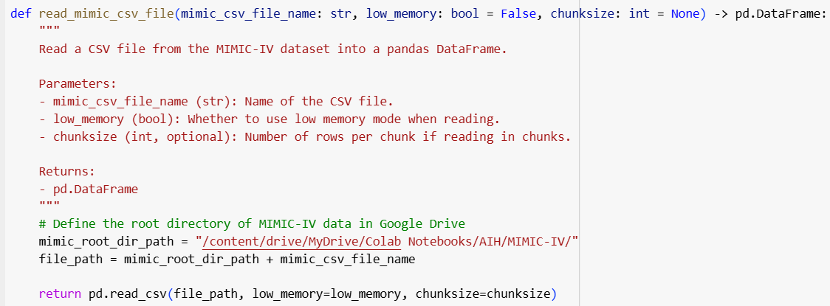
Step 2: Loading and Filter Data for ARF
This function reads a given CSV file from the MIMIC-IV dataset (stored in Google Drive) and returns a pandas DataFrame. Some files, like labevents, are very large, so this method supports reading in chunks to optimize memory usage.

Slide 5
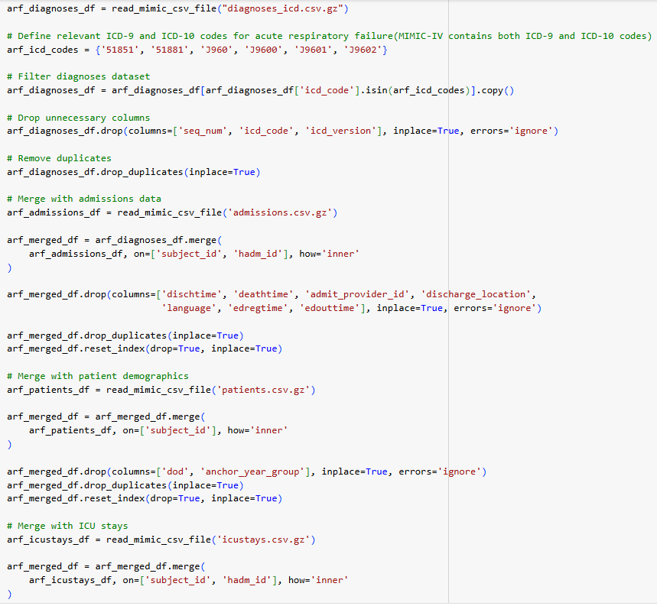
Step 2: Loading and Filter Data for ARF(Continued)...
This part filters diagnoses using ICD-9 and ICD-10 codes related to Acute Respiratory Failure (ARF) and merges the filtered data with the admissions, patients, and ICU stays tables. Additionally, unnecessary columns are dropped, duplicates are removed, and the dataset is reset for a clean structure.

Slide 6
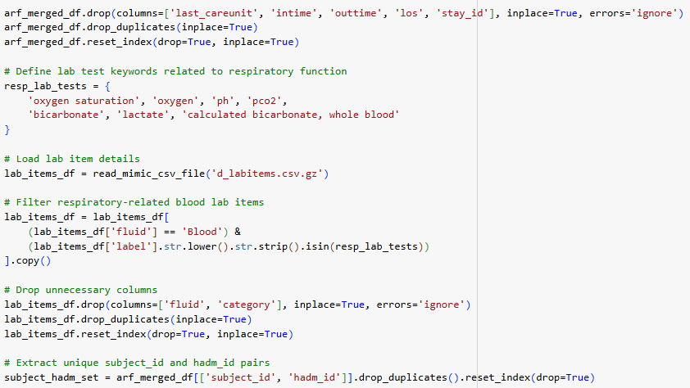
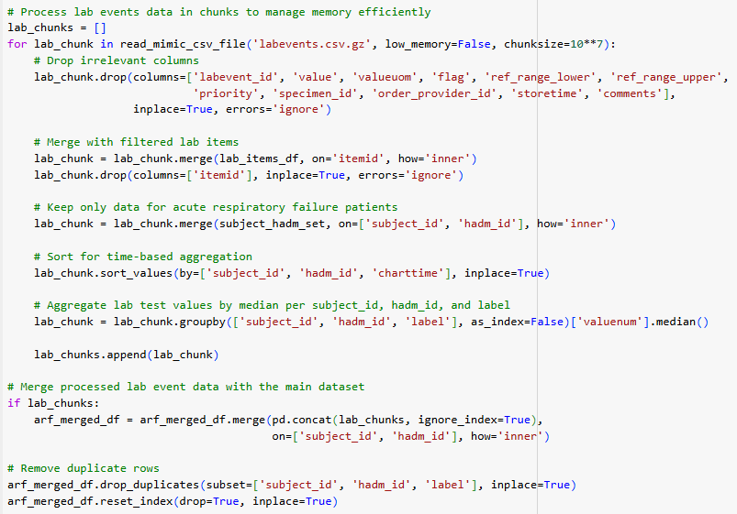
Step 2: Loading and Filter Data for ARF(Continued)...
Lab tests, such as oxygen saturation, pH, pCO₂, and bicarbonate levels, are critical indicators of respiratory function and can serve as important features for mortality prediction. This code filters ARF-specific lab events and merges the datasets. To manage the large volume of lab event data efficiently, we processed it in chunks, ensuring memory optimization throughout the process.

Slide 7
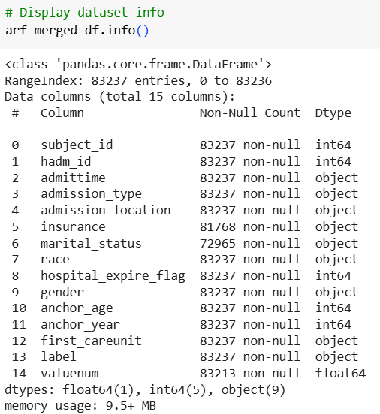
Step 2: Loading and Filter Data for ARF(Continued)...
After loading and filtering the data, the columns include patient identifiers, admission details, lab test results, and demographic information related to Acute Respiratory Failure (ARF). The next step involves understanding, processing, and cleaning the data to ensure it's ready for modeling. This may include handling missing values, transforming variables, and ensuring consistency across datasets.

Slide 8
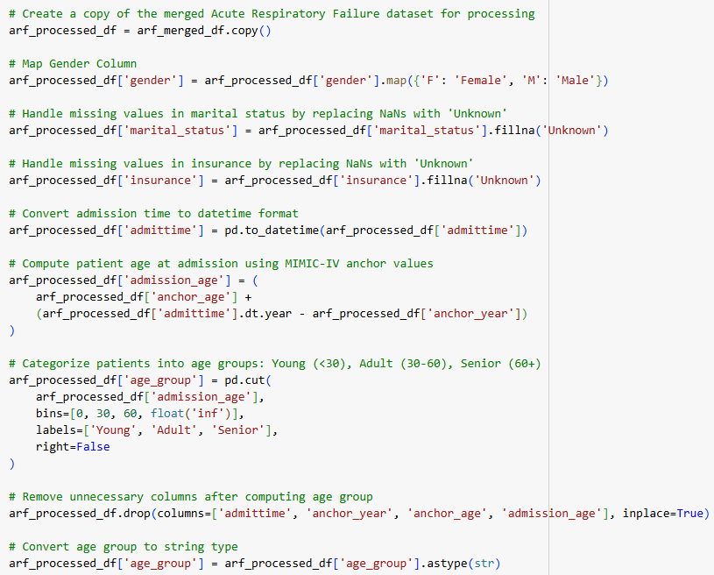
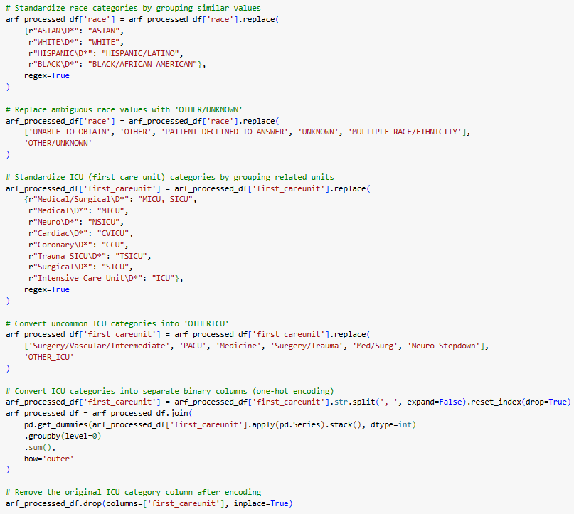
Step 3: Preprocessing and Feature Engineering for ARF
This step performs preprocessing (cleaning, mapping) and feature engineering on the dataset created earlier. The following processing is done:
Mapping gender, handling missing values in marital status and insurance.
Calculating age and categorizing patients into age groups.
Standardizing race and ICU categories and creating separate columns for each ICU unit.
Removing unnecessary columns to prepare the dataset for analysis.

Slide 9
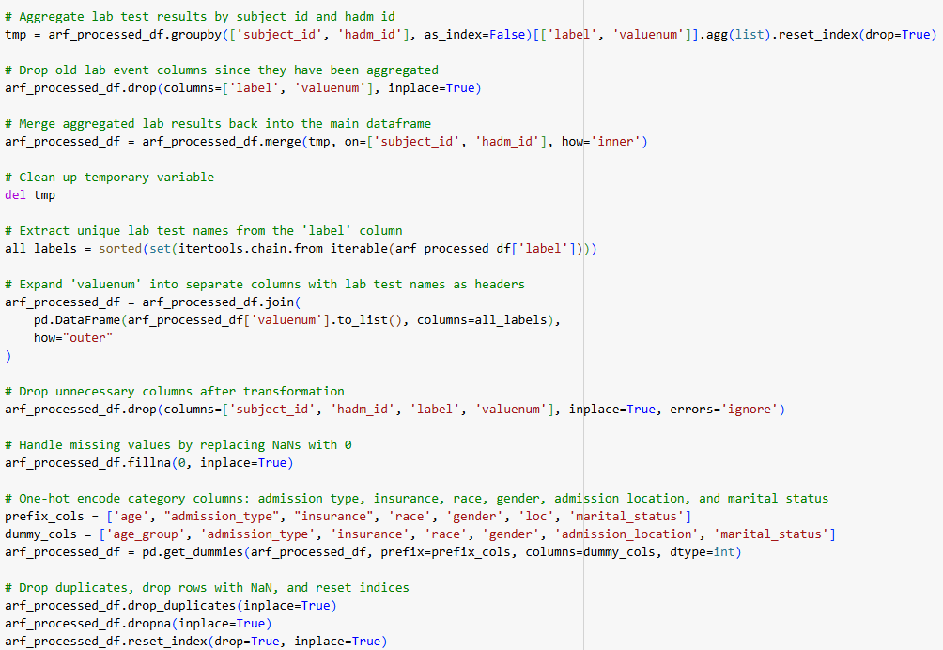
Step 3: Preprocessing and Feature Engineering for ARF(Continued)...
Continuing data processing:
Aggregate lab test results for each patient encounter.
Transform lab test names into separate columns.
Replace missing values (NaNs) with 0.
Convert categorical features (admission type, insurance, race, gender, admission location, and marital status) into a binary format.
Remove duplicates and reset indices to finalize the dataset for model training.

Slide 10
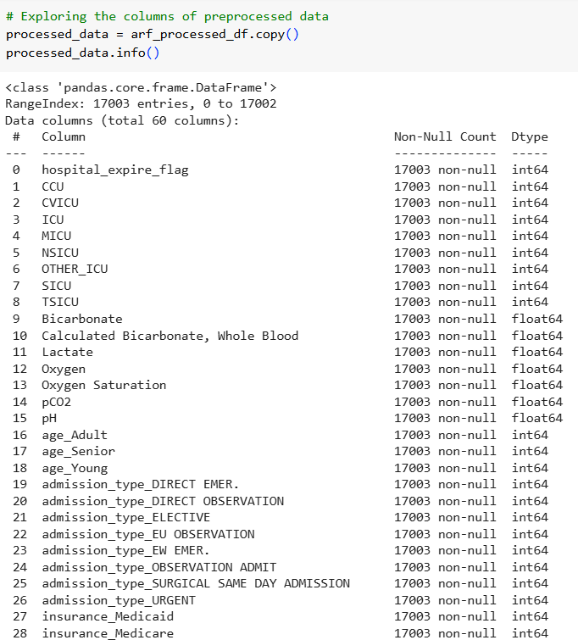
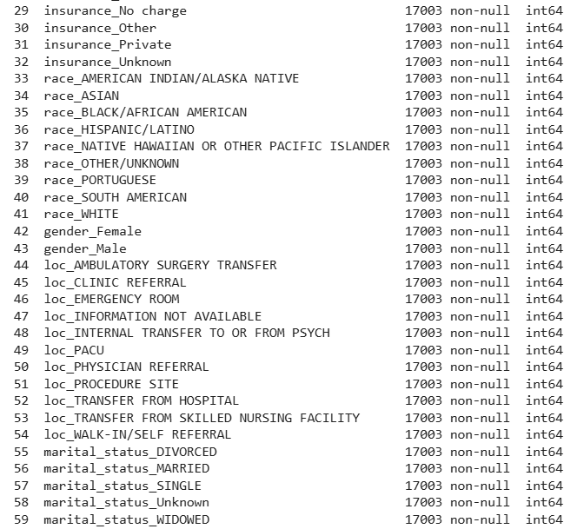
Step 3: Preprocessing and Feature Engineering for ARF(Continued)...
After processing and feature engineering, the dataset now contains the following columns. It is now ready for model training.

Slide 11
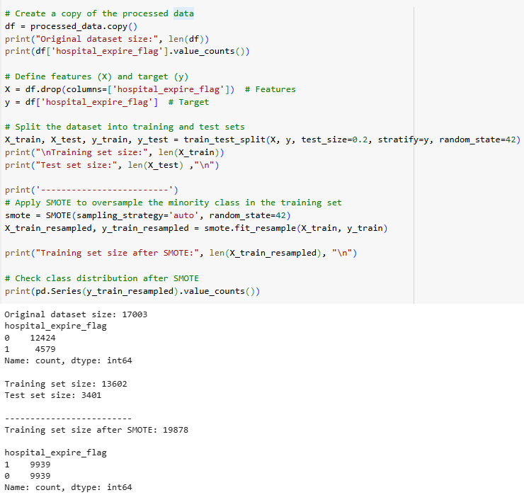
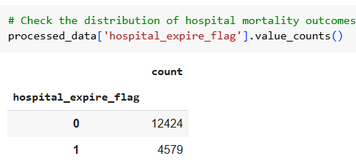
Step 4: Splitting the Data into Training and Test Sets
This step prepares the dataset for modeling:
Defines features (X) and target (y).
Splits the dataset into training (80%) and test (20%) sets while preserving class distribution.
As the data is imbalanced(12424 negative case and 4579 positive case), applies SMOTE to oversample the minority class in the training set, ensuring a balanced dataset for better model performance.

Slide 12
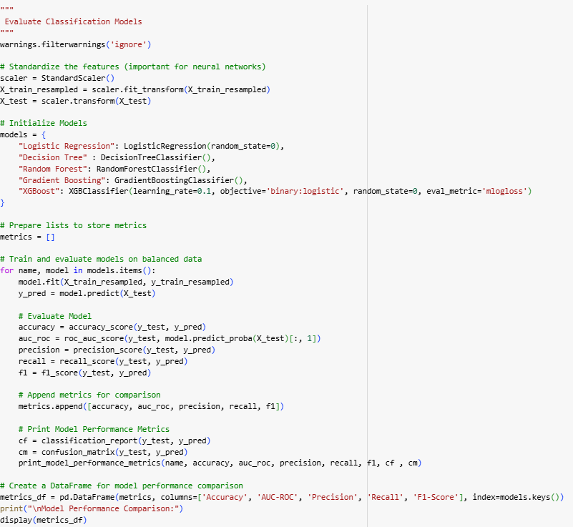
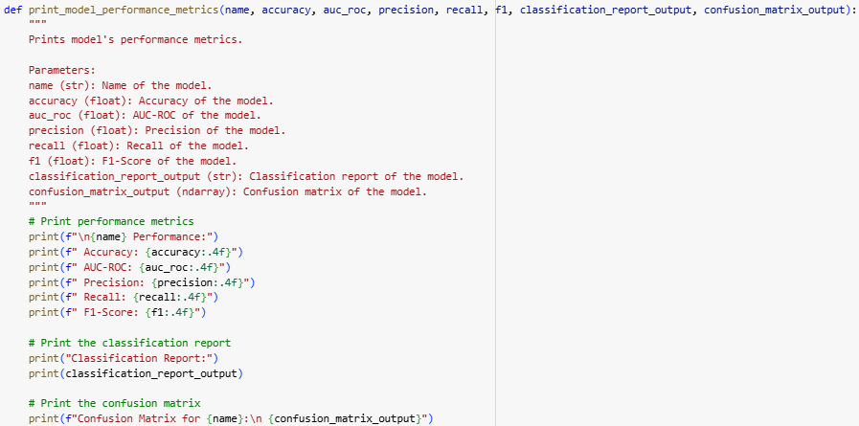
Step 4:Model Evaluation and Comparison
This step evaluates various classification models to predict mortality in Acute Respiratory Failure (ARF) patients. The features are standardized to improve model performance. Multiple models—Logistic Regression, Decision Tree, Random Forest, Gradient Boosting, and XGBoost—are trained and tested. The models are evaluated and compared using the following performance metrics:
Accuracy: The proportion of correct predictions out of all predictions.
AUC-ROC: A measure of the model's ability to distinguish between classes.
Precision: The proportion of true positive predictions among all positive predictions.
Recall: The proportion of actual positive cases correctly identified by the model.
F1-Score: The harmonic mean of precision and recall, balancing both metrics.
This comparison helps identify the best-performing model for predicting mortality in ARF patients.

Slide 13
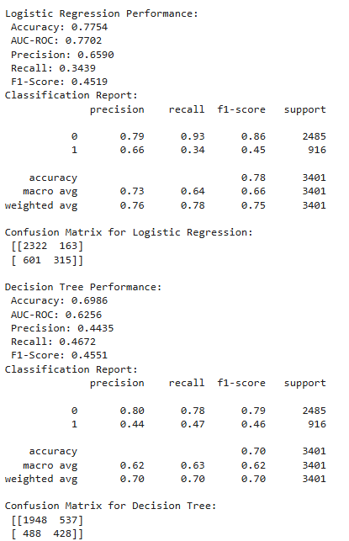
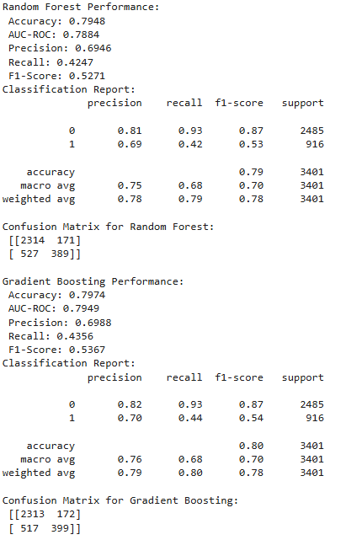
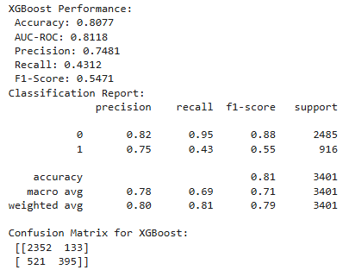
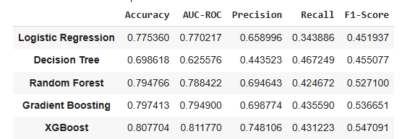
Step 4: Model Evaluation and Comparison(Continued)...
Following is outcome of how each model performed.

Slide 14
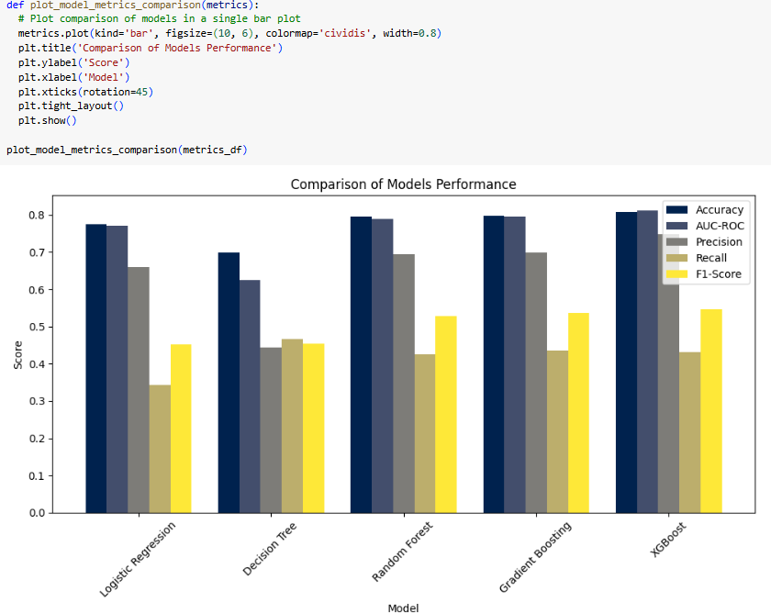
Step 4: Model Evaluation and Comparison(Continued)...
The right-side plot visualizes the model comparison, highlighting the performance differences across various metrics. As observed from the metrics and visuals:
Logistic Regression struggles with recall (34.4%), missing many mortality cases, but maintains decent precision (65.9%).
Decision Tree performs the worst overall, with the lowest AUC-ROC (62.6%) and precision (44.3%).
Random Forest and Gradient Boosting show improvements in recall (42.5% and 43.6%, respectively), meaning they identify more mortality cases.
XGBoost performs the best, achieving the highest accuracy (80.8%) and AUC-ROC (81.2%), demonstrating a better balance of precision (74.8%) and recall (43.1%) compared to the other models.
So overall XGBoost is best performing model.

Slide 15
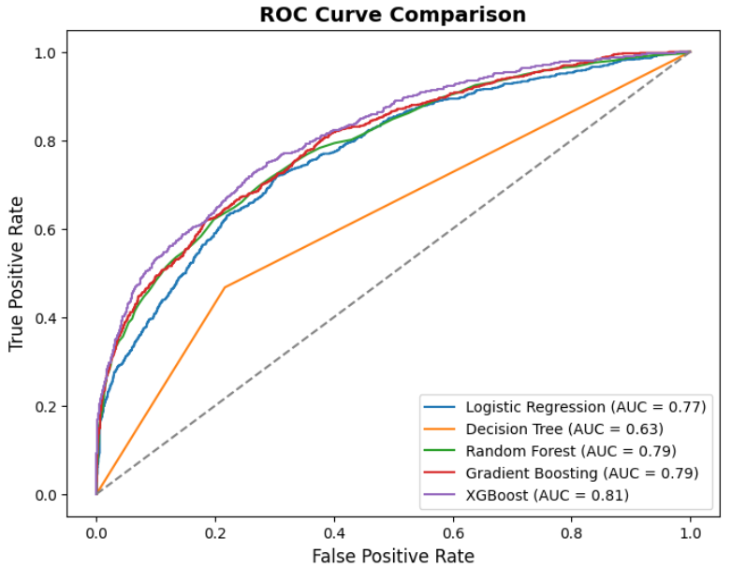
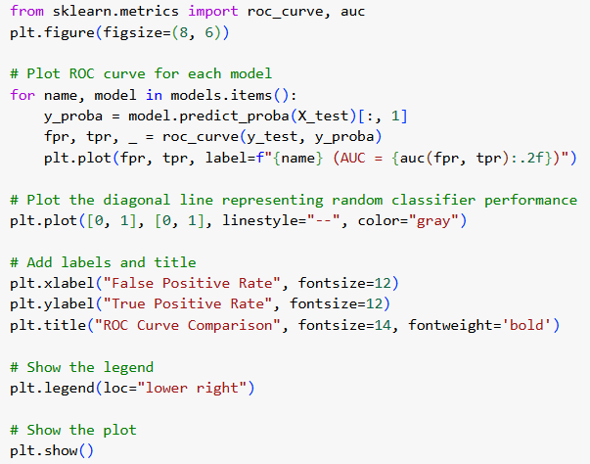
Step 4: Model Evaluation and Comparison(Continued)...
This shows the ROC curves, which visualize the True Positive Rate (TPR) and False Positive Rate (FPR) for each classification model. By comparing the curves, we can identify which model best balances the trade-off between false positives and true positives. A higher AUC indicates better performance in distinguishing between the mortality and survival classes.

Slide 16
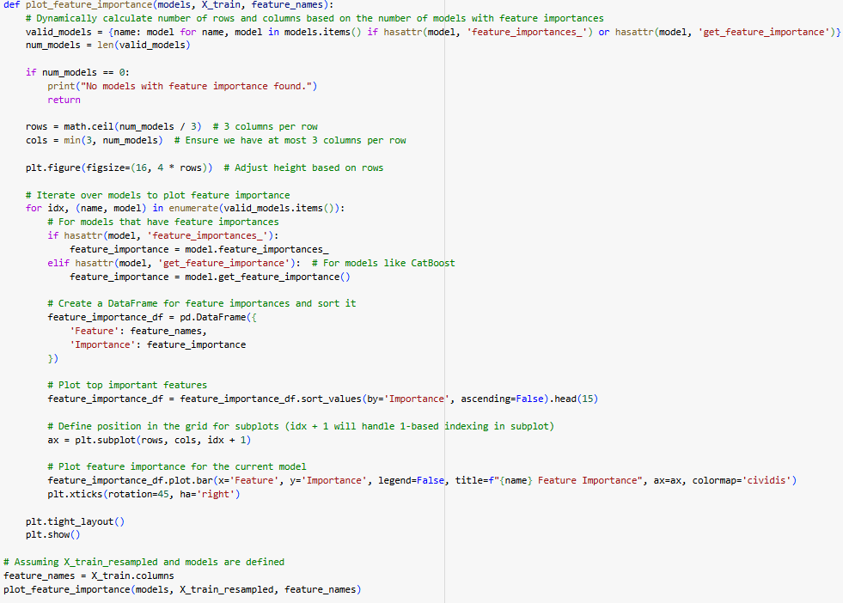
Step 4: Model Evaluation and Comparison(Continued)...
This code visualizes the feature importance for each model, helping us understand which features have the most influence on the model's predictions.
Code plots the top 15 most important features for each model that supports featue_importances_.

Slide 17
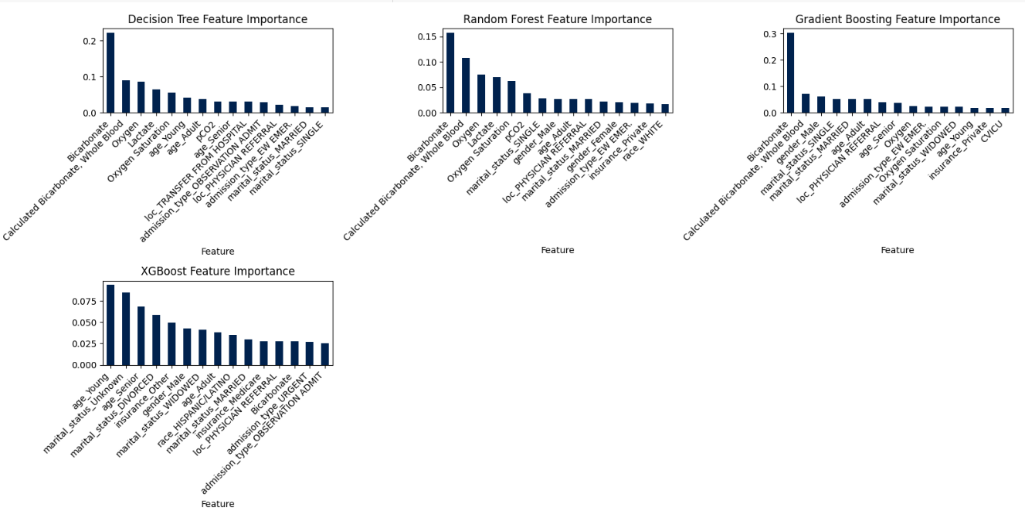
Step 4: Model Evaluation and Comparison(Continued)...
The feature importance plots strongly suggest that lab tests, particularly oxygen-related measures and bicarbonate levels, are crucial predictors across all the models.

Slide 18
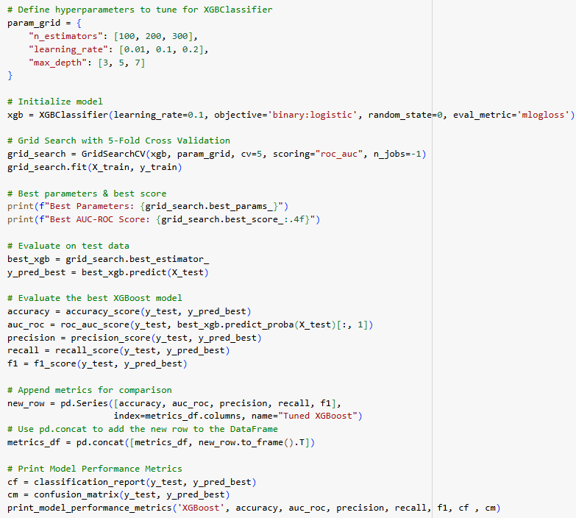
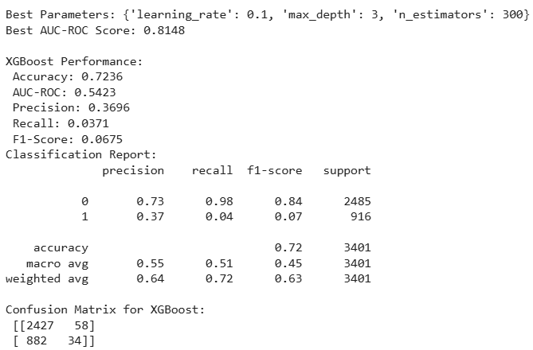
Step 4: Model Evaluation and Comparison(Continued)...
This shows hyperparameter tuning of best performing model(XGBoost) we found in earlier steps.
After tuning, unfortunately model’s performance worsened. The model's accuracy dropped from 80.8% to 72.4%, and more importantly, its recall for mortality cases significantly declined to 3.7%.
This suggests that the tuned hyperparameters may have overfitted to training data or altered the balance between precision and recall, making the model less effective at identifying critical cases. So out earlier model was better.

Slide 19
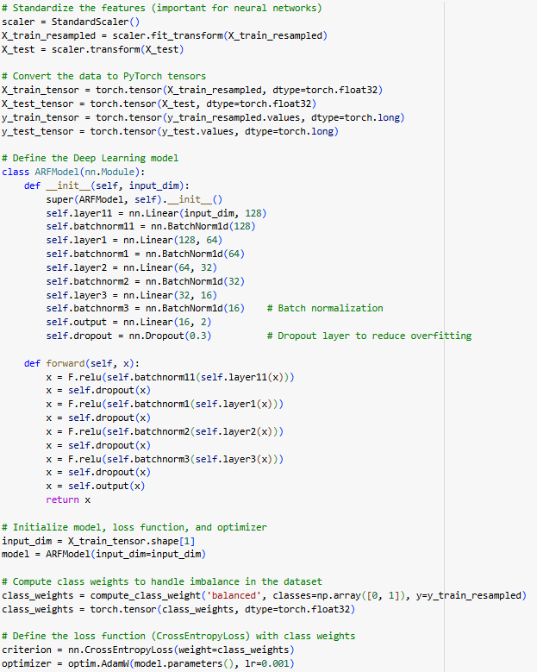
Step 5: Evaluate Neural Network Model
Here, the Neural Network model is evaluated for predicting mortality in ARF patients.
Features are standardized to ensure that all inputs are on a similar scale, improving model stability.
Training and test datasets are converted into PyTorch tensors for compatibility with the deep learning framework.
Multiple fully connected layers are used to capture complex patterns.
Batch Normalization is applied to stabilize training and improve generalization.
Dropout layers are added to reduce overfitting.
CrossEntropyLoss is used since the task involves classification (mortality prediction).
AdamW optimizer is chosen for efficient weight updates while reducing overfitting.
Next, we will evaluate this model and compare its performance with earlier models.

Slide 20
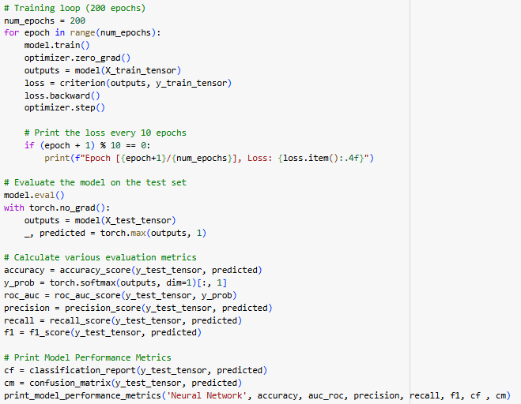
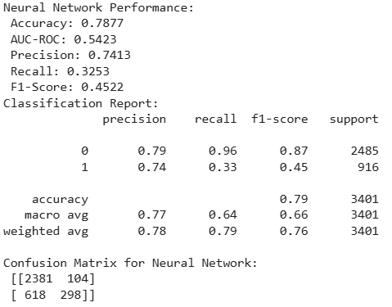
Step 5: Evaluate Neural Network Model(Continued)...
Here ARFModel is evaluated and following are observations,
The Neural Network model achieved 78.8% accuracy, but its AUC-ROC (0.5423) and recall (32.5%) indicate weak discrimination in predicting mortality. It correctly classifies survival cases well (precision: 74.1%) but struggles to identify mortality cases.
Compared to XGBoost before tuning (accuracy: 80.8%, recall: ~43%), the Neural Network underperforms in recall and overall discrimination. However, unlike XGBoost after tuning, which saw a drop in accuracy (72.4%) and recall (3.7%), the Neural Network maintains a relatively stable performance.

Slide 21
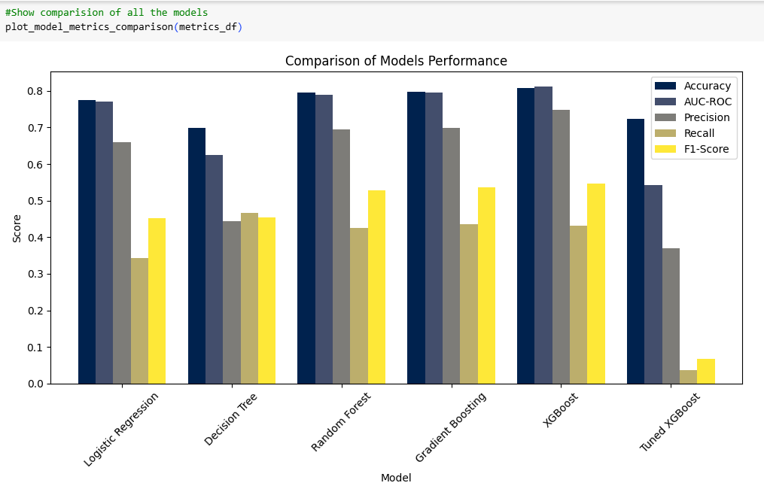
Step 5: Evaluate Neural Network Model(Continued)...
The following plot visually compares all models, showcasing their performance across key metrics such as accuracy, AUC-ROC, precision, recall, and F1-score.

Slide 22
Conclusion :
Among all the models evaluated, XGBoost demonstrated the best performance in predicting mortality in ARF patients. Despite hyperparameter tuning, its initial version outperformed other models, including the neural network. The feature analysis suggests that laboratory test results played a significant role in prediction, indicating their importance in assessing ARF severity and patient outcomes. Future improvements could involve further feature engineering, advanced ensemble methods, or incorporating temporal trends in lab values for better predictive accuracy.
Future improvements:
Future improvements could involve further feature engineering, additional hyperparameter tuning, or exploring different models to enhance predictive accuracy. Incorporating temporal trends in lab values and leveraging ensemble methods could also improve performance.

