Slide 1
MIMIC-III NLP
Ankita Savaliya
AI in Healthcare

Slide 2
What Disease Did I Pick?​​
I selected disease codes related to 4010 – Malignant Essential Hypertension. Malignant essential hypertension is a severe and life-threatening form of high blood pressure that develops rapidly and can cause damage to multiple organs.​​
​​
What About the Text Data?​​
The objective of this analysis is to extract medical entities using Named Entity Recognition (NER) with SpaCy, SciSpaCy, Word2Vec, and t-SNE plots.
Additionally, used bc5cdr, BlueBert, MedSpacy to perform a similar analysis.
​​GitHub and Google Colab Links:
https://colab.research.google.com/github/AnkitaSavaliya/AIH/blob/main/MIMIC_III_NLP.ipynb
​
https://github.com/AnkitaSavaliya/AIH/blob/main/MIMIC_III_NLP.ipynb
https://github.com/AnkitaSavaliya/AIH/blob/main/MIMIC-III_NLP.pptx

Slide 3
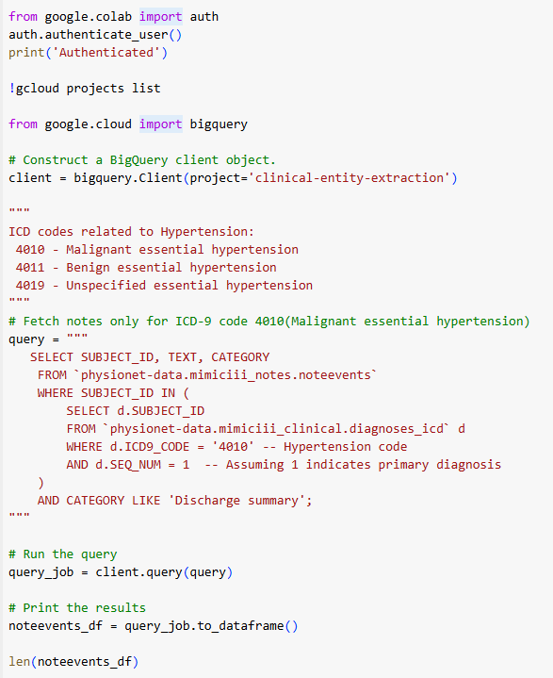
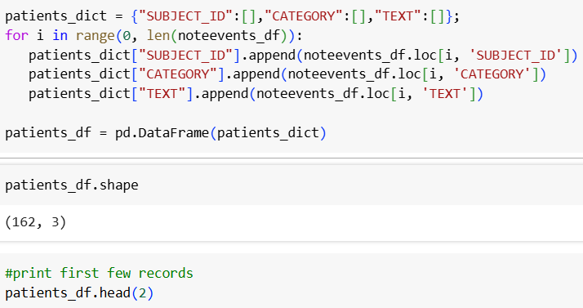

Data Preparation
Fetched rows from noteevents only for ICD-9 CODE 4010 and category 'Discharge Summary' using the BigQuery client. Here selected records have 4010 (Maligant Hypertension) as primary diagnosis.
The query returned 162 rows.
Prepared a DataFrame with the required columns.
Saved the query result to a CSV/XLSX file to reduce queries to the database.

Slide 4
Spacy

Slide 5
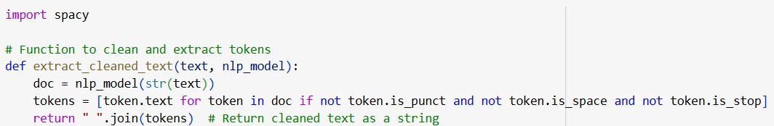
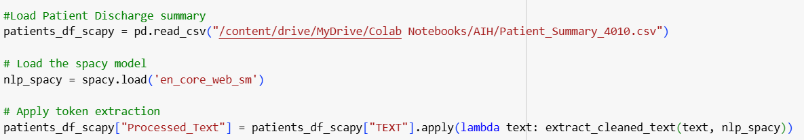
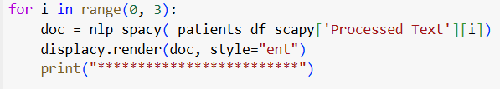
Extract and Visualize SpaCy Entities
Created a common function to clean text for the given model.
Processed the Discharge Summary TEXT column using the spaCy model.
Displayed spaCy entities using displaCy.

Slide 6
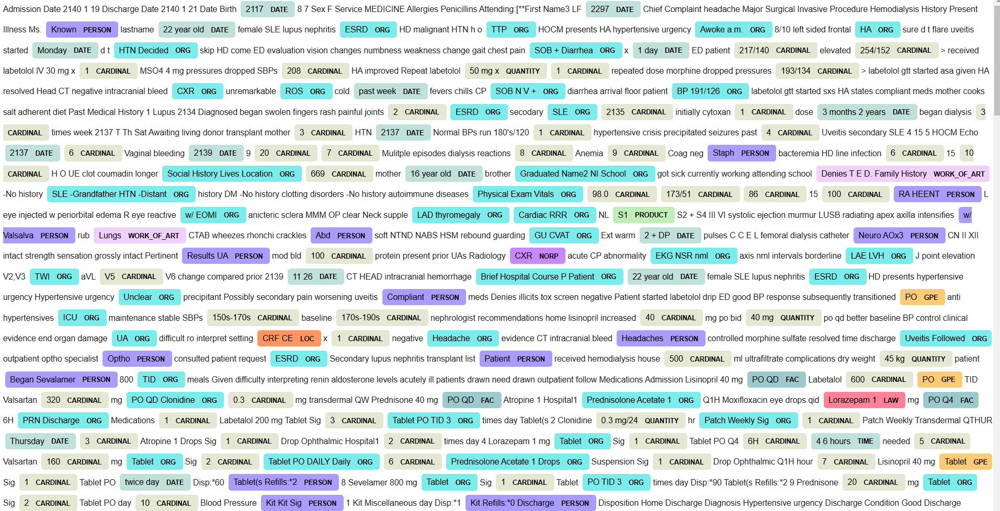
Spacy Entities

Slide 7
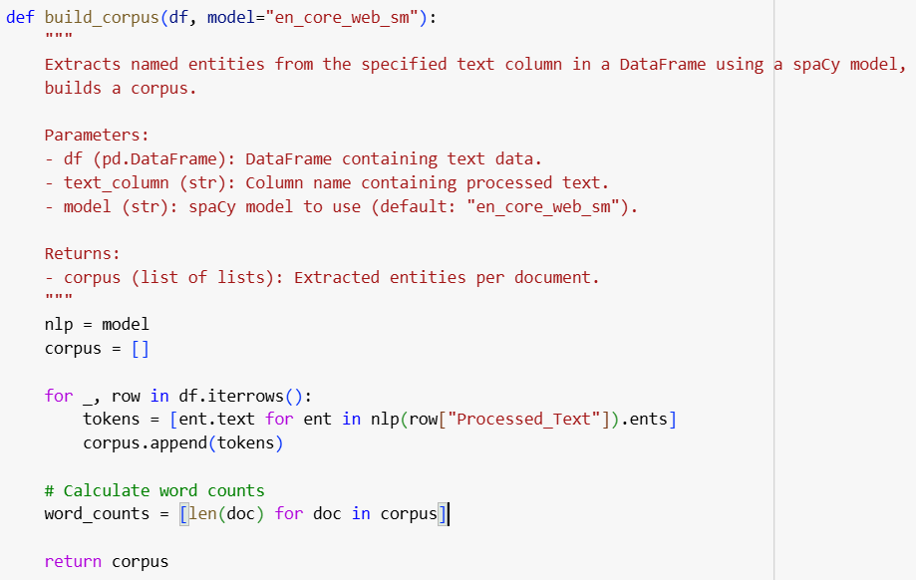
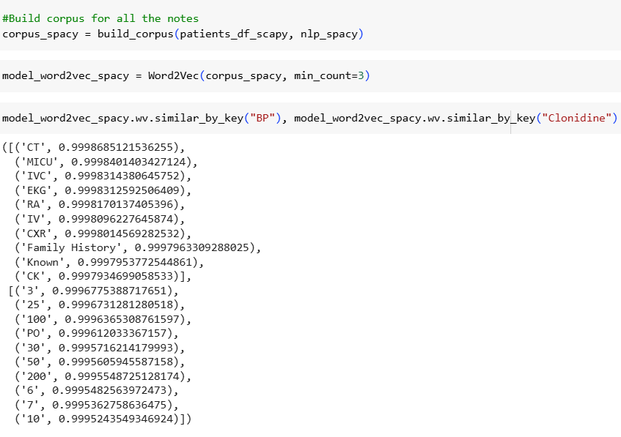
Word2Vec and t-SNE Visualization Using SpaCy-Processed Data
Created common function to build corpus using given model SpaCy/SciSpaCy/other

Slide 8
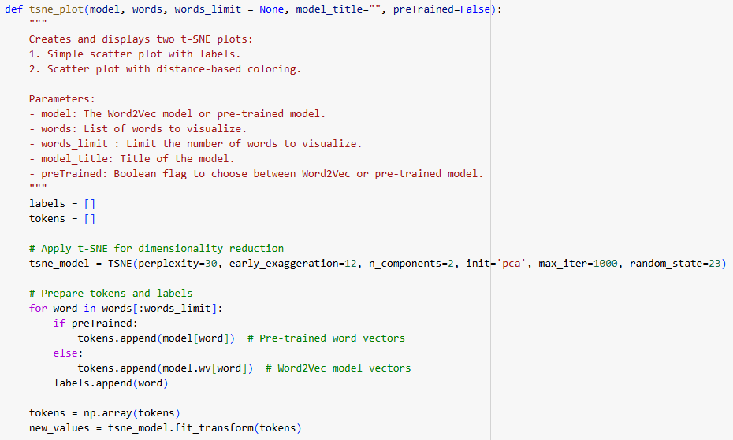
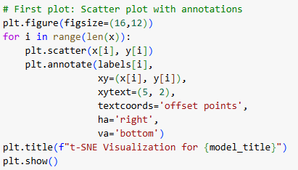
Defined common function for t-SNE plot.
Call function using corpus built using Spacy processed text.

Slide 9
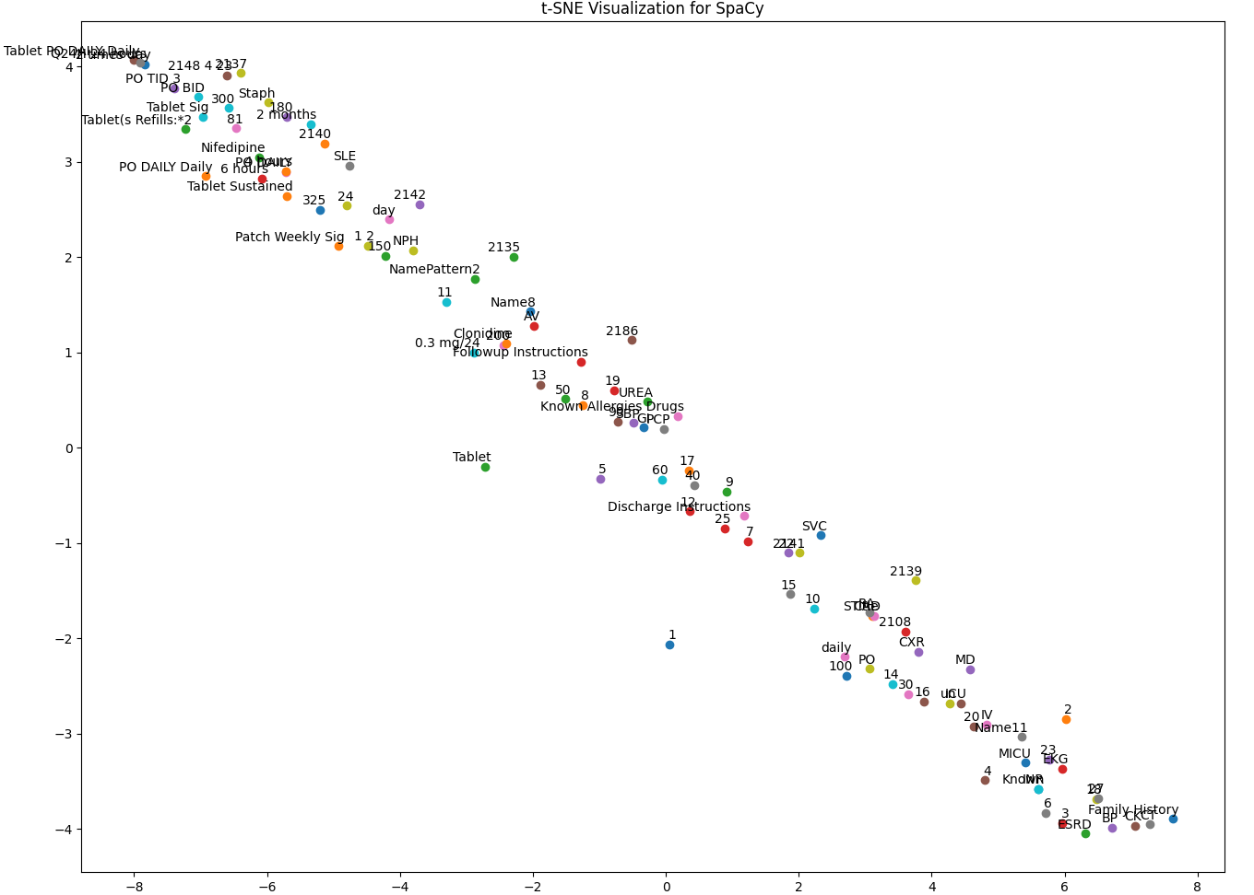
t-SNE visualization of the top 100 words from Word2Vec (SpaCy), with a limited word count for better label clarity.
From Word2Vec similarity and above plot we can see that, the entity recognition using SpaCy was limited in extracting hypertension-related terms, likely because it focuses on general English entities rather than clinical ones.

Slide 10
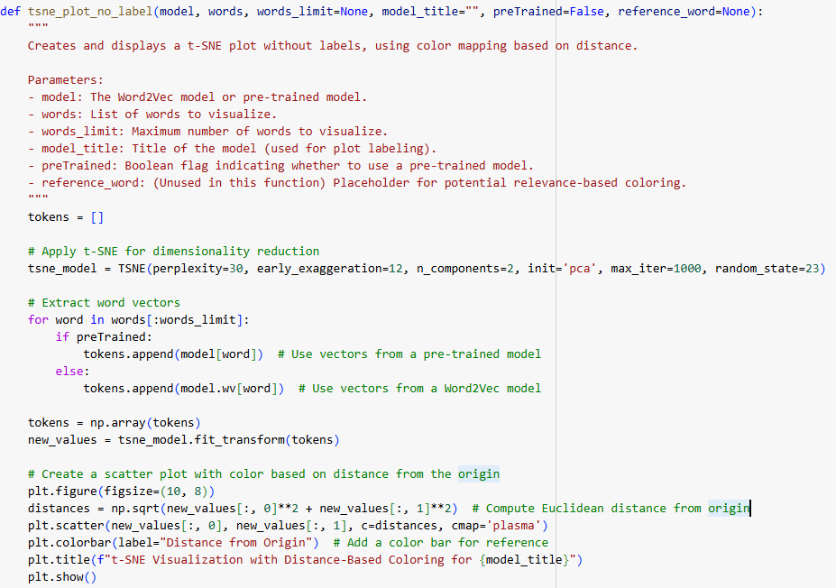
Defined common function to generates a t-SNE scatter plot of word embeddings, coloring points based on their distance from the origin.
Call function using corpus built using Spacy processed text.

Slide 11
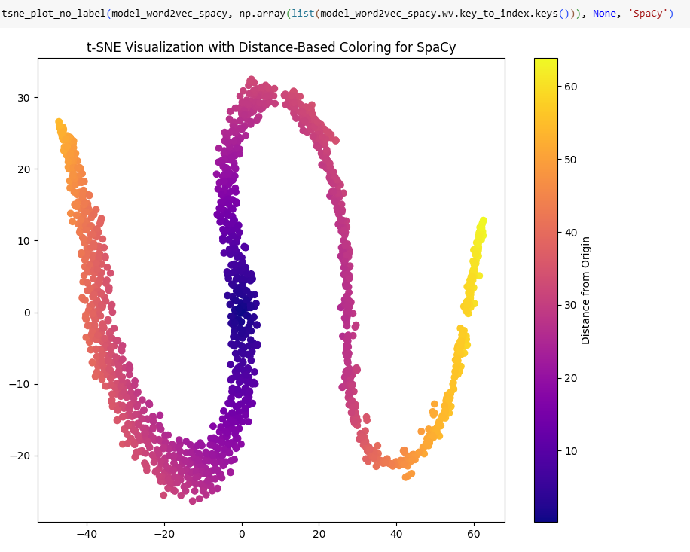
t-SNE Visualization with Distance-Based Coloring Of All Words from Word2Vec (SpaCy)

Slide 12
SciSpacy

Slide 13
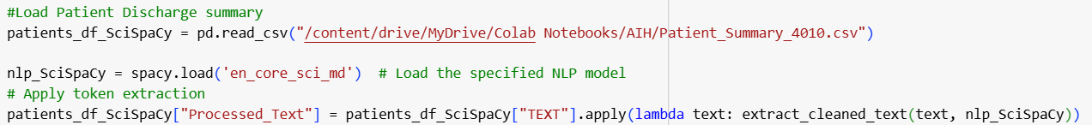

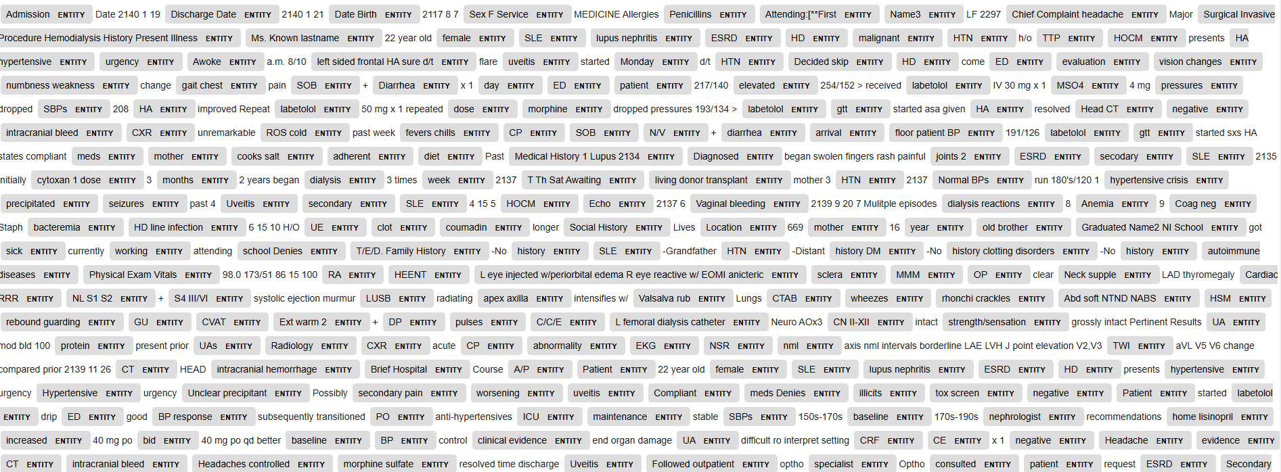
Extract and Visualize SciSpaCy Entities

Slide 14
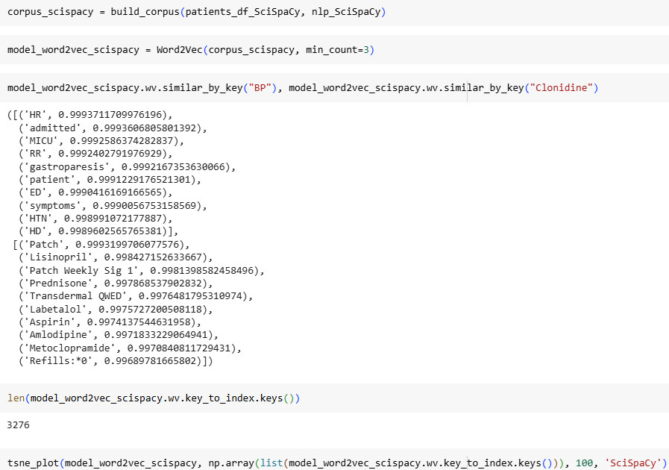
Word2Vec and t-SNE Visualization Using SciSpaCy-Processed Data

Slide 15
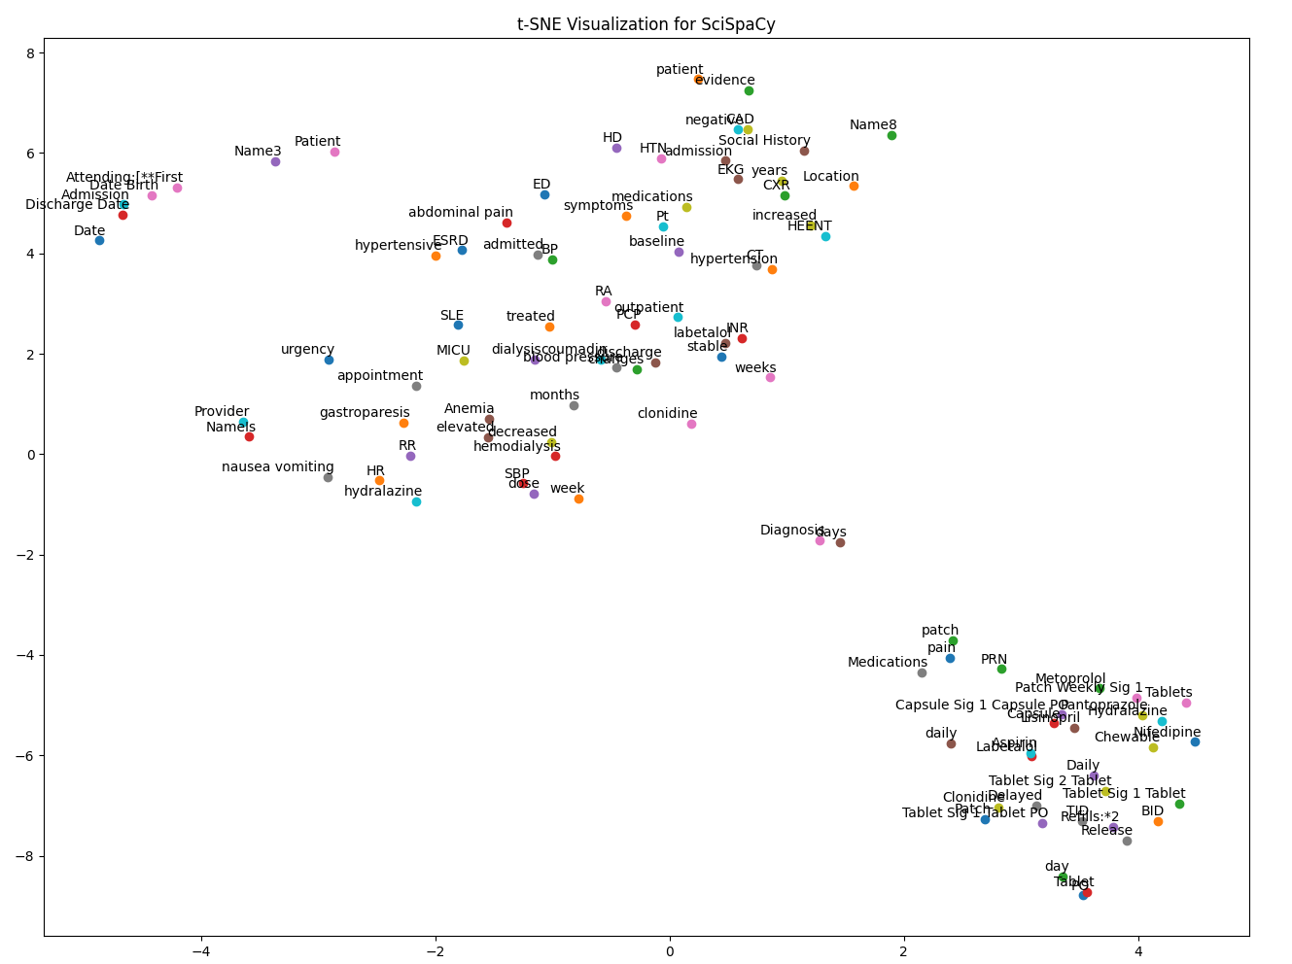
t-SNE visualization of the top 100 words from Word2Vec (SciSpaCy), with a limited word count for better label clarity.
From Word2Vec similarity and above plot , SciSpaCy primarily recognized medication names and formulations, such as Clonidine and Labetalol, but it did not specifically highlight key hypertension-related entities beyond drug mentions.

Slide 16
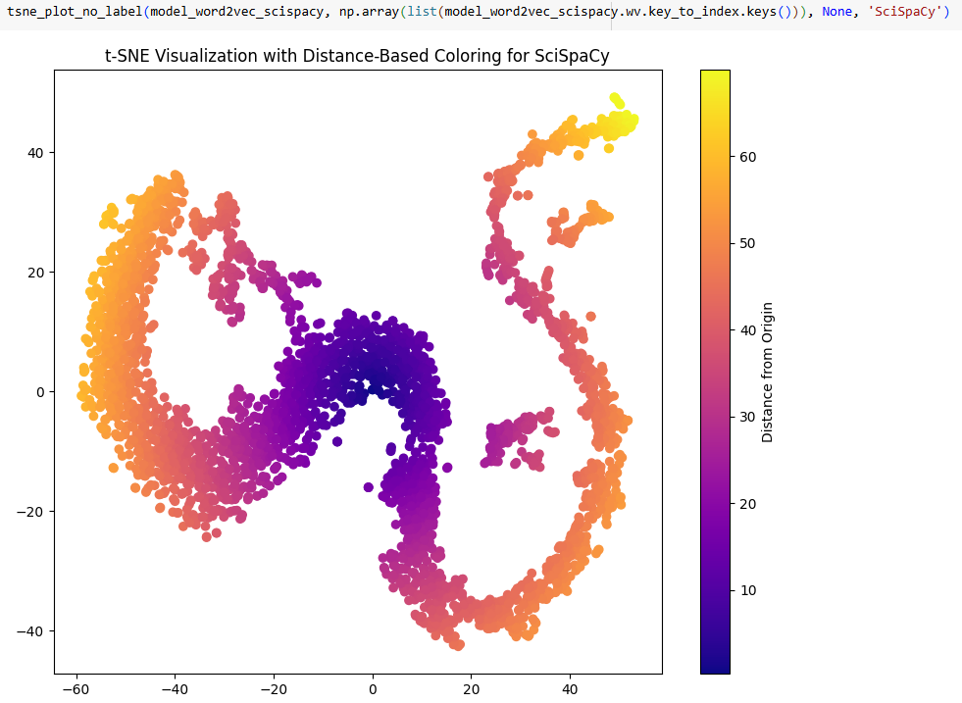
t-SNE Visualization with Distance-Based Coloring Of All Words from Word2Vec (SciSpaCy)

Slide 17
BC5CDR (BioCreative V Chemical-Disease Relation)

Slide 18
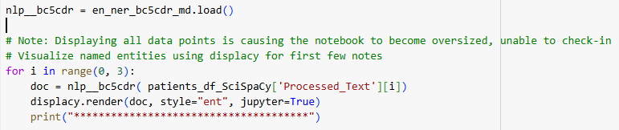
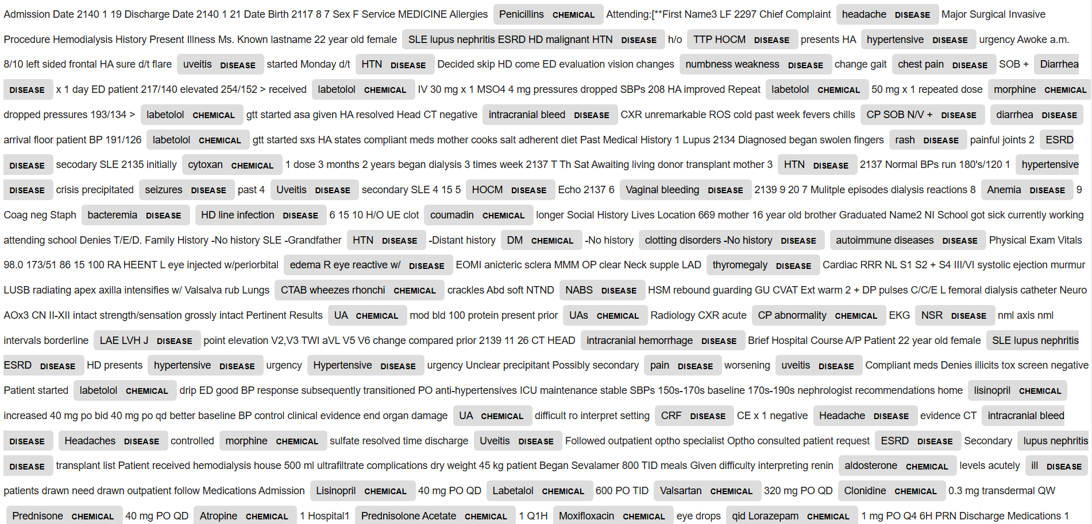
BC5CDR Entity Visualization Using SciSpaCy-Processed Data
en_ner_bc5cdr_md is a Named Entity Recognition (NER) model from SciSpaCy that specializes in identifying diseases and chemicals in text

Slide 19
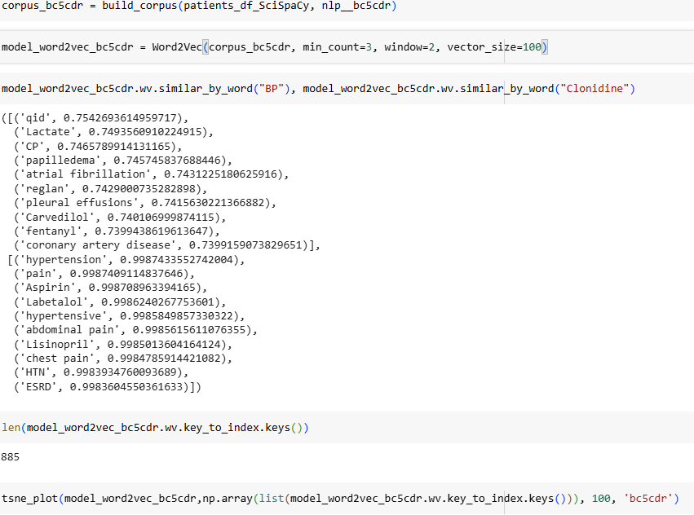
Word2Vec and t-SNE Visualization For BC5CDR

Slide 20
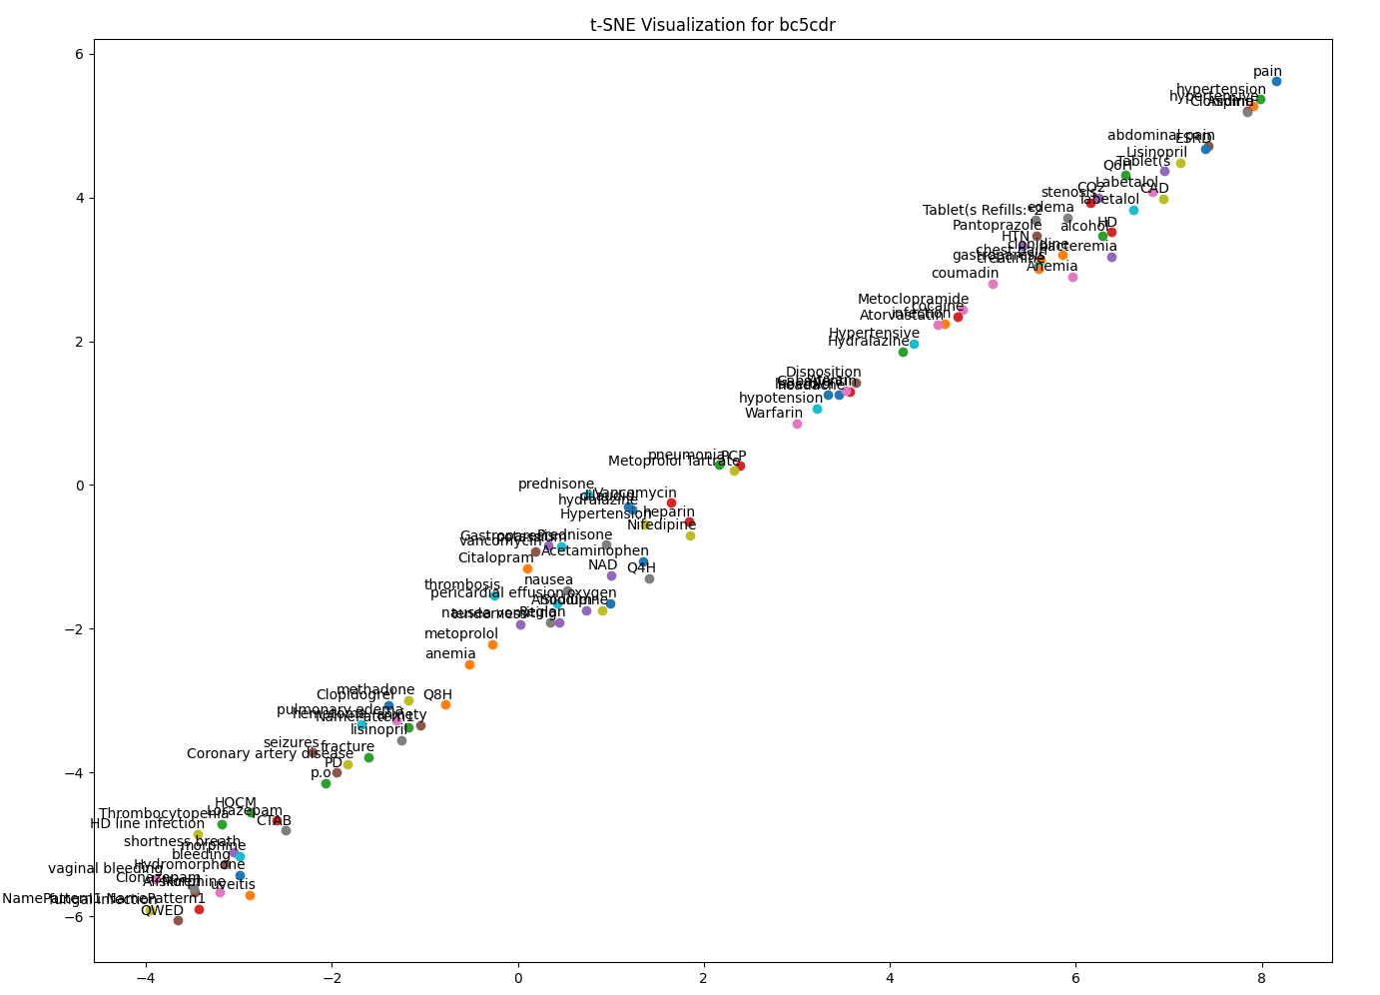
t-SNE visualization of the top 100 words from Word2Vec (bc5cdr), with a limited word count for better label clarity.
Based on Word2Vec similarity and the above plot, BC5CDR appears to capture disease and medication entities well, with a good emphasis on hypertension-related terms (e.g., "hypertension," "hypertensive," "lisinopril" , "metoprolol" ).

Slide 21
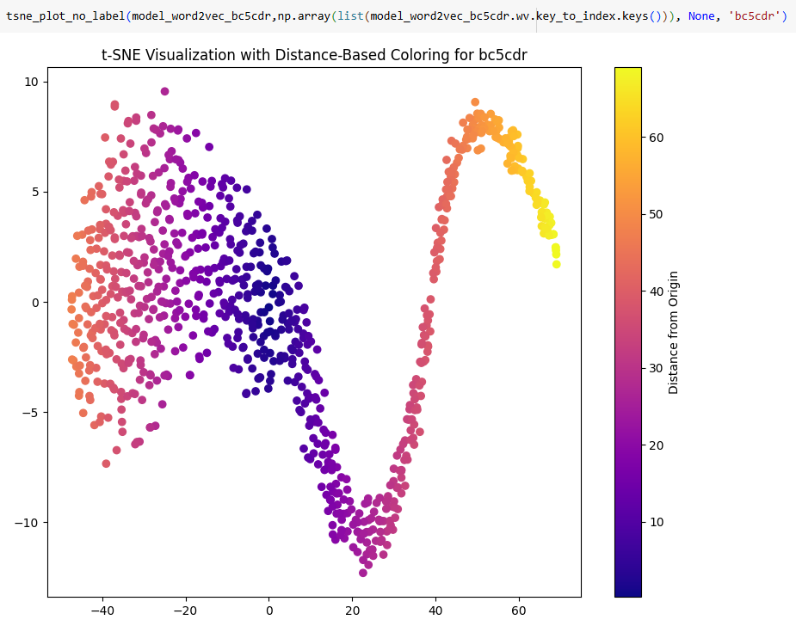
t-SNE Visualization with Distance-Based Coloring Of All Words from Word2Vec (bc5cdr)

Slide 22
MedSpacy

Slide 23
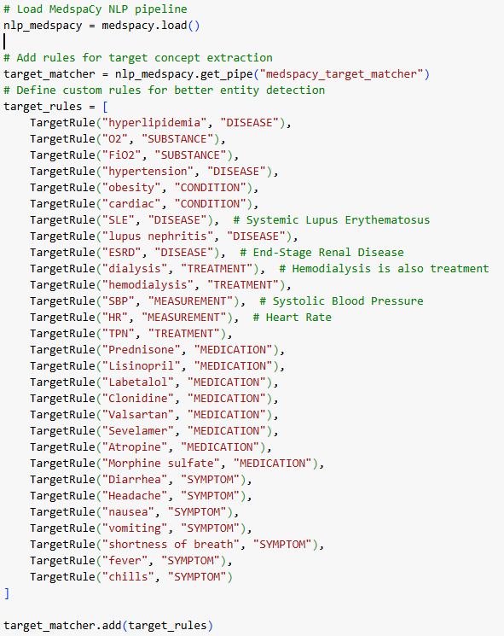
Custom Rule-Based Entity Extraction with MedspaCy NLP Pipeline
MedSpaCy is a library designed for processing clinical and biomedical text.
In this code, MedSpaCy is being enhanced by adding custom target rules to better detect specific medical entities such as diseases, treatments, symptoms, and medications in clinical notes.
Loaded the MedspaCy NLP pipeline. Used the medspacy_target_matcher to add custom rules for extracting medical concepts.
Defined specific target rules to identify entities like diseases (e.g., hypertension), treatments (e.g., hemodialysis), medications (e.g., Lisinopril), symptoms (e.g., headache), and measurements (e.g., SBP).
Applied these rules to clinical text for improved entity detection.

Slide 24
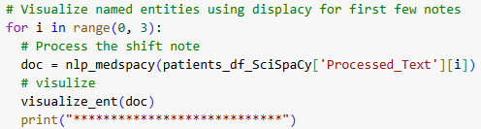
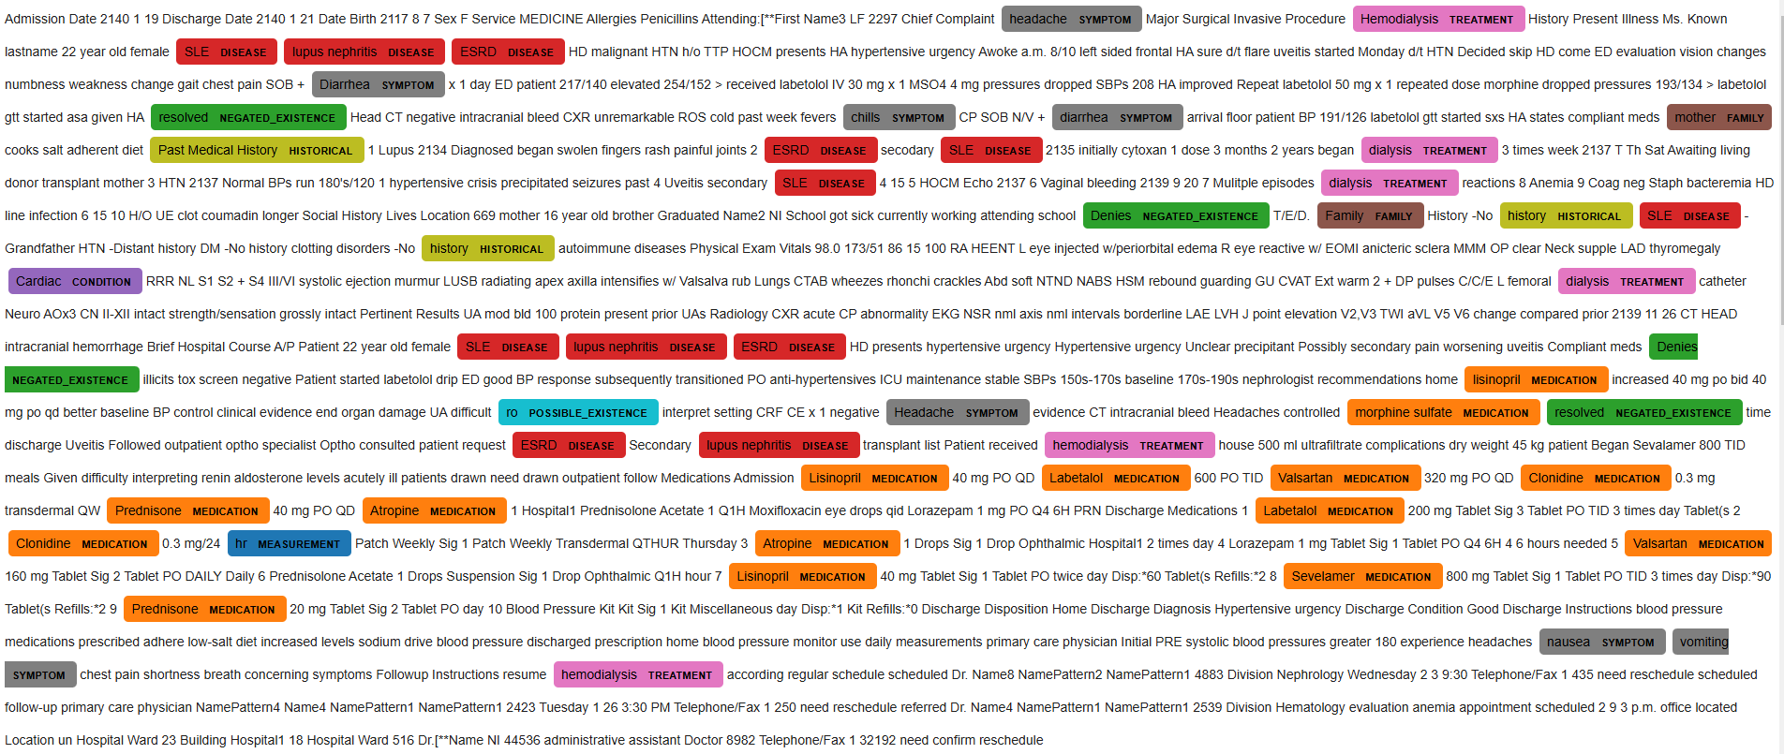
MedSpacy Visualization Using SciSpaCy-Processed Data

Slide 25
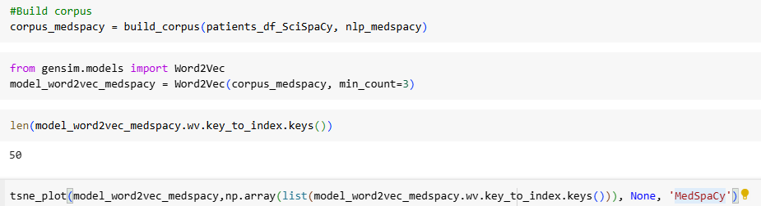
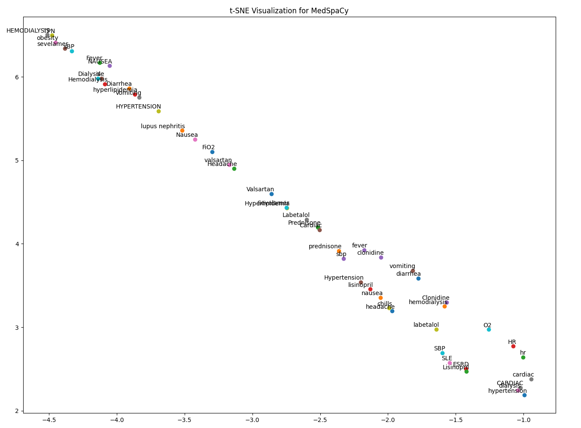
t-SNE visualization of the top 100 words from Word2Vec (MedSpaCy), with a limited word count for better label clarity.
Based on the plot, MedSpaCy effectively identifies and clusters terms associated with hypertension (e.g., Hypertension, Lisinopril, Labetalol, SBP, Clonidine, Headache, and Nausea). This suggests that the model is successfully recognizing and extracting a diverse range of hypertension-related entities, including medications, symptoms, and conditions, from the clinical text.

Slide 26
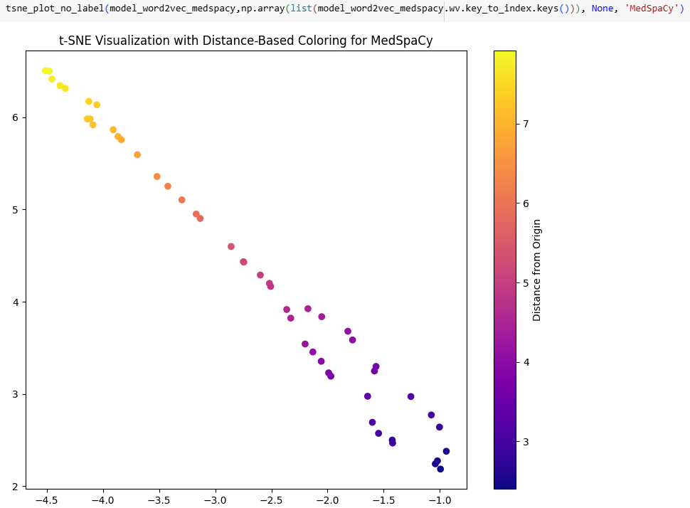
t-SNE Visualization with Distance-Based Coloring Of All Words from Word2Vec (MedSpaCy)

Slide 27
BlueBert

Slide 28
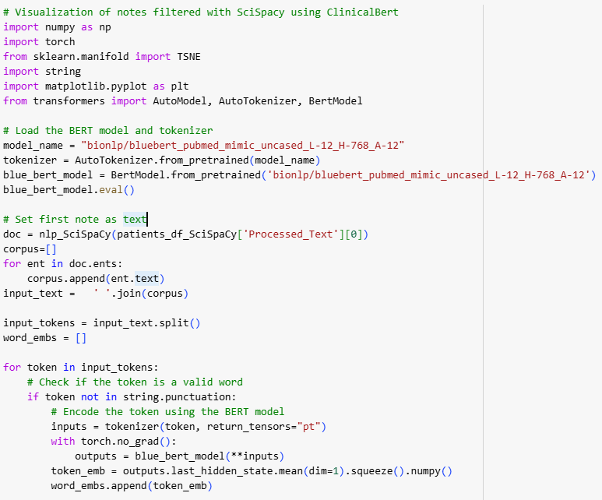
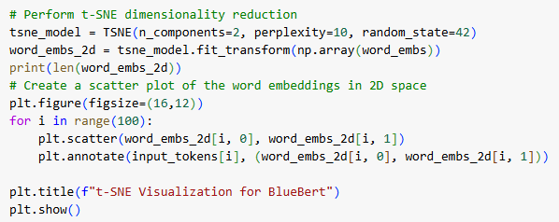
t-SNE Visualization For BlueBert
This script utilizes BlueBERT (bionlp/bluebert_pubmed_mimic_uncased_L-12_H-768_A-12) to extract word embeddings from clinical notes processed with SciSpaCy.
Named entities are identified and tokenized, then their embeddings are computed using BlueBERT.
Only one note was used here because processing all notes with BlueBERT for embedding extraction requires significant time and memory.
The embeddings are visualized in a 2D space using t-SNE, highlighting relationships among clinical terms.

Slide 29
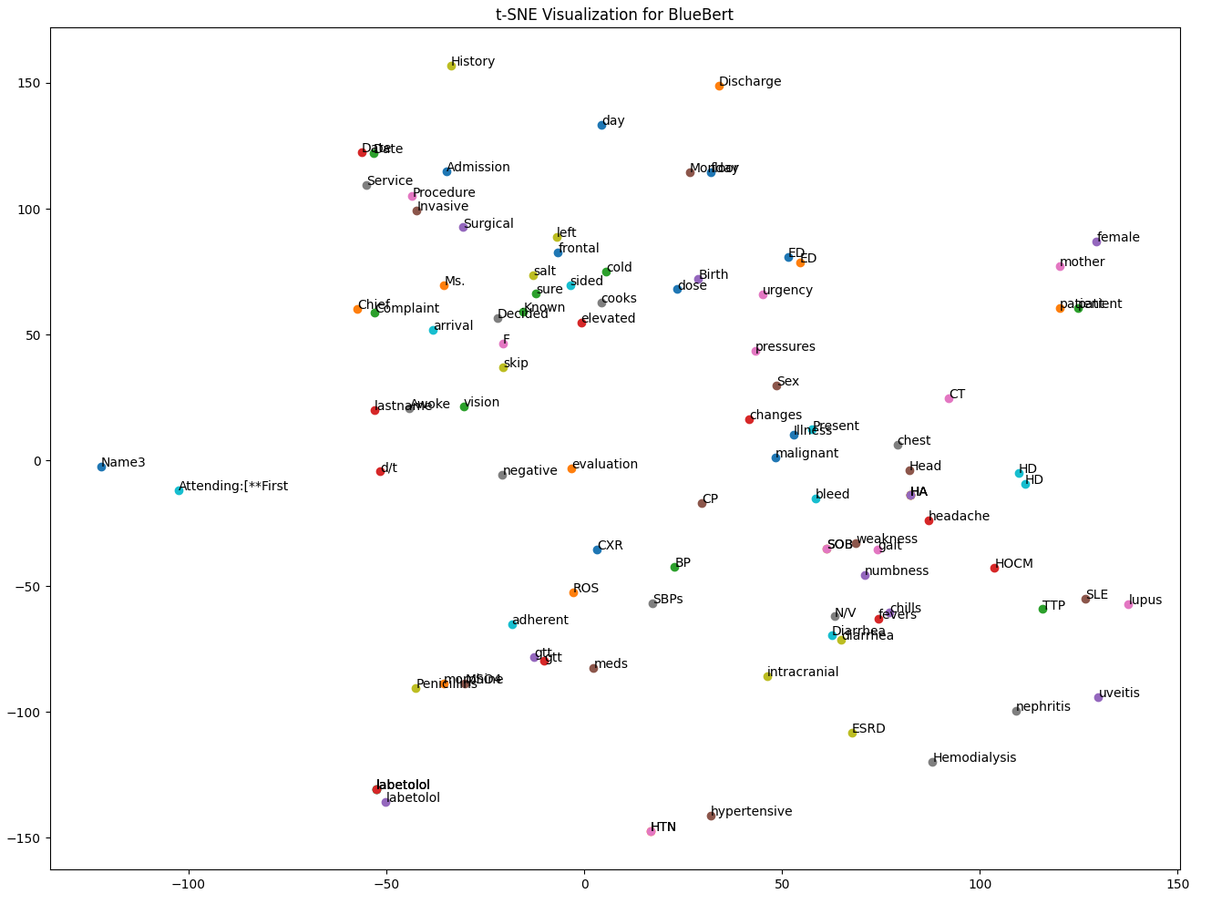
t-SNE visualization of the top 100 words from Word2Vec (BlueBert), with a limited word count for better label clarity.
Based on Word2Vec similarity and the plot, BlueBert effectively captures key medical terms related to hypertension, such as Labetalol, hypertension, and hemodialysis. It groups related terms like HTN, hypertensive, BP, SBPs, and medications like Labetalol, indicating its ability to identify and understand hypertension-related concepts.

Slide 30
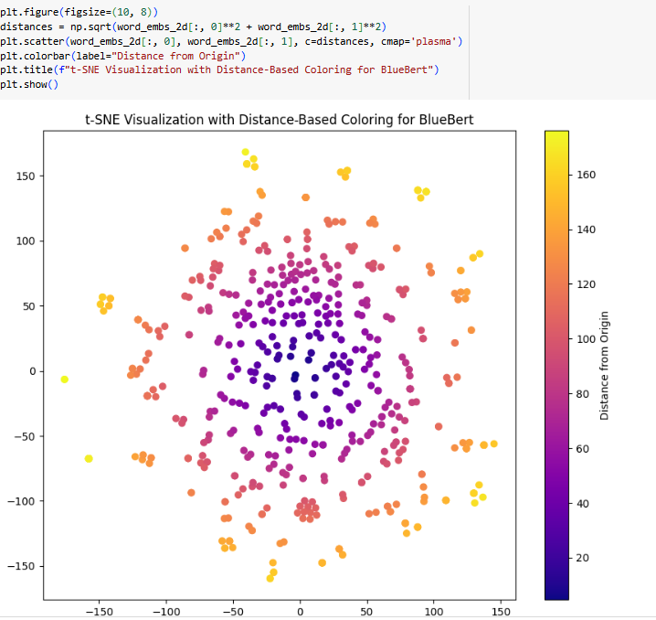
t-SNE Visualization with Distance-Based Coloring Of All Words from Word2Vec (BlueBert)

Slide 31
Conclusion
The MIMIC data, especially the free-text notes, contains a lot of shorthand, misspellings, and extra details like dates and measurements that aren't useful for Named Entity Recognition (NER). Pre-trained models like BlueBERT, BC5CDR, and MedSpaCy, tailored for the medical field and charting terminology, tend to extract more relevant and accurate entities in NER than models like SpaCy and SciSpaCy.

