Slide 1
MIMIC-III NLP
Ankita Savaliya
AI in Healthcare

Slide 2
What Disease Did I Pick?​​
I selected disease codes related to 4010 – Malignant Essential Hypertension. Malignant essential hypertension is a severe and life-threatening form of high blood pressure that develops rapidly and can cause damage to multiple organs.​​
​​
What About the Text Data?​​
The objective of this analysis is to extract medical entities using Named Entity Recognition (NER) with SpaCy, SciSpaCy, Word2Vec, and t-SNE plots.
Additionally, used bc5cdr, BlueBert, MedSpacy to perform a similar analysis.
​​GitHub and Google Colab Links:
https://colab.research.google.com/github/AnkitaSavaliya/AIH/blob/main/MIMIC_III_NLP.ipynb
https://github.com/AnkitaSavaliya/AIH/blob/main/MIMIC_III_NLP.ipynb
https://github.com/AnkitaSavaliya/AIH/blob/main/MIMIC-III_NLP.pptx

Slide 3
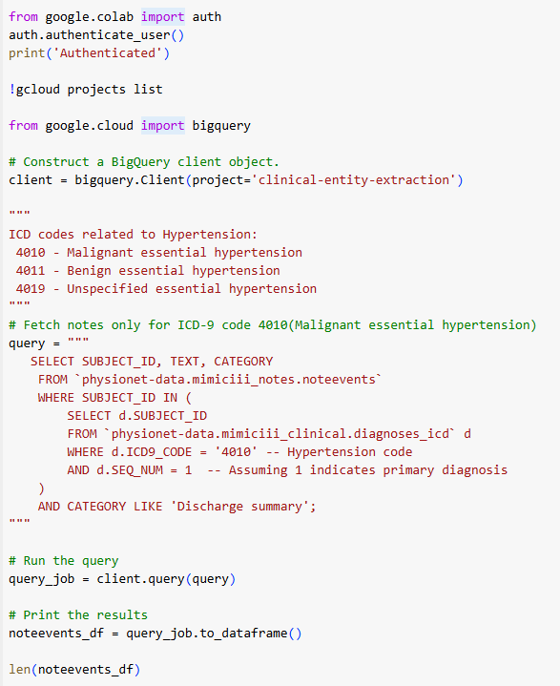
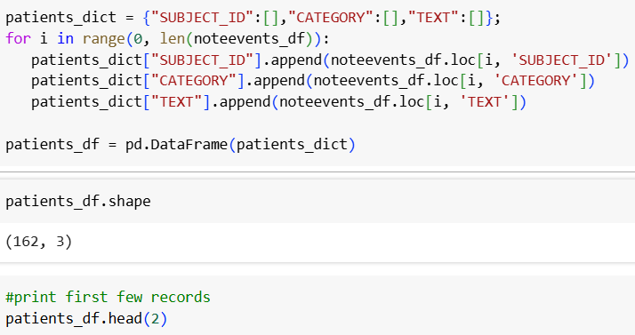

Data Preparation
Fetched rows from noteevents only for ICD-9 CODE 4010 and category 'Discharge Summary' using the BigQuery client.
The query returned 162 rows.
Prepared a DataFrame with the required columns.
Saved the query result to a CSV/XLSX file to reduce queries to the database.

Slide 4
Spacy

Slide 5
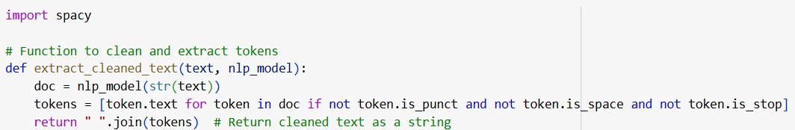
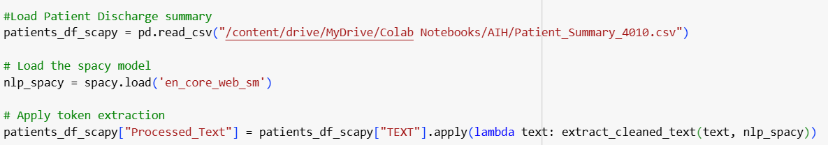
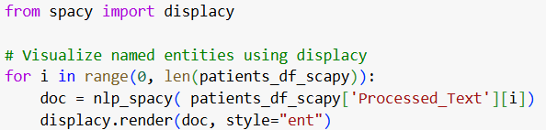
Extract and Visualize SpaCy Entities

Slide 6
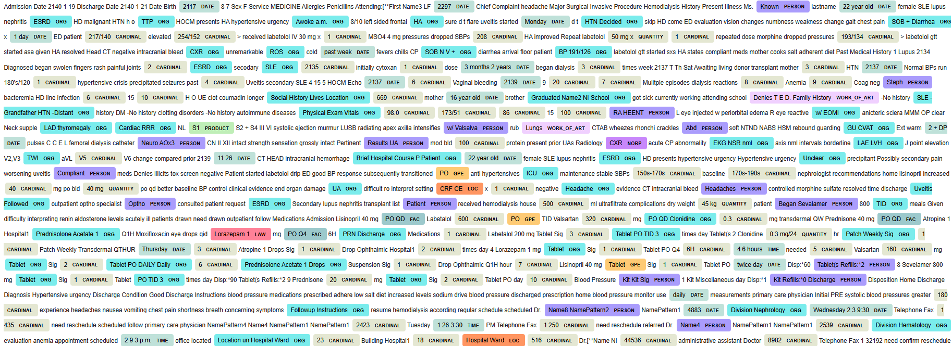

Slide 7
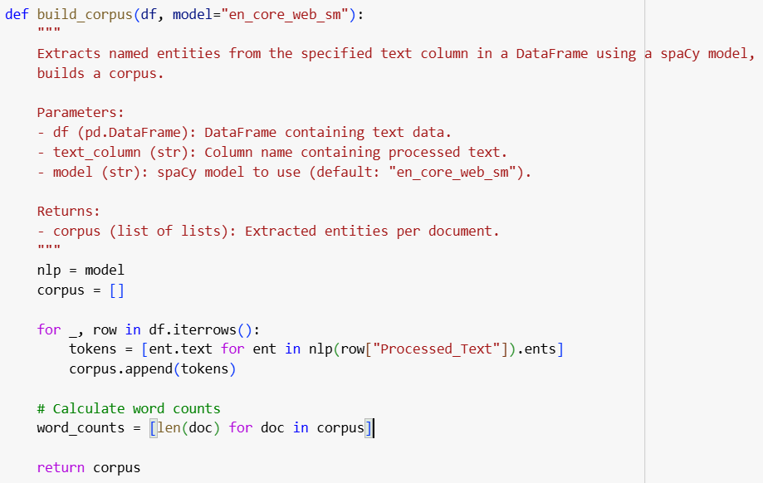
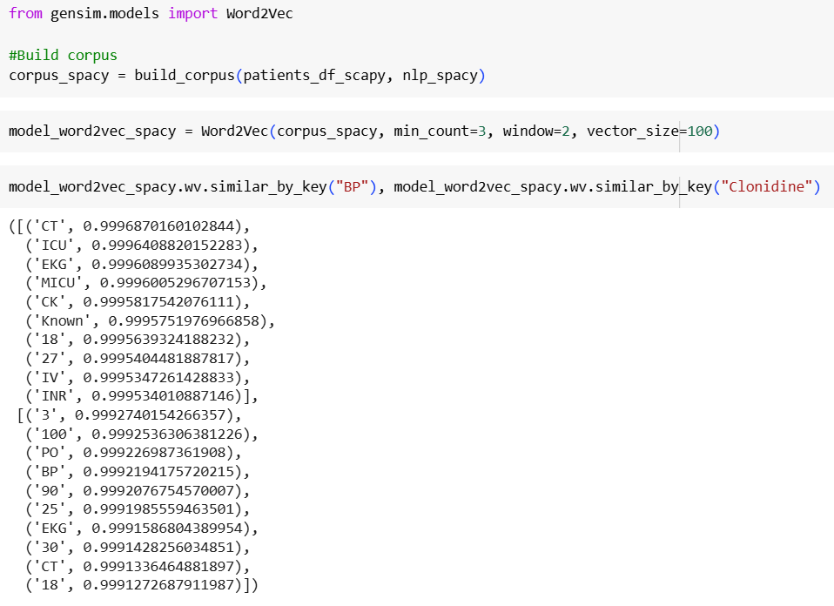
Word2Vec and t-SNE Visualization Using SpaCy-Processed Data
Created common function to build corpus using given model SpaCy/SciSpaCy/other

Slide 8
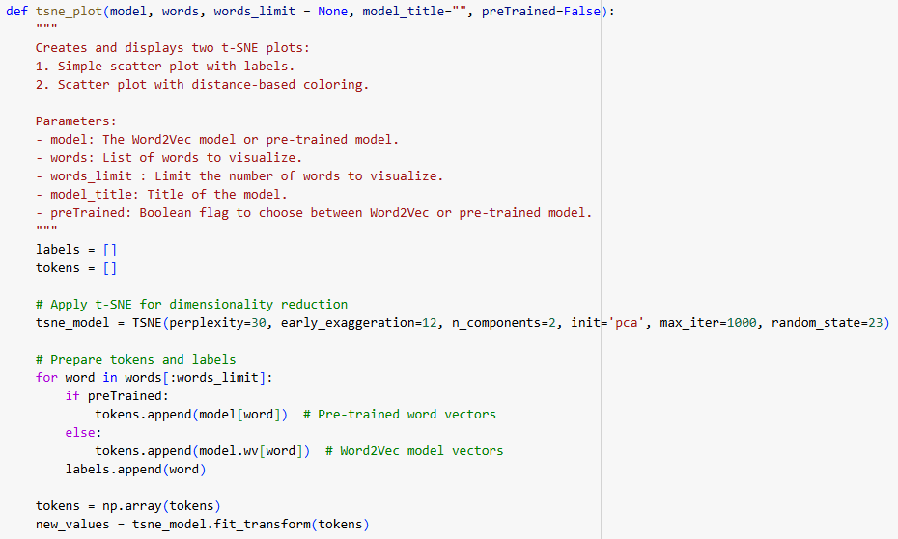
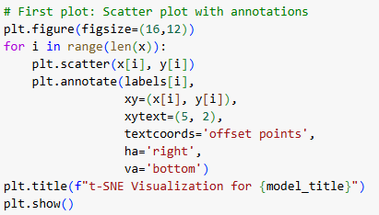
Defined common function for t-SNE plot.
Call function using corpus built using Spacy processed text.

Slide 9
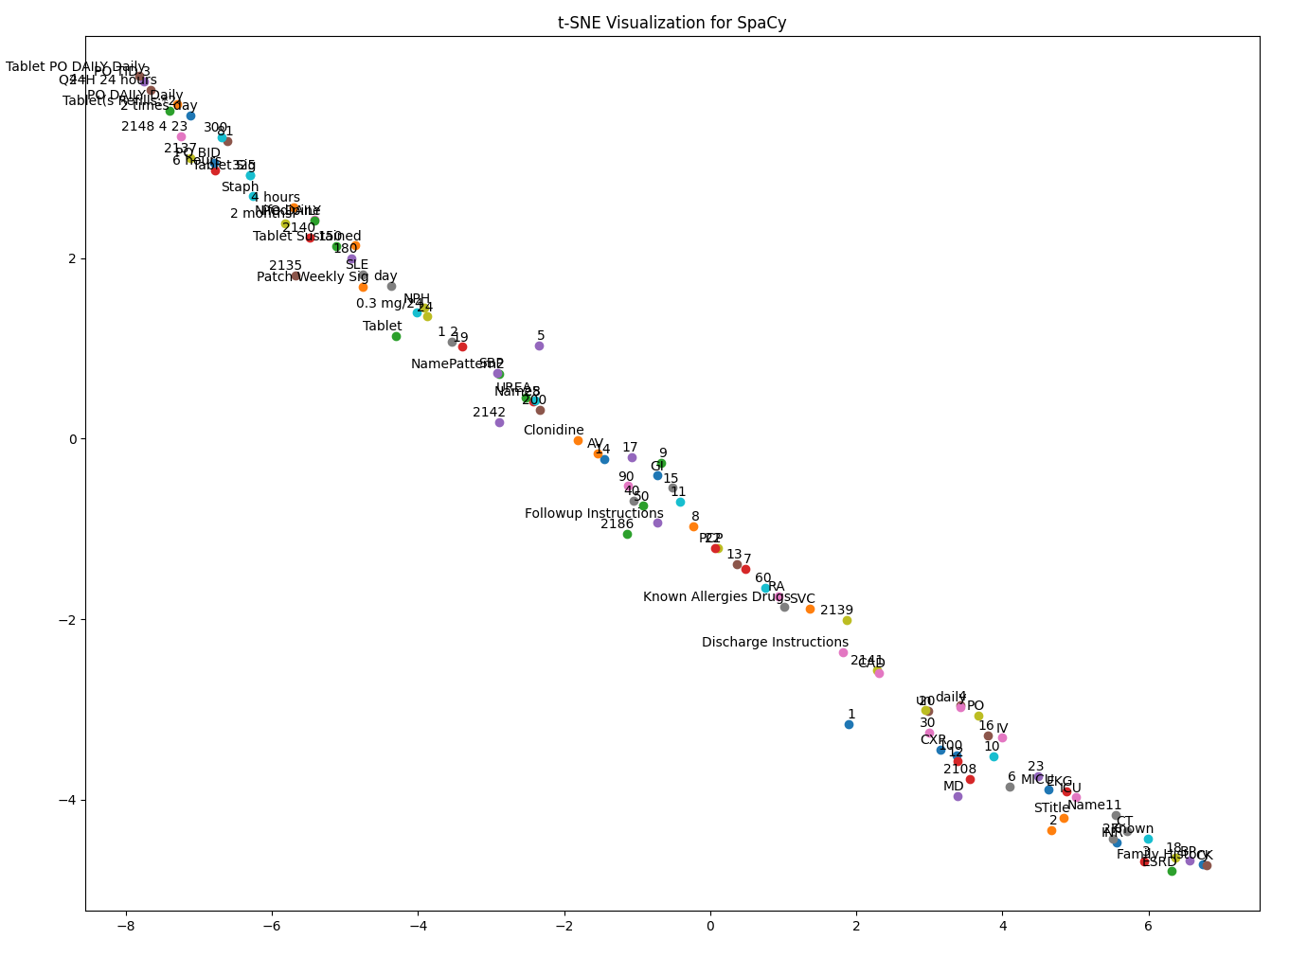
t-SNE Visualization of Top 100 Words from Word2Vec (SpaCy)
From Word2Vec similarity and above plot we can see that, the entity recognition using SpaCy was limited in extracting hypertension-related terms, likely because it focuses on general English entities rather than clinical ones.

Slide 10
SciSpacy

Slide 11
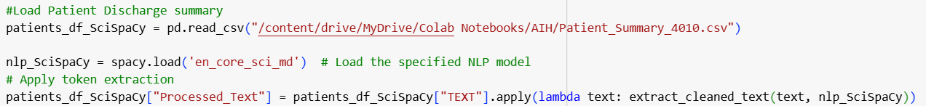

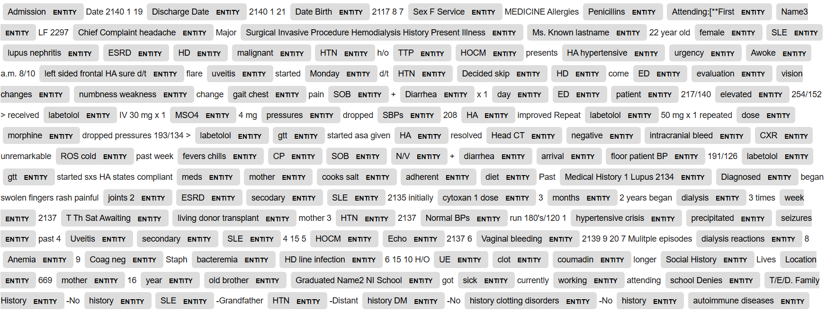
Extract and Visualize SciSpaCy Entities

Slide 12
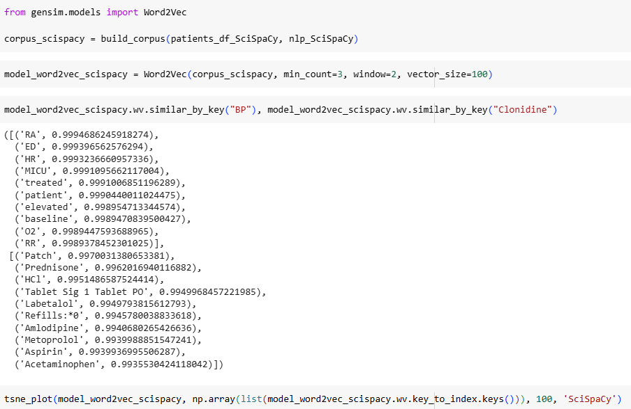
Word2Vec and t-SNE Visualization Using SciSpaCy-Processed Data

Slide 13
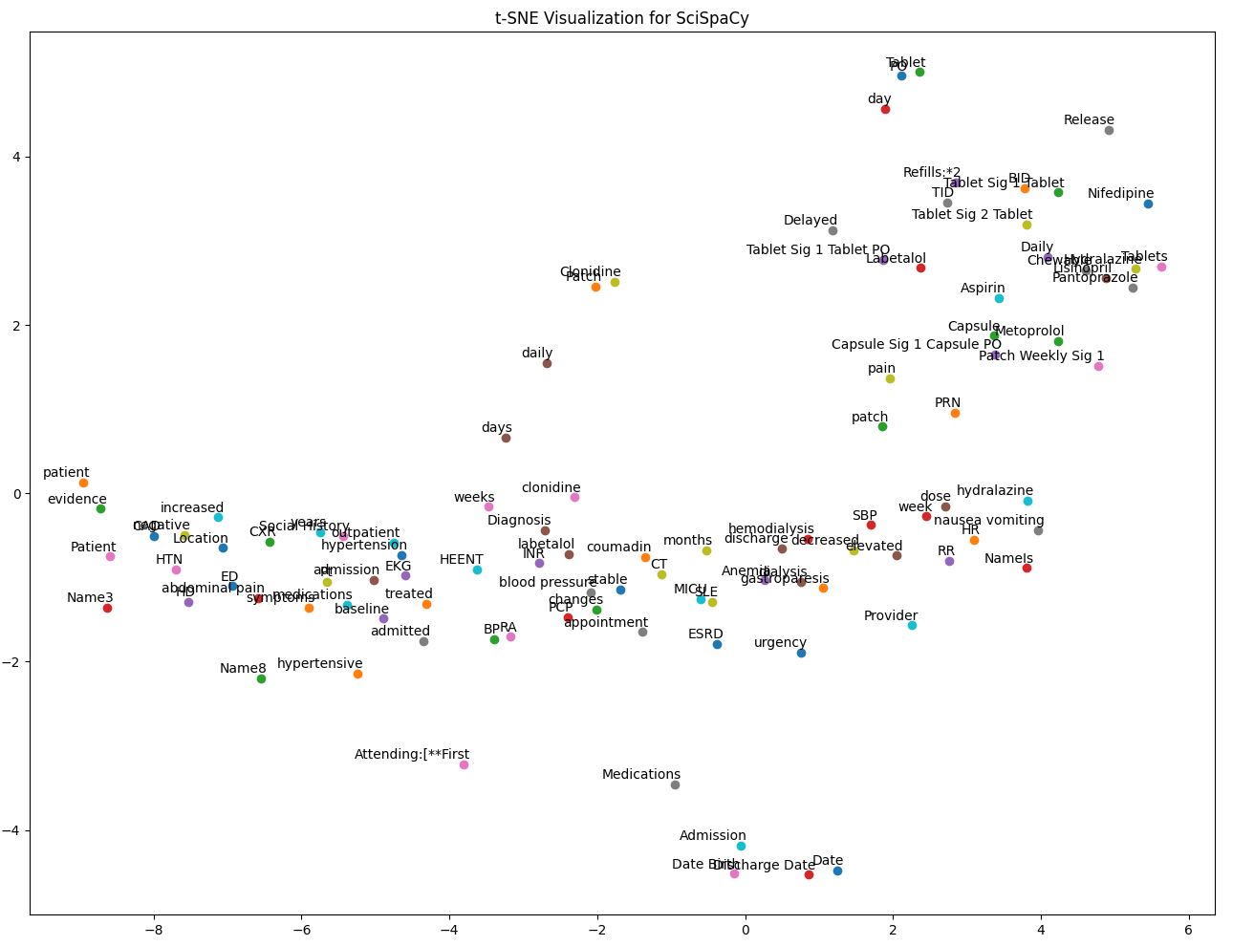
t-SNE Visualization of Top 100 Words from Word2Vec (SciSpaCy)
From Word2Vec similarity and above plot , SciSpaCy primarily recognized medication names and formulations, such as Clonidine and Labetalol, but it did not specifically highlight key hypertension-related entities beyond drug mentions.

Slide 14
BC5CDR (BioCreative V Chemical-Disease Relation)

Slide 15
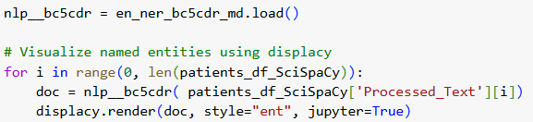
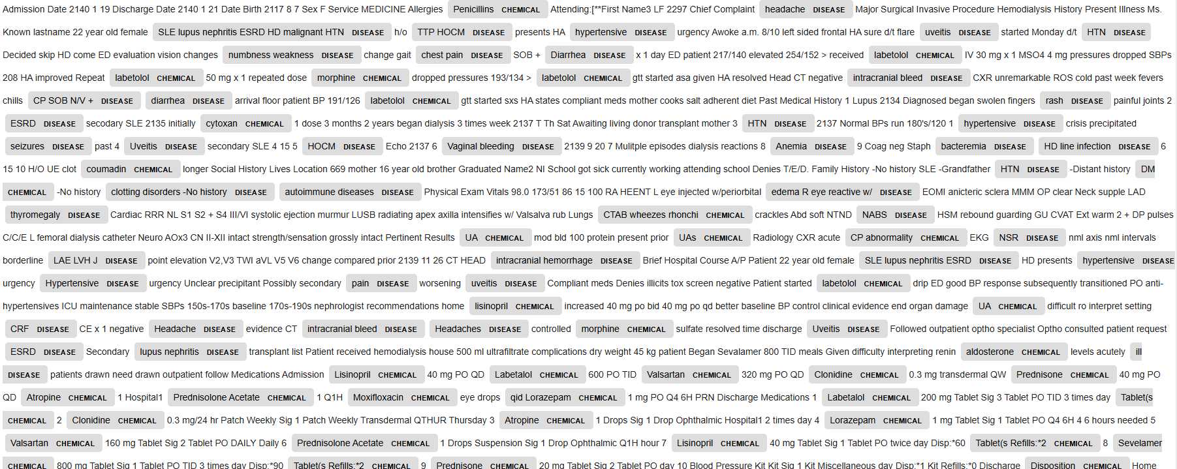
BC5CDR Entity Visualization Using SciSpaCy-Processed Data
en_ner_bc5cdr_md is a Named Entity Recognition (NER) model from SciSpaCy that specializes in identifying diseases and chemicals in text

Slide 16
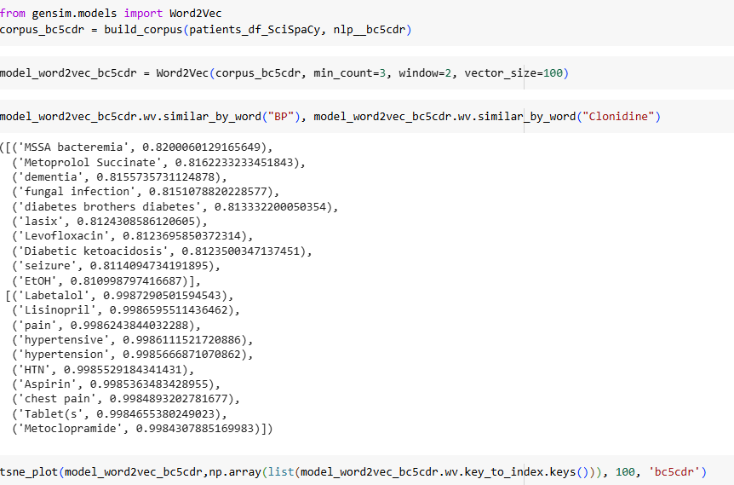
Word2Vec and t-SNE Visualization For BC5CDR

Slide 17
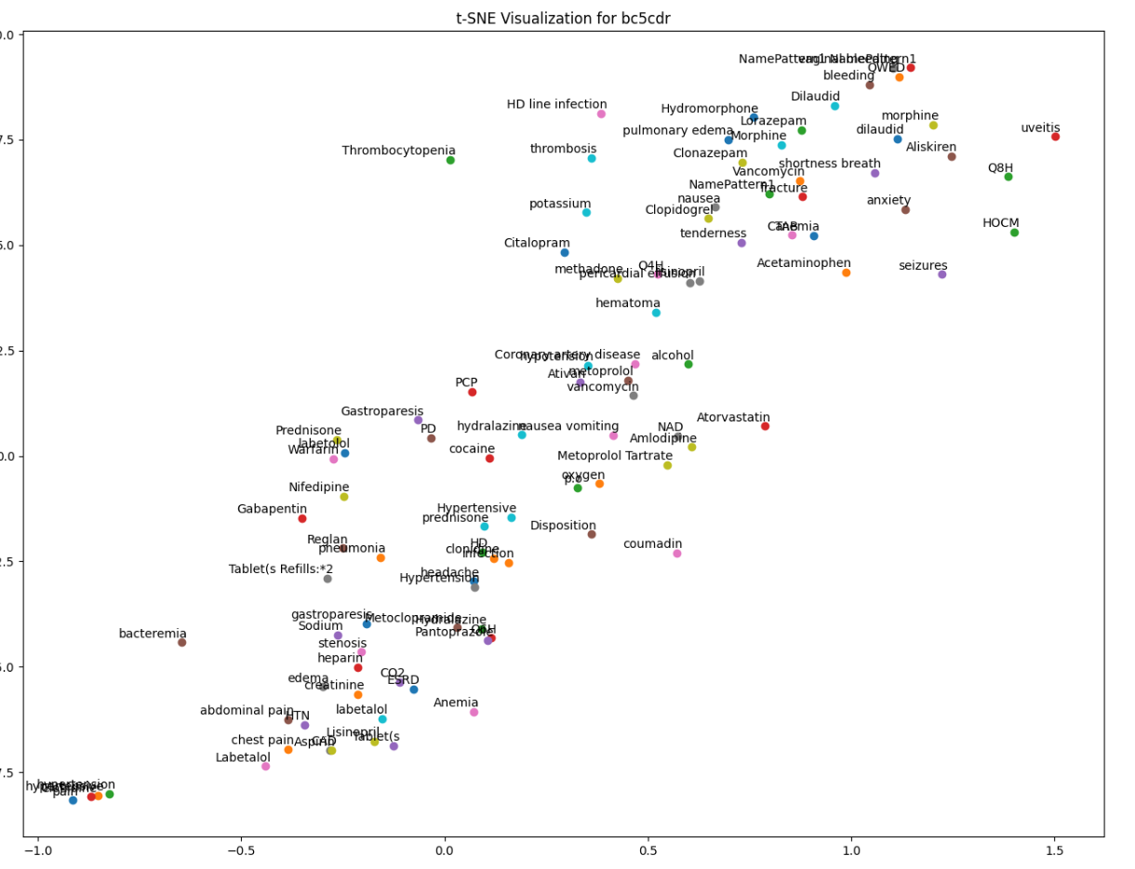
t-SNE Visualization of Top 100 Words from Word2Vec (bc5cdr)
Based on Word2Vec similarity and the above plot, BC5CDR appears to capture disease and medication entities well, with a strong emphasis on hypertension-related terms (e.g., Labetalol, hypertension, headache).

Slide 18
BlueBert

Slide 19
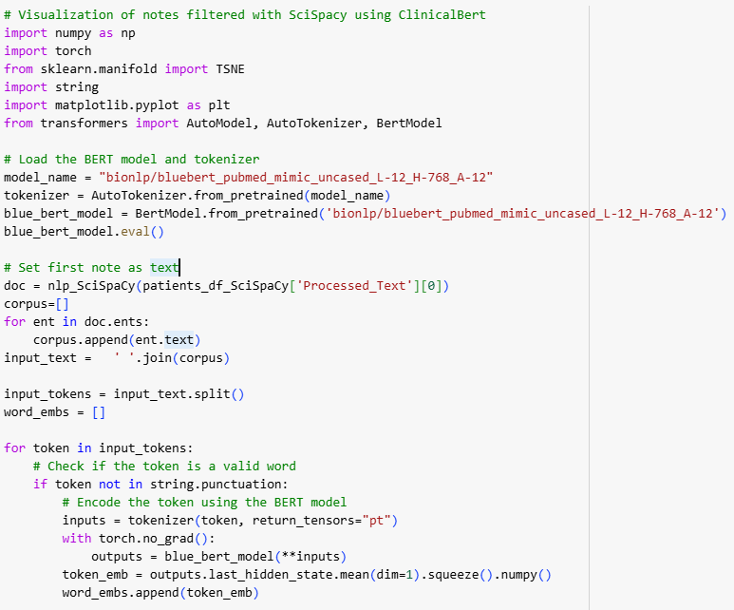
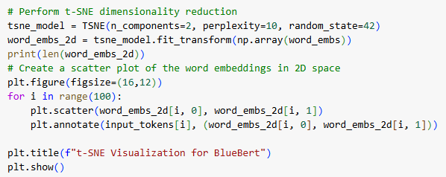
t-SNE Visualization For BlueBert
This script utilizes BlueBERT (bionlp/bluebert_pubmed_mimic_uncased_L-12_H-768_A-12) to extract word embeddings from clinical notes processed with SciSpaCy.
Named entities are identified and tokenized, then their embeddings are computed using BlueBERT.
Only one note was used here because processing all notes with BlueBERT for embedding extraction requires significant time and memory.
The embeddings are visualized in a 2D space using t-SNE, highlighting relationships among clinical terms.

Slide 20
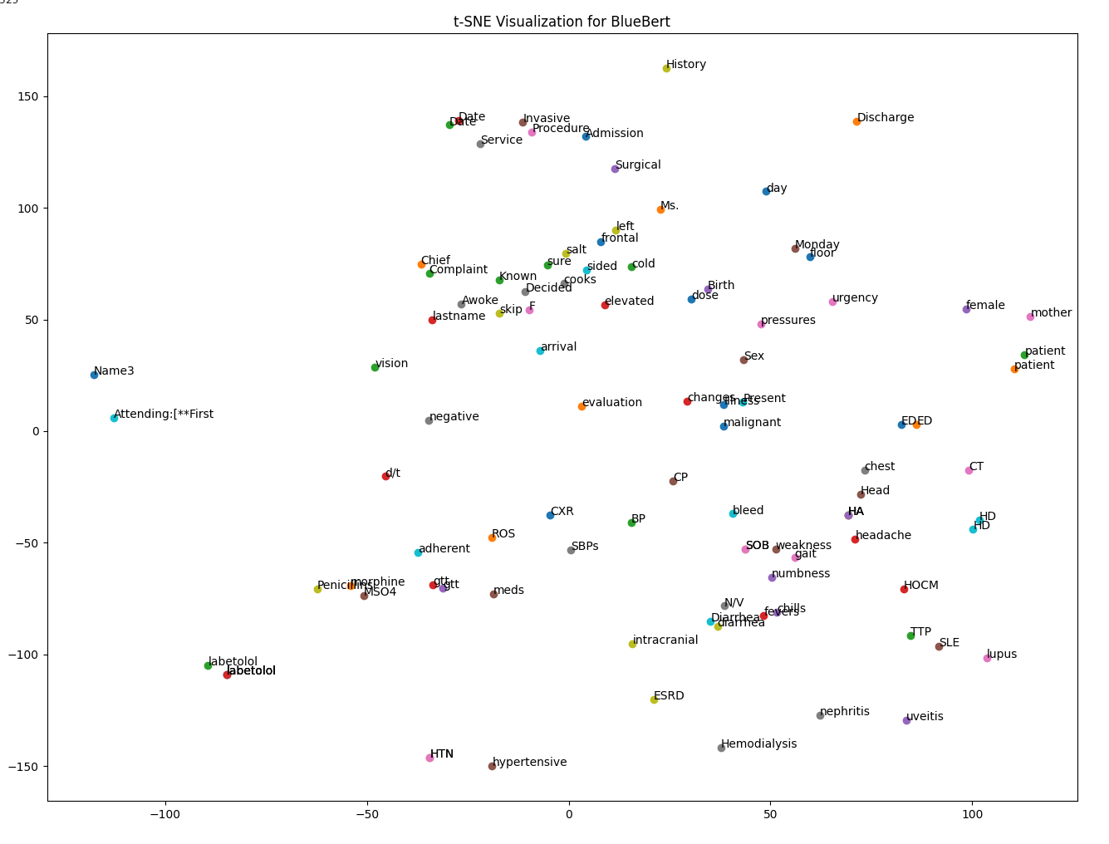
t-SNE Visualization of Top 100 Words from Word2Vec (BlueBert)
Based on Word2Vec similarity and the above plot, BlueBert appears to capture medical terms(e.g., Labetalol, hypertension, hemodialysis ).

Slide 21
MedSpacy

Slide 22
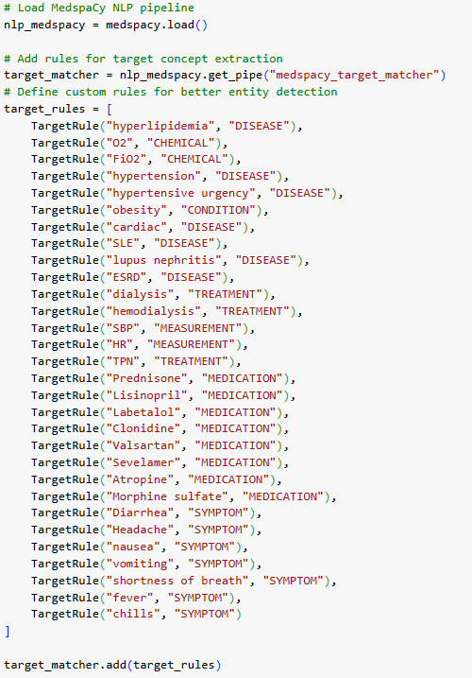
Custom Rule-Based Entity Extraction with MedspaCy NLP Pipeline
MedSpaCy is a library designed for processing clinical and biomedical text.
In this code, MedSpaCy is being enhanced by adding custom target rules to better detect specific medical entities such as diseases, treatments, symptoms, and medications in clinical notes.
Loaded the MedspaCy NLP pipeline. Used the medspacy_target_matcher to add custom rules for extracting medical concepts.
Defined specific target rules to identify entities like diseases (e.g., hypertension), treatments (e.g., hemodialysis), medications (e.g., Lisinopril), symptoms (e.g., headache), and measurements (e.g., SBP).
Applied these rules to clinical text for improved entity detection.

Slide 23

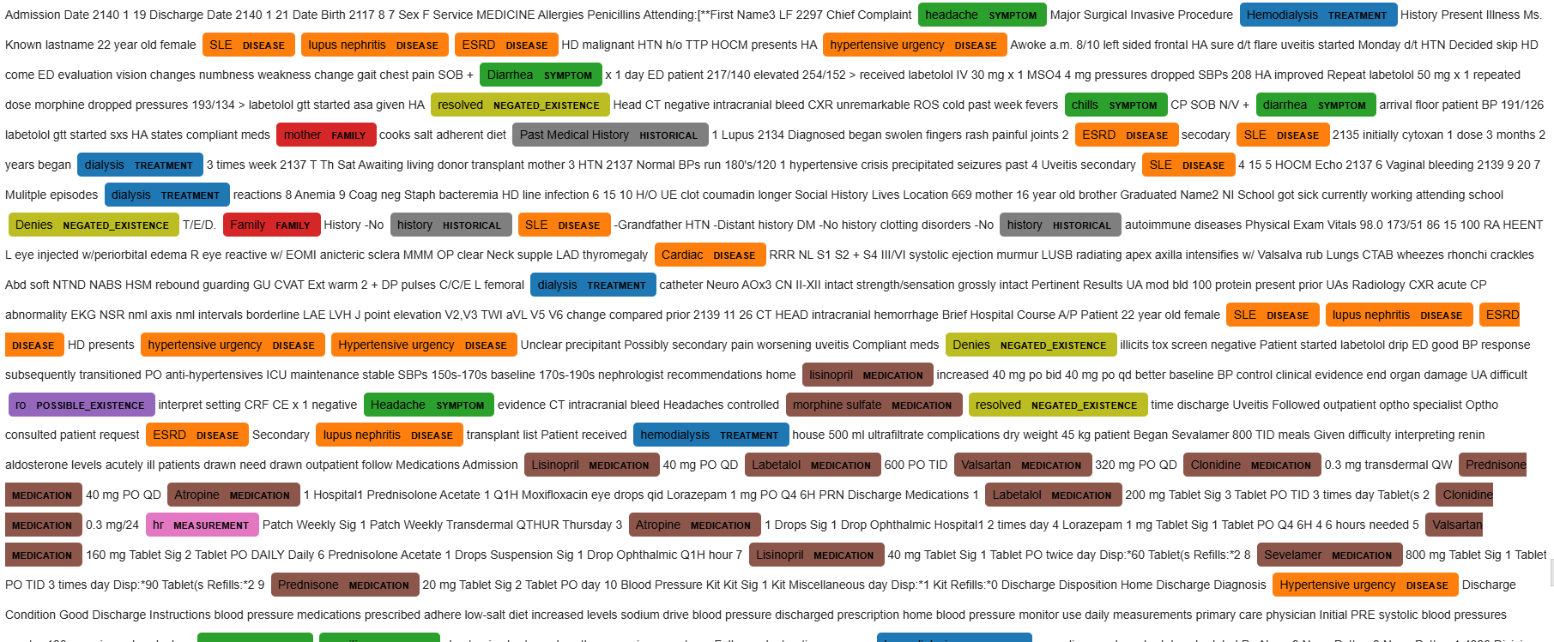
MedSpacy Visualization Using SciSpaCy-Processed Data

Slide 24
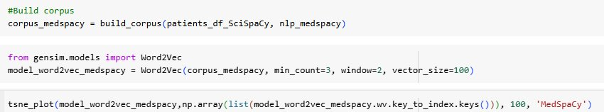
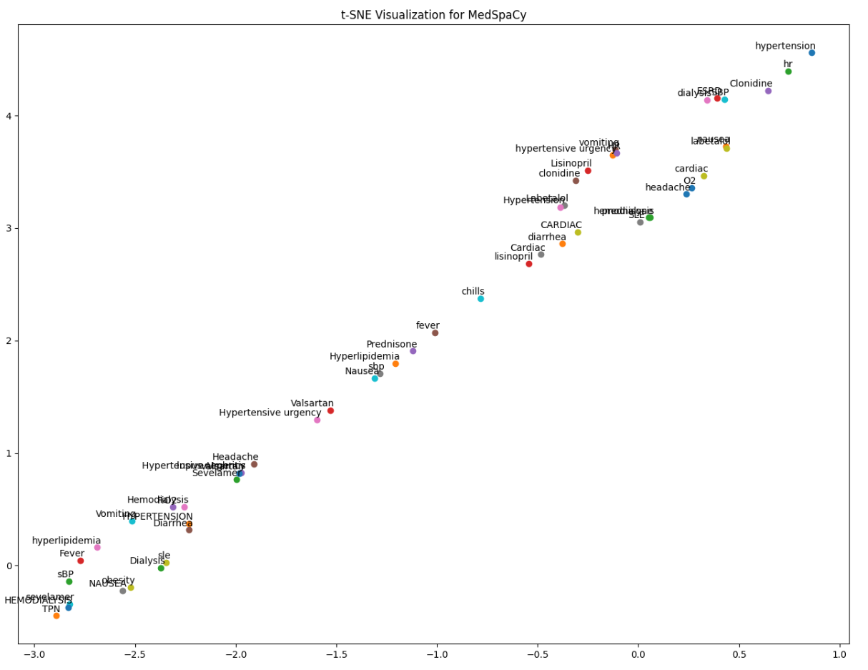
t-SNE Visualization of Top 100 Words from Word2Vec (MedSpacy)
Based on the plot, MedspaCy shows a higher frequency of terms associated with hypertension, indicating that the model is effectively recognizing and extracting a broader range of hypertension-related entities, such as medications, symptoms, and conditions, from the clinical text.

Slide 25
Conclusion
The MIMIC data, especially the free-text notes, contains a lot of shorthand, misspellings, and extra details like dates and measurements that aren't useful for Named Entity Recognition (NER). Pre-trained models like BlueBERT, BC5CDR, and MedSpaCy, tailored for the medical field and charting terminology, tend to extract more relevant and accurate entities in NER than models like SpaCy and SciSpaCy.

