Slide 1
Sentiment Analysis on Hindi Movie Reviews

Slide 2
Why Dataset in Hindi?
Little work has been done in Sentiment Analysis for Indian Languages.
Web content in Hindi is booming .
Sentiment Analysis of movie reviews could help in better rating of movies.

Slide 3
Challenges of sentiment analysis for Hindi
Hindi is morphologically rich and a free order language as compared to English language.
Hindi is a resource scarce language which causes problems in collection and generation of datasets.
Limited resources are available for this language like Hindi SentiWordNet (H-SWN).

Slide 4
Methods implemented
Resource based classification using Hindi SentiWordNet(H-SWN).
In-language classification through various classifiers like Deep Belief Network, Neural Network, SVM, Decision Tree etc.
Machine Translation- Based Semantic Analysis.

Slide 5
Resource based Classification
It uses Hindi SentiWordNet (H-SWN).
Every word available in H-SWN has a corresponding positive and a negative sentiment score.
A vote is taken for each word in a review.
The polarity with majority is predicted as the sentiment of a review.

Slide 6
Algorithm for Resource based classification
Input:
A list of reviews, R which contain positive reviews and negative reviews in string format R = { p₁, p₂....p_{m1}, n₁, n₂....n_{m2}}
where,
m₁ = number of positive reviews
m₂ = number of negative reviews
Hindi SentiWordNet dictionary dict which contain a tuple for every word having its positive polarity score and negative polarity score
Output:
A list P containing the polarity of reviews

Slide 7
1.Make a list of polarity of reviews P =[]
2.For each review r_{i} in R:
3. Apply preprocessing on r_{i}
4. Make a list of votes v=[]
5. Initialize two variables x1=0, x2=0
6. For each word w in r_{i} :
7. if w exists in dict
8. pos_score, neg_score = dict[w]
9. if pos_score > neg_score
10. v.append(1)
11. x1+=pos_score
12. else
13. v.append(0)
14. x2+=neg_score
15. else
16. ignore the word
17. ENDFOR

Slide 8
18. x = number of ones in the list
19. y = number of zeros in list
20. if x > y
21. sense = 1 (here 1 denotes positive)
22. else if y > x
23. sense = 0 (here 0 denotes negative)
24. else if x1 > x2
25. sense = 1
26. else
27. sense = 0
28. P.append(sense)
29.ENDFOR

Slide 9
In-Language Classification
Feature extraction using 2 methods:
Unigram Model
TF-IDF Model

Slide 10
Unigram Model
A lexicon is created that contains all words in dataset except stop words and some highly frequent words that donot affect review sentiment.
Feature matrix of size m*n
where,
m= number of reviews in our dataset
n= number of words in the lexicon
For each element of the matrix, if that lexicon word occurs in the review, we add 1 to index of that word in lexicon set.

Slide 11
Algorithm for computing feature matrix using Unigrams
Input: We have a list of reviews, R which contain positive reviews and negative reviews in string format. R = {p₁, p₂....p_{m1}, n₁, n₂....n_{m2}} where,
m₁= number of positive reviews
m₂= number of negative reviews
Output: A feature set F, which is list of features for each review.
F ={f₁, f₂...f_{m1}, f_{m1+1}...f_{m1+m2}}
size of feature set F : (m₁+m₂)*n
where,
n = the number of features in a single review that is equal to the length of lexicons set

Slide 12
1.Create a set of lexicons L.
2.For each review r_{i} in R:
3. tokenized_words = word_tokenize(r_{i})
4. words = preprocessing(tokenized_words)
L+=words
6.ENDFOR
7.For each review r_{i} in R:
8. F = list along with features and labels
9. features = list of zeros, size equal to length of lexicons set L
10. For each word w in r_{i}:
11. If w exist in L
12. index = L.index(w)
13. features[index] += 1
14. If it belongs to positive review
15. F.append([features,1])
16. Else
17. F.append([features,0])
18.ENDFOR
19.Shuffle the Feature set F

Slide 13
TF-IDF
TfidfVectorizer() funtion available in scikit-learn library.
It is used to convert a collection of raw documents to a matrix of TF-IDF features.
TF-IDF score of a word in a review= term frequency* inverse document frequency (idf)
where,
idf= 1/(1+log(no. of reviews in which the word occurs))

Slide 14
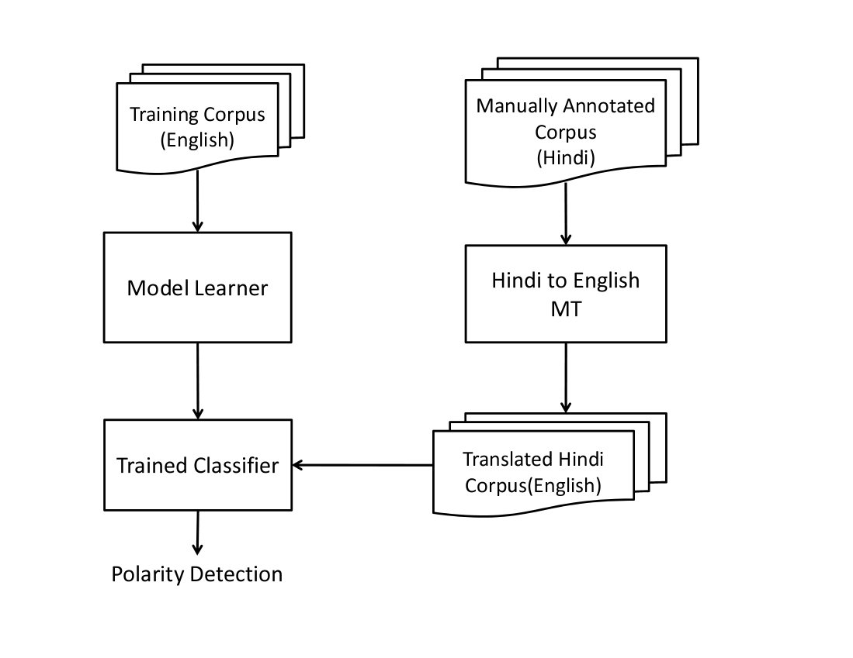
Machine Translation based Semantic Analysis

Slide 15
Small dataset available for Hindi.
Train our classifier on publically available large dataset of movie review in English.
Translate Hindi reviews to English assuming sentiment not lost in translation.
Translation done using Google Translate.
Run the already trained classifier on the Hindi data as test data.

Slide 16
Classification
We have used various classifiers for our in-language classification model
Naïve Bayes
Support Vector Machine
Decision Trees
Neural Network
Deep Belief Network

Slide 17
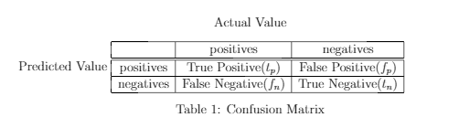




Results and Graphical Analysis

Slide 18
Accuracy
Classifiers Used / Accuracy(%) | Unigram(%) | TF-IDF(%)
Resource Based Classifier | 53.51 | 53.51
Logistic Regression | 78.98 | 85.24
Stochastic Gradient descent | 75.46 | 90.05
Multinomial Naive Bayes | 77.8 | 85.14
Support Vector Machine | 50.4 | 85.14
Decision Tree | 72.08 | 90.85
Voting Classifier | 79.09 | 89.54
Deep Neural Network | 61 | 70.99
Deep Belief Network | 50.5 | 54.33
DecisionTreeClassifier(in case of translation) | 54.5 | 72.5

Slide 19
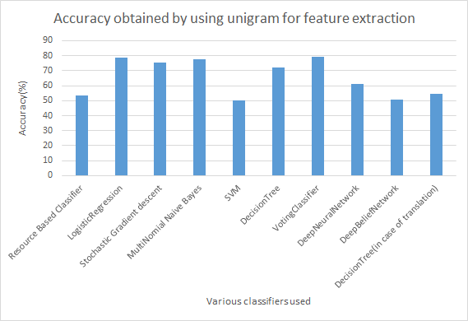
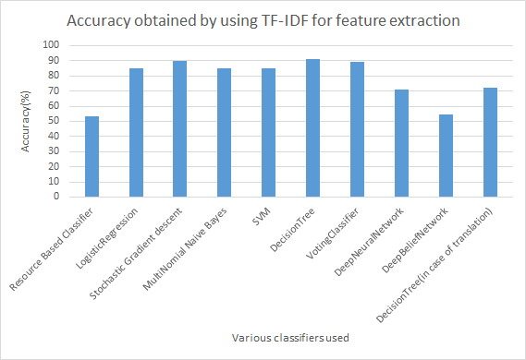

Slide 21
F-measure
Classifiers Used/F-measure | Unigram | TF-IDF
Resource Based Classifier | 0.527 | 0.527
Logistic Regression | 0.7853 | 0.9303
Stochastic Gradient descent | 0.7661 | 0.9433
MultiNomial Naive Bayes | 0.7848 | 0.9298
Support Vector Machine | 0.6702 | 0.9278
DecisionTree | 0.72 | 0.9533
Voting Classifier | 0.7628 | 0.9491
Deep Neural Network | 0.583 | 0.678
Deep Belief Network | 0.54 | 0.67
Decision Tree Classifier(in case of translation) | 0.654 | 0.8382

Slide 22
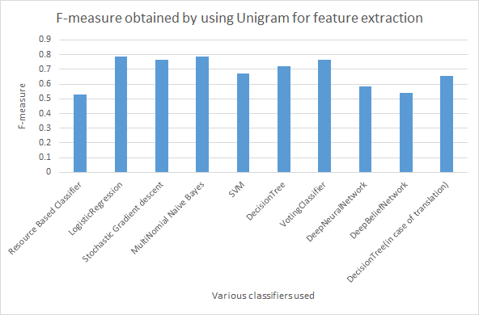
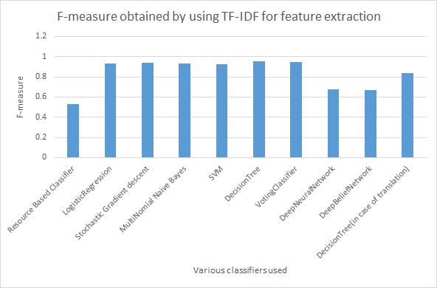

Slide 24
Conclusion
In-language classification approach performs the best among all three.
The TF-IDF method of Feature Matrix Generation gives better results than Unigram Model.
Machine Translation based approach performs better than Resource based approach

Slide 25
Future Work
Resource-based Sentiment Analysis Approach could be extended to include Word Sense Disambiguation and lexical chaining approach to get better results.
Hindi SentiWordNet (H-SWN) currently contains limited words. Improving dictionary can give much better predictions.
Present models implemented do not support negation rules.

Slide 26
References
Arora, P. Sentiment analysis for hindi language. MS by Research in Computer Science (2013).
Bansal, N., Ahmed, U. Z., and Mukherjee, A. Sentiment analysis in hindi. Department of Computer Science and Engineering, Indian Institute of Technology, Kanpur, India (2013), 1–10.
Joshi, A., Balamurali, A., and Bhattacharyya, P. A fall-back strategy for sentiment analysis in hindi: a case study. Proceedings of the 8th ICON (2010).
Mittal, N., Agarwal, B., Chouhan, G., Pareek, P., and Bania, N. Discourse based sentiment analysis for hindi reviews. In International Conference on Pattern Recognition and Machine Intelligence (2013), Springer, pp. 720–725

Slide 27
THANK YOU

