Slide 1
Tutorial BioGeoBears
PaleoCafé
Carrie Tribble

Slide 2
Introducción a BioGeoBears
"BioGeography with Bayesian (and likelihood) Evolutionary Analysis in R Scripts”
Permite la modelación estadistica de historias biogeograficas
Pruebas estadísticas entre distintos modelos
DEC
DEC + J

Slide 3
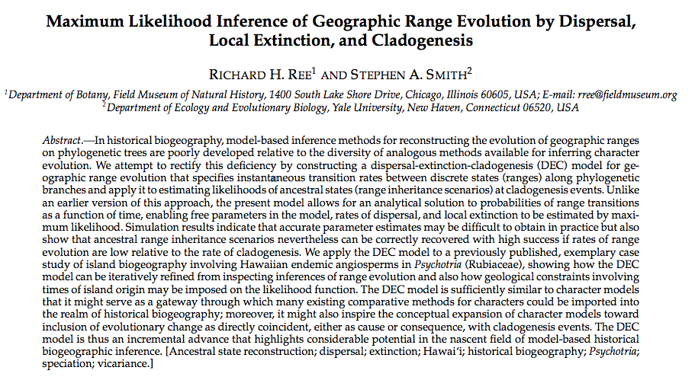

Slide 4
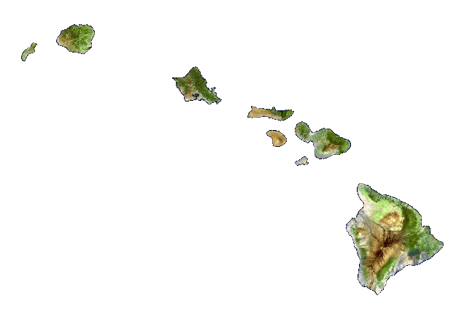
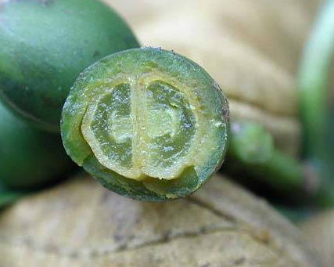
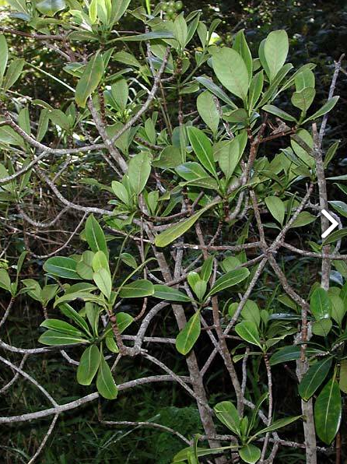
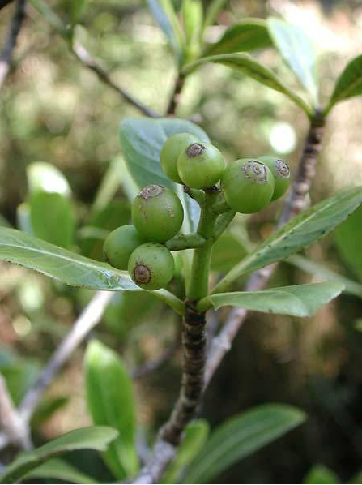
Kauai
Oahu
Maui Nui
Hawaii
Psychotria maritiana
Fotos de Botany of the Hawaiian Islands, Smithsonian Museum of Natural History

Slide 5
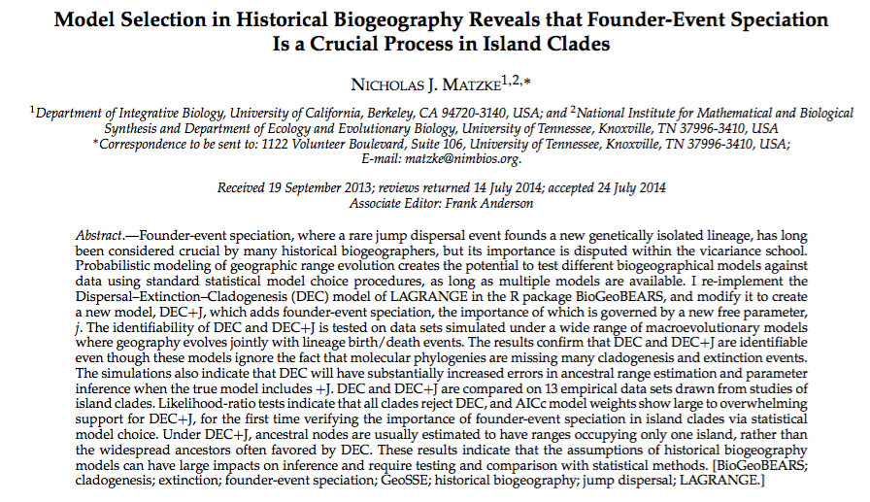

Slide 6
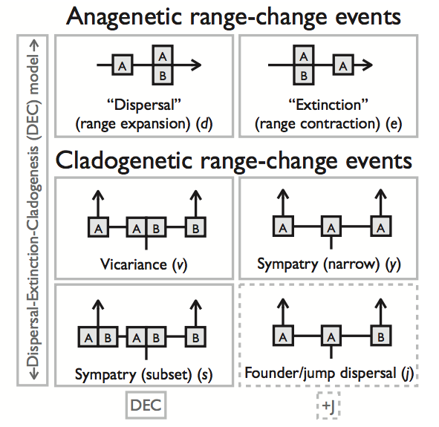
Van Dam and Matkze 2016

Slide 7
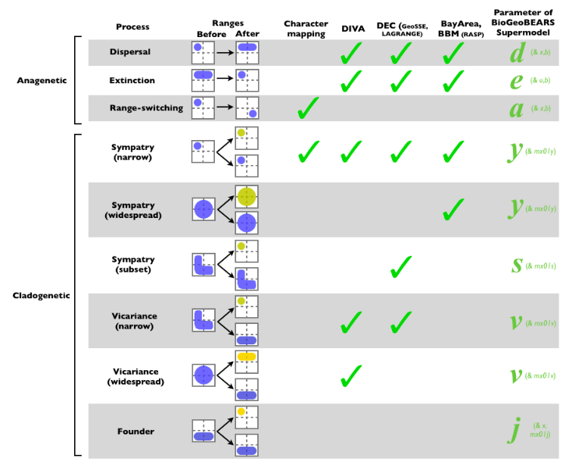
Image: Nick Matzke @ http://phylo.wikidot.com/biogeobears#BioGeoBEARS_supermodel_graphic

Slide 8
Image: Nick Matzke @ http://phylo.wikidot.com/biogeobears#BioGeoBEARS_supermodel_graphic

Slide 9
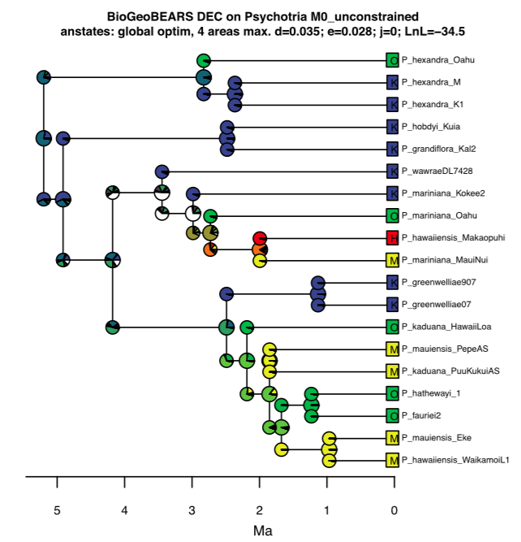
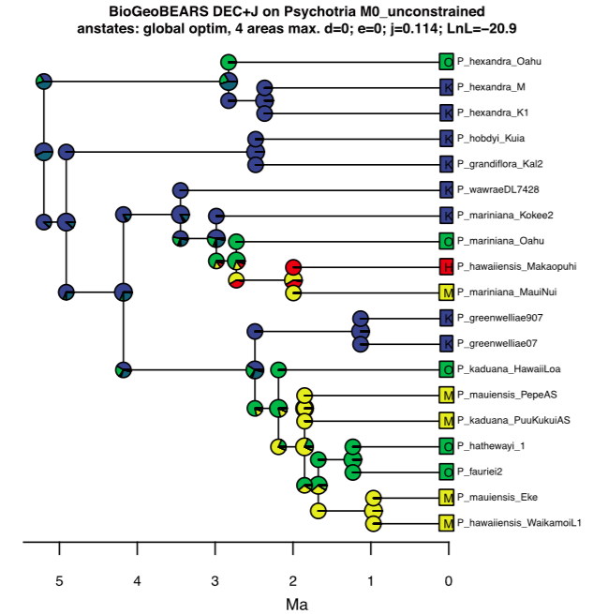

Slide 10
Avances
Incorporar distancias entre los rangos geográficos (opción +x) y que cambian por tiempo geológico
Incorporar caracteres de los organismos que podrían afectar su capacidad de dispersar

Slide 11
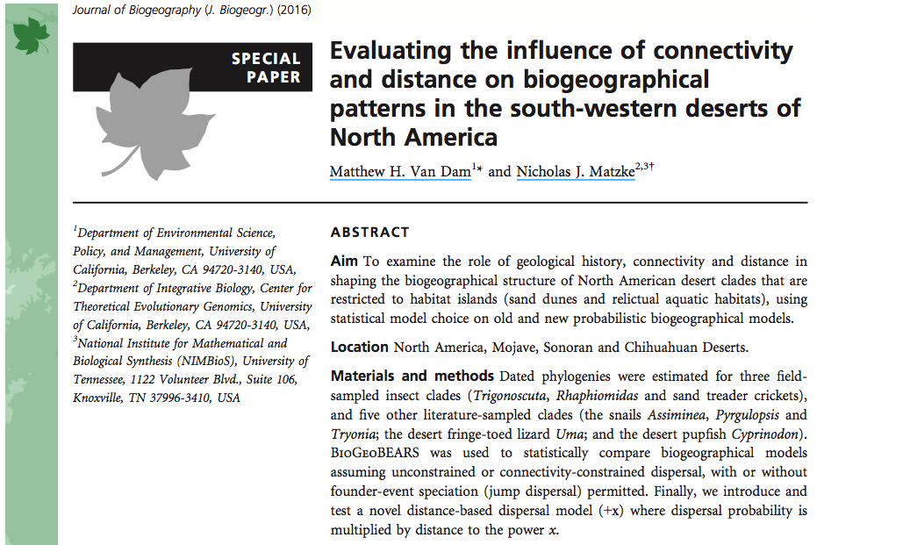

Slide 12
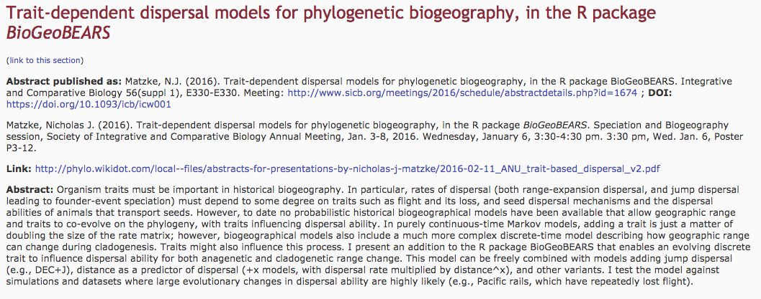
http://phylo.wikidot.com/abstracts-for-presentations-by-nicholas-j-matzke#trait

Slide 13
Recursos adicionales
BioGeoBEARS wiki
BioGeoBEARS phylo wiki

Slide 14
https://github.com/cmt2/biogeobears_tutorial_20170515
Este tutorial está basado en un ejercicio escrito por Will Freyman

Slide 15
Transition Probability Matrices
4 states -> 2⁴ -> 16
 | K | O | M | H | KO | KM | KH | OM | OH | MH | KOM | KOH | KMH | OMH | KOHM
K | - | r | r | r | r | r | r | r | r | r | r | r | r | r | r
O | r | - | r | r | r | r | r | r | r | r | r | r | r | r | r
M | r | r | - | r | r | r | r | r | r | r | r | r | r | r | r
H | r | r | r | - | r | r | r | r | r | r | r | r | r | r | r
KO | r | r | r | r | - | r | r | r | r | r | r | r | r | r | r
KM | r | r | r | r | r | - | r | r | r | r | r | r | r | r | r
KH | r | r | r | r | r | r | - | r | r | r | r | r | r | r | r
OM | r | r | r | r | r | r | r | - | r | r | r | r | r | r | r
OH | r | r | r | r | r | r | r | r | - | r | r | r | r | r | r
MH | r | r | r | r | r | r | r | r | r | - | r | r | r | r | r
KOM | r | r | r | r | r | r | r | r | r | r | - | r | r | r | r
KOH | r | r | r | r | r | r | r | r | r | r | r | - | r | r | r
KMH | r | r | r | r | r | r | r | r | r | r | r | r | - | r | r
OMH | r | r | r | r | r | r | r | r | r | r | r | r | r | - | r
KOHM | r | r | r | r | r | r | r | r | r | r | r | r | r | r | -
Matriz de 16 x 16
10 states -> 2¹⁰ -> 1024, etc.

Slide 16
Modelando el proceso cladogenético
2^{4 * 3} -> 2¹² -> 4096 x 4096

Slide 17
^{Question 1:}
Take a look at the results DEC object. What is the maximum likelihood estimate of the rate of anagenetic “dispersal” (range expansion)? And the rate of anagenetic “extinction” (range contraction)?
Notes:
0.03504546 for “dispersal"
0.02835632 for “extinction”
Look in: results_DEC$outputs

Slide 18
^{Question 2:}
Compare the estimated ancestral ranges of the lineages leading to P. hexandra Oahu all the way back to the root of the tree. Explain the results in context of biogeographic hypothesis testing. Which hypothesis makes more sense to you given Hawaiian island geography?
Notes:
In the DEC model, the P_hexandra_Oahu is reconstructed to have diverged from P_hexandra_M through vicariance. It also shows the common ancestor of these OTUs living on a KO area before splitting. However, the DEC J model shows dispersal of P_hexandra_Oahu to Oahu from Kauai. Given that we know Kauai and Oahu were never connected, vicariance is an unlikely explanation.

Slide 19
^{Question 3:}
2. Which model does the AIC support? What about the LRT?
2. These models incorporate cladogenetic evolutionary events, where evolutionary change occurs at speciation events. However, in our reconstructed phylogenies we usually only consider the speciation events that led to the extant taxa. How might unobserved speciation events (lineages that went extinct) affect our inferences?
Notes:
Part 1: The AIC supports the second model (47.89518 vs 73.08392, p value of 1.84530410526692e-07), as does the LRT (. LnL_1= -20.94759, LnL_2 =-34.54196)
Part 2: Extinction can mess up biogeographical models in the same way it can mess with other phylogenetic analyses. For example, if we suddenly find many new taxa in the same clad as P_hexandra_M and P_hexandra_Oahu on Maui, our models might identify Maui as the ancestral range of their common ancestor.

