Slide 1
DATA ANAYLSIS ON SOCIAL MEDIA
Group Members:
ANKITA SINHA
(15BCS2240)
SUBHANKAR PRASAD
(15BCS2253)

Slide 2
What is data analysis of SOCIAL MEDIA?
Twitter, Facebook, Instagram, LinkedIn, and many more social media site receives millions of tweets, status, stories, and applications every day on variety of important topic. This large amount of raw data can be used for industrial, Social, Economic, Government policies or business purpose by organizing according to our need and processing. Hadoop is one of the best tool options for Social media data analysis and Hadoop works for distributed big data, Streaming data, Time Stamped data, text data etc. This project will analyze the Real Time Data using Hadoop and according which decision-making and strategy planning can be done easily.

Slide 3
What Is The OBJECTIVE Of This Project?
The main objective of this project is to focus on how data generated from Social Media can be stored and utilized by different companies to make targeted, real time and informed decisions about their product that can increase their market share. This can be done by using Hadoop concepts.
The given project will focus on how data generated from Social Media Websites can be analyzed and utilized. There are multiple applications of this project.
This project can also help in analyzing new emerging trends and knowing about people's changing behavior with time

Slide 4
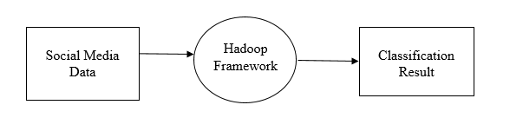
Working PROCESS
LEVEL 0 DFD
Data Collection from Social Media acts as an input where we read the data on the topics from twitter, Facebook, Instagram using hadoop. Hadoop used in designing the result.

Slide 5
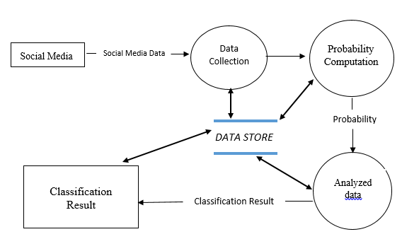
LEVEL 1 DFD

Slide 6
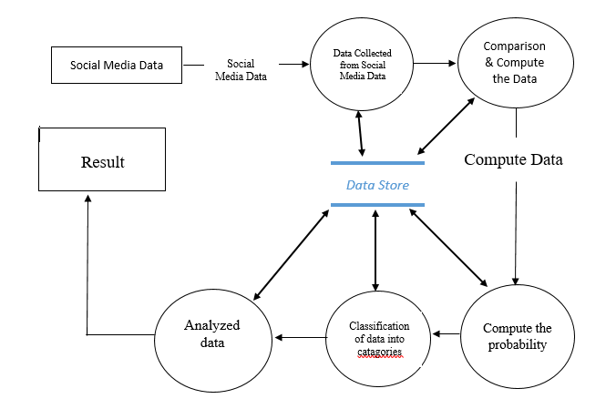
LEVEL 2 DFD

Slide 7
HARDWARE/SOFTWARE REQUIREMENTS:-
HARDWARE SPECIFICATIONS:
PROCESSOR: Intel Core i3
RAM: 4 GB
HARD DISK: 500 GB
MONITOR: LCD Monitor
KEYBOARD: 101 keys or more
MOUSE: Simple Mouse
NETWORK: Internet
SOFTWARE SPECIFICATIONS:
PLATFORM: Windows 10
SOFTWARE: VMWARE Work Station, IBM Infosphere, Hadoop (HDFS and Map Reduce) ,Pig

Slide 8
FUTURE SCOPE OF THE PROJECT
Social media is one of the popular media right now to share opinions or variety of topics and twitter is very popular social site to share everything related to opinions on variety of topics and discussions on current issues.
Twitter, Facebook, Instagram, LinkedIn and many more websites receives petabytes of data every day and these data is nothing but a collection of tweets so these data is very important in real life to analyze different scenario through which its helps us in decision making.
The analysis of Social Media data gives real view or different user opinions regarding what they think and to analysis, these data provide a better way for making any decision.

Slide 9
OUTPUT

Slide 10
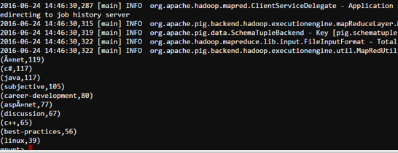
Top 10 most commonly used tags in this data set

Slide 11
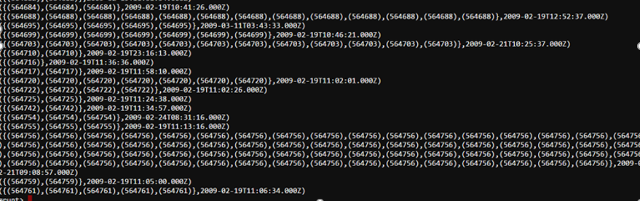
Average time to answer questions

Slide 12
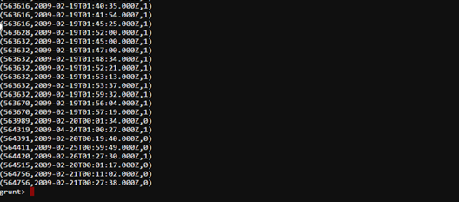
Number of questions which got answered within 1 hour

Slide 13
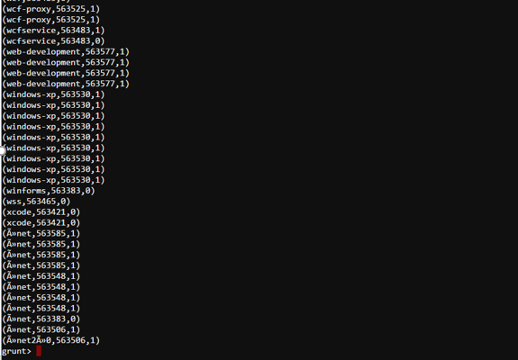
Tags of questions which got answered within 1 hour

Slide 14
THANK YOU

