Slide 1

DEPARTMENT OF COMPUTER SCIENCE & ENGINEERING
VISUALIZATION OF A* PATH FINDING ALGORITHM
COURSE NAME : MINI PROJECT
COURSE CODE:20CSE59
Presentation by, Under the Guidance of,
Name: Ankita Tandon Ms. Pramilarani
USN: 1NH18CS023

Slide 2
Agenda
Objective of course
Objectives of the project
Problem Definition
Design
Algorithm
Result (Output Screen)
Conclusion: Objectives achieved

Slide 3
Objective of the course
Mini Project helps you to explore and strengthen the understanding of fundamentals through practical application of theoretical concepts. Mini Project can help us to boost our skills and widen your horizon of thinking. It acts like a beginners guide to do larger projects later in their career.
CO1: Understand technological and/or societal needs
CO2: Design & develop an algorithm by applying PYTHON concepts
CO3: Analyze & evaluate the algorithm’s performance matrices
CO4: Test, validate and communicate the identified solutions in a structured way.

Slide 4
Objective of the project
In this project, the objective is to design and implement an application involved in generating an optimal solution to find the shortest distance from the initial/start point to the final/end point, eliminating the obstacles in the path using A* pathfinding algorithm
A* (pronounced as "A star") is a computer algorithm that is widely used in pathfinding and graph traversal. The algorithm efficiently plots a walkable path between multiple nodes, or points, on the graph. On a map with many obstacles, pathfinding from points A to B can be difficult.

Slide 5
Problem Definition
To approximate the shortest path in real-life situations, where there can be many hindrances. Consider a 2D grid having several obstacles, apply A* Pathfinding Algorithm to find the shortest path from the starting source cell to reach the destination cell. It is a computer algorithm widely used to efficiently plot a walkable path overcoming the obstacles coming in the path.

Slide 6
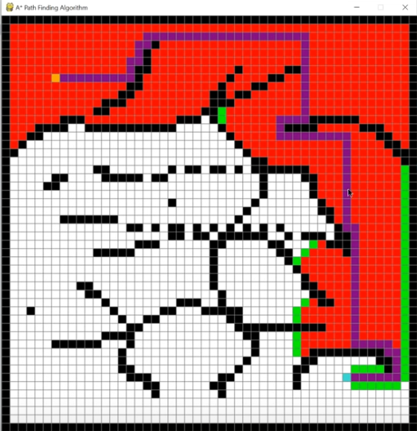
Design
To design an application, with an effectively efficient mechanism which takes in the start and end point on a two-dimensional grid where the black blocks represents the obstacles. Then finds the shortest path from start point to the end point and deploys it on the grid.
Representation of 2D grid

Slide 7
Algorithm
Consider a square grid having many obstacles and we are given a starting cell and a target cell. We want to reach the target cell (if possible) from the starting cell as quickly as possible. Here A* Search Algorithm comes to the rescue. A* Search Algorithm picks the node according to a value: ‘f’ which is a parameter equal to the sum of two other parameters – ‘g’ and ‘h’. At each step it picks the node/cell having the lowest ‘f’, and process that node/cell.
FORMULA: f(n) = g(n) + h(n)
g = the movement cost to move from the starting point to a given square on the grid, following the path generated to get there.
h = the estimated movement cost to move from that given square on the grid to the final destination. This is often referred to as the heuristic, which is nothing but a kind of smart guess. We really don’t know the actual distance until we find the path, because all sorts of things can be in the way (walls, water, etc.). There can be many ways to calculate this ‘h’, here we take the absolute distance between two points.

Slide 8
STEPS
1. Initialize the open list [start node(leave its f at zero)]: list of nodes to be visited in queue fashion (BFS)
2. Initialize the closed list []: list of visited nodes
3. While the open list is not empty:
a. Find the node with the least f on the open list, call it "q"
b. Pop q off the open list
c. Generate q's 8 successors and set their parents to q
d. For each successor:
i. If successor is the goal, stop search
successor.g = q.g + distance between successor and q
successor.h = distance from goal to successor
successor.f = successor.g + successor.h

Slide 9
ii. If a node with the same position as successor is in the OPEN list which has a lower ‘f’ than successor, skip this successor
iii. If a node with the same position as successor is in the CLOSED list which has a lower ‘f’ than successor, skip this successor otherwise, add the node to the open list end (for loop)
e. Push q on the closed list end (while loop)
Hence, the openList can be empty in two conditions:
Either the destination is achieved
There is no possible solution

Slide 10

OUTPUT SCREENS
1. On Execution of the Code
Visualization of A* Path Finding Algorithm Window where all the cells are blank i.e. white representing walkable path.

Slide 11
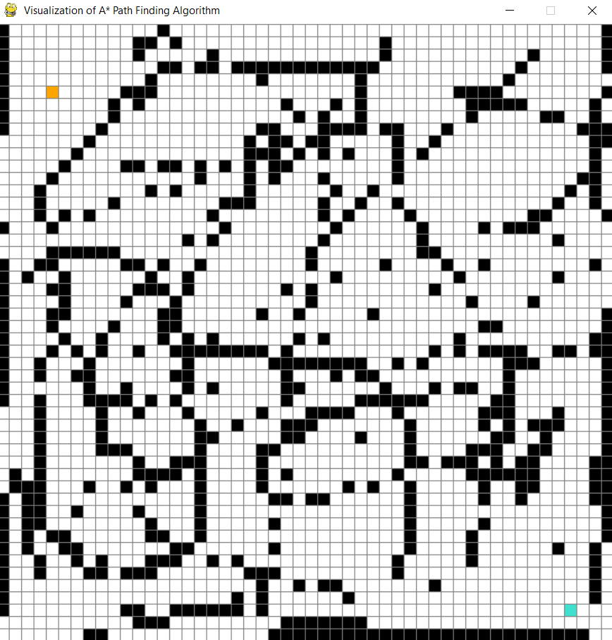
2. Feed Input
Click the cells to feed the input where orange is the start point, blue is the end point and black cells are the obstacles.
1st click : Start Cell
2nd click : End Cell
Others : Barriers

Slide 12
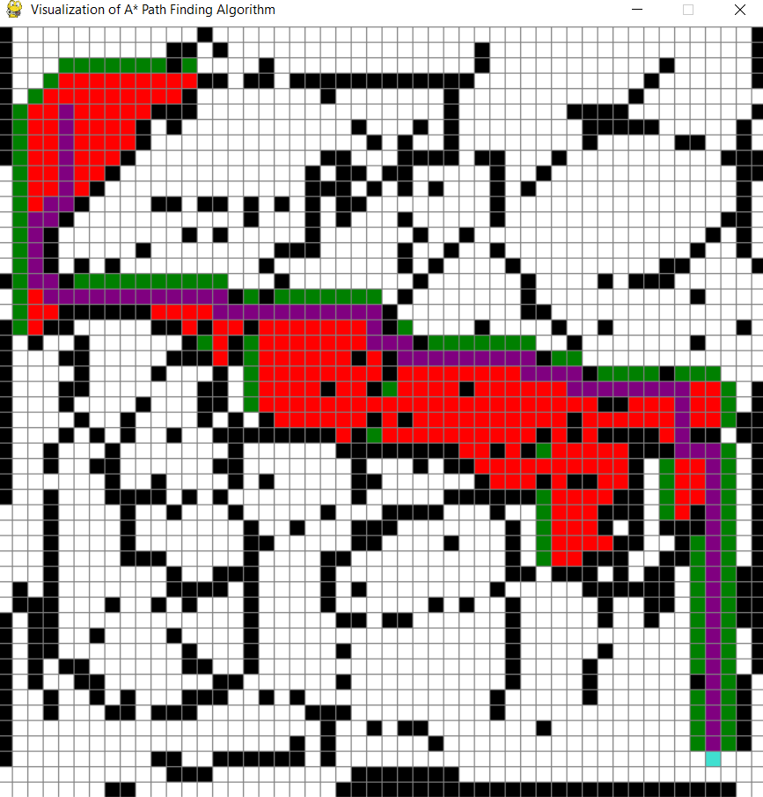
3. Output
Enter Spacebar on the keyboard to obtain the result where the purple blocks represent the path to be travelled to reach the destination.
Here, the RED blocks are closed set values while GREEN blocks holds the open set values of the x, y coordinates of the cells.

Slide 13
Conclusion
Hence, the application developed allows the user to use the system to figure out the optimal path to reach the destination at minimal cost using A* pathfinding algorithm with a visual display.
Through this project, I learn to implement complex problems by eliminating the impossible paths and focusing more towards the possibilities to obtain the most optimal solution for real-world problems.

Slide 14
Thank you!

