Slide 1
MBC 638 Final Project
Bank Term Deposit Analysis
Ankita Vartak
Dhrumil Parekh
Nivesh Vaze
Pranav Seth

Slide 2

Descriptive Analytics
Part A

Slide 3
PART A: Descriptive Analysis
Dataset Description and Source
Variable Description
Descriptive and Statistical Analysis of Variables

Slide 4
Data Description and Source
Data is related with direct marketing campaigns of a Portuguese banking institution
Marketing campaigns were based on phone calls where often more than one contact to the same client was required, in order to access if the product (bank term deposit) would ('yes') or would not ('no') be subscribed
Classification goal is to predict if the client will subscribe (yes/no) to a term deposit (variable y)
Dataset Source: UCI Machine Learning Repository, Center for Machine Learning and Intelligent Systems

Slide 5
VARIABLE DESCRIPTION
VARIABLES | DESCRIPTION
Age | Age of the customer (in Years)
Job | Type of job (eg. Admin, student, technician, retired )
Marital | Marital status (singly, married, divorced)
Education | Education Categories (primary, secondary, tertiary)
Default | Default in credit (yes, no)
Contact | Contact communication type (cellular, telephone, unknown)
Housing | Has a Housing loan (yes, no)
month | Last contact month of year (eg. Jan, feb, mar)
day_of_week | Last contact day of the week (1,2,3, etc)
duration | Last contact duration (in seconds)

Slide 6
campaign | Number of contacts performed during this campaign and for this client
pdays | Number of days that passed by after the client was last contacted from a previous campaign
previous | Number of contacts performed before this campaign and for this client
poutcome | Outcome of the previous marketing campaign
emp.var.rate | Employment variation rate - quarterly indicator
cons.price.idx | Consumer price index - monthly indicator
cons.conf.idx | Consumer confidence index - monthly indicator
euribor3m | Euribor 3 month rate - daily indicator
nr.employed | Number of employees - quarterly indicator
Y(Term deposit enrollment) | Has the client subscribed a term deposit

Slide 7
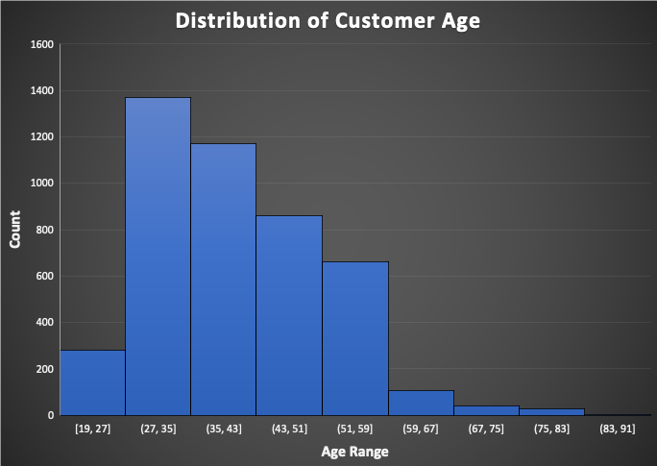
Summary
The given chart shows the Distribution of Customer Age captured for the data set
Maximum customers fall in the 27-35 years of age helping Business teams run targeted Marketing campaigns

Slide 8
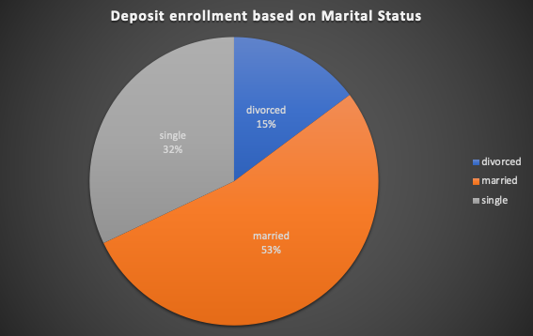
Summary
The given Pie chart shows the distribution of Deposit Enrollment based on Marital Status.
The chart shows that Married people have the highest enrollment for Term Deposits.

Slide 9
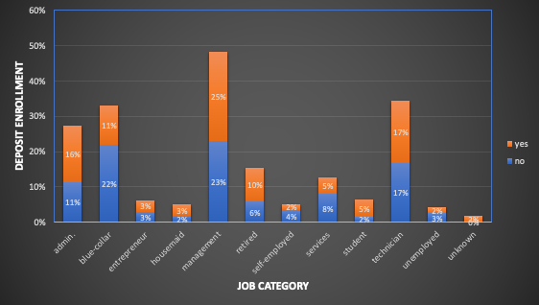
Summary
This chart shows distribution according to job categories who did not enroll for Term Deposit in the previous campaign but enrolled after attending the current campaign.
Data shows that the Management category had the highest percentage of customers who did not enroll in Term Deposit even after attending the current campaign.

Slide 10
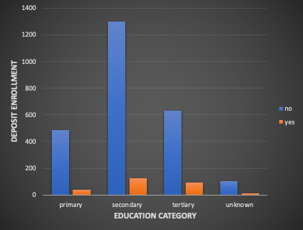
Summary
The given Pivot chart shows the distribution of Married people enrolled for Deposit based on their Education Category helping Business teams understand their customers and gaps to be filled

Slide 11
Association Between variables
Part B

Slide 12
Explanatory and dependent variables
Correlation Analysis
Logistic Regression Analysis
Interpretation of results
Evaluation of findings
Predictions
Business Use
Part B

Slide 13
Objective of Regression Analysis
In this section, we did the Logistic regression. A logistic regression model predicts a dependent data variable by analyzing the relationship between one or more existing independent variables.
Our data is related to direct marketing campaigns of a Portuguese banking institution. The marketing campaigns were based on phone calls. Often, more than one contact with the same client was required, to access if the product (bank term deposit) would be (‘yes’) or not (‘no’) subscribed. Thus, our dependent variable is named y(term deposit enrollment) in the dataset.

Slide 14
Selection of independent variables for the multiple regression
model – Table of Correlation Coefficients
The variables that are used to explain or predict the y(term deposit enrollment) variable are called the explanatory variables. we carry out the correlation analysis to highlight the significant independent variable and include those variables in the regression model.
 | balance | age | campaign | pdays | previous | duration | Yout
balance | 1
age | 0.083820142 | 1
campaign | -0.009976166 | -0.00515 | 1
pdays | 0.009436676 | -0.00889 | -0.09314 | 1
previous | 0.026196357 | -0.00351 | -0.06783 | 0.577562 | 1
duration | -0.015949918 | -0.00237 | -0.06838 | 0.01038 | 0.01808 | 1
Y(term deposit enrollment) | 0.017905098 | 0.045092 | -0.06115 | 0.104087 | 0.116714 | 0.401118 | 1

Slide 15
Selection of independent variables for the multiple regression
model – Table of Correlation Coefficients
Order of independent variables inputted as referenced from the correlation table:
duration
previous
pdays
age
balance
Campaign
Based on the degree of correlation, we included duration, pdays and previous variables as explanatory variables in the regression model

Slide 16
Scatterplots of Explanatory Variables:

Slide 17
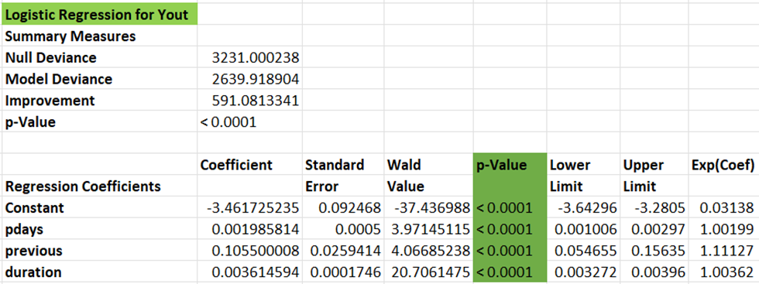
Regression Analysis Interpretation:
The p-values of all three co-efficient are <0.0001 which suggests that all the
three explanatory variables considered in the regression analysis are
statistically significant in explaining the dependent variable y(term deposit enrollment).

Slide 18
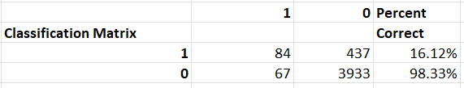
In Logistic regression, we first calculate Logit and then the Probability of the outcome using the regression coefficients. Calculation of logit is given below:
Logit = -3.46172 + 0.001985 pdays + 0.105550 previous + 0.003614 duration.
Calculation of Probability is given below: -
Probability = EXP(Logit)/(1+EXP(Logit))
Based on the value of previous, pdays and duration of each customer we have calculated Logit and probability. The performance of the Logistic regression model is shown below.
From this, we can interpret that our model is able to predict enrollment outcomes
with 16.12% accuracy. i.e., 16.12% of historical records with y(term deposit enrollment) as 1 have a probability
of >50%.

Slide 19
Prediction using the regression equation
Here, we have calculated the probability of two different customers to check whether they might enroll for the term deposit.
1. Duration = 2769 seconds, previous = 0, pdays = -1.
For this customer, the Logit = 6.545 and Probability = 0.998. As the duration of the call is high the probability of enrolling for the deposit is higher. i.e., 99%
This data is a historical record, and the customer did enroll for the deposit.
2. Duration = 3025 seconds, previous = 0, pdays = -1
For this customer, the Logit = 7.470 and Probability = 0.999. As the duration of the call is high the probability of enrolling for the deposit is higher. i.e., 99%
In this case, the model suggests that the customer will enroll for the term deposit, however, the customer did not enroll.
In conclusion, I would say that there are certain non-linearities that are not being considered in the regression analysis.

Slide 20
Conclusion:
Based on the analysis performed throughout the project, we can
say that the regression model could be used to predict the outcome
of the Term Deposit Enrollment and accordingly provide inputs to the
Bank Telemarketing team to segment and target the audience
accurately.
Also, the model is quite rigid and cannot model adequately complex nonlinear relationships. Hence the accuracy of the Logistic regression in this case is lesser.
As a future scope, we can work on implementing decision trees (DTs), neural networks (NNs) or support vector machines to better understand the prospective bank customer and save hefty contact costs for the banking client.

Slide 21
Thank You

