Slide 1
LOW PASS FILTER FOR SPEECH ENHANCEMENT
TEAM NO :21
ANKITA.A 231IT007
LEKHANA.R 231IT036
Department Of Information Technology, NITK

Slide 2
TABLE OF CONTENTS
CONTENT | PAGE NUMBER
1.INTRODUCTION | 2-3
2.LITERATURE SURVEY | 4
3.PROBLEM STATEMENT AND OBJECTIVES | 5
4.METHODOLOGY | 6-8
6.EXPERIMENTAL SETUP | 9-11
5.RESULTS AND ANALYSIS | 11-12
6.CONCLUSION AND FUTURE WORK | 13
7.REFERENCES | 15
1 of 15

Slide 3
INTRODUCTION
1.Importance of Speech Enhancement:
Enhances audio quality for applications such as telecommunications, assistive listening devices, and communication systems.
2.Role of Low-Pass Filters
Allows low-frequency sounds to pass through while attenuating high-frequency noise.
Effective for reducing unwanted noise and preserving key components of the speech signal.
2 of 15

Slide 4
3.Challenges in Speech Enhancement
Balancing noise reduction with maintaining speech quality.
Ensuring that speech clarity and intelligibility are not compromised by filtering.
4.Significance of Research
Potential to improve communication systems and hearing aids.
Offers insights into the impact of different low-pass filter configurations on speech quality.
Contributes to the development of more effective enhancement tools for real-world applications.
3 of 15

Slide 5
LITERATURE SURVEY
Serial Number | Key Observations | Title, Author, Year of Publication
1. | To reduce unwanted background noise in the audio file using low-pass filters, improving signal clarity and enhancing detection and classification in noisy environments. This paper explored how dynamic low pass filtering could better handle varying noise conditions. | Title: “Audio Signal Filtering With Low Pass And High Pass Filters” Author: Phyo Thu Zar Tun, Khaing Thand Swe Year: 2020
2. | The study aims to improve speech enhancement by integrating multiple techniques to effectively reduce noise while preserving critical speech elements. This research demonstrates an effective framework for speech enhancement, paving the way for future developments in hybrid models that combine machine learning with signal processing techniques to improve speech quality in noisy environments. | Title: "Speech Enhancement Based on the Integration of Fully Convolutional Network, Temporal Lowpass Filtering, and Spectrogram Masking" Authors: Kuan-Yi Liu, Syu-Siang Wang Year: 2019
4 of 15

Slide 6
. PROBLEM STATEMENT AND OBJECTIVES
PROBLEM STATEMENT : To address the challenge of maintaining speech clarity in noisy environments by designing an adaptive low-pass filter system that effectively reduces background noise without compromising speech quality.
Objective 1: Evaluate the performance of various low pass filter designs in terms of their impact on speech quality and intelligibility. Therefore it determines the optimal configurations for speech enhancement.
Objective 2: Develop a practical implementation of an adaptive low pass filter system that dynamically adjusts filtering parameters based on real-time speech and noise characteristics.
A).Frequency Domain Filters
B).Spectral Subtraction techniques will be explored for this purpose.
5 of 15​

Slide 7
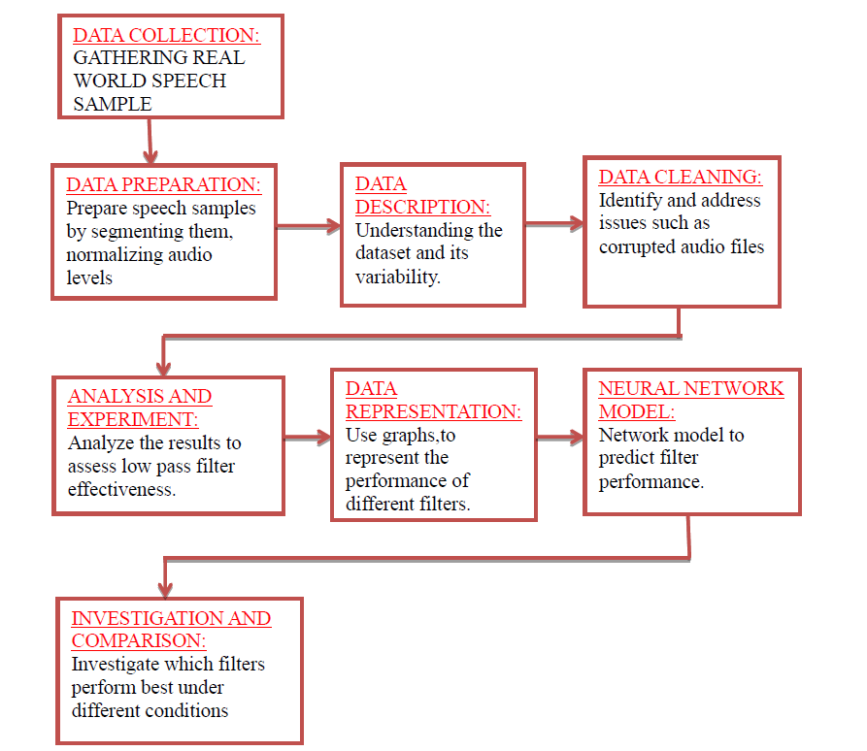
PROPOSED METHODOLOGY
Fig. 1. Flowchart showing the project methodology
6 of 15

Slide 8
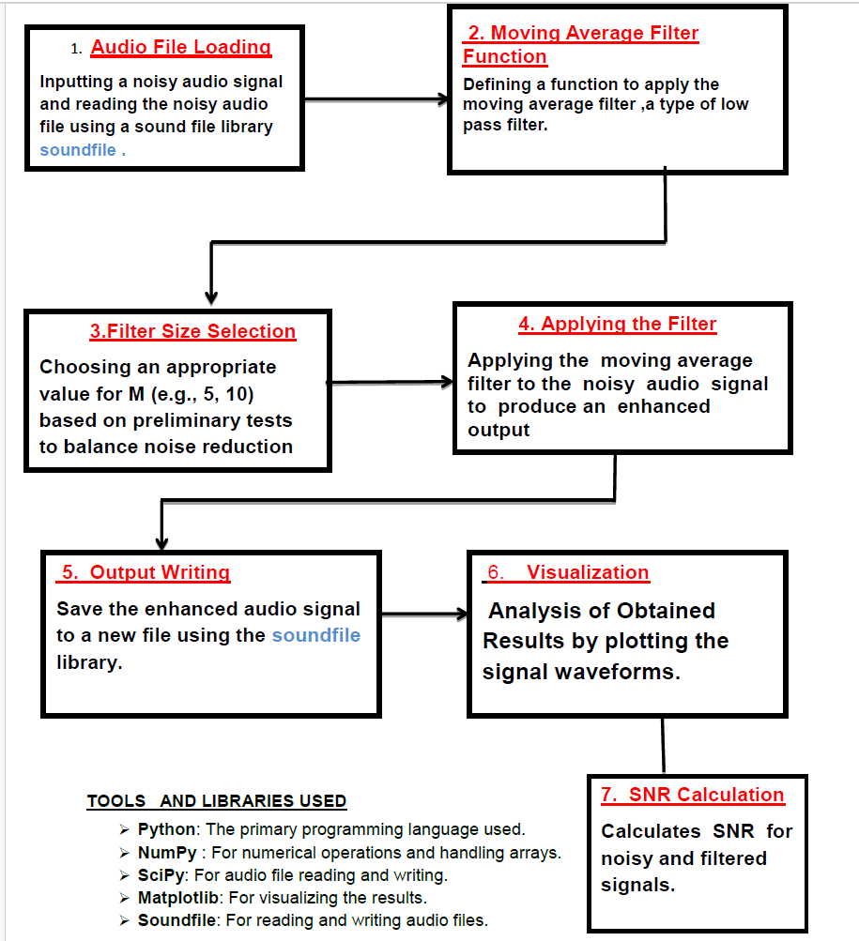
METHODOLOGY FOR OBJECTIVE-1
Fig. 2. Flowchart showing methodology for objective 1
7 of 15

Slide 9
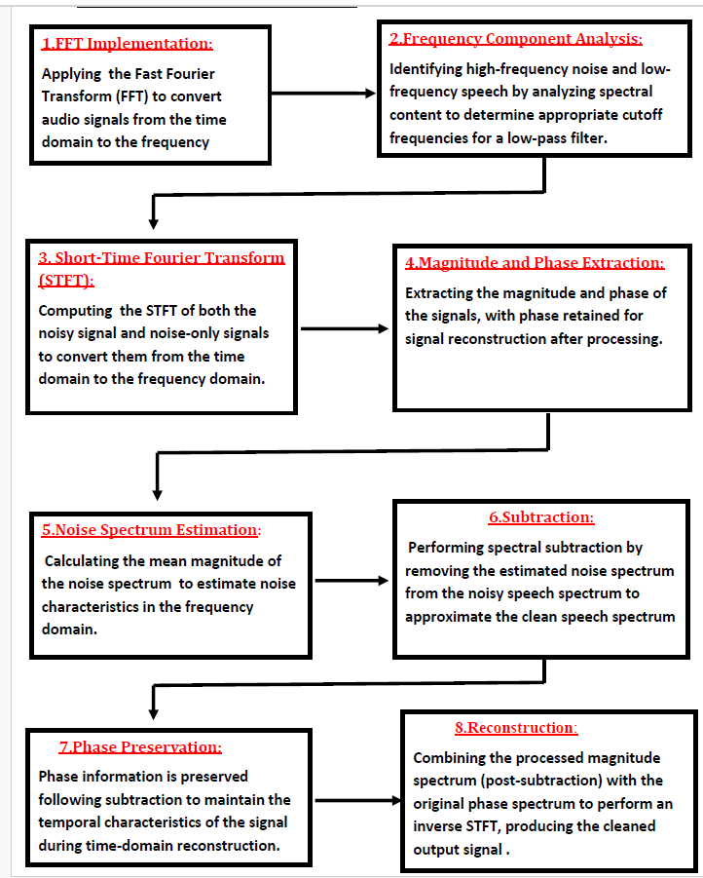
METHODOLOGY FOR OBJECTIVE-2
Fig. 2. Flowchart showing methodology for objective 2
8 of 15​

Slide 10
EXPERIMENTAL SETUP
Dataset Statistics
Attribute | Description
Dataset | NOIZEUS Speech Dataset
Sample Size | 50 audio files
Audio Duration | 1-4 seconds per sample
Signal-to-Noise Ratios | 0 dB to 20 dB
9 of 15​

Slide 11
50 audio samples are present in the data set out of which 7 have been tried in which 5 have been successful and 3 of which didn’t give the expected results.
Example Signals Used
Original Signal: Waveform of a clean speech sample.
Noisy Signal: Waveform of the same sample with added high-frequency noise.
Filtered Signal: Waveform after applying the low-pass filter, frequency domain filter and spectral subtraction to reduce noise.
10 of 15​

Slide 12





DEMO OF THE PROJECT
1.Noise
2.Original Clear Audio Sample
3.Audio Sample with noise
4. Audio sample after applying moving average filter
5. Audio sample after applying Spectral Subtraction
6.Audio sample after applying Frequency domain filter
11 of 15​

Slide 13
RESULTS AND ANALYSIS
Improved Signal Quality: Frequency domain filtering and spectral subtraction yielded clearer audio outputs, with significant reductions in unwanted noise components, as confirmed by both listener feedback and quantitative metrics.
Enhanced Signal-to-Noise Ratio (SNR): SNR measurements showed marked improvement post-processing, indicating effective noise reduction while maintaining speech integrity.
12 of 15​

Slide 14
Frequency Domain Filtering – Effectiveness in Denoising: Frequency domain filters enabled precise manipulation of specific frequency ranges, effectively reducing high-frequency noise while preserving essential speech frequencies, showcasing the strength of this approach in noise reduction.
Spectral Subtraction – Successful Noise Estimation: Noise spectrum estimation during silent intervals allowed for effective noise subtraction, yielding a cleaner speech signal consistent with spectral subtraction principles.
Comparison of input and filtered data: Side-by-side
plots are used in the project to compare the original noisy signal and
the filtered (smoothed) signal.
13 of 15​

Slide 15
CONCLUSIONS AND FUTURE WORK
CONCLUSIONS:
Method Effectiveness: All methods reduced noise effectively, with varying performance based on noise type and level.
Moving Average filter: Reduced noise but caused minor speech blurring, especially at higher noise levels.
Frequency Domain Filtering: Enabled targeted noise reduction, achieving clearer speech than Moving Average.
Spectral Subtraction: Best for stationary noise, delivering the most natural speech enhancement.
Overall: The project met its objectives, highlighting each method's strengths and limitations.
FUTURE SCOPE:
Advanced Filtering: Explore adaptive filters that adjust to noise levels.
Real-Time Processing: Develop solutions for real-time applications.
Hybrid Techniques: Combine methods for improved noise reduction.
14 of 15​

Slide 16
REFERENCE PAPERS
1.Title: ”Enhancing Speech Signal Quality through Noise Reduction for Improved Communication”
Author: Karan Khatavkar
Journal: International Journal for Research in Applied Science & Engineering Technology (IJRASET), 2023.
2.Title: ”Audio Signal Filtering With Low Pass And High Pass Filters”
Authors: Phyo Thu Zar Tun, Khaing Thand Swe
Journal: IJCIRAS Journal, 2020.
3.Title: ”Speech enhancement based on the integration of fully convolutional network, temporal lowpass filtering and spectrogram masking”
Authors: 1.Kuan-Yi Liu 2.Syu-Siang Wang
Journal: The 2019 Conference on Computational Linguistics and Speech Processing ROCLING 2019, pp. 226- 240.
15 of 15​

