Slide 1
Market Basket Analysis
Machine Learning Advance Project

Slide 2
M.Sc. Statistics Data Analyst –Kantar WorldPanel INSAID, March 2020 GCD Cohort
Ankita Bhanushali

Slide 3
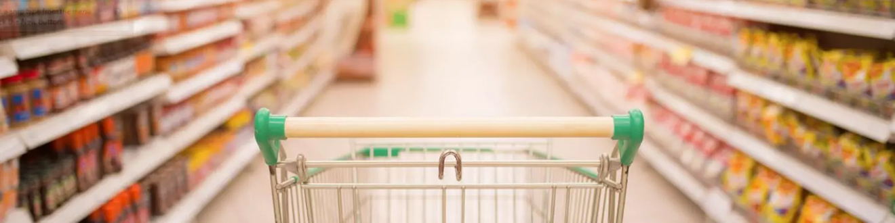
About Dataset
The Groceries Market Basket Dataset. The dataset contains 9836 transactions by customers shopping for groceries. The data contains 169 unique items.
The data is suitable to do data mining for market basket analysis which has multiple variables.
Groceries Data Set contains: a collection of receipts with each line representing 1 receipt and the items purchased. Each line is called a transaction and each column in a row represents an item.

Slide 4
9836
The data contains 169 unique items

Slide 5
Goal
Problem Statement
Imagine 10000 receipts sitting on your table. Each receipt represents a transaction with items that were purchased. The receipt is a representation of stuff that went into a customer’s basket - and therefore “Market Basket Analysis”.
That is exactly what the Groceries Data Set contains: a collection of receipts with each line representing 1 receipt and the items purchased. Each line is called a transaction and each column in a row represents an item.

Slide 6
Table of Contents
01
02
03
EDA
Model Evaluation
Conclusion
Word cloud
Frequency plot
Tree Map
Apriori Algorithm

Slide 7
01
EDA
Word cloud
Frequency plot
Tree Map

Slide 8
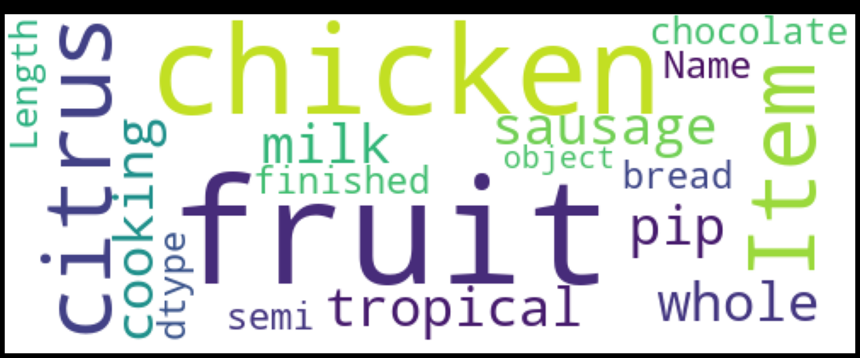
EDA: Word Cloud

Slide 9
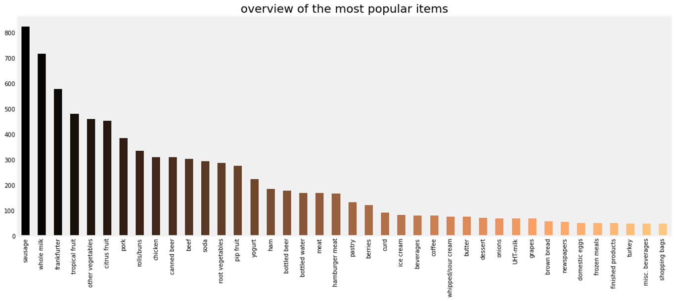
EDA: Frequency Plot

Slide 10
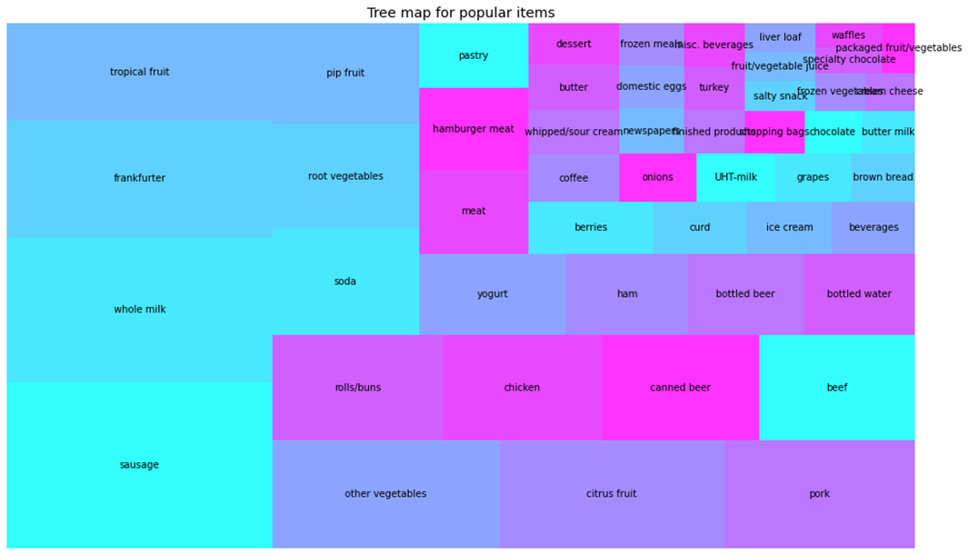
EDA: Tree Map

Slide 11
02
Model Evaluation
Apriori Algorithm

Slide 12
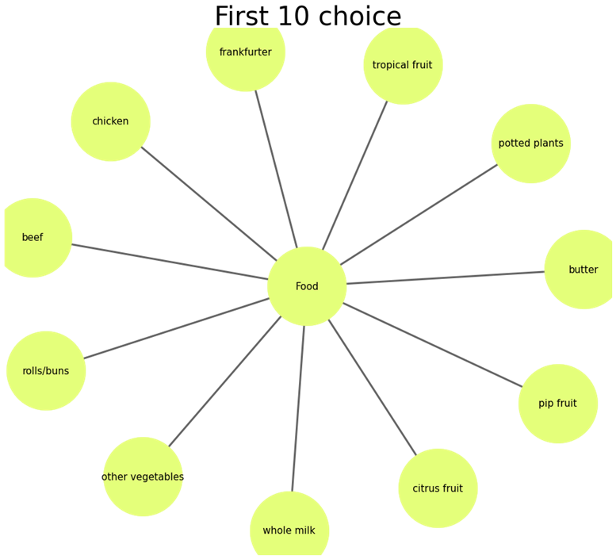
Top Choices in Grocery Store
This graph gives an idea of frequencies of top 10 most frequent items from 169 unique values. This graph corroborate the few observations in summary

Slide 13
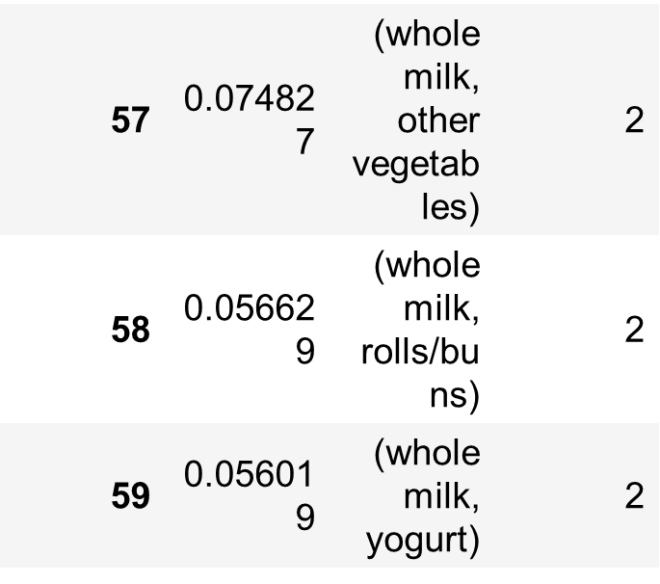
Output of item sets with a length = 2 and support above 10%
Inspecting the top ten rules sorted by confidence shows that most of the associations are with whole milk and other vegetables which are the two most purchased items. This relationship can also be seen in the plot of the network where most arrows are pointing toward whole milk and other vegetables

Slide 14
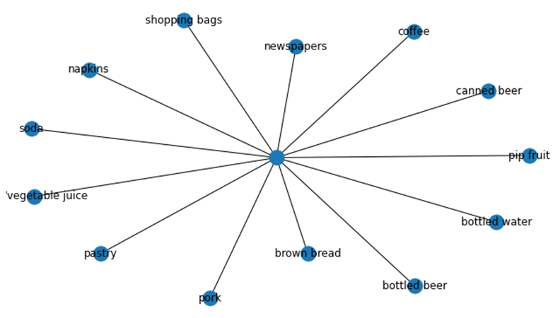
Visualizing the association:
These are the bestseller of this Grocery store - Coffee, canned beer, Pip fruit etc. There are a couple of strategies that the store can adopt to increase its sales considering the association we have seen this

Slide 15
Conclusion
Market basket analysis is an unsupervised machine learning technique that can be useful for finding patterns in transactional data. It can be a very powerful tool for analyzing the purchasing patterns of consumers. The main algorithm used in market basket analysis is the apriori algorithm. The three statistical measures in market basket analysis are support, confidence, and lift. Support measures the frequency an item appears in a given transactional data set, confidence measures the algorithm’s predictive power or accuracy, and lift measures how much more likely an item is purchased relative to its typical purchase rate. In project, we examined the transactional patterns of grocery purchases and discovered both obvious and not-so-obvious patterns in certain transactions.

Slide 16
Resources
https://towardsdatascience.com/mba-for-breakfast-4c18164ef82b
https://analyticsindiamag.com/hands-on-guide-to-market-basket-analysis-with-python-codes/
https://pythondata.com/market-basket-analysis-with-python-and-pandas/

Slide 17
THANKS!

