Slide 1

AI-Based Resume Screening and Candidate Shortlisting System
Ankita Kumari
B.Tech CSE (Data Science), 3rd Year
ABES Engineering College (AKTU), Noida
Notes:
Introduce yourself and the project: a machine-learning tool that ranks resumes against a job description and explains each score.

Slide 2



Why manual screening fails
Slow
Inconsistent
Bias-prone
Hundreds of resumes arrive for one opening and each must be read by hand.
Different reviewers apply different criteria to the same resume.
Names and personal details can sway first impressions.
Goal: rank candidates automatically, fairly and with reasons a recruiter can check.
Notes:
Screening is slow, inconsistent and can be biased. The project automates the first pass and keeps a human in charge of the final decision.

Slide 3




Proposed solution
Paste JD
Upload
Anonymise
Score
Shortlist
Recruiter enters the job description
Resumes as PDF, DOCX or TXT files
Name, email, phone and links removed
TF-IDF, skill match and experience into a model
Ranked list with matched and missing skills
Decision support only: the recruiter makes the final hiring decision.
Notes:
Walk through the five steps left to right. Stress that anonymisation happens before scoring.

Slide 4
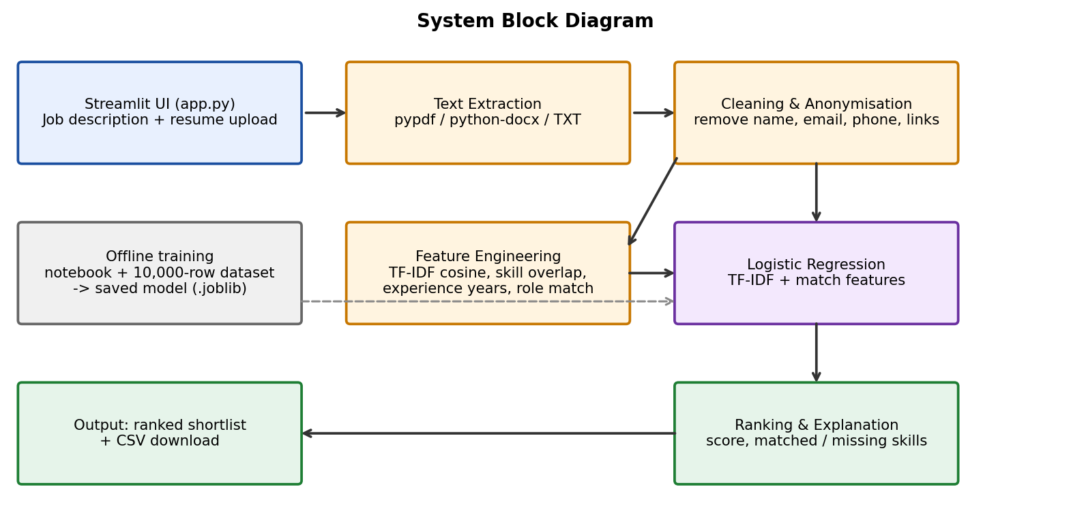
System architecture
Streamlit front end
One page: inputs, results, CSV download
scikit-learn model
Pre-trained, loaded once per session
No database
Resumes stay in memory for the session
Notes:
Explain the flow: UI, text extraction, anonymisation, feature engineering, model, ranking. Training happens offline in the notebook.

Slide 5
Dataset
10,000
resume and job-description pairs
15
job roles
1,500
unique job descriptions
Synthetic data from a seeded script; the label comes from a hidden weighted match score plus noise.
Notes:
The data is synthetic and generated with generate_dataset.py (seed 42). 45% select and 55% reject. Be upfront that real hiring data would be needed for production validation.

Slide 6




Features and model
Model
Logistic Regression
TF-IDF similarity
Cosine match of resume and JD text
Skill overlap
125 skills with synonym handling
Trained on TF-IDF text plus the match features. Output is a selection probability; 0.5 or higher means Recommend.
Experience
Years found vs years required
Role match
Selected or auto-detected role
Notes:
Text alone is a weak signal because a resume only makes sense relative to a job description. The engineered match features carry most of the signal.

Slide 7
Results on 2,000 test resumes
85.6%
accuracy (Logistic Regression)
0.936
ROC-AUC
0.973
Precision@10 per role, random is 0.45
Match features lift accuracy from 69% to 86%. Logistic Regression is deployed: near-best accuracy, fast and explainable.
Notes:
Four models using match features land around 86 percent; text-only models are far behind. We deploy Logistic Regression because it is simple, fast and explainable. Results are on synthetic data.

Slide 8
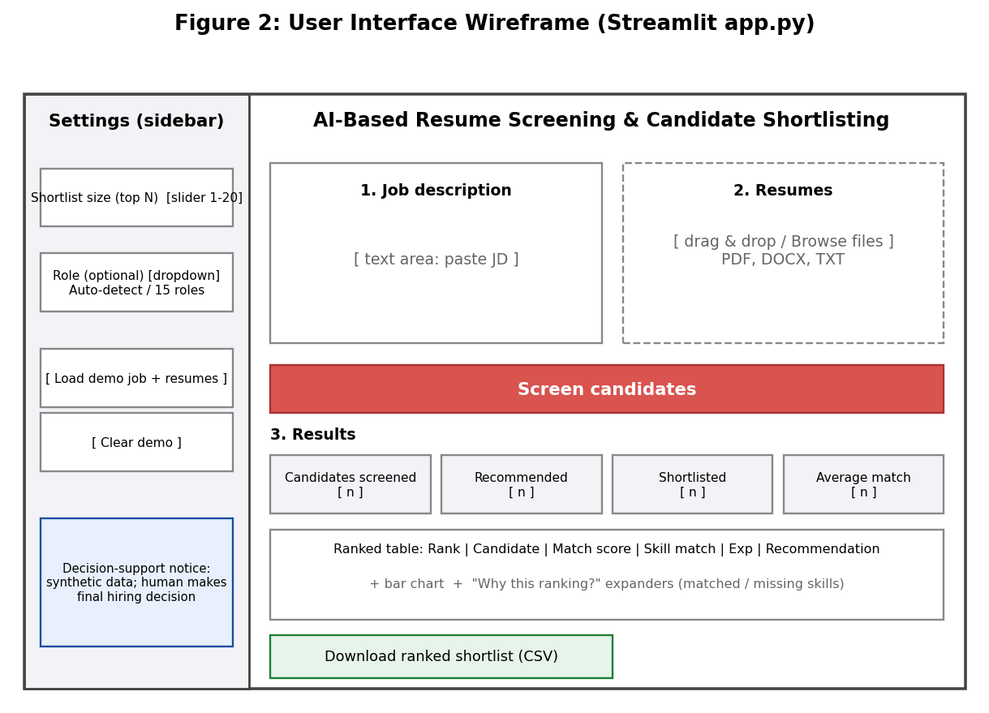


The Streamlit app
Input
Paste the JD and upload PDF, DOCX or TXT resumes
Settings
Choose top-N (1 to 20) and an optional role
Output
Ranked table, explanations and CSV download
Notes:
Layout of the app (wireframe). Replace this with a live screenshot or run the live demo if time allows.

Slide 9
Demo: ranking 6 candidates
Top 2 cover every skill
candidate_5 and candidate_4 match 100% of the skills found in the JD.
Gaps are visible
Matched and missing skills are listed for each candidate.
Clear shortlist rule
Shortlisted = in the top N and recommended.
Notes:
Built-in demo: six sample resumes against a Data Scientist job description. The tool separates strong matches from weak ones and shows why.

Slide 10


Challenges and fixes
Label leakage
Weak text-only model
Privacy and formats
Problem: One column stated the outcome and gave 100% accuracy.
Fix: Excluded it from training; kept for analysis only.
Problem: TF-IDF alone reached only 69% accuracy.
Fix: Added match features: about 86%.
Problem: Resumes hold personal data in mixed formats.
Fix: Anonymise first; extract PDF, DOCX, TXT.
Notes:
Three lessons: watch for label leakage, engineer features that compare the resume to the JD, and protect personal data.

Slide 11


Limitations and future scope
Limitations
Future scope
Trained on synthetic data
Text resumes only: no OCR for scans
Fixed skill vocabulary (125 skills)
English resumes only
Validate on real hiring data
OCR for scanned resumes
Bias and fairness audits
ATS integration
Notes:
Be honest about the synthetic-data limitation. Future work focuses on real data, OCR, fairness checks and integration.

Slide 12
Thank you
Faster, more consistent first-round screening, with a human making the final call.
Ankita Kumari
github.com/Ankitakumari13/AI-BASED-RESUME-SCREENING
Notes:
Close and invite questions. Repository link is on screen.

