Slide 1
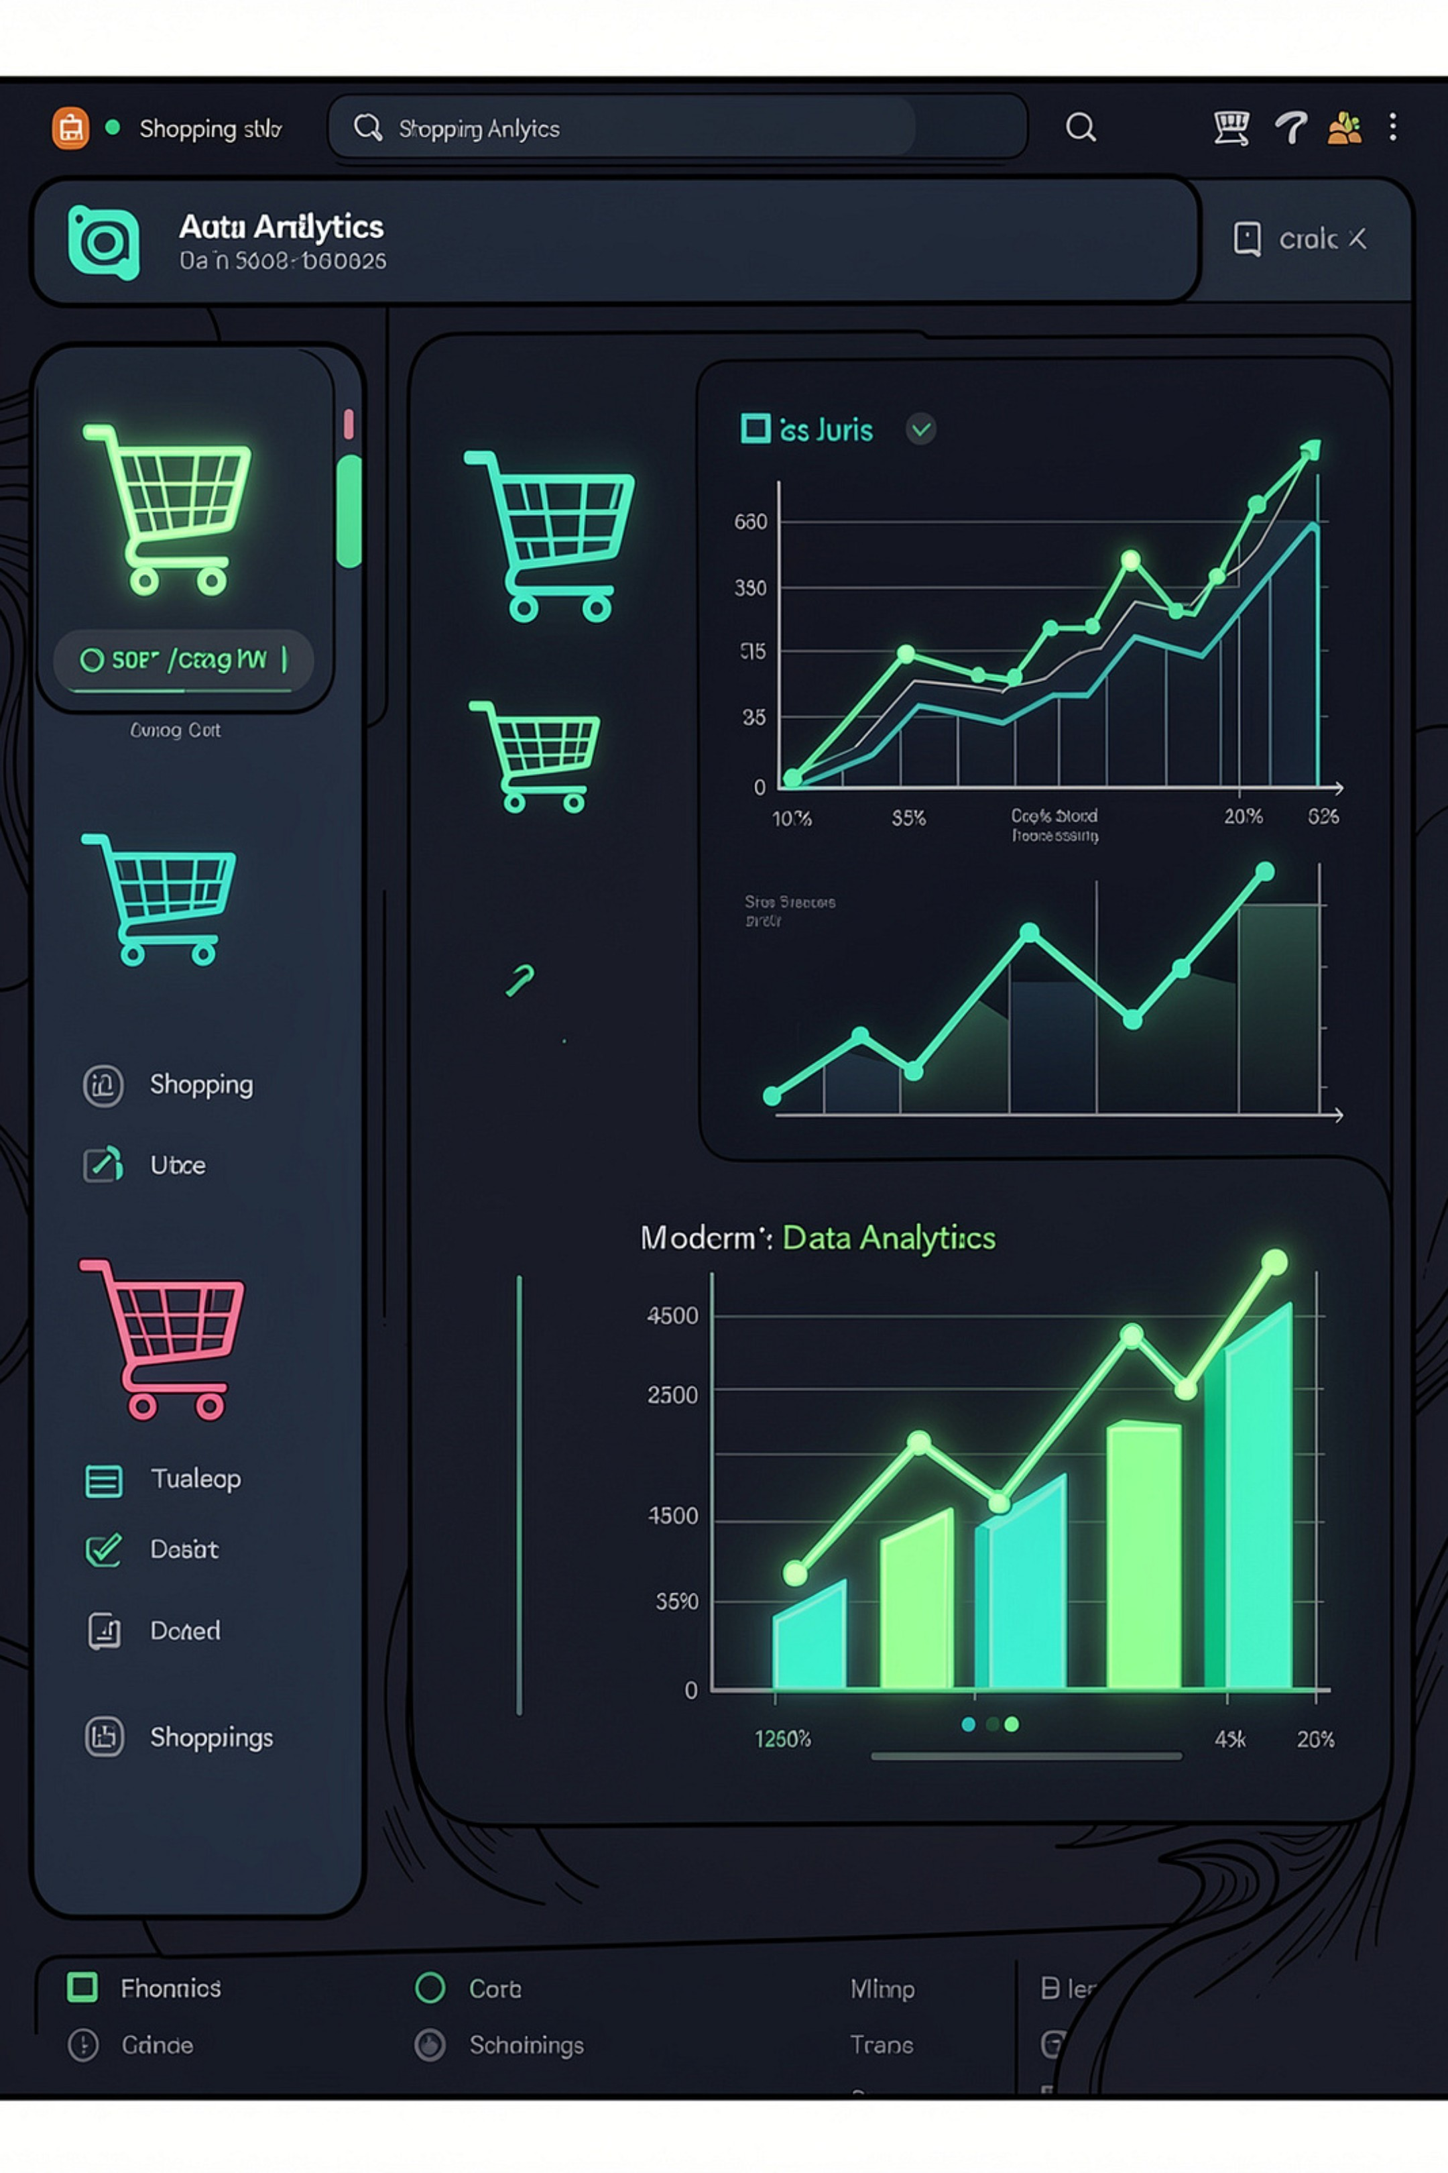
Customer Shopping Behavior Analysis
3,900 transactions · 18 features · Strategic insights across demographics, purchases & behavior

Slide 2
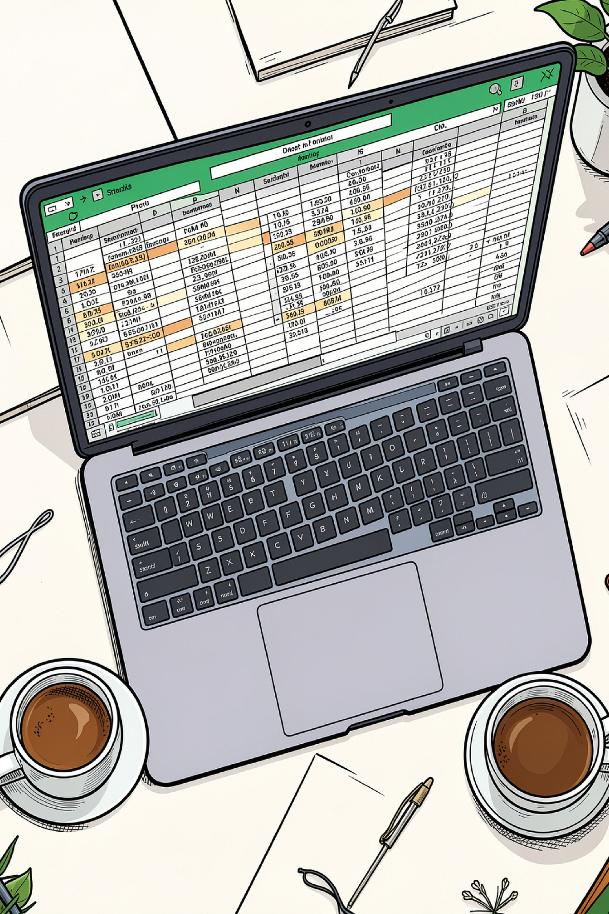
Dataset at a Glance
3900
18
Transactions
Columns
4
Categories
Clothing, Footwear, Accessories, Outerwear

Slide 3
Key Data Features
Demographics
Purchase Details
Shopping Behavior
Age, Gender, Location, Subscription Status, Age Group
Item, Category, Amount, Color, Season
Rating, Shipping, Discount, Payment Method, Frequency

Slide 4
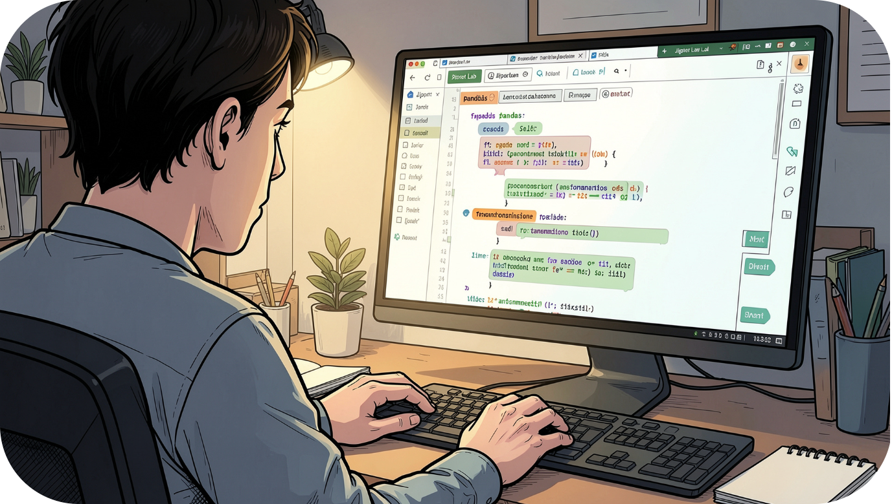
EDA in Python
Load & Explore
Standardize
Feature Engineering
Clean & Export
used pandas →df.info(),
df.describe(),df.head()
df.isnull().sum()
Snake_case columns · renamed fields
age_group bins · purchase_frequency_days mapping
Dropped redundant column -promo_code_used → CSV

Slide 5
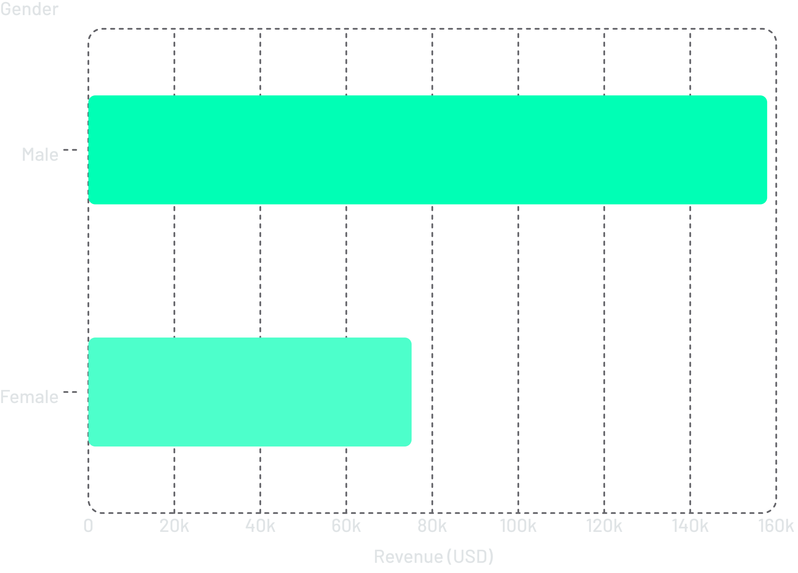
Revenue & High Spenders
Male customers generate 2× more revenue
high-spending discount users identified — purchases above average even with discounts applied.

Slide 6
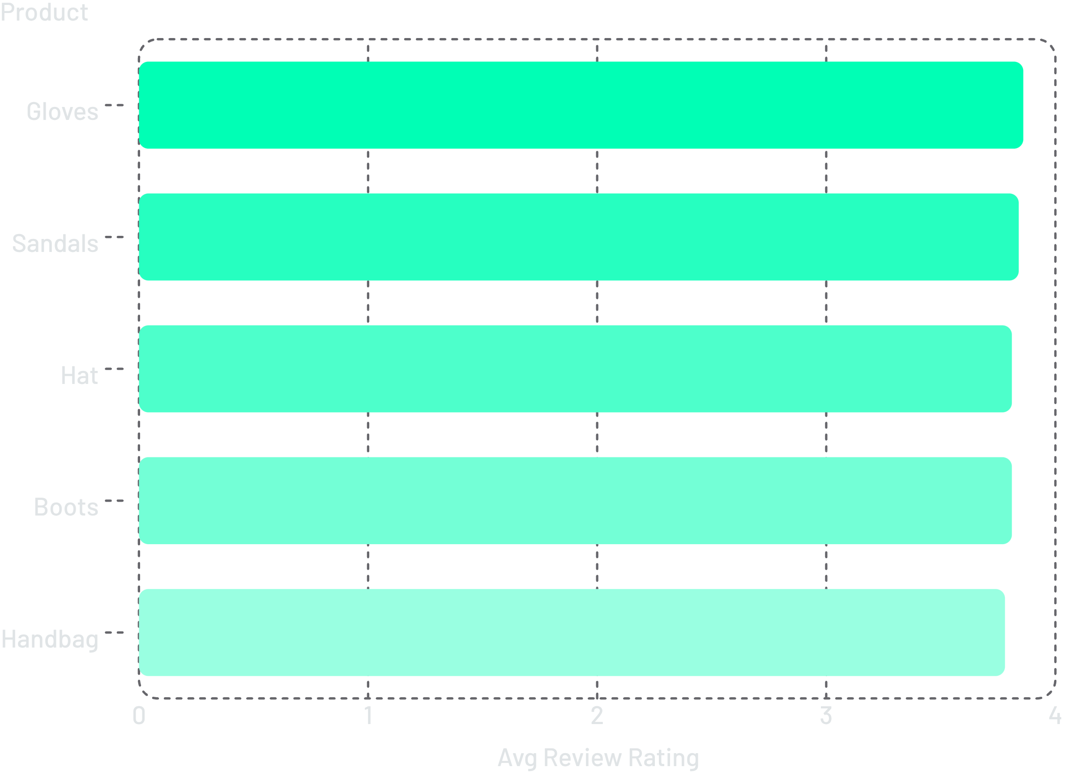
Top Products by Discount
Top Discounted Products
Item | Discount %
Hat | 50.00%
Sneakers | 49.66%
Coat | 49.07%
Sweater | 48.17%
Pants | 47.37%

Slide 7
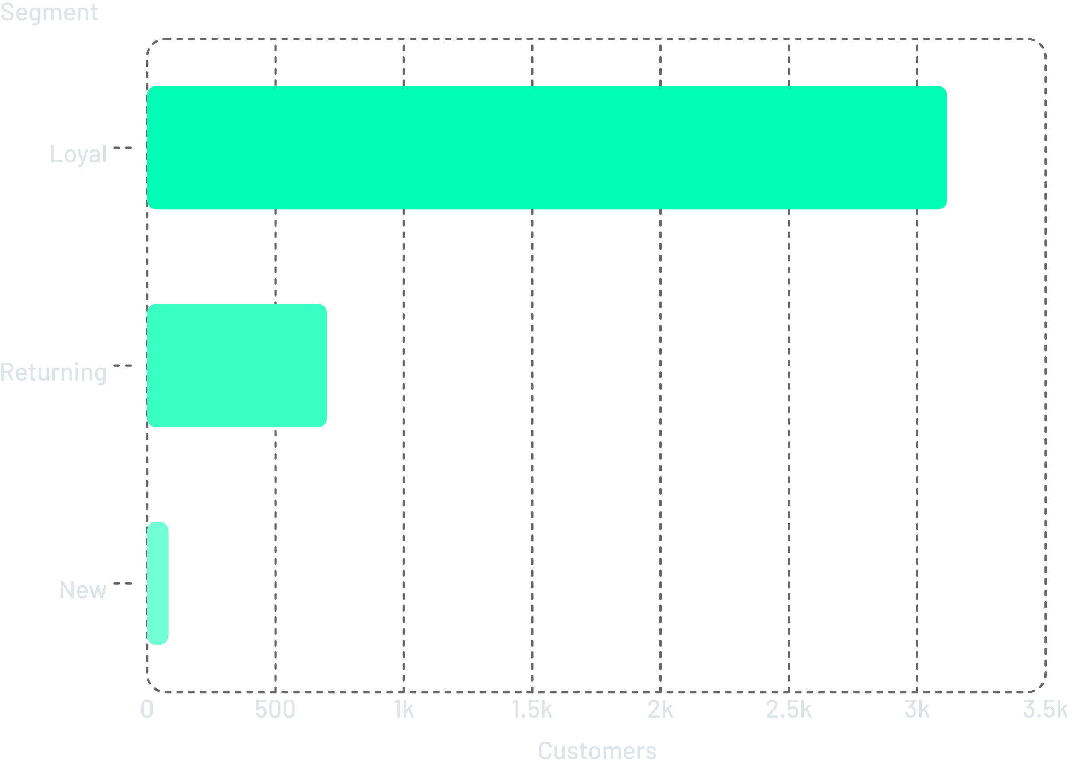
Customer Segmentation & Shipping
Segments by Previous Purchases
Loyal (3,116) · Returning (701) · New (83)
Average Purchase Amount by Shipping
Express: $60.48 vs Standard: $58.46

Slide 8
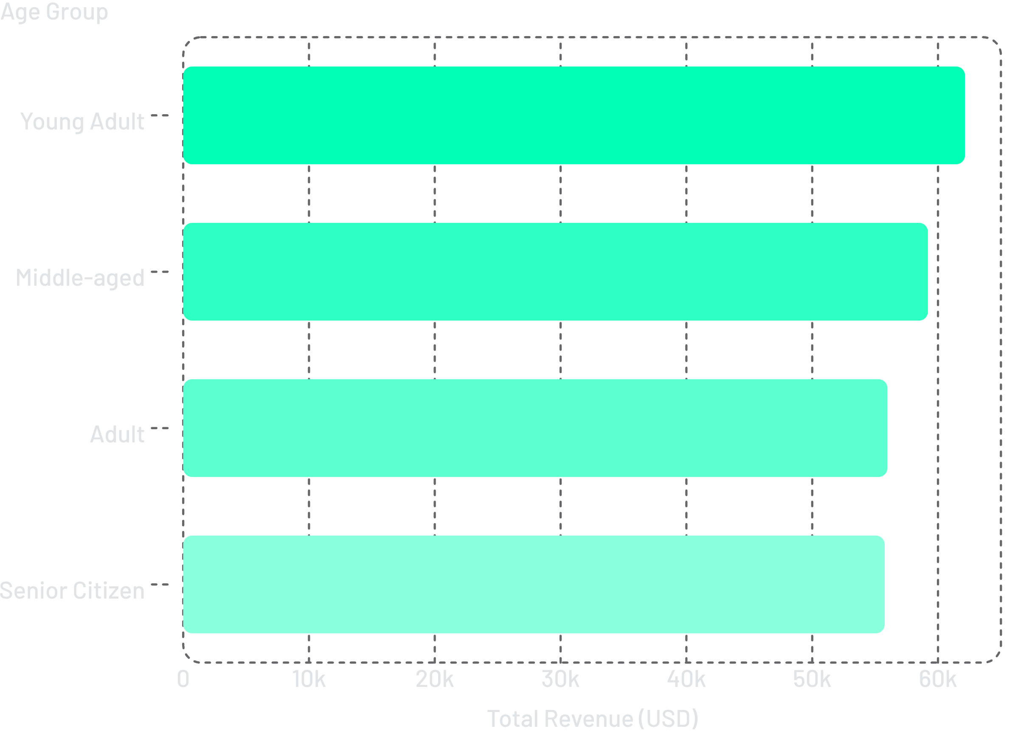

Subscription & Age Group Insights
Subscription Status
Subscribers: 1,053 · Non-subscribers: 2,847
Repeat buyers (5+ purchases): 2,518 non-subscribers vs 958 subscribers — major untapped opportunity.
Young Adults lead revenue — prime subscription target.

Slide 9
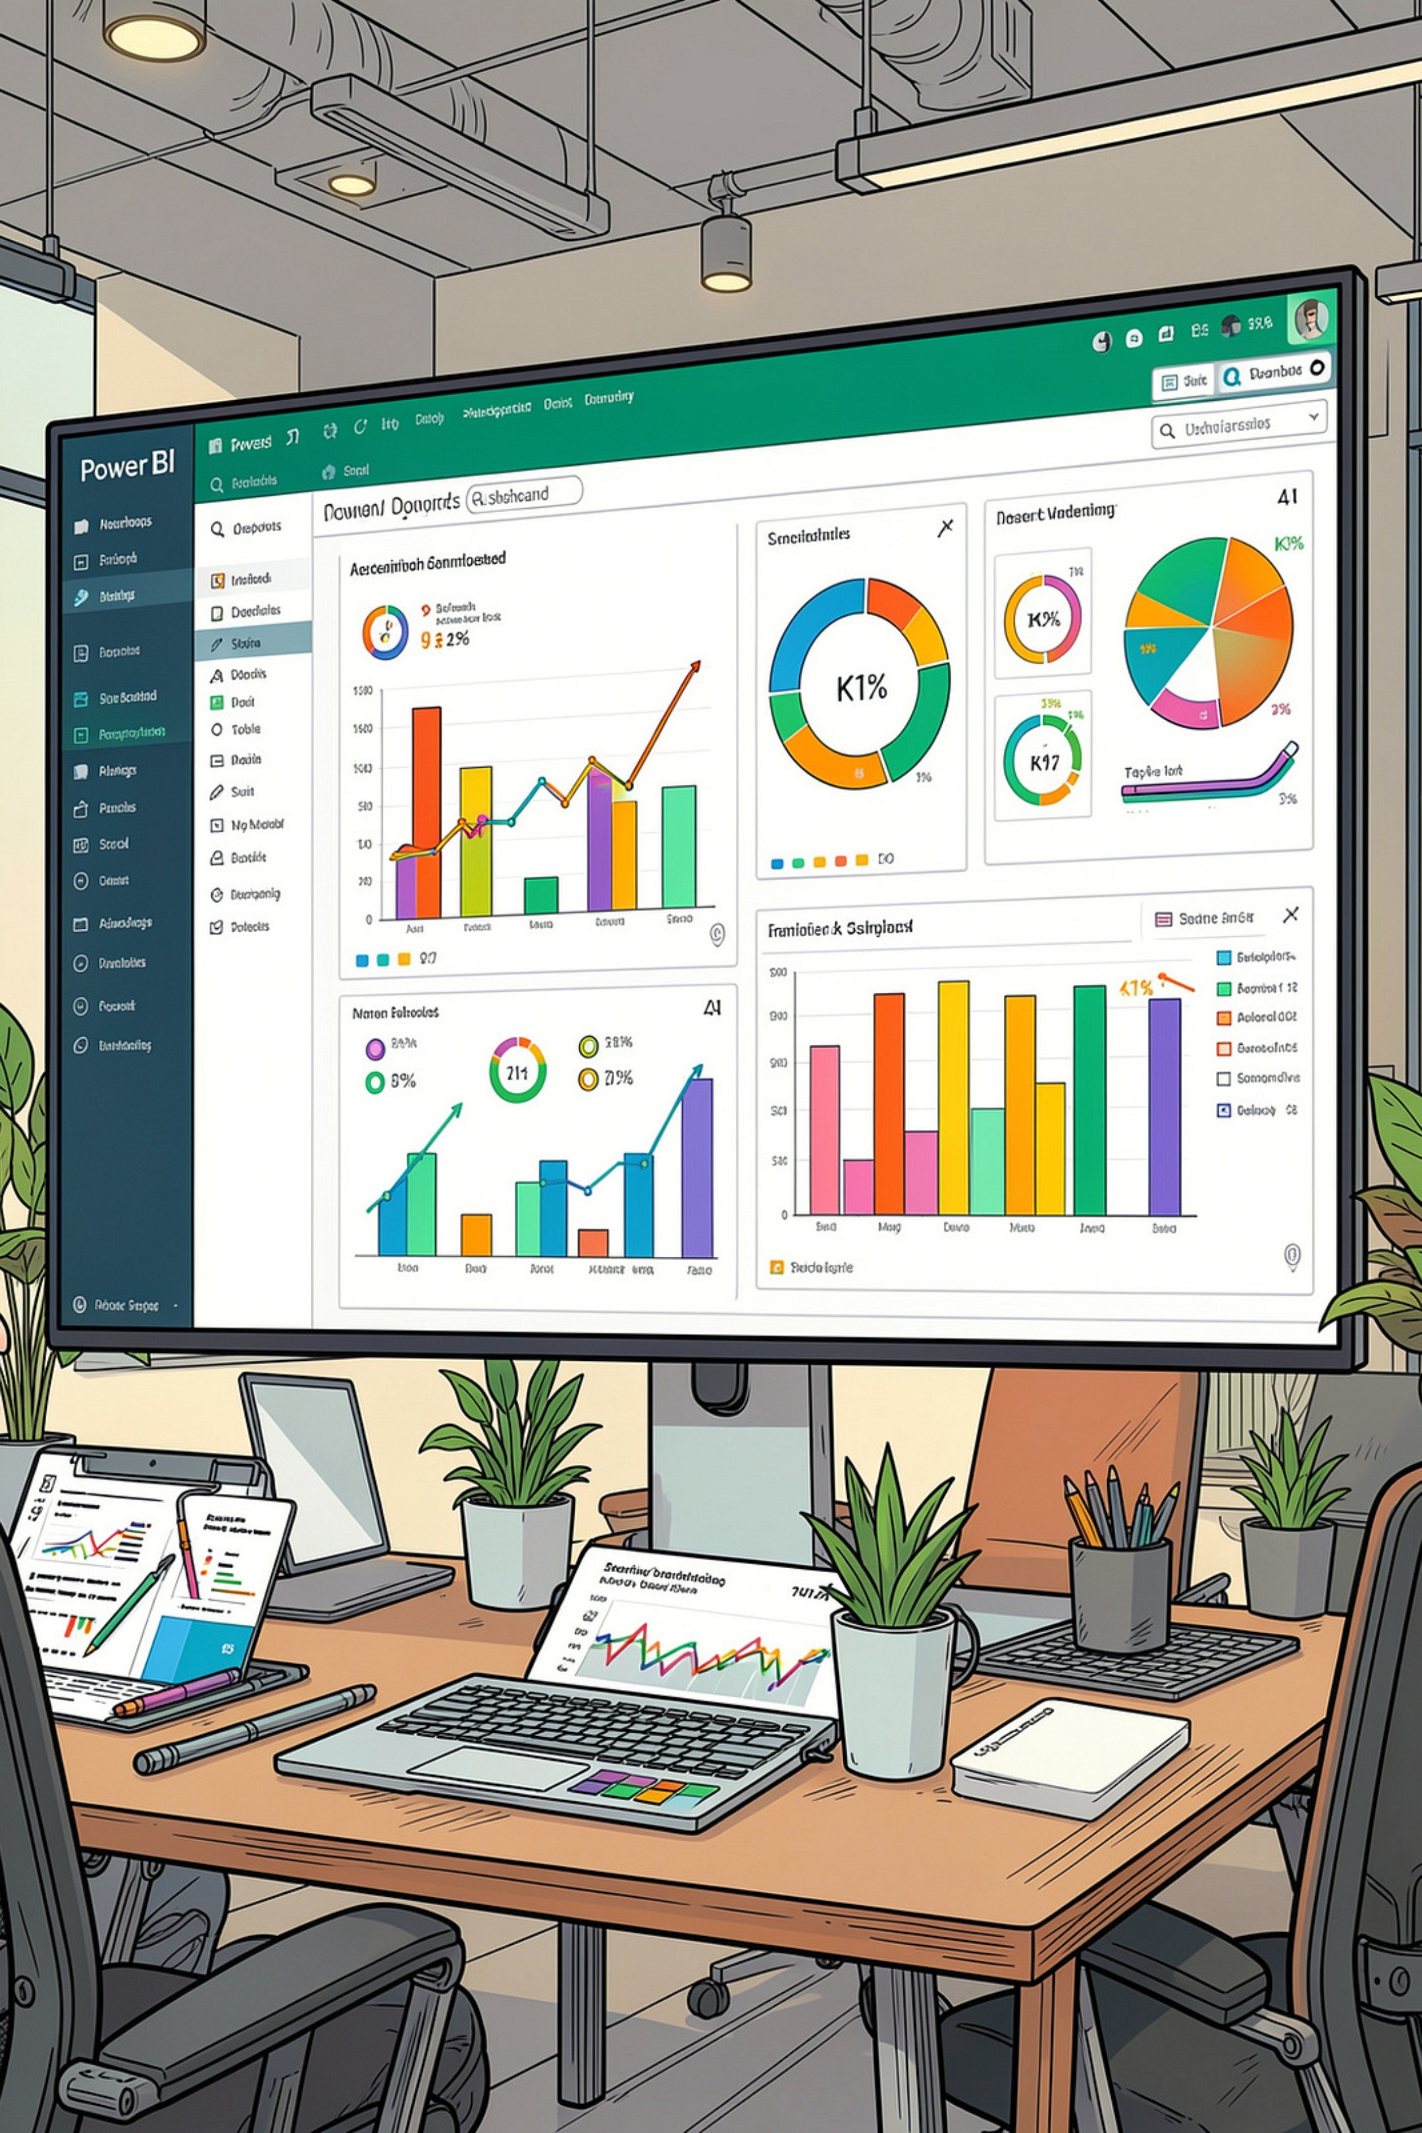
Power BI Dashboard
1
3.9K
2
$59.76
Total Customers
Avg Purchase Amount
3
3.75
4
27%
Avg Rating
Subscribers
5
73 %
Non-Subscribers
Filters: Subscription Status · Gender · Category · Shipping Type

Slide 10
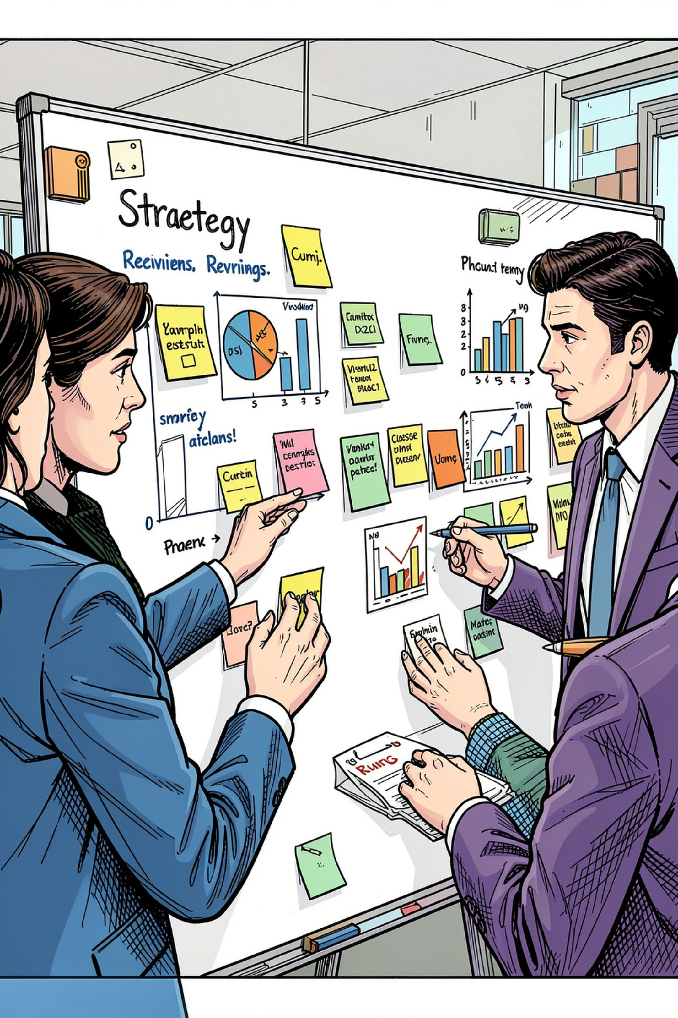




Business Recommendations
Boost Subscriptions
Customer Loyalty Programs
Better offers to convert 2,518 non-subscribers repeat buyers to subscribers.
Reward Returning customers to grow Loyal segment.
Targeted Marketing
Product Positioning
Focus on Young Adults & Express shipping users.
Highlight top-rated & best-selling items in campaigns.

