Slide 1

HR Analytics Report
An in-depth analysis of 17,414 employees across 9 departments — uncovering performance patterns, recognizing excellence, and identifying areas to improve workflow.

Slide 2
Dataset at a Glance
17,414
9
15
Total Employees
Departments
Features
Key feature groups: Demographics (Education, Gender, Age) · Details (Employee ID, Department, Region) · Records (Recruitment Channel, Trainings, Length of Service) · Achievements (Rating, KPIs, Awards, Training Score)

Slide 3

Data Preparation in Python
01
02
03
Load & Explore
Clean Nulls & Duplicates
Map & Engineer Features
Imported csv via Kaggle; used df.head(), df.info(), df.isnull().sum()
Education → "Unknown"; previous_year_rating → department mode; dropped duplicates
Gender: m→male, f→female; created age_group and work_experience
04
Finalize
Renamed KPI feature name to lowercase characters; exported cleaned DataFrame to csv file.

Slide 4
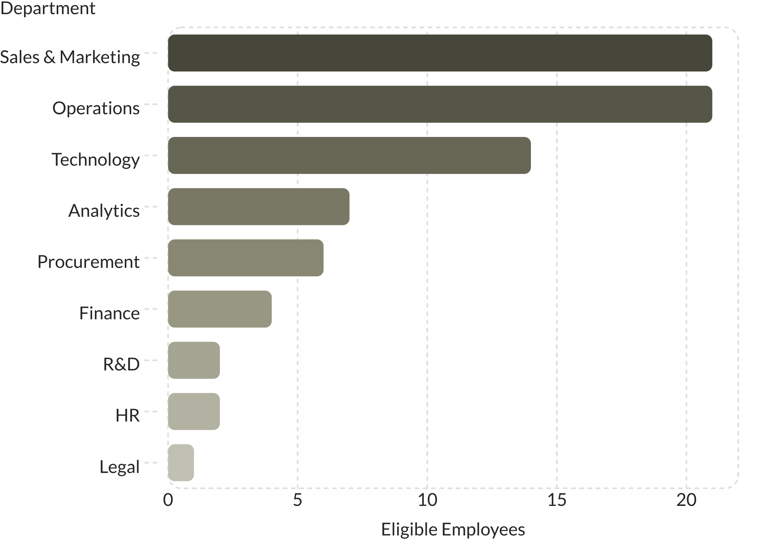
Top Performers by Department
Notable Averages
Technology leads in avg training score (85.21). Analytics employees have the longest avg tenure (5.6 yrs). R&D top performers average 85.50 training score despite only 2 eligible employees.

Slide 5
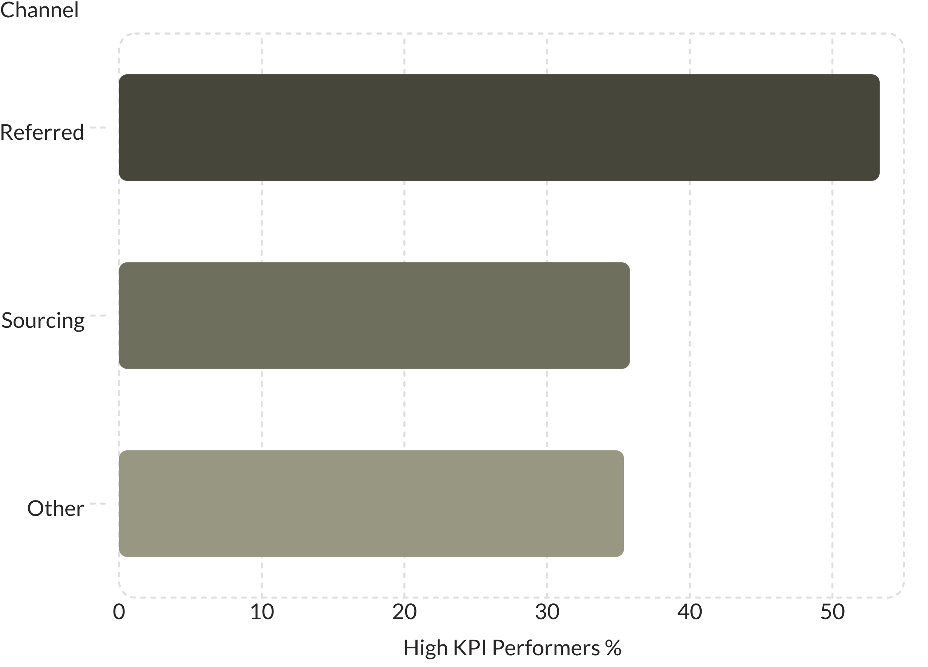
Recruitment Channel & Gender Insights
Recruitment
Referrals yield the highest-performing hires — 53.31% meet KPIs vs. ~35% for other channels, despite fewer total hires (317 vs. 7,349 sourcing / 9,749 other).
Gender Distribution
Workforce is 71% male and 29% female.

Slide 6
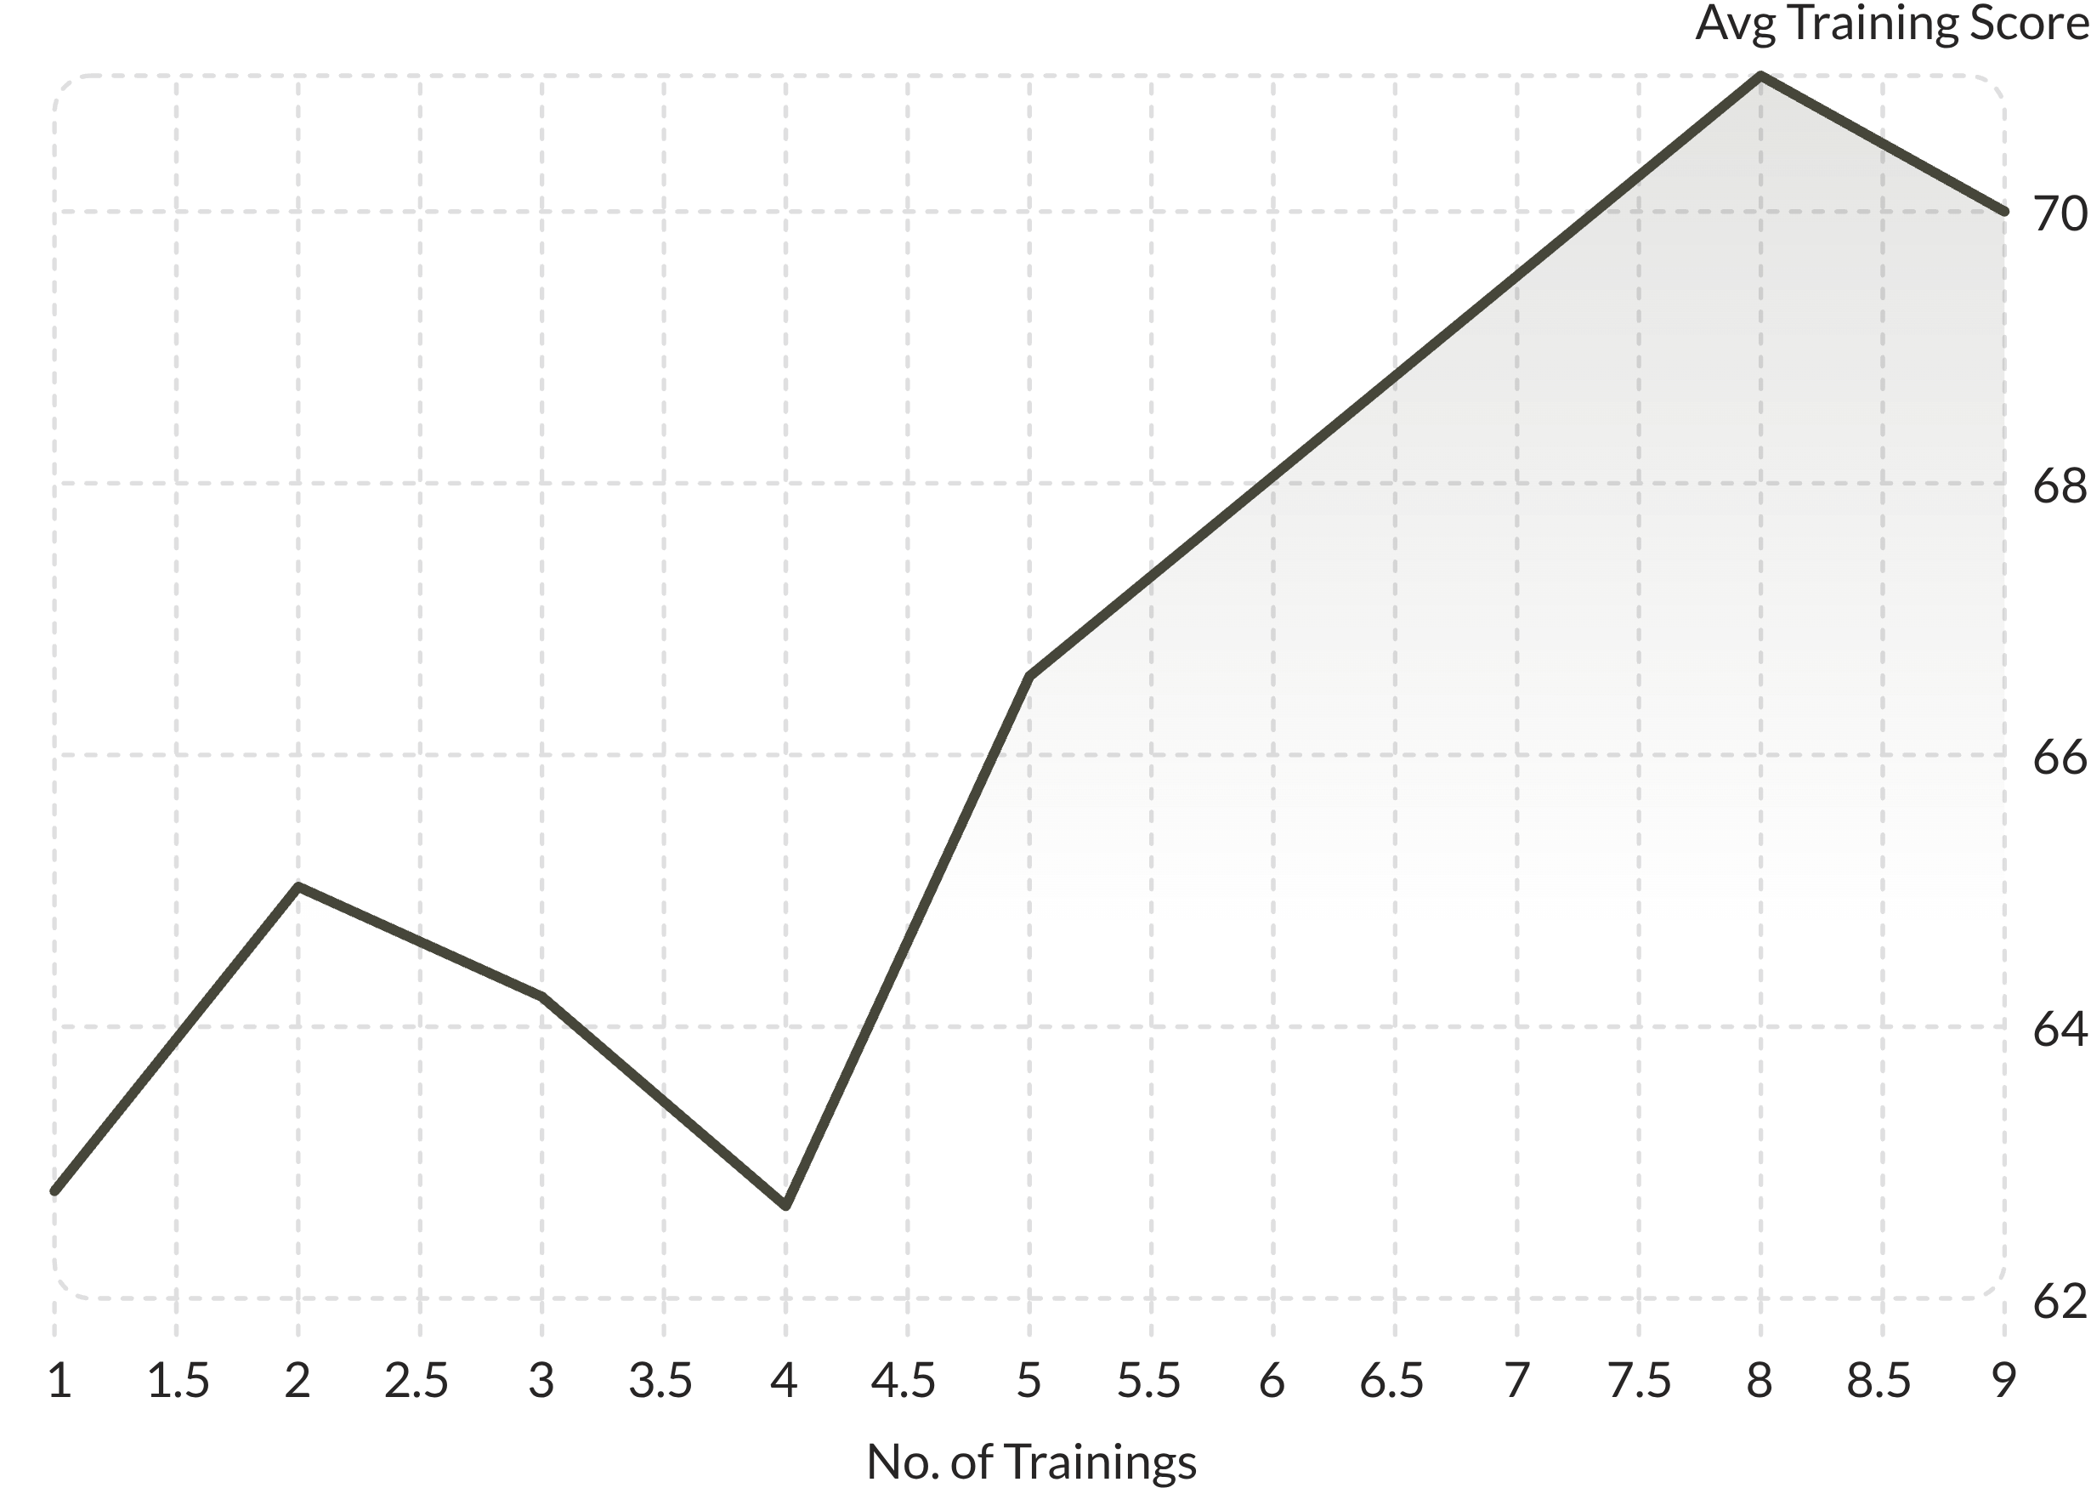
Training Impact & Education Correlation
Training → Performance
More trainings generally raise avg training scores (peak at 8 trainings: 71.00). However, KPI completion declines with more trainings — 1 training = 36.77% KPI met vs. 6 trainings = 0%.
Education & Tenure
Masters & above employees have the longest tenure (7.4 yrs). Below Secondary employees have shortest tenure (1.8 yrs) but surprisingly high training scores (65.90).

Slide 7
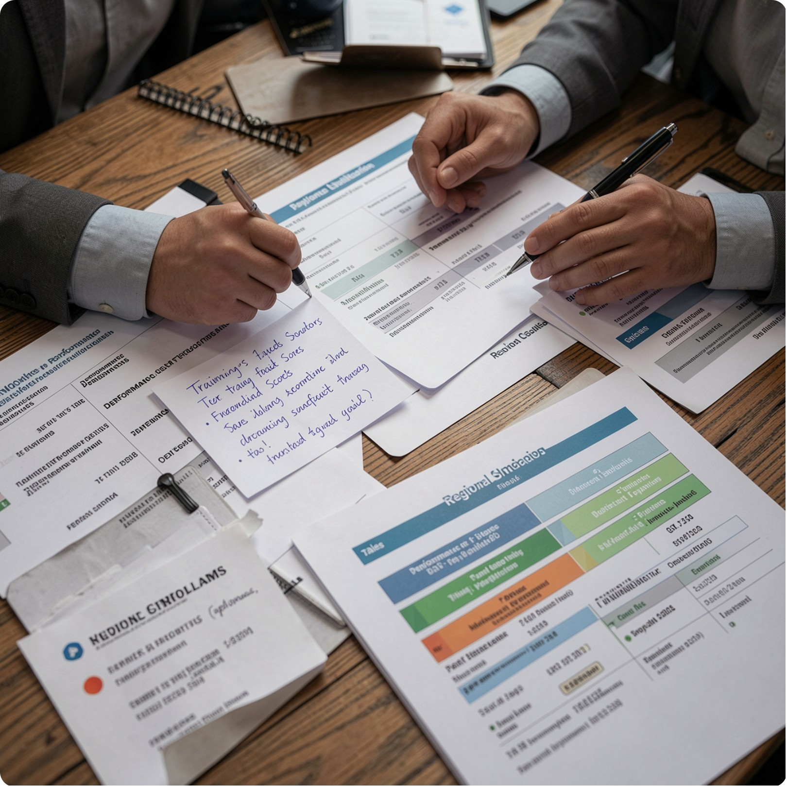
Struggling Employees & Performance Tiers
Where Struggles Concentrate
Sales & Marketing dominates struggling employees — especially region_2 (248 employees, avg training score 49.40).
Performance Tiers
Employees classified into tiers: Tier 1: Top Performer , Tier 2: High Performer , Tier 3: Good Performer, Tier 4: Needs Improvement — based on KPI, award won and rating.

Slide 8
Age, Experience & HR Metrics
Age & Experience Profile
Core HR Metrics
Adults dominate every department. Young adults have lowest ratings across departments except Legal Department.
R&D leads in KPI met % (44.88%) and avg rating (3.7). Analytics leads in avg training score (84.57). Sales & Marketing is largest dept (5,458 employees).

Slide 9

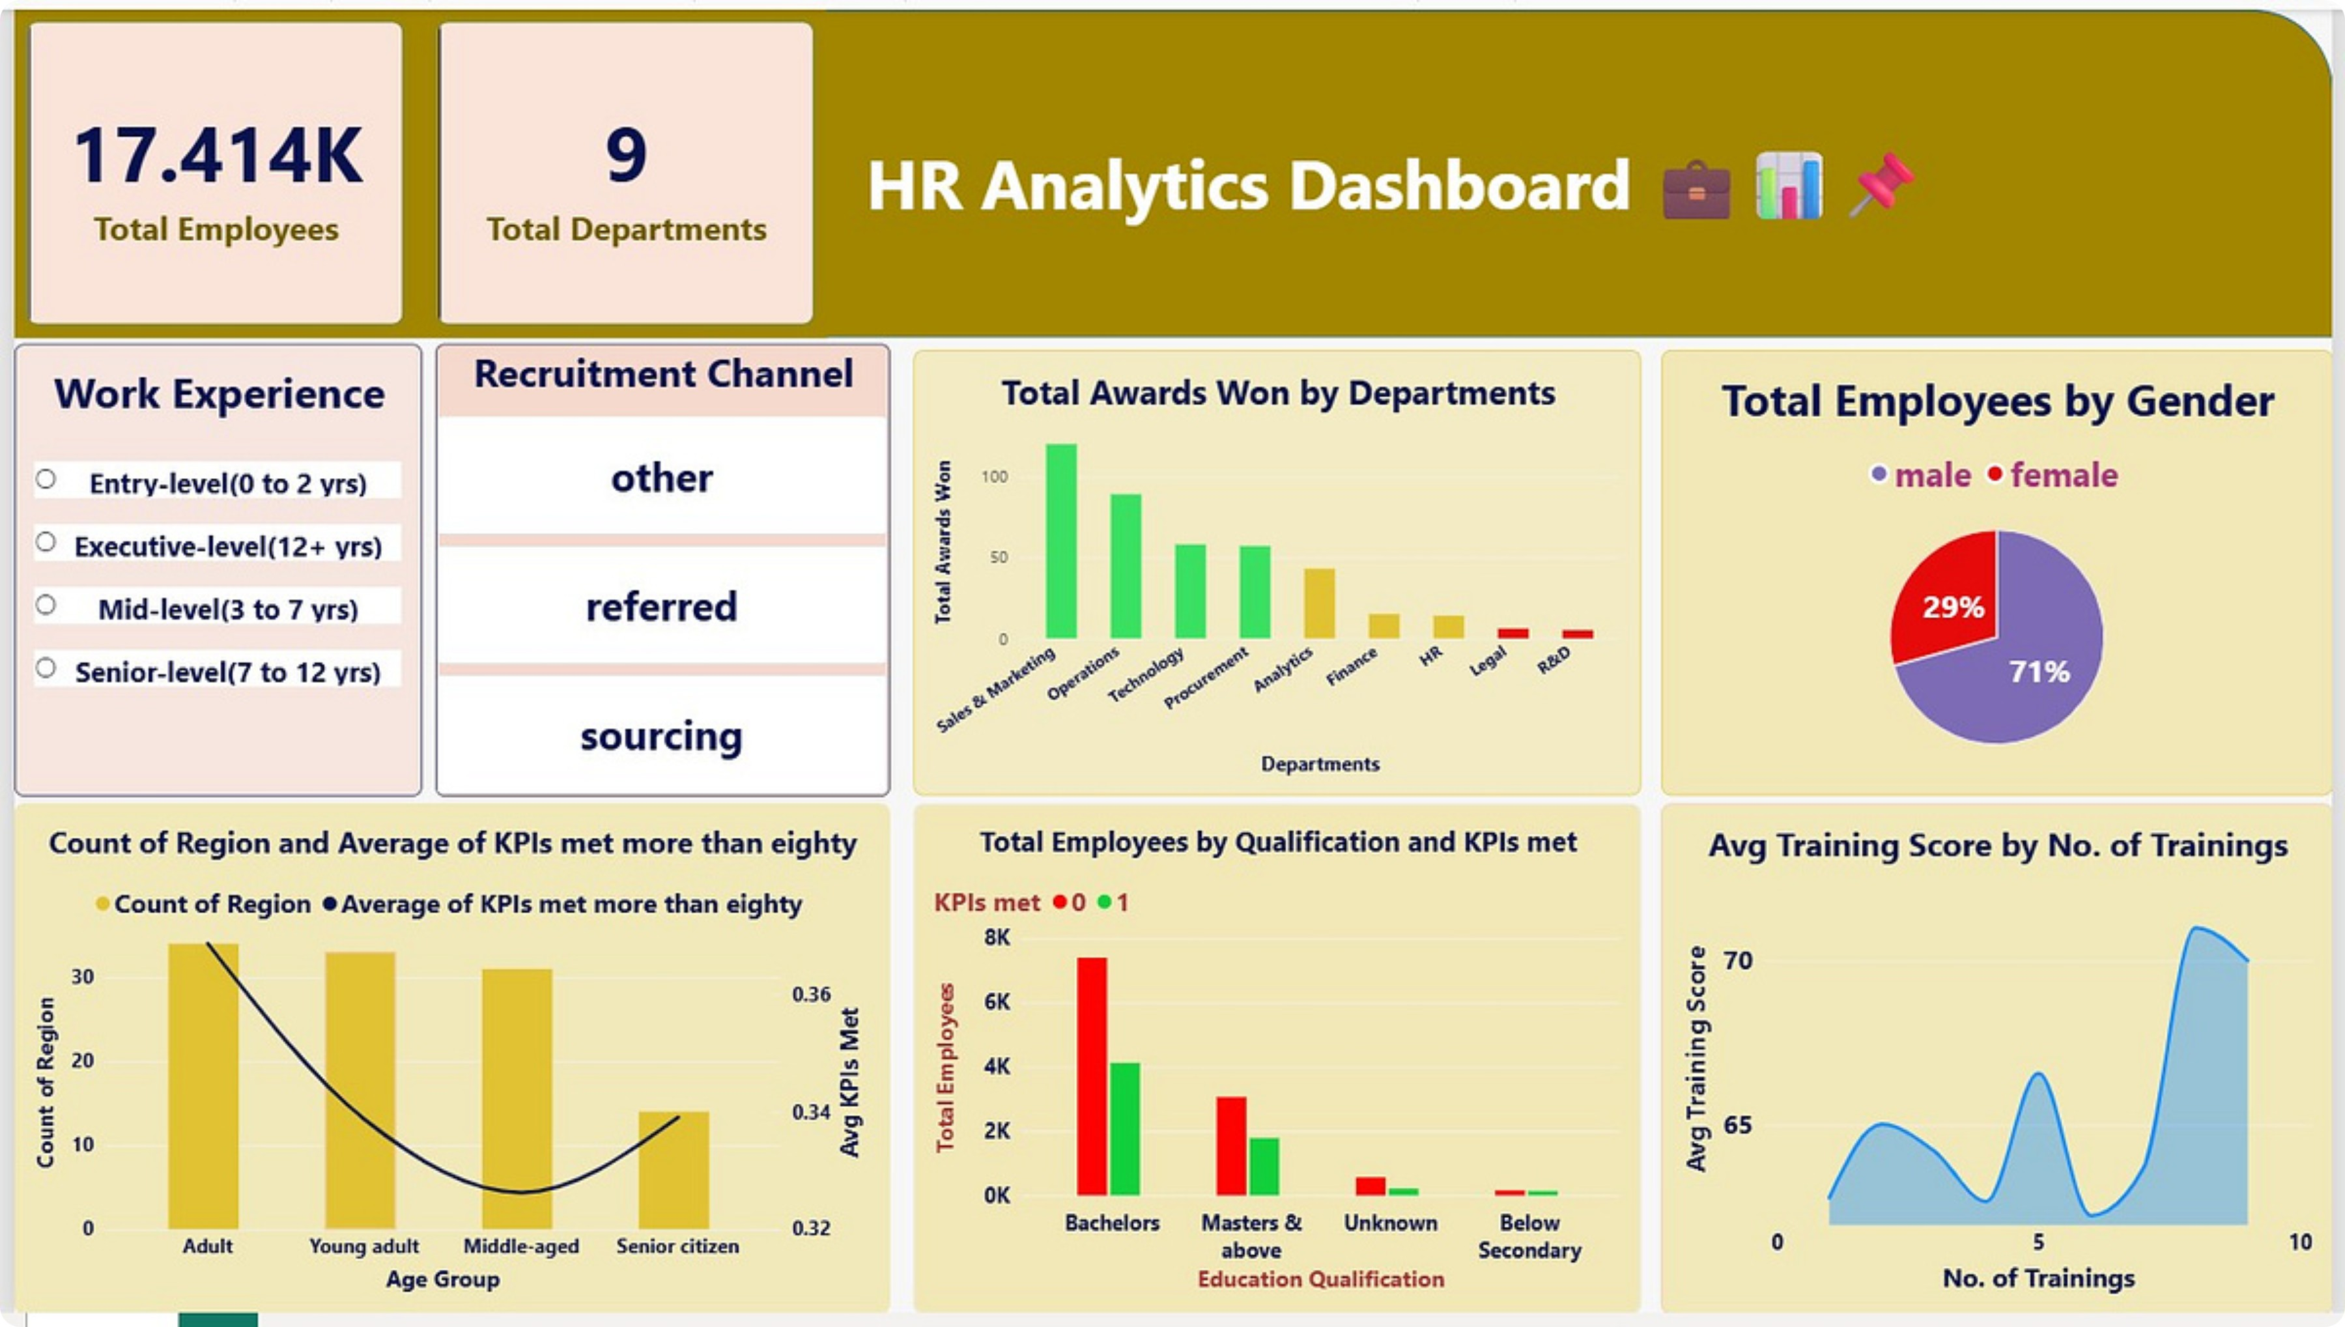
Power BI Dashboard

Slide 10
Key Insights & Recommendations
Key Insights
Recommendations
More trainings → higher avg training scores
Over half the workforce is male (71%)
Referral channel yields maximum KPI-meeting employees
KPI dips in <10 regions across young adults (entry/mid-level), middle aged(senior level) and adults(executive-level)
Hire more capable female candidates for workforce balance
Entry & mid-level young adults should focus on improving KPI goals
Encourage referral recruitment — it consistently hires top performers
Executive-level adults need to improve average KPI through greater goal engagement

