Slide 1
FRONTEND PROJECT
ALLERGY GROCERS
INSTRUCTOR:MR.LOVISH ARORA
Ankit Bansal| 2110990202 | G5

Slide 2

Table of contents
01
02
03
04
05
06
Introduction
Why Choose Us?
Goals
Challenges
Screenshots
Future Scope

Slide 3
01
Introduction

Slide 4

Introduction
Allergy Grocers is an e-commerce website that is revolutionizing the way people shop online. In a world that's becoming increasingly digital, Allergy Grocers is your destination for an unmatched shopping experience.We are a digital marketplace where endless possibilities meet your desires.

Slide 5
02
Why Choose Us?

Slide 6

Why Choose Us?
Why should you choose Allergy Grocers over other e-commerce websites? Here are a few compelling reasons:
Personalization
Great Deals
Fast and Reliable Shipping
User Reviews and Ratings

Slide 7
03
Goals

Slide 8

Goals
Provide Allergy-Friendly Products
Allergen Information
Quality Assurance
Delivery and Shipping Options
Customer Support Excellence
Data Security
Marketing and Branding

Slide 9
04
Challenges

Slide 10

Challenges:
Load Speed
Product Sourcing
Allergen Labeling and Accuracy
Educational Content
Content Presentation
Compliance with Regulations
Cost Management

Slide 11
05
Screenshots

Slide 12
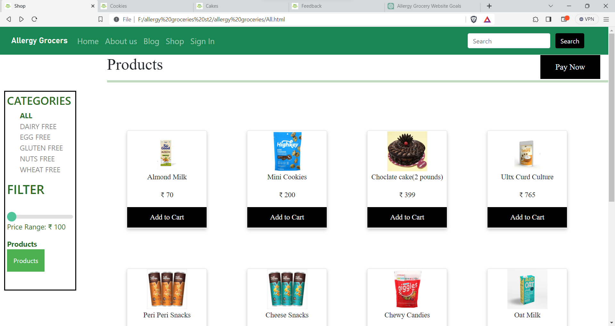
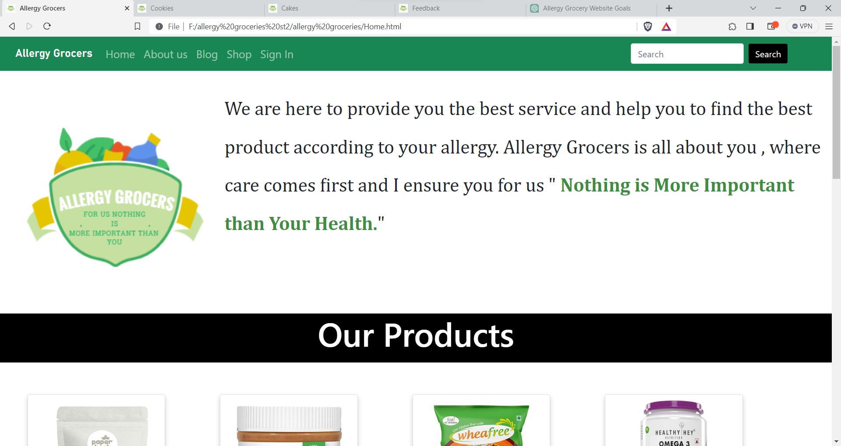
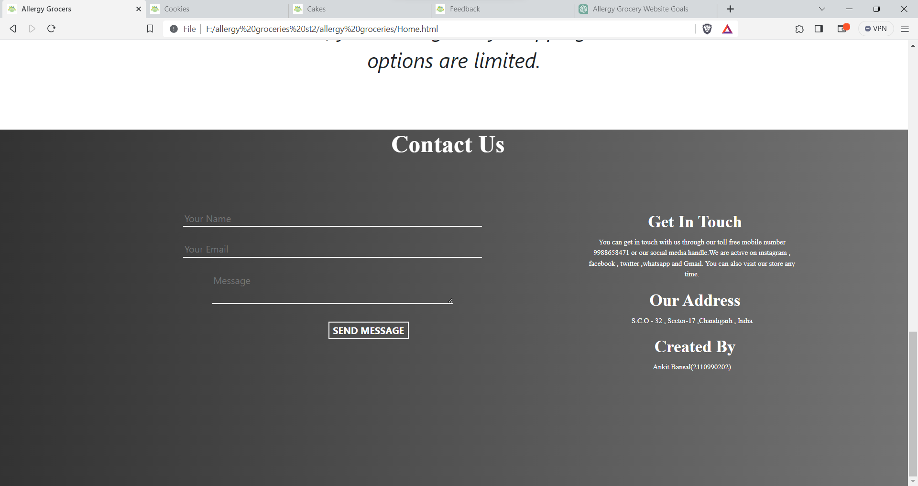
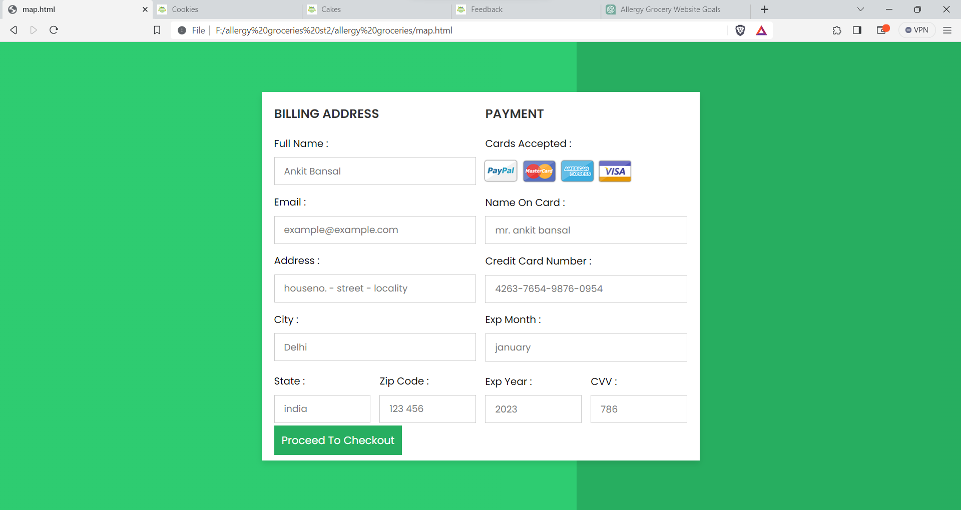

Slide 13
06
Future Scope

Slide 14

Future Plans:
Mobile App
Allergy-Friendly Recipes and Meal Plans
Sustainability
Community Building
Virtual Allergy Clinics
Expanded Product Range
Local Partnerships

Slide 15
Thank You

