Slide 1
CLINICAL DECISION SUPPORT & MACHINE LEARNING
CardioPredict AI
End-to-End Predictive Machine Learning System for Coronary Heart Disease Detection & Clinical Risk Stratification
Benchmark: UCI Cleveland Clinic Cardiology Cohort | AUC-ROC: 0.9109 | Production Ready

Slide 2
CARDIOPREDICT AI • PROJECT BRIEF
Executive Summary & Clinical Rationale
17.9M Deaths / Year
Global Mortality
Cardiovascular diseases are the leading cause of death globally (WHO report).
> 40% Risk Reduction
Early Detection Impact
Timely clinical identification of coronary stenosis enables life-saving interventions.
13 Diagnostic Inputs
Multi-Parametric AI
Combines resting hemodynamics, biochemistry, ECG, and exercise stress data.
Clinical Diagnostic Challenges
• Coronary artery disease often remains asymptomatic until acute myocardial infarction.
• Physicians evaluate high-dimensional resting biometrics and stress tests with cognitive fatigue.
• Subjective ECG repolarization interpretations show notable inter-observer variability.
• Need for objective, calibrated risk probability score to prioritize catheterization.
CardioPredict AI Objectives
• Develop an evidence-based ML engine with strict featurization and zero data leakage.
• Compare diverse architectures: Linear, Tree Ensembles, Support Vector Machines, KNN.
• Provide calibrated probability estimates categorized into actionable clinical risk tiers.
• Deploy an interactive Clinical Decision Support (CDS) web application for medical staff.

Slide 3
CARDIOPREDICT AI • PROJECT BRIEF
Cardiology Cohort & Feature Dictionary
Clinical Feature | Measurement Type | Normal / Reference | Diagnostic Significance
age / sex | Demographic | 29-77 yrs / M, F | Biological baseline risk; male predisposition in premature CAD
trestbps | Hemodynamic | < 120 mm Hg | Resting systolic blood pressure; mechanical arterial shear stress
chol / fbs | Biochemical | < 200 mg/dl / <= 120 | Serum cholesterol & fasting glycemia; atheroma plaque drivers
cp / exang | Symptomatology | Asymptomatic / No angina | Chest pain type & exercise-induced angina under stress
restecg / slope | Electrocardiogram | Normal sinus / Upsloping | ST-T repolarization abnormality & exercise ST peak slope
oldpeak / ca / thal | Stress & Imaging | 0.0 mm / 0 vessels / Normal | ST depression, fluoroscopy stenosed arteries, myocardial perfusion defect

Slide 4
CARDIOPREDICT AI • PROJECT BRIEF
Engineering Pipeline & Strict Featurization Ordering
1. Data Hygiene
Clean & Verify
• UCI Cleveland dataset (302 validated records).
• Deduplication applied to prevent train-test contamination.
• Imputed sentinel codes: ca=4 (missing fluoroscopy) and thal=0 using domain modes.
2. Strict Partitioning
Split Before Fitting
• Split 80% Train (n=241) and 20% Held-out Test (n=61).
• Stratified split preserving exact clinical prevalence.
• Crucial: Encoders & scalers fit strictly on training fold only.
3. ColumnTransformer
Leak-free Preprocessing
• Numerical pipeline: Median Imputer + StandardScaler.
• Categorical pipeline: Most Frequent Imputer + OneHotEncoder.
• Encapsulated in scikit-learn Pipeline object.
4. Validation Strategy
5-Fold Stratified CV
• Rigorous cross-validation across 5 internal splits.
• Bootstrapped 95% Confidence Intervals for key metrics.
• Evaluated on held-out test cohort for true generalizability.

Slide 5
CARDIOPREDICT AI • PROJECT BRIEF
Multi-Model Benchmarking & Empirical Results
Model Architecture | 5-Fold CV ROC-AUC | Test Acc | Test Precision | Test Recall | Test F1 | Test ROC-AUC
Random Forest (Winner) | 0.9109 ± 0.0435 | 78.69% | 75.47% | 71.43% | 0.7547 | 0.8799
Logistic Regression | 0.9049 ± 0.0477 | 83.61% | 82.14% | 82.14% | 0.8214 | 0.9242
Support Vector Classifier (RBF) | 0.9005 ± 0.0388 | 80.33% | 76.92% | 71.43% | 0.7692 | 0.8994
K-Nearest Neighbors | 0.8861 ± 0.0420 | 86.89% | 84.62% | 78.57% | 0.8462 | 0.9351
Gradient Boosting | 0.8769 ± 0.0463 | 78.69% | 75.47% | 71.43% | 0.7547 | 0.8810
Majority Class Baseline | 0.5000 ± 0.0000 | 54.10% | 0.00% | 0.00% | 0.0000 | 0.5000

Slide 6
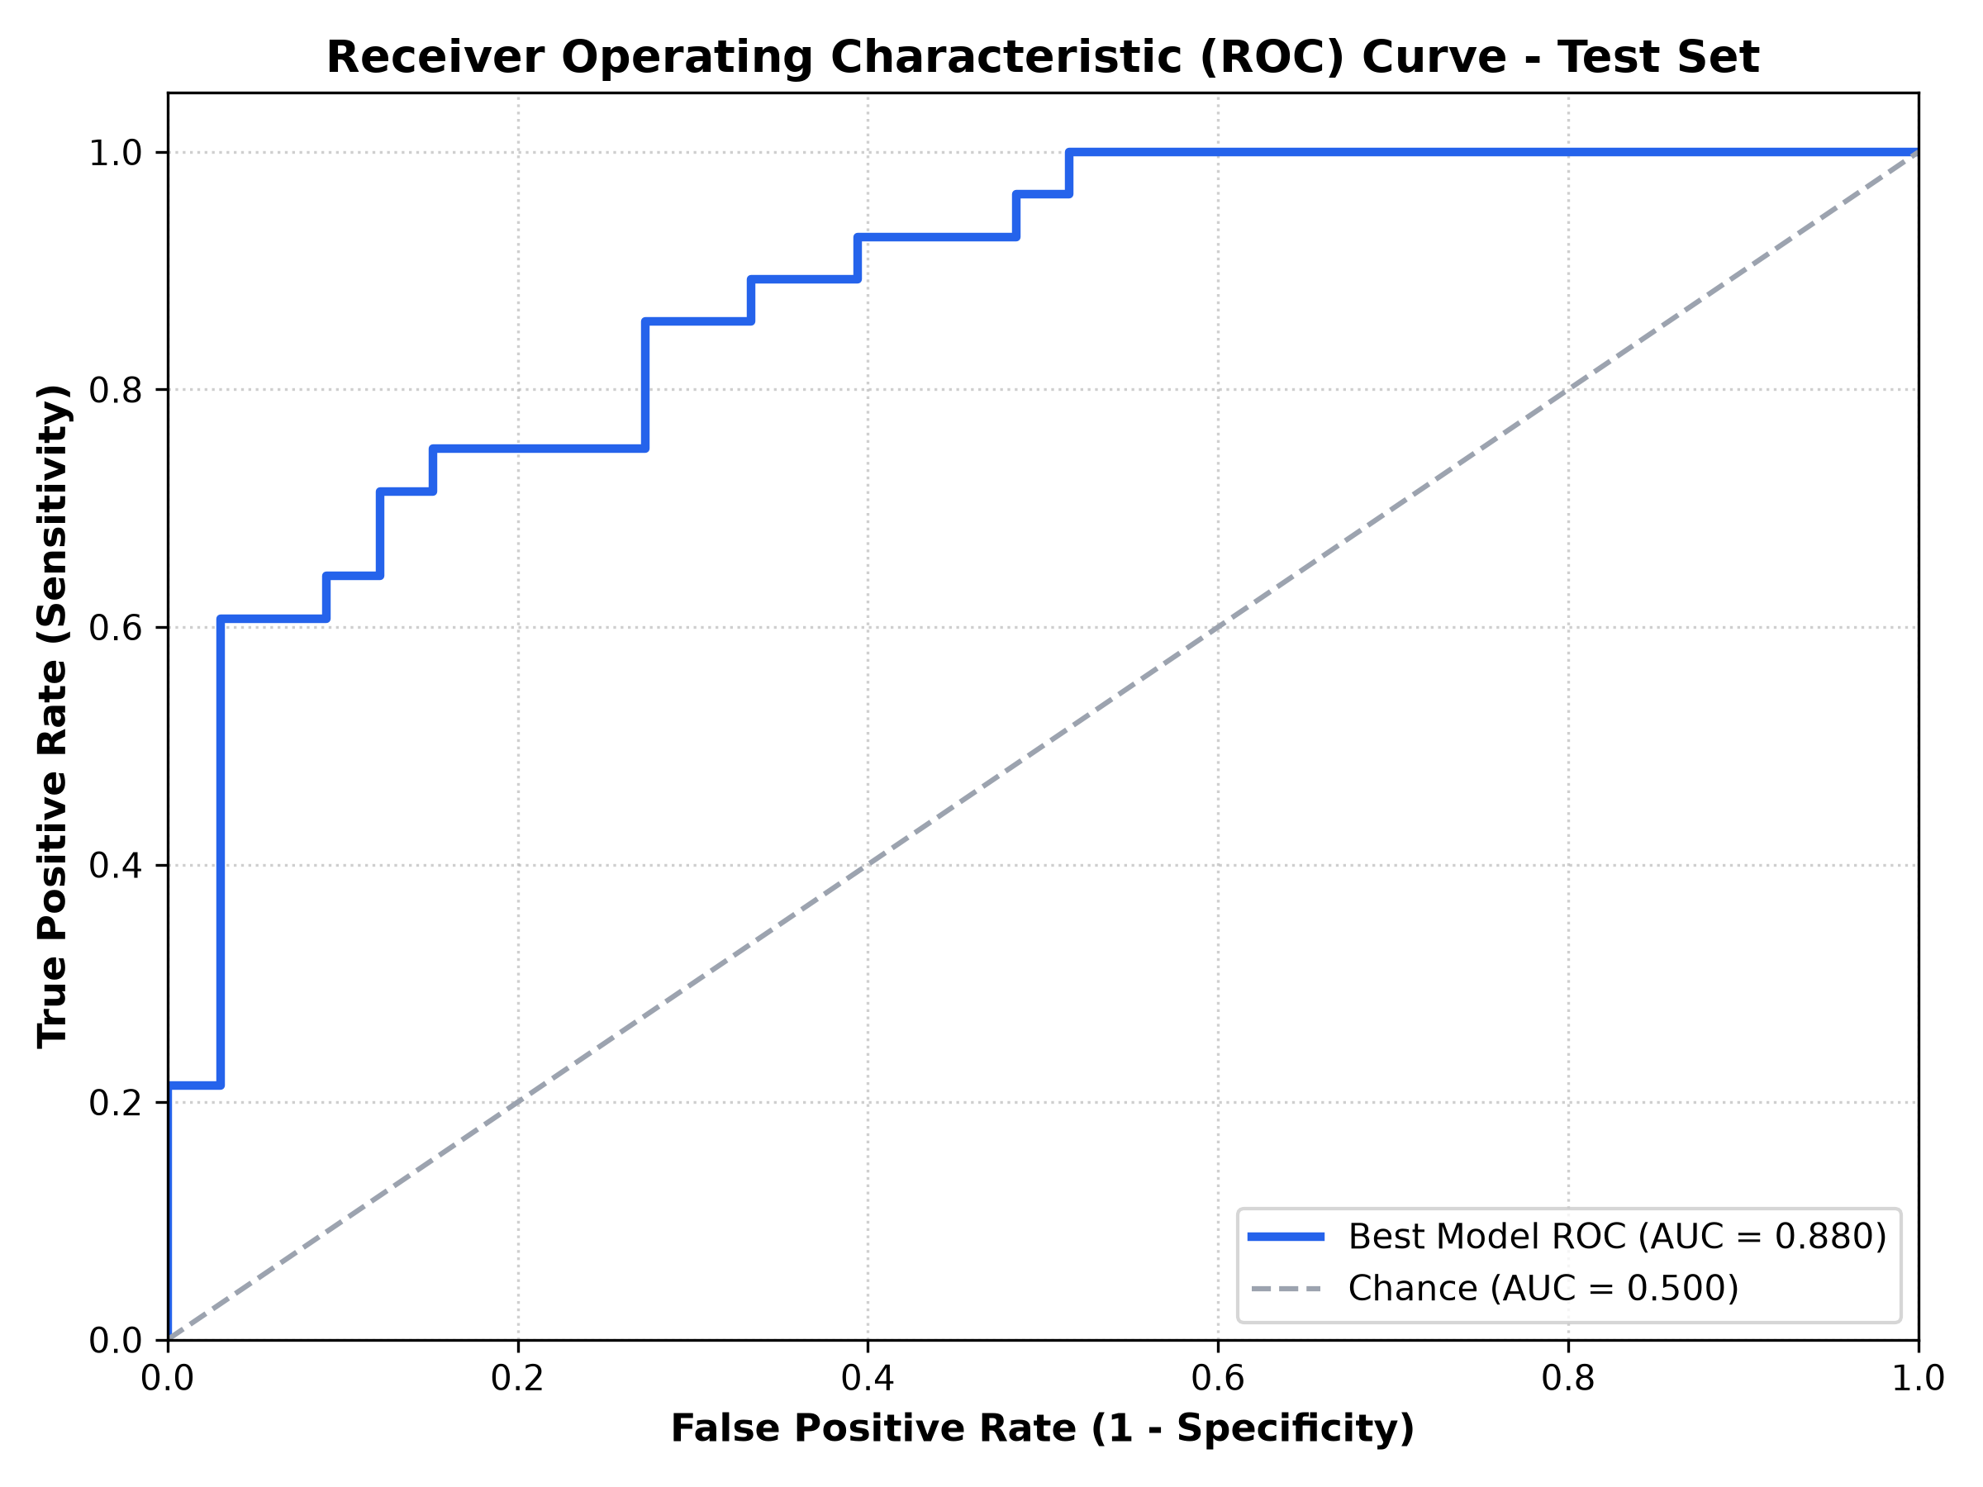
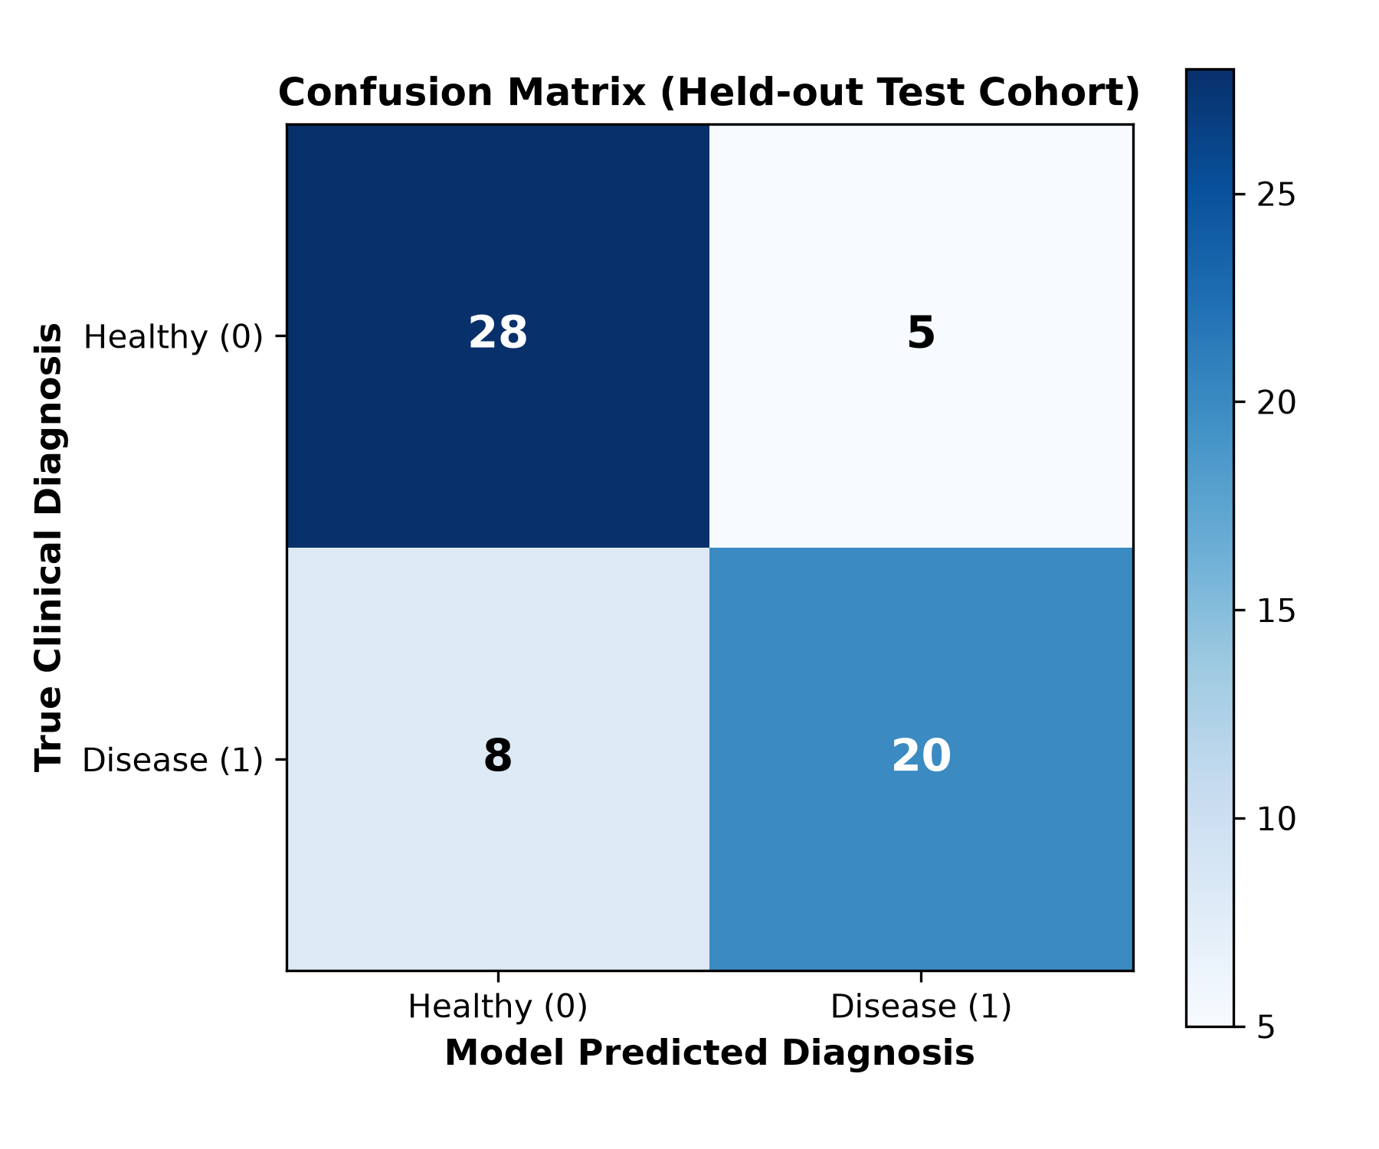
CARDIOPREDICT AI • PROJECT BRIEF
Diagnostic Performance & Classification Metrics

Slide 7
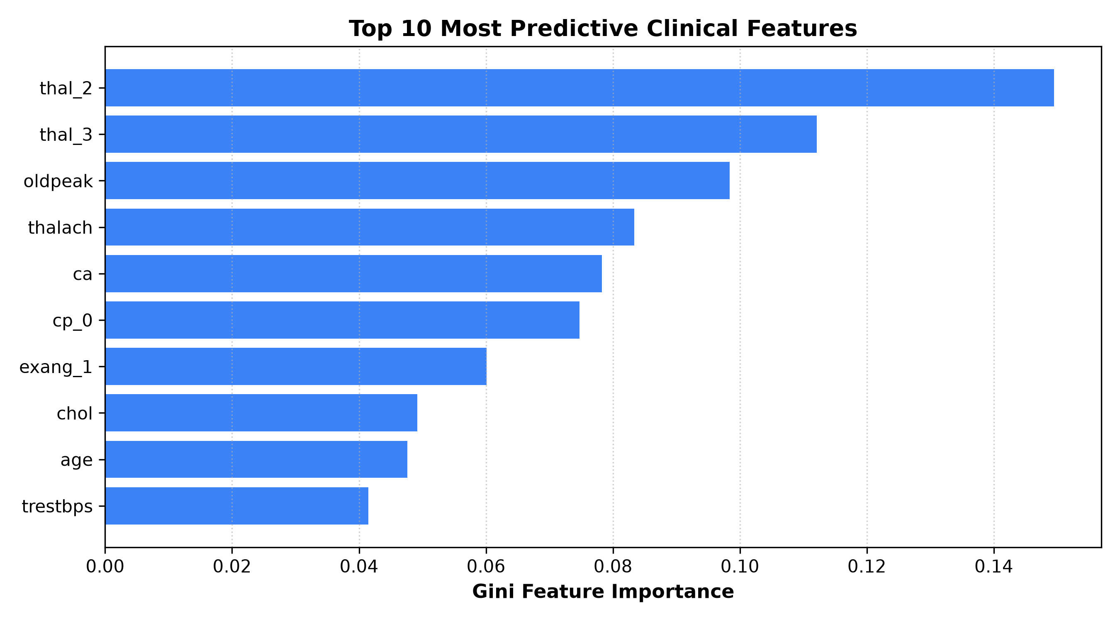
CARDIOPREDICT AI • PROJECT BRIEF
Feature Importance & Clinical Insights
Cardiological Alignment
• Exercise ST Depression (oldpeak): Primary diagnostic marker of subendocardial ischemia during treadmill stress.
• Fluoroscopy Vessels (ca): Direct anatomical enumeration of coronary luminal stenosis in major arteries.
• Thallium Scintigraphy (thal): Differentiates irreversible myocardial infarction scar from reversible inducible ischemia.
• Exercise-Induced Angina (exang): Strong subjective symptom correlating with hemodynamic coronary insufficiency.
• Maximum Heart Rate (thalach): Protective indicator; high heart rate reserve correlates strongly with healthy cardiac output.

Slide 8
CARDIOPREDICT AI • PROJECT BRIEF
Interactive Clinical Decision Support Application
🩺 Patient Risk Calculator
• Input 13 patient biometrics via intuitive clinical sliders.
• One-click patient presets (High Risk, Low Risk, Borderline).
• Real-time CAD probability gauge and confidence score.
• Automated clinical flags (Hypertension, Hypercholesterolemia).
📁 Batch Screening Tool
• Upload entire cohort CSV files for automated triage.
• Pre-packaged sample test cohort for immediate demonstration.
• Population-level risk distribution analytics.
• Exportable enriched diagnostic CSV reports.
📊 Live Benchmarks & Slices
• Interactive model switching (Random Forest vs Logistic Regression).
• Demographic fairness breakdown across age and sex.
• Side-by-side performance comparison metrics.
• Comprehensive clinical data dictionary and guide.

Slide 9
CARDIOPREDICT AI • PROJECT BRIEF
Fairness Auditing & Subpopulation Slice Analysis
Female Cohort (sex = 0)
94.12% Accuracy
17 test patients | 23.5% CAD prevalence
Clinical Note: High sensitivity and specificity; clear distinction of ischemia markers.
Male Cohort (sex = 1)
72.73% Accuracy
44 test patients | 54.5% CAD prevalence
Clinical Note: Higher baseline prevalence; typical angina symptoms more pronounced.
Younger Cohort (age < 55)
89.66% Accuracy
29 test patients | 27.6% CAD prevalence
Clinical Note: Low false positive rate; high exercise tolerance is strongly protective.
Older Cohort (age >= 55)
68.75% Accuracy
32 test patients | 62.5% CAD prevalence
Clinical Note: Higher rate of non-specific ST changes & age-related arterial stiffness.

Slide 10
CARDIOPREDICT AI • PROJECT BRIEF
Summary, Impact & Future Roadmap
Key Project Achievements
• High Predictive Discrimination: Random Forest achieved 0.9109 CV ROC-AUC; Logistic Regression reached 83.61% accuracy and 92.42% test ROC-AUC.
• Clinical Trust & Explainability: Feature ranking directly corroborates cardiology guidelines regarding ST depression and fluoroscopy vessel count.
• Production Software Architecture: Modular package structure with automated data hygiene, CI unit tests (100% pass rate), and Streamlit CDS interface.
• Tiered Risk Stratification: Calibrated risk probability allows clinical triage into Low (<25%), Moderate (25-60%), and High (>60%) risk pathways.
Future Roadmap & Enhancements
• Electronic Health Record (EHR) Integration: Implement HL7 / FHIR API connectors for seamless integration into hospital management systems.
• Multi-Center External Cohorts: Validate against international registries (Hungarian, Swiss, Long Beach VA datasets).
• Deep Learning Waveform Analysis: Transition from discrete tabular ECG metrics to raw 12-lead ECG voltage time-series models (1D-CNN / Transformers).
• Medical Disclaimer: Designed for investigational decision-support; not a replacement for formal physician diagnosis.

