Slide 1

Summer Training Project
Spreadsheet Clone Application
From Coding Blocks (Competitive Programming)

Slide 2

1
To develop a spreadsheet software by implementing their functionality using graph data structure.
Objectives
2
Feature for automatic recalculation and real time update when numeric values or formulas get updated.
3
Features for text and cell formatting.

Slide 3
Technology Used:
-> HTML,
-> CSS,
-> Javascript, and
-> Electron ( for desktop application )

Slide 4
Spreadsheet
-> A spreadsheet is a software which consist of a sheet of grid with rows and columns.
-> Rows are referenced through 1-100 and columns are referenced through A-Z.
-> It is implemented using 2-dimensional matrix, where row number are referenced using 0-99 whereas column name can be referenced using ASCII codes (A-65 upto Z-90).
-> ASCII codes are transformed to 0 to 25.
Time: 5 minutes

Slide 5
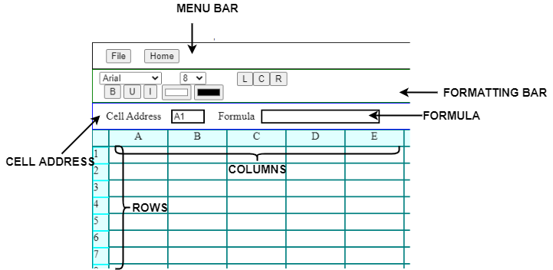
User Interface
Snapshot of the application

Slide 6
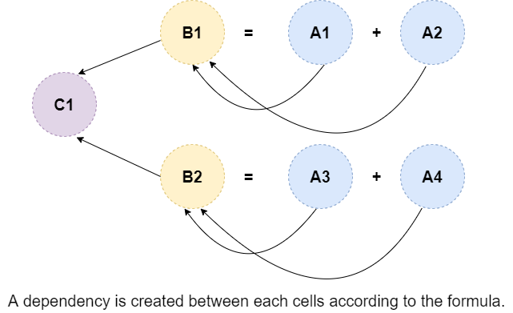
Data Structure Used :
Graph Data Structure
-> When formulas are entered in the cells, it creates a dependency between cells.
If cell B1 = (A1 + A2) and B2 = (A3 + A4), then
B1 is dependent on A1 and A2, and
B2 is dependent on A3 and A4.
Similarly, C1 is dependent on B1 and B2.
+

Slide 7
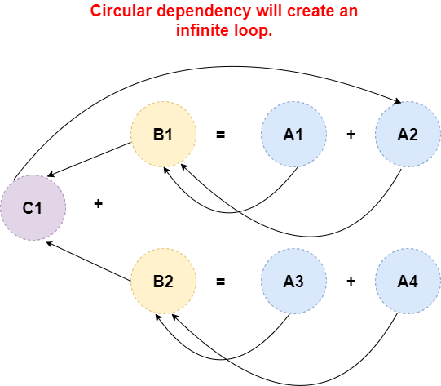
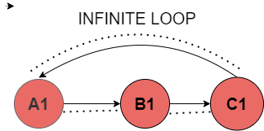
How dependency is created between each cell ?
-> Dependencies are created using Directed Acyclic Graphs
-> There should be no circular dependencies in the graph. For example -
-> C1 is indirectly dependent on A1, A2, A3 and A4, but edge between
-> C1 and A2 shows A2 is dependent over C1.
-> Circular dependencies will make the cell values INFINITY or INVALID.

Slide 8
Graph Representation and Cell Attributes
-> Graphs is represented using adjacency list.
-> Each cell state includes four variables:
1. Cell Value
2. Upstream
3. Downstream
4. Formula of the cell
-> For text formatting , it includes variables like
1. Bold
2. Italic
3. Underline
4. Font-family
5. Font-size
It is handled by altering CSS properties of the cells.

Slide 9
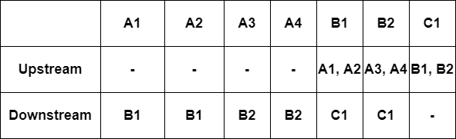
Downstream and Upstream of a cell ?
- > Upstream of a cell are the parent nodes of a cell.
-> Downstream of a cell are child nodes of a cell.
-> A separate list of upstream and downstream will be created for each cell.

Slide 10
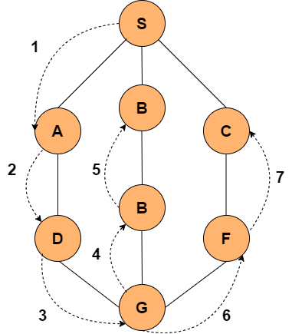
How automatic cell updation works ?
-> When a cell value is updated, then all its dependent node (downstream) needs to be updated using DFS algorithm.
-> When new formula gets updated, previous dependencies is to be deleted and new edges (dependencies) is to be added.
-> Algorithm used: DEPTH FIRST SEARCH algorithm.
DFS algorithm

Slide 11
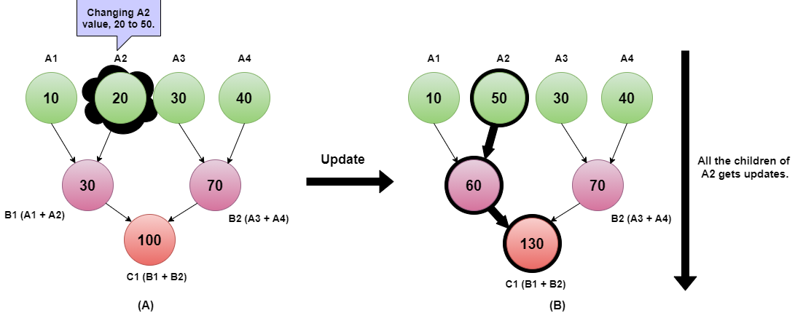
Graph Visualization
Case I: When cell value (numeric) is updated

Slide 12
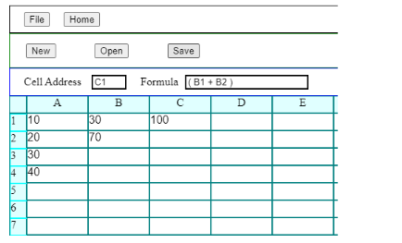
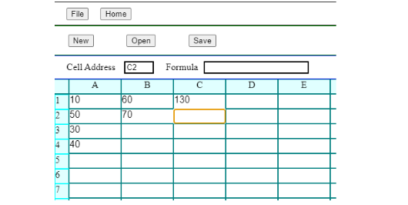
Before Update :
After Cell Update :

Slide 13
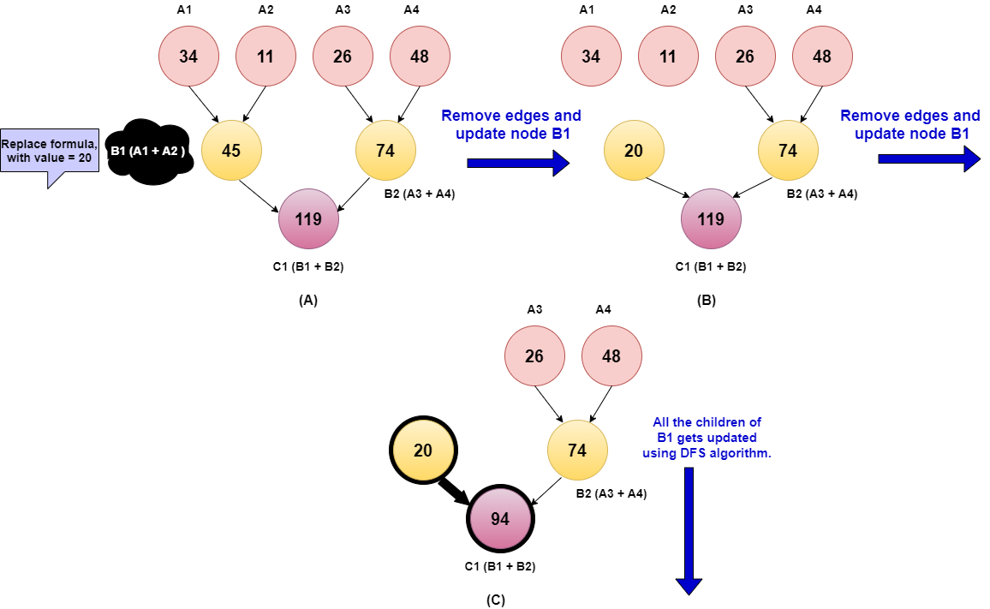
Case II: When formula is replaced with a numeric value.
-> Delete the upstreams of the cell and itself from its parents downstream, Then add new value to the cell and update all its children.

Slide 14
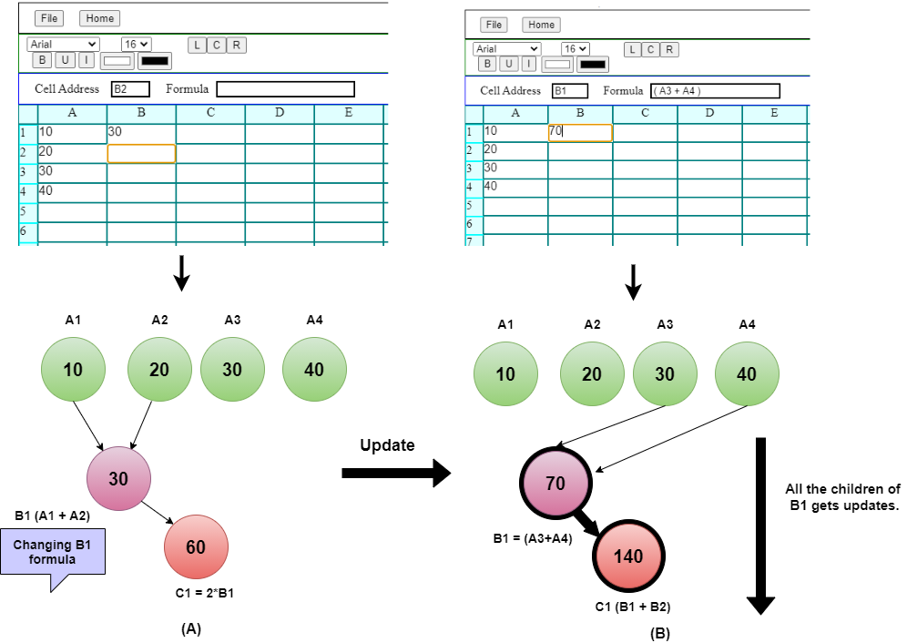
Case III: When formula is replaced with a another formula.
-> Firstly, all the previous edges are removed of the previous formula, and new edges satisfying the dependencies will be added to the graph.
-> New formula will be evaluated and updating of its children will takes place using DFS algorithm will run.
->

Slide 16
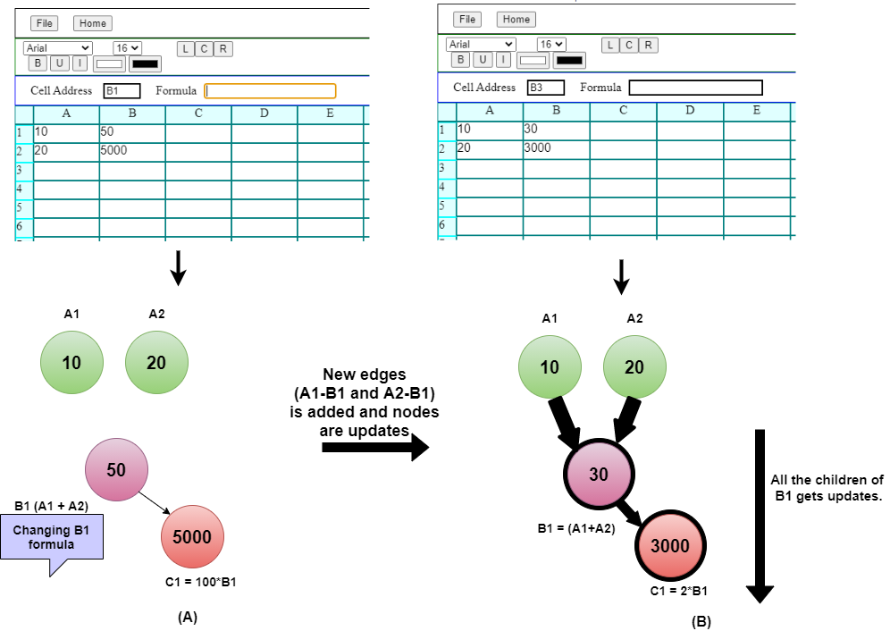
Case IV: When formula is added in place of a numeric value

Slide 17
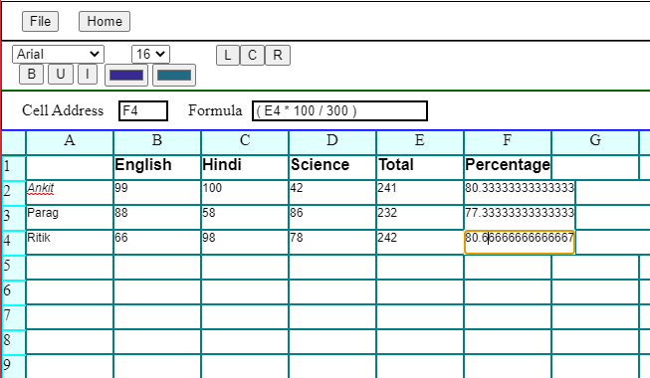
Application Use Case :

Slide 18
Thank you

