Slide 1

Presentation
On Air canvas using python.

Slide 2

Tech Geeks

Slide 3
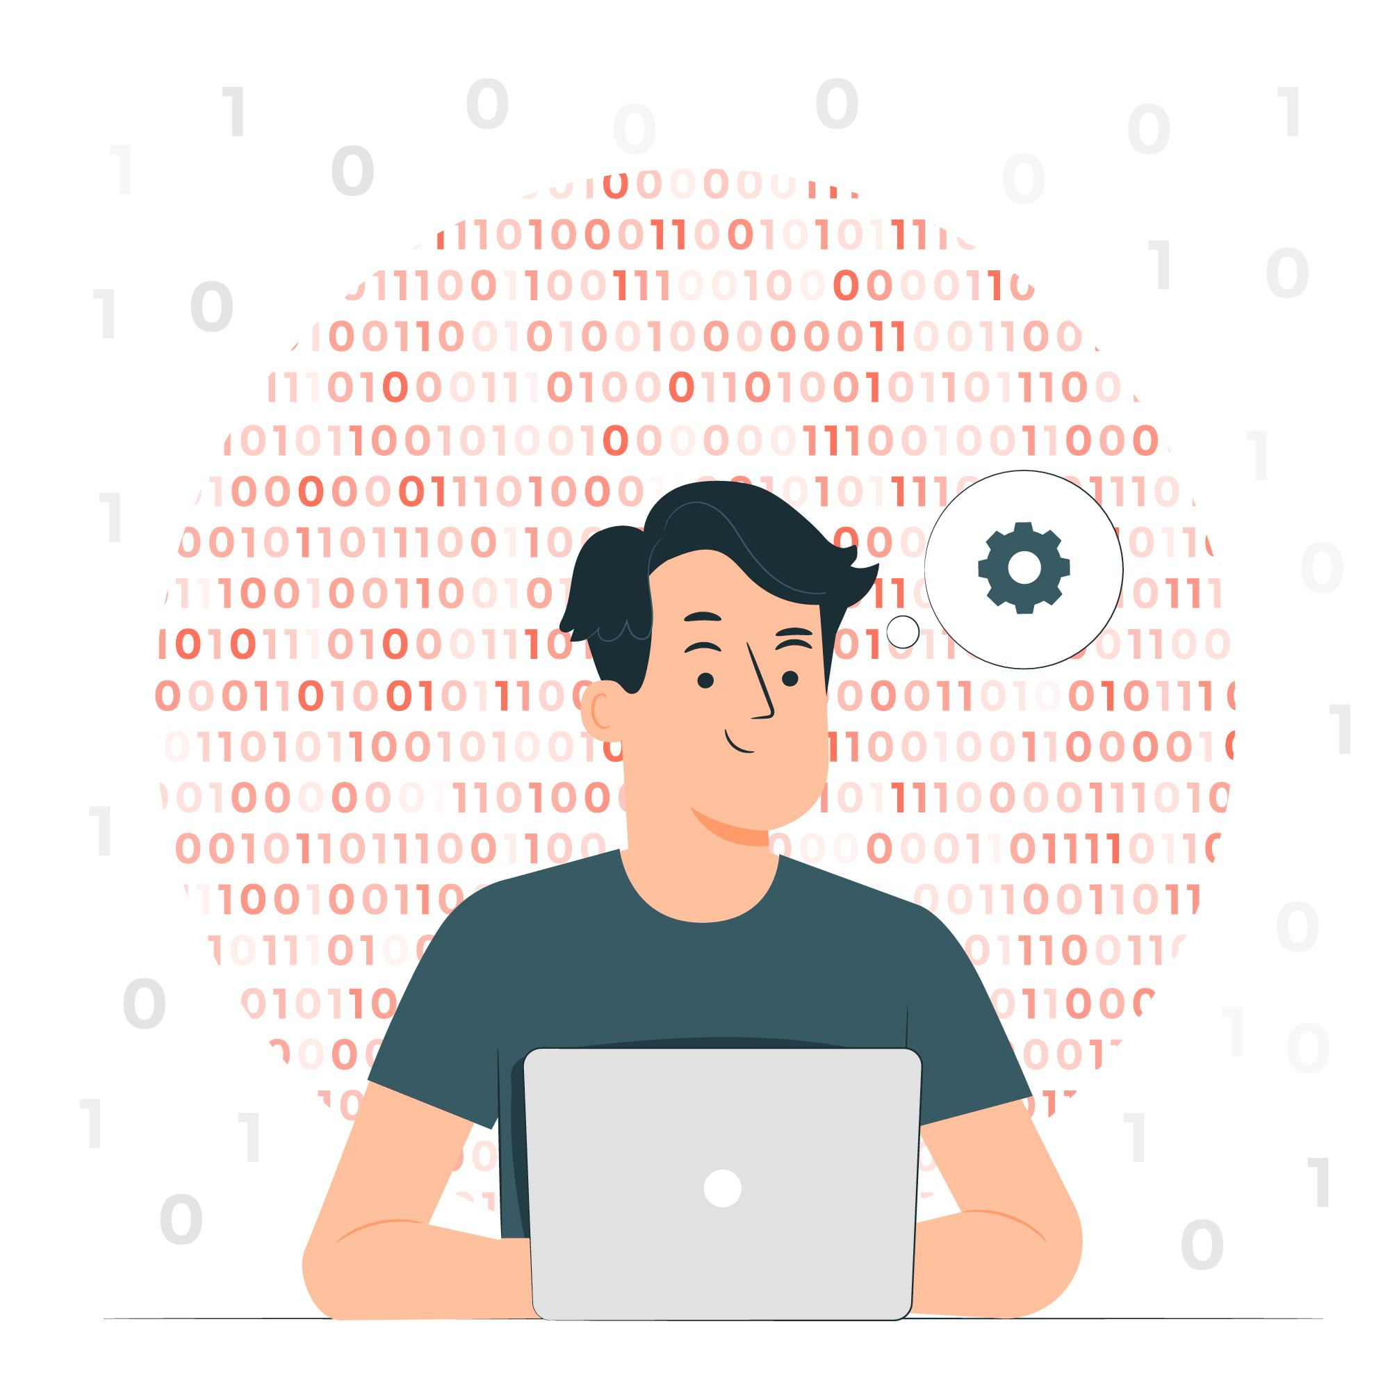
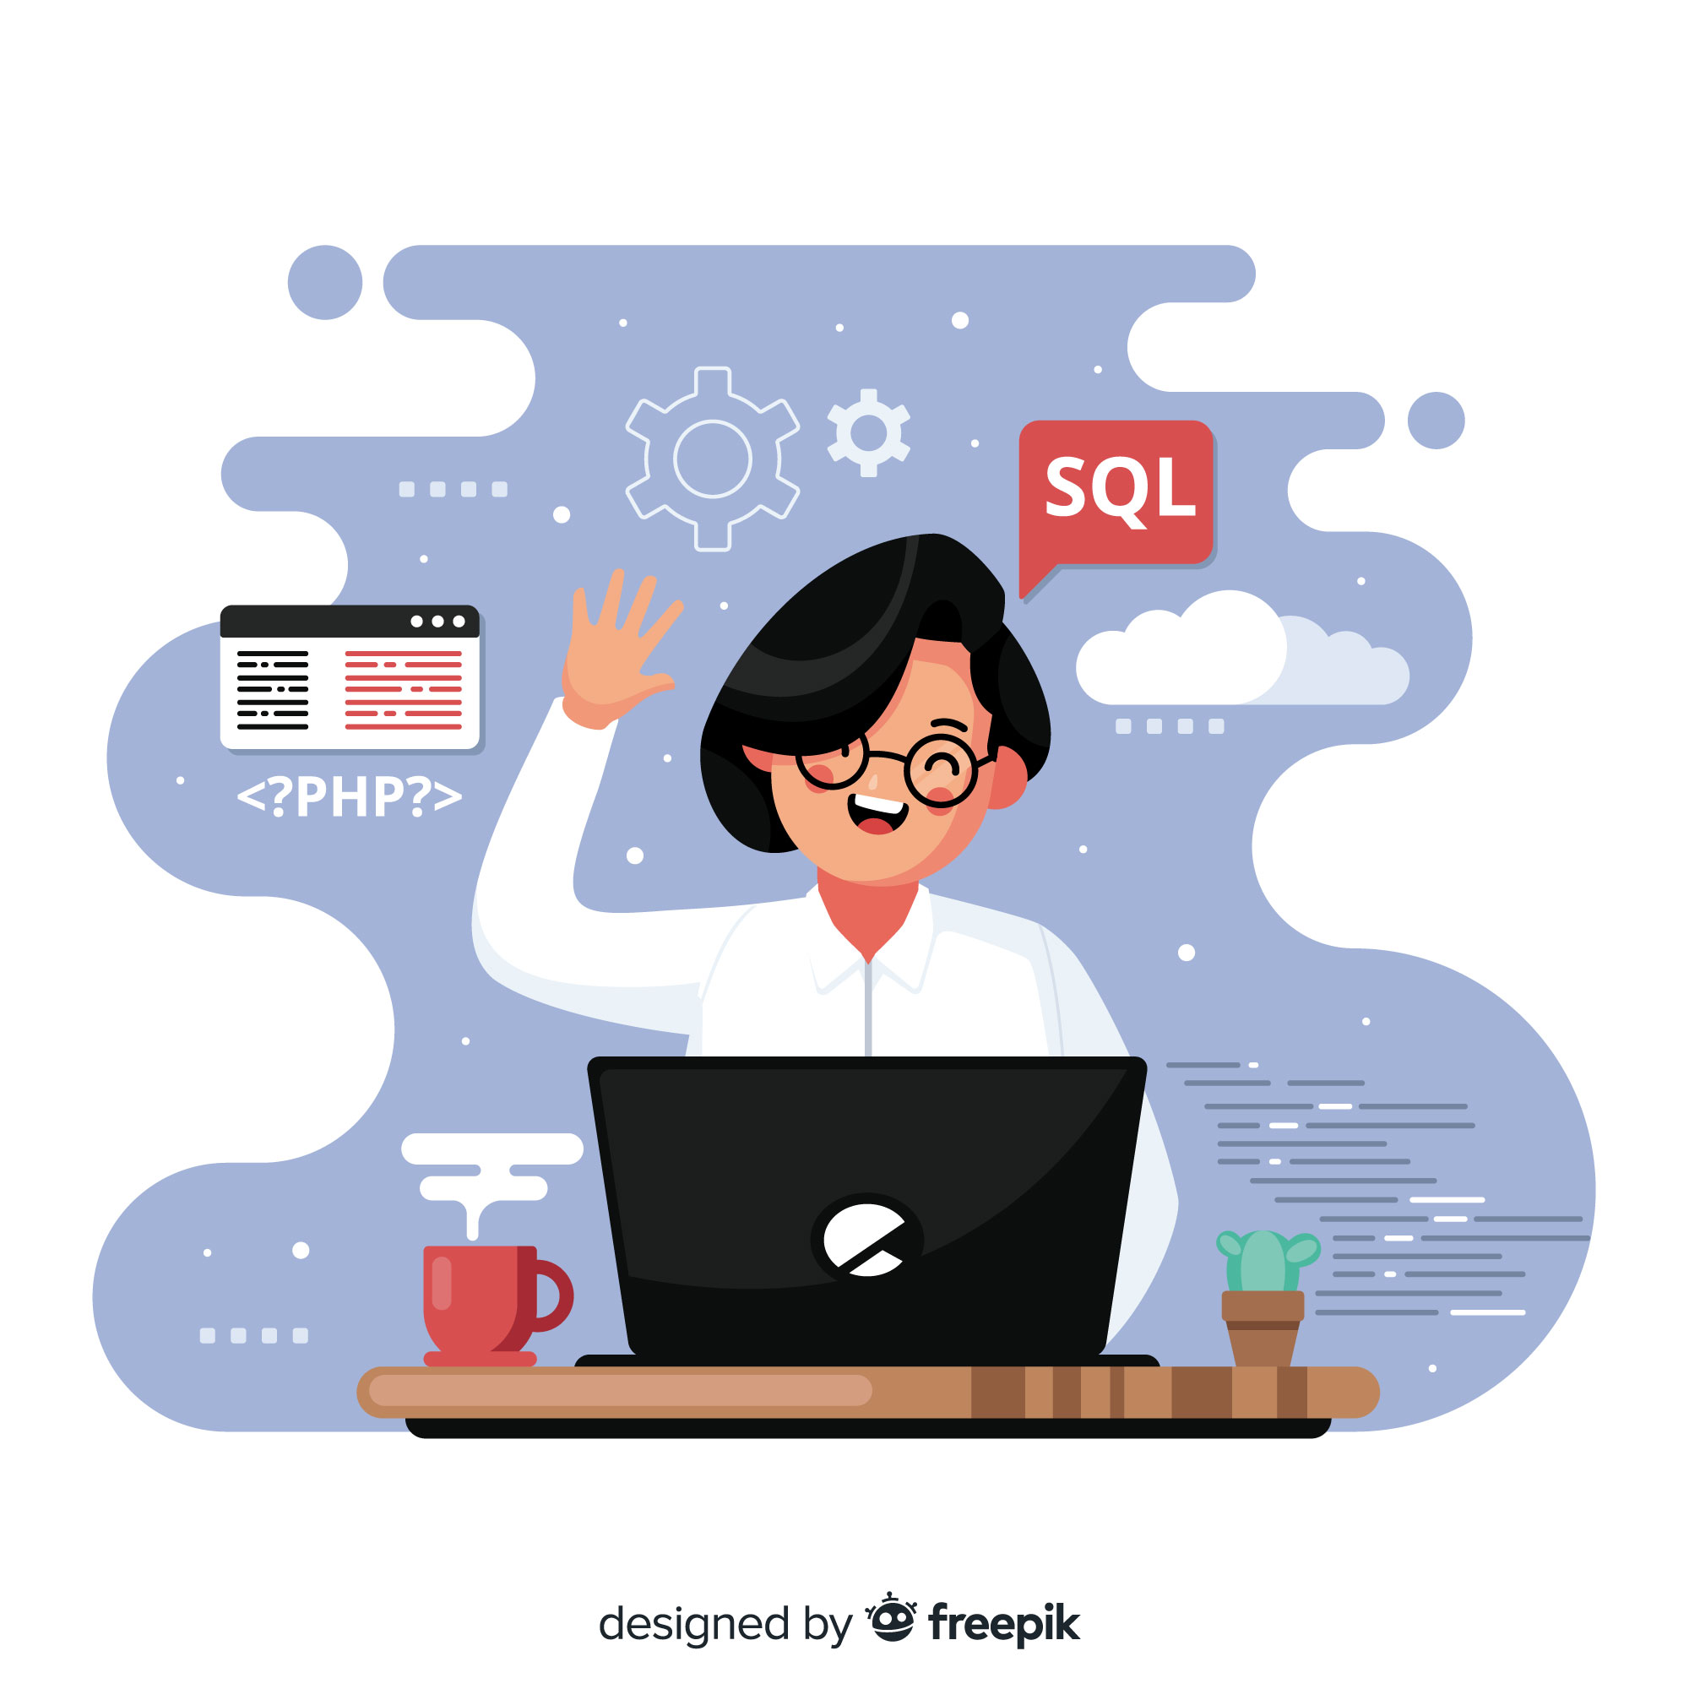

Lakshay
Himanshi
Ankit

Slide 4
AIR CANVAS

Slide 5
Ever wanted to draw your imagination by waiving your finger in the air?
Guess what! It is now possible using the Air Canvas.
It will draw anything on it by detecting the motion of your finger and noticing the landmarks of your knuckles.
Here, hand landmarks and tracking is used in order to achieve the objective.

Slide 6

Why Air Canvas?
The project focuses on developing a motion-to-text converter that can potentially serve as software for intelligent wearable devices for writing from the air.
Writing in air, one of the most challenging research areas, contributes immensely to the advancement of an automation process and can improve the interface between man and machine in numerous applications.

Slide 7

AIM
1
To build an air canvas that draws whatever you draw using your finger in the air, on the canvas

Slide 8

LIBRARIES USED
2
Numpy
OpenCV
MediaPipe

Slide 9
ROADMAP
Start reading the frames and convert the captured frames vertically to RGB color space which is easy for color detection.
Adjust the values of the mediapipe intilization to detect one hand only.
Detect the landmarks, find the forefinger coordinates and keep storing them in the array for successive frames.
1
3
5
2
4
6
Prepare the canvas frame and put the respective ink buttons on it
Detect the landmarks by passing the RGB frame to the mediapipe hand detector.
Finally draw the points stored in array on the frames and canvas.

Slide 10
How does it make a change?
It will be a powerful means of communication for the people with hearing or speaking impairment.
It has the potential to challenge traditional writing methods.
It eradicates the need to carry a mobile phone in hand to jot down notes.
Even senior citizens or people who find it difficult to use keyboards will able to use system effortlessly.
It is an effective communication method that reduces mobile and laptop usage by eliminating the need to write.

Slide 11
ROOM FOR IMPROVMENT
Steadiness
The landmarks should be smoothen out / dilated in a way that the drawing seems to be seamless
Multiple users
More than one users should be able to use it simultaneously
More functions
More color options and drawing options and many more functions can be added to bring it a lot closer to a mobile device

Slide 12
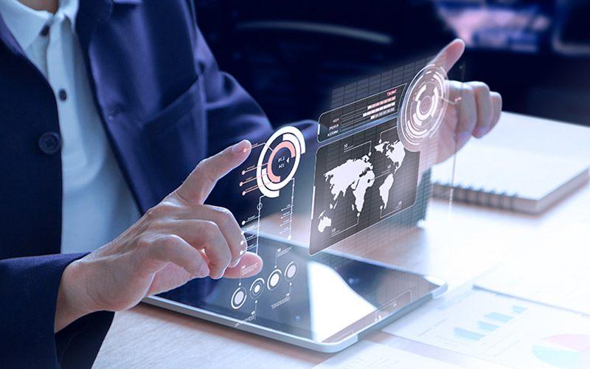
FUTURE SCOPE
Air touch panels
No need to keep a contact with your gadget. You can do all the work by waiving in the air.

Slide 13

GAMING
As gaming industry is increasing day by day,
you can play games in more effective and intresting manner.

Slide 14
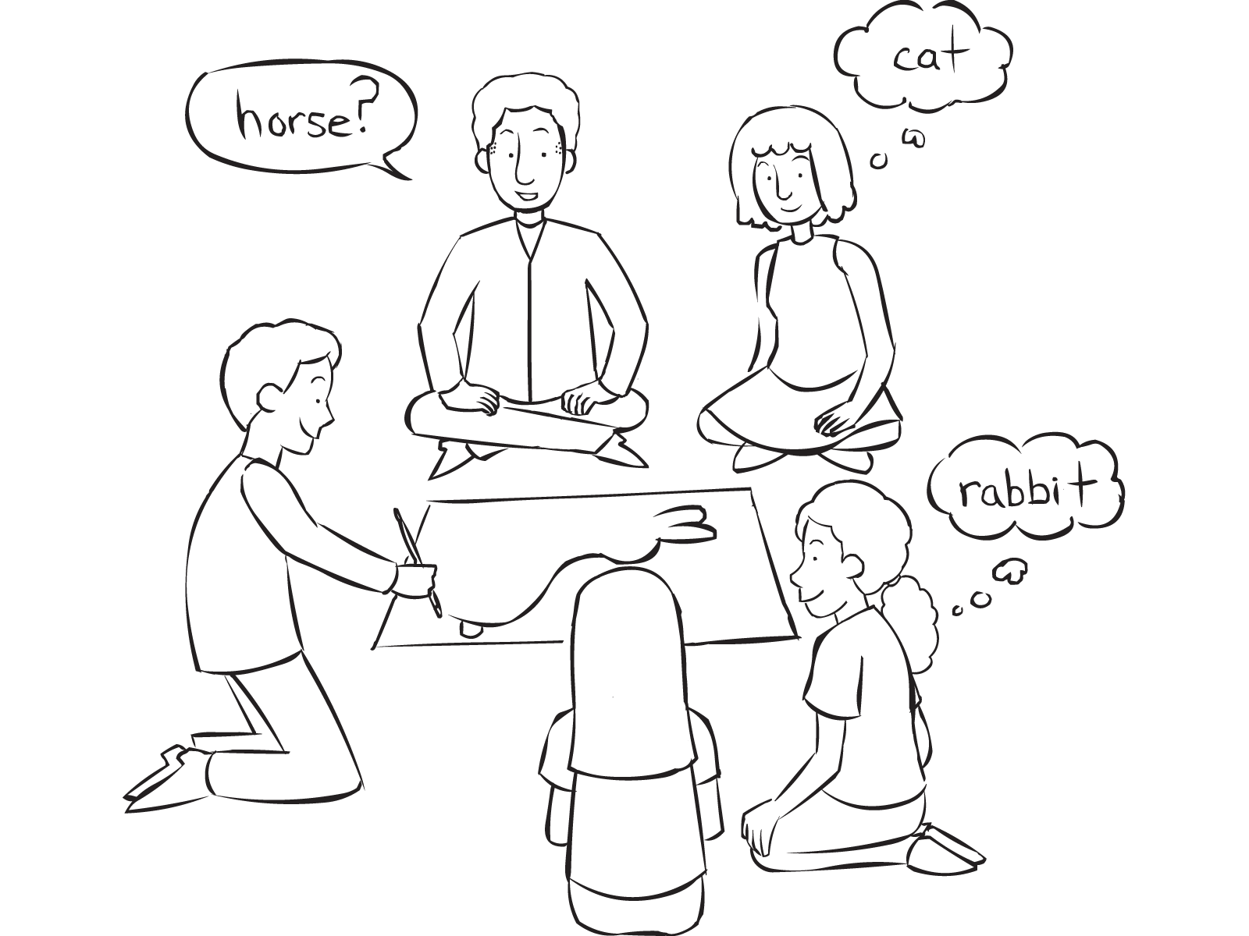
FUTURE SCOPE
Pictionary
You can now play this game with your friends without pen / paper!

Slide 15
Research and References
https://www.researchgate.net/publication/354142408_AIR_CANVAS_APPLICATION_USING_OPENCV_AND_NUMPY_IN_PYTHON
https://www.irjmets.com/uploadedfiles/paper//issue_5_may_2022/22247/final/fin_irjmets1651836068.pdf
https://mediapipe.dev/
https://opencv.org/

Slide 16
THANK YOU!

