Slide 1

Consumer Goods Ad_Hoc Insights

Slide 2
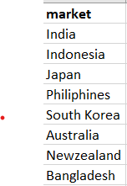
Request 1: Provide the list of markets in which customer "Atliq Exclusive" operates its business in the APAC region.

Slide 3

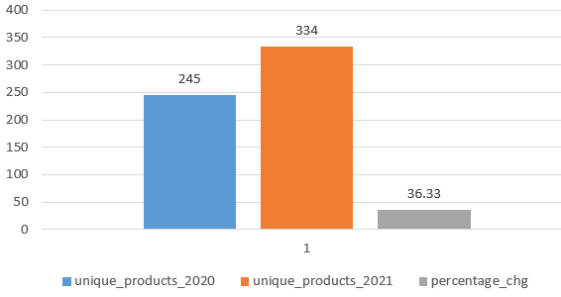
Request 2 : What is the percentage of unique product increase in 2021 vs. 2020? The final output contains these fields, unique_products_2020, unique_products_2021, percentage_chg

Slide 4
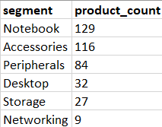
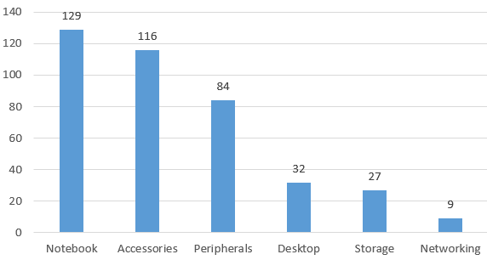
Request 3 : Provide a report with all the unique product counts for each segment and sort them in descending order of product counts. The final output contains 2 fields, segment, product_count.

Slide 5
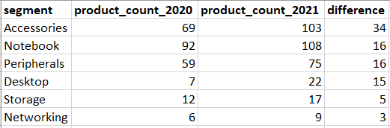
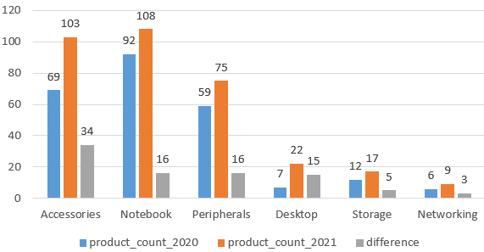
Request 4 : Follow-up: Which segment had the most increase in unique products in 2021 vs 2020? The final output contains these fields, segment, product_count_2020, product_count_2021, difference.

Slide 6
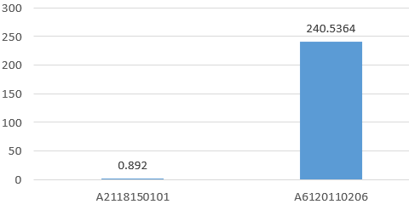

Request 5 : Get the products that have the highest and lowest manufacturing costs. The final output should contain these fields, product_code, product, manufacturing_cost.

Slide 7
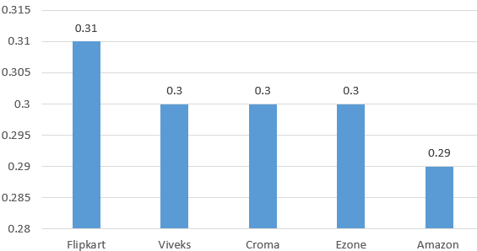
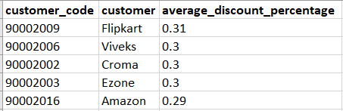
Request 6 : Generate a report which contains the top 5 customers who received an average high pre_invoice_discount_pct for the fiscal year 2021 and in the Indian market. The final output contains these fields, customer_code, customer, average_discount_percentage.

Slide 8
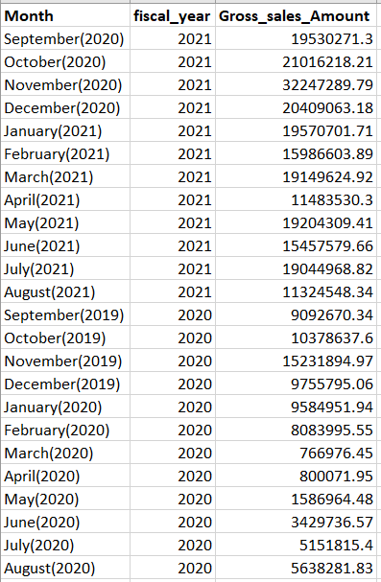
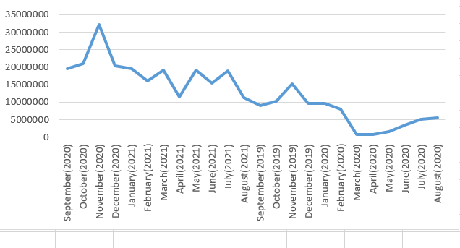
Request 7 : Get the complete report of the Gross sales amount for the customer “Atliq Exclusive” for each month . This analysis helps to get an idea of low and high-performing months and take strategic decisions. The final report contains these columns: Month, Year, Gross sales Amount.
FY 2021
FY 2020

Slide 9
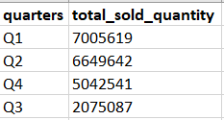
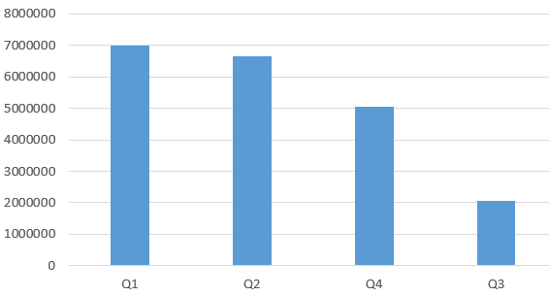
Request 8 : In which quarter of 2020, got the maximum total_sold_quantity? The final output contains these fields sorted by the total_sold_quantity, Quarter total_sold_quantity.

Slide 10
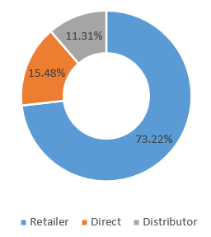
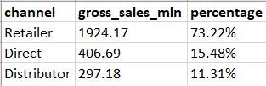
Request 9 : Which channel helped to bring more gross sales in the fiscal year 2021 and the percentage of contribution?-- The final output contains these fields, channel, gross_sales_mln, percentage.

Slide 11
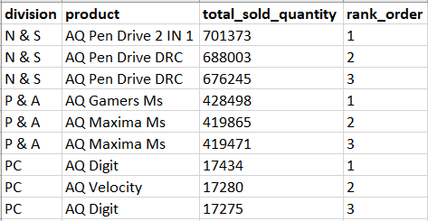
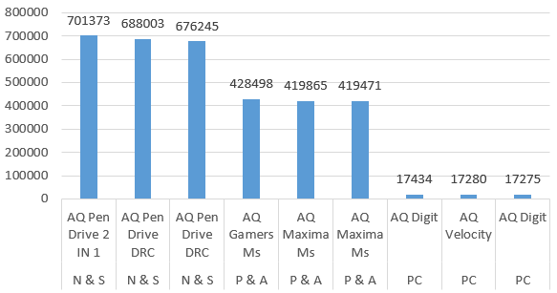
Request 10 : Get the Top 3 products in each division that have a high total_sold_quantity in the fiscal_year 2021? The final output contains these fields, division, product_code, product, total_sold_quantity, rank_order.

