Slide 1
TASK-2
Finding Vulnerabilities and loophole using Automatic Vulnerability Scanner on website

Slide 2
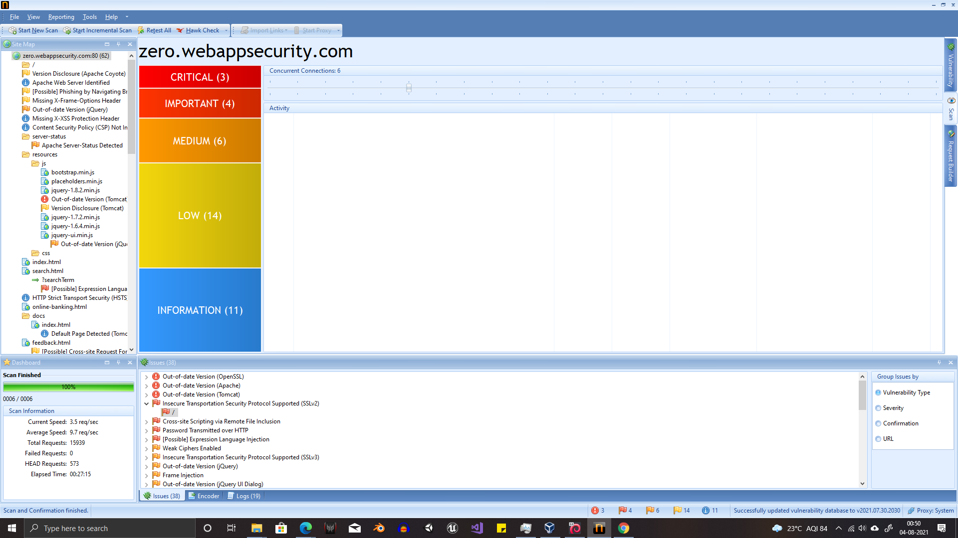
The ScreenShots of the Netsparker analysis are added.

Slide 3
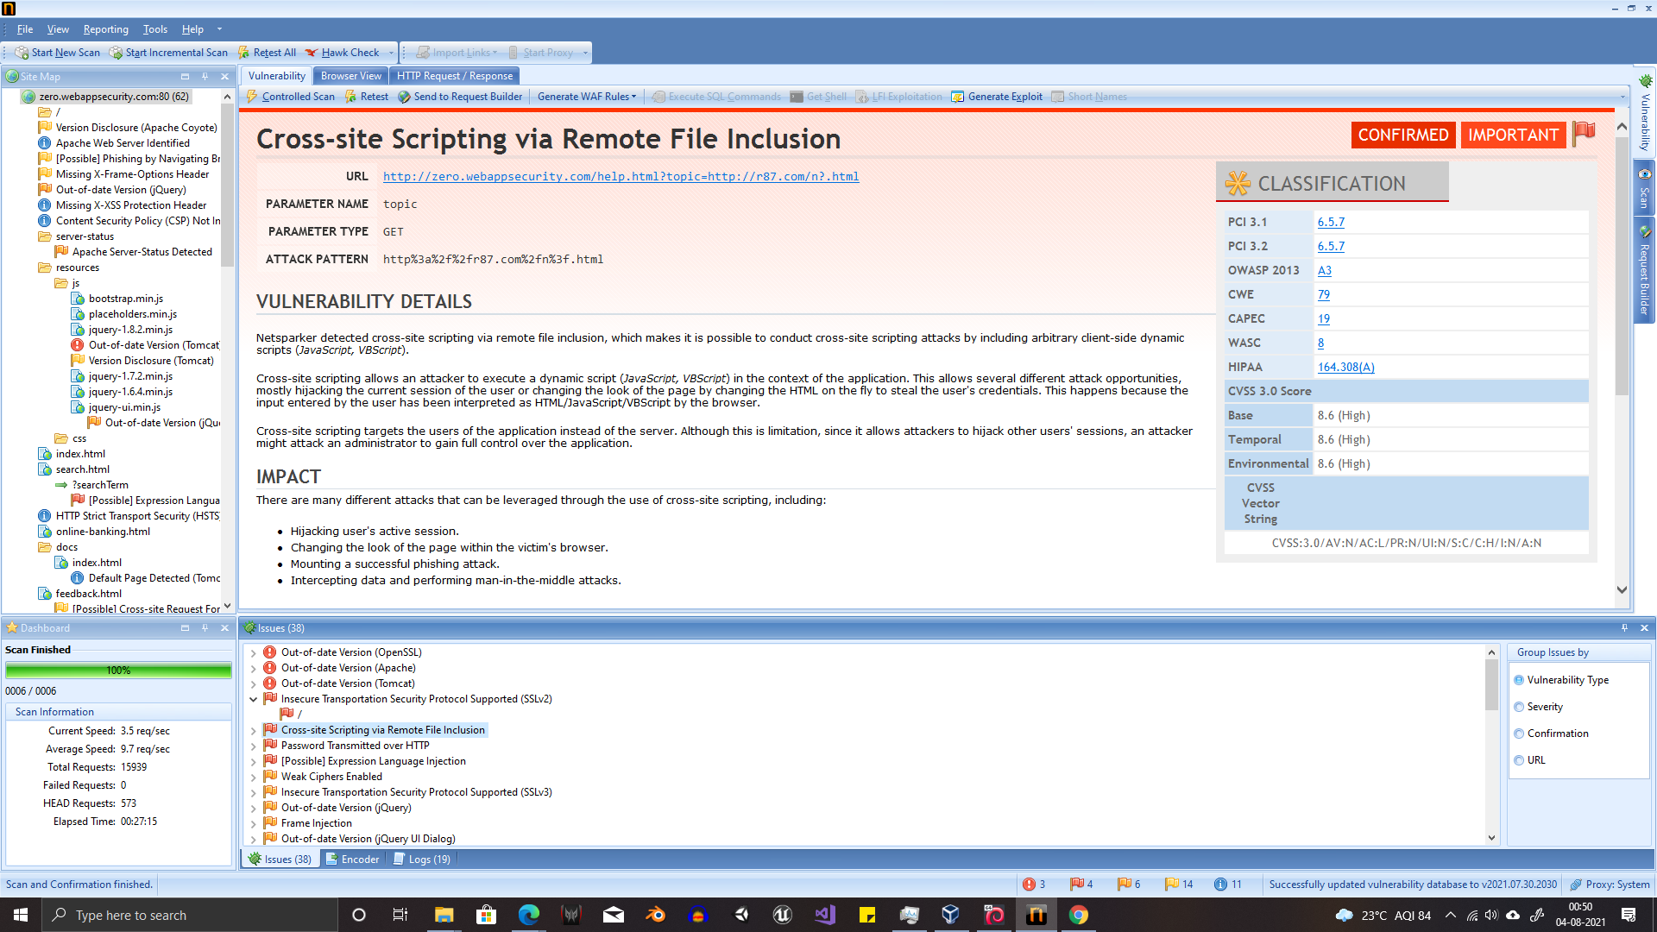

Slide 4
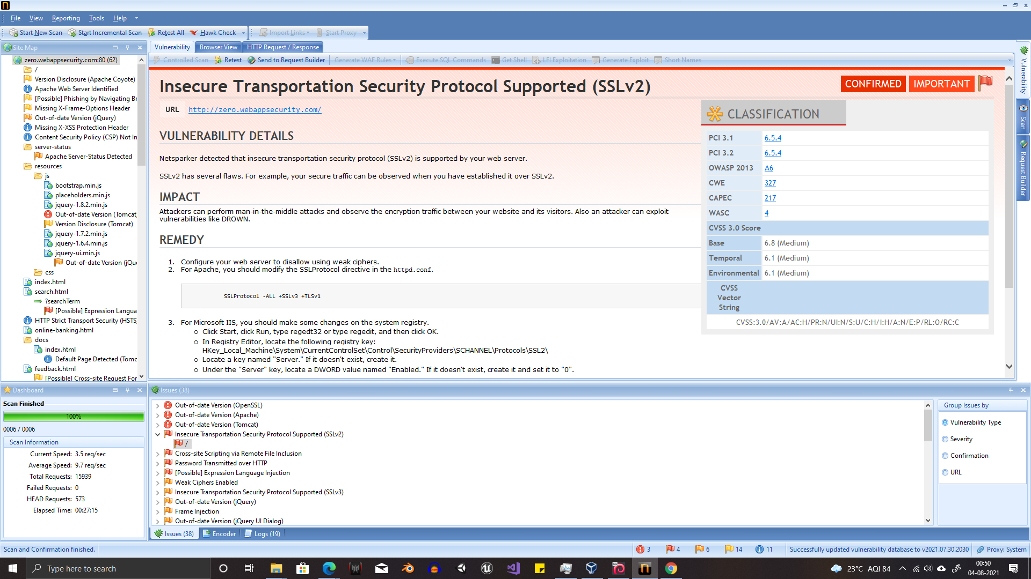

Slide 5
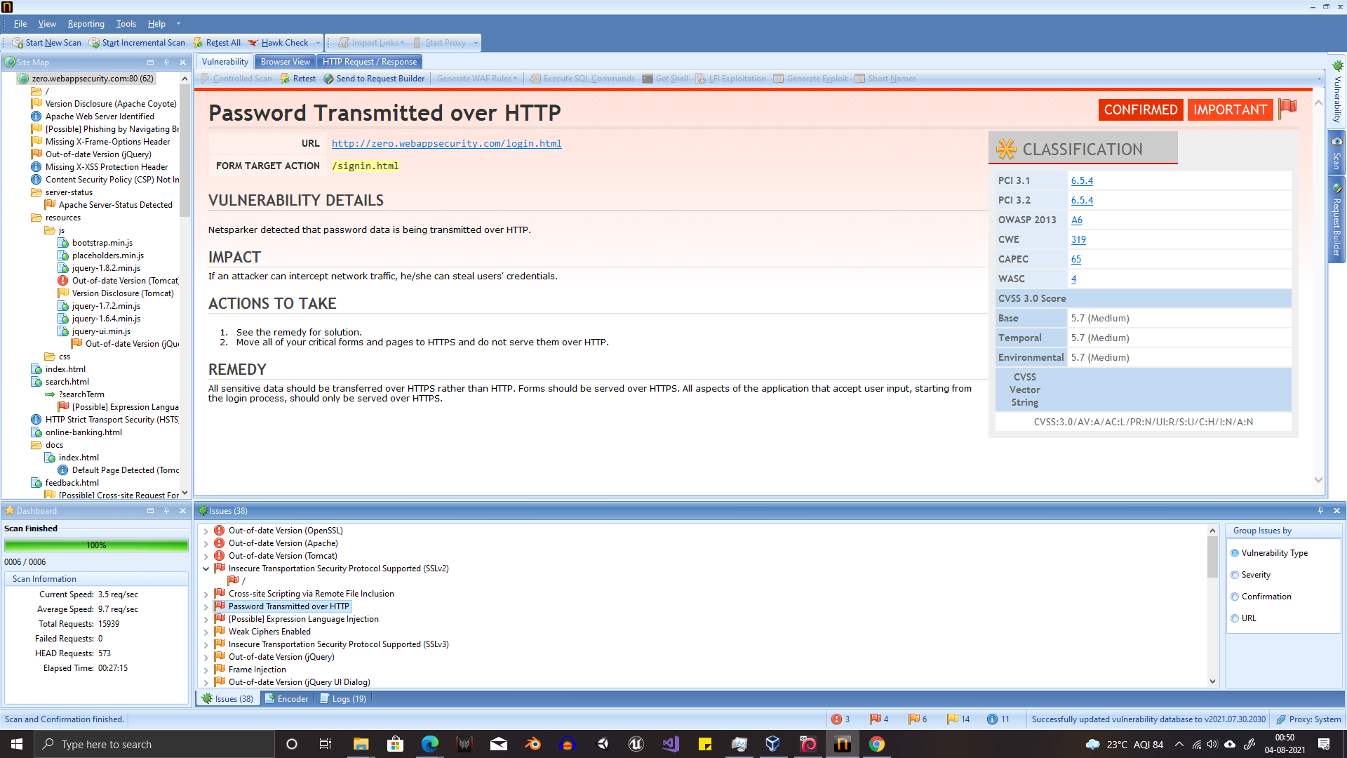

Slide 6
Causes for XSS
Data enters a Web application through an untrusted source, most frequently a web request.
The data is included in dynamic content that is sent to a web user without being validated for malicious content.
Impact
Cross site scripting attacks can have devastating consequences. Code injected into a vulnerable application can exfiltrate data or install malware on the user’s machine. Attackers can masquerade as authorized users via session cookies, allowing them to perform any action allowed by the user account.
XSS can also impact a business’s reputation. An attacker can deface a corporate website by altering its content, thereby damaging the company’s image or spreading misinformation. A hacker can also change the instructions given to users who visit the target website, misdirecting their behavior. This scenario is particularly dangerous if the target is a government website or provides vital resources in times of crisis.

Slide 7
Cross-site Scripting via Remote File Inclusion was discovered to be available on the aforementioned site, which should not be overlooked because this vulnerability allows a person to make changes to the site utilising dynamic scripts. This opens up the possibility of a wide range of attacks. A user can alter the site's design with dynamic scripts, they can create unwanted pop-ups or notifications, making the site less user-friendly, and they can leak cookies from browsers.
Site Name: Zero Bank’s Website
URL : http://zero.webappsecurity.com/
Impact: An attacker can easily obtain session details and change the website's appearance, as well as change the data going from the user to the server.
Solution:
Filter input on arrival. At the point where user input is received, filter as strictly as possible based on what is expected or valid input.
Encode data on output. At the point where user-controllable data is output in HTTP responses, encode the output to prevent it from being interpreted as active content. Depending on the output context, this might require applying combinations of HTML, URL, JavaScript, and CSS encoding
Report

