Slide 1
Identifying Influentials in a Social Network: Performance of Procedures and Prediction of Resource Usage
Ankith Mohan

Slide 2
Problem Statement
For a given social network:
Apply the procedures given by Cole and Weiss to find influentials
Apply preprocessing techniques to check the changes in the performances of procedures
Predict the time and memory required to find the influentials based on its network properties.

Slide 3
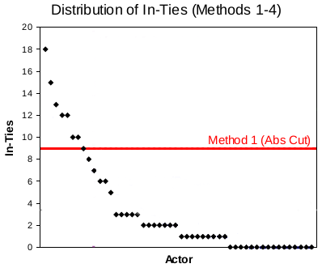
Cole and Weiss Procedures

Slide 4
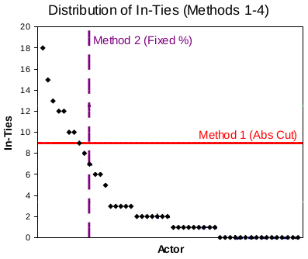
Cole and Weiss Procedures

Slide 5
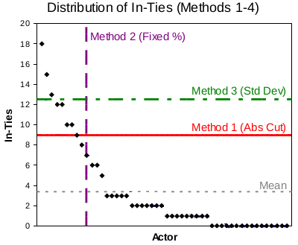
Cole and Weiss Procedures

Slide 6
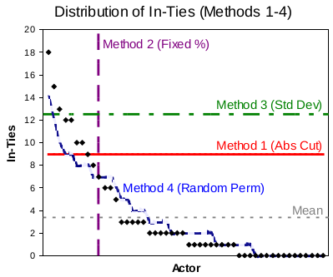
Cole and Weiss Procedures

Slide 7
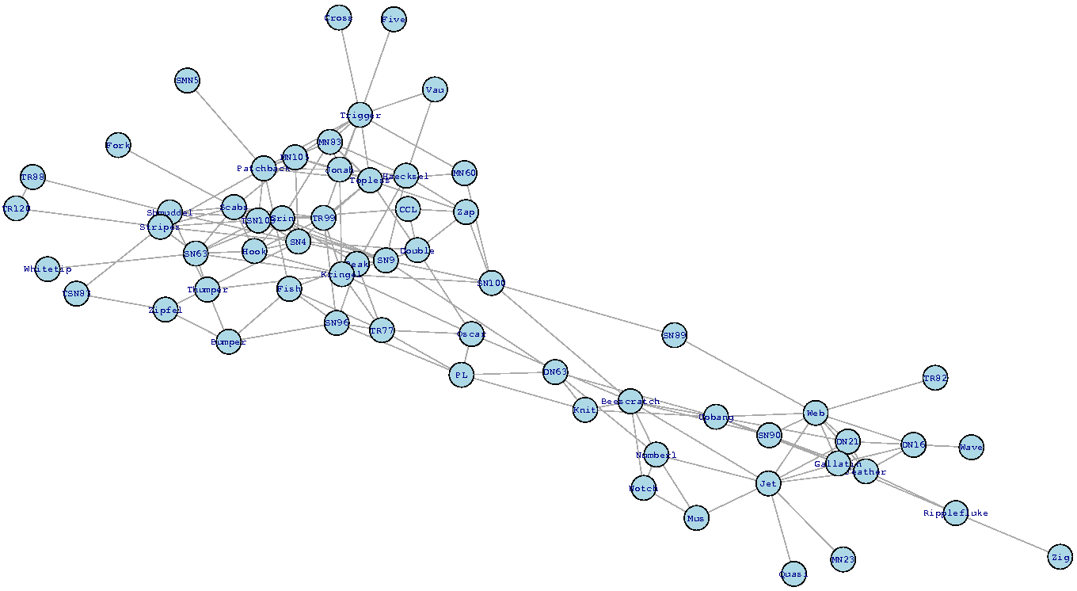
Cluster Analysis

Slide 8
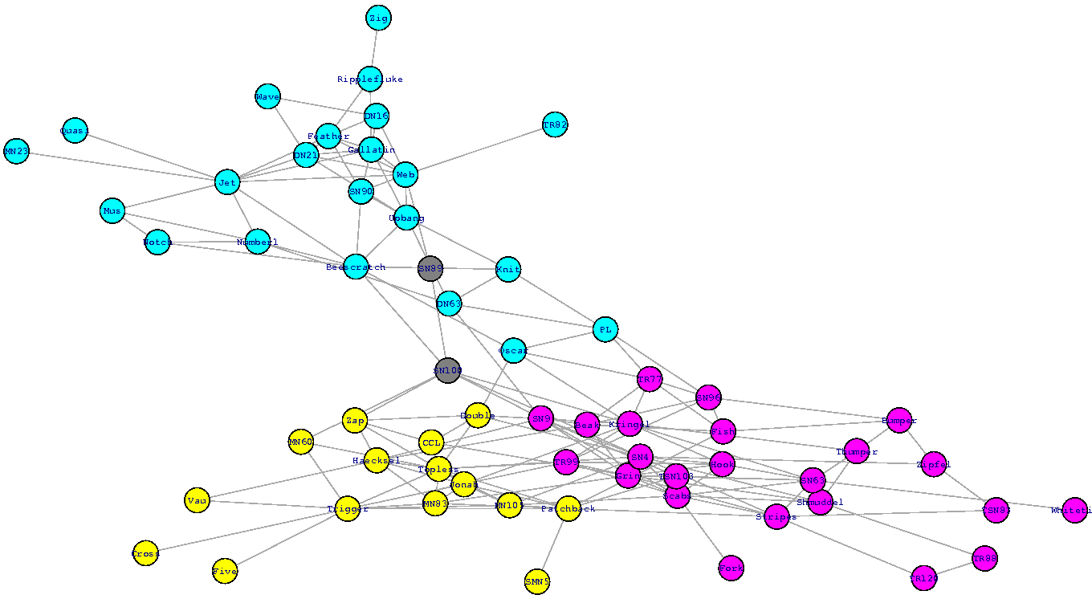
Cluster Analysis

Slide 9
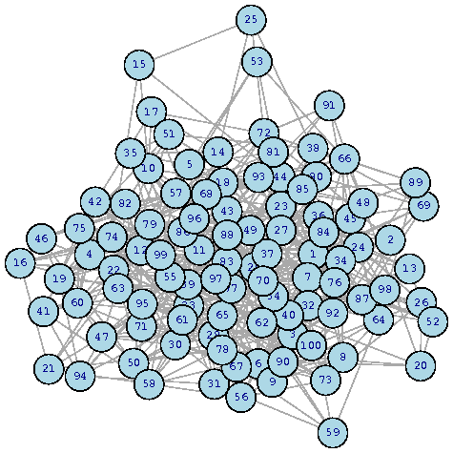
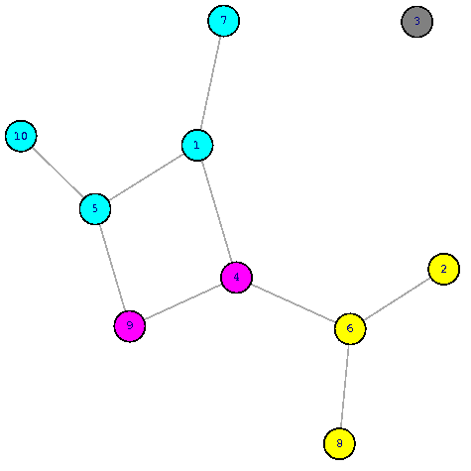
Sampling
10%

Slide 10
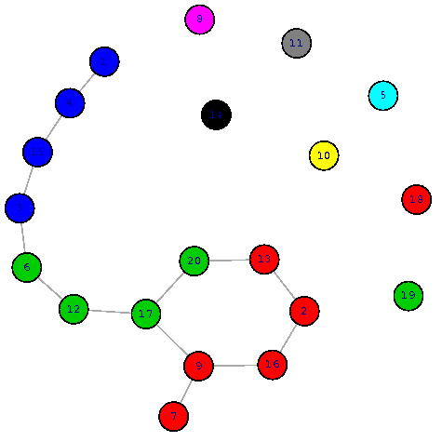
Sampling
10%
20%

Slide 11
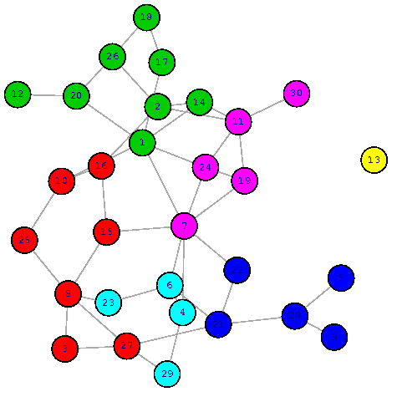
Sampling
10%
20%
30%

Slide 12
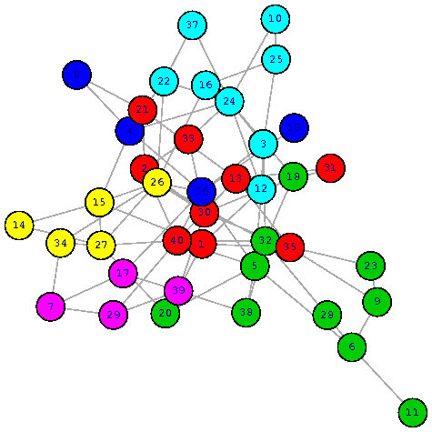
Sampling
10%
20%
30%
40%

Slide 13
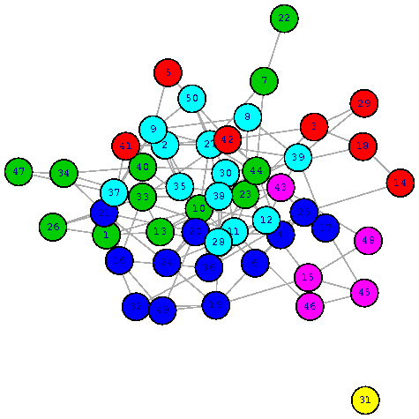
Sampling
10%
20%
30%
40%
50%

Slide 14
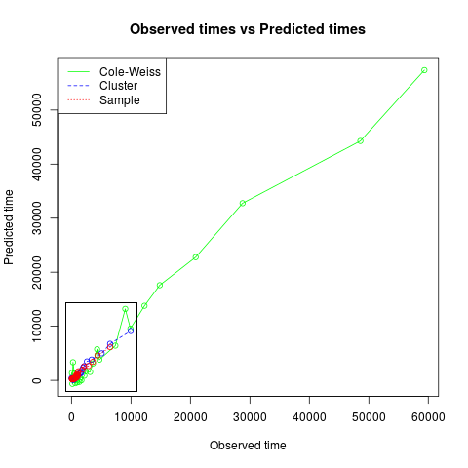
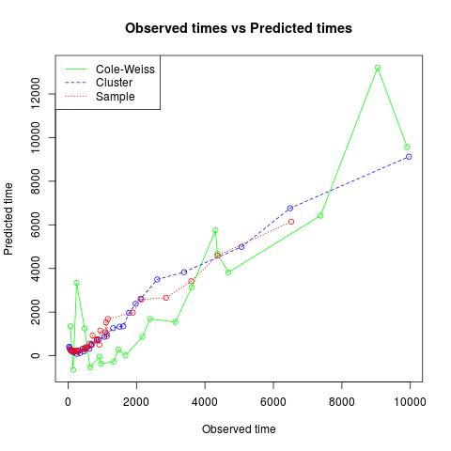
Performance

Slide 15
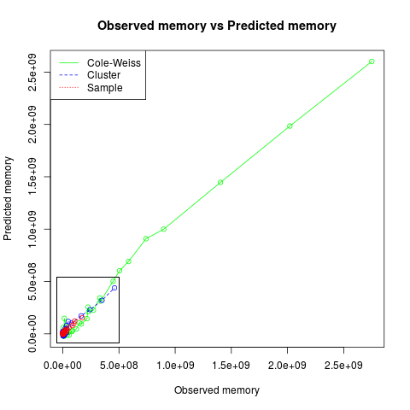
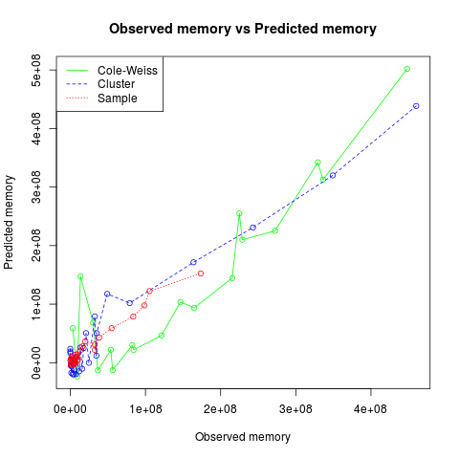
Performance

