Slide 1

FLIGHT STATUS ANALYSIS
By- Ankitha Kundal

Slide 2
INTRODUCTION:
This project focuses on analyzing airline data to gain insights into flight statuses and patterns.
The dataset contains information from various airlines, and the goal is to perform a comprehensive analysis of flight status, including on-time, delayed, and canceled flights, as well as the average delay time. Additionally, we aim to uncover valuable information about the best times to book flights and peak flight hours.

Slide 3
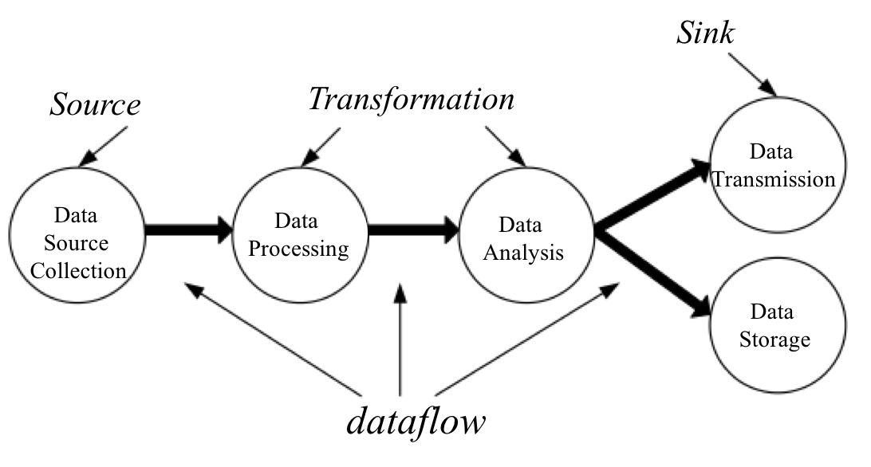
WORK FLOW:
Data collection: Gathering data from different relevant resources.
Data cleaning: Removing errors, inconsistencies, missing values.
Data preparation: Preparing data in a format suitable for analysis.
Data transformation: Loaded into power query.
Dashboard design and development: Using power BI.

Slide 4
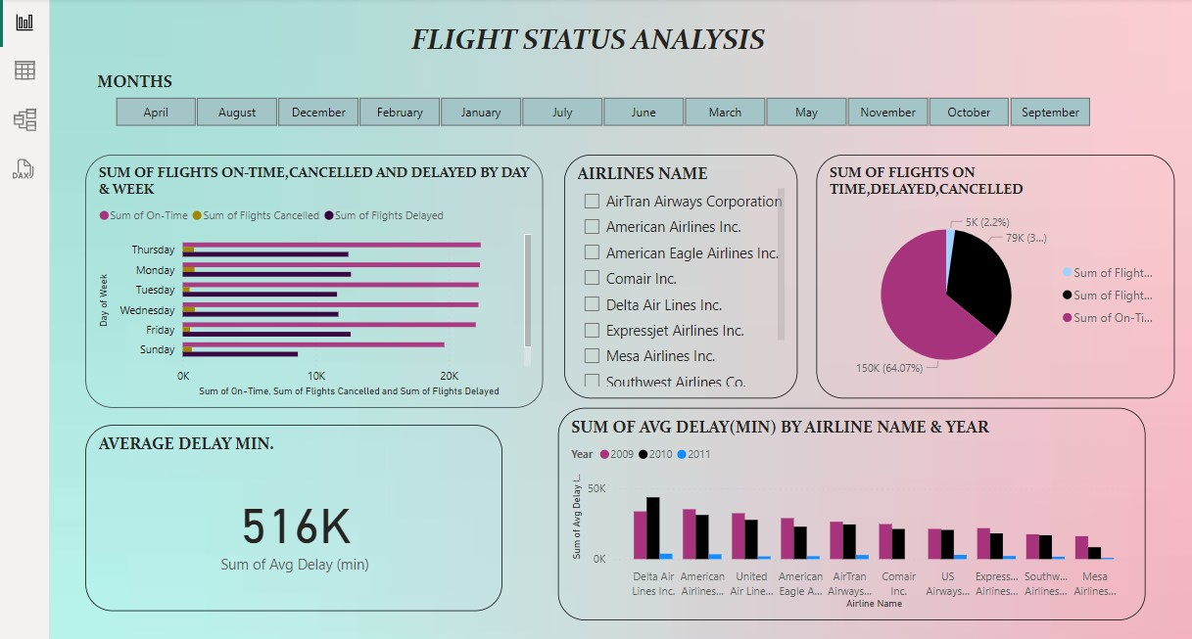

Slide 5
BENEFITS:
Trends for weekend travelers and weekday travelers.
Examine the insights on flights, passengers, fuel and revenue over time.
Provide strategic airport viewpoints.
Helps passengers for better travel planning.
Easy to use and understand.

Slide 6

FUTURE SCOPE:
In future we can publish the report to the web version of PowerBI and accessing the dashboard as the mobile application.
Leveraging Power BI for flight status analysis offers a powerful solution for understanding, optimizing, and improving flight operations.
As technology and data continue to evolve, Power BI remains a versatile and indispensable tool for driving innovation and excellence in flight status analysis.

Slide 7
THANK YOU

