Slide 1
VIDYA JYOTHI INSTITUTE OF TECHNOLOGY (Autonomous)
Skin Disease Detection Using Machine Learning
Under the guidance of:
DR. Mohamed Nazeer Sir
By :
R.Ankitha-22911A7250
Department of Artificial Intelligence & Data Science

Slide 2
Problem Statement
Develop a machine learning model to accurately detect and classify various skin diseases from images.
Department of Artificial Intelligence & Data Science

Slide 3
Abstract
Skin diseases affect millions of people worldwide, leading to significant healthcare costs and impacting quality of life. Early detection and accurate diagnosis are crucial for effective treatment and management. Traditional diagnostic methods often require expert dermatologists, which can be time-consuming and inaccessible to many. Machine learning offers a promising solution by automating the detection process, providing faster and potentially more accurate diagnoses.
Department of Artificial Intelligence & Data Science

Slide 4
Literature Survey
S. No. | Title | Methodology | Metrics | Limitations
1 | Automated Skin Disease Diagnosis Using Deep Learning | Utilized Convolutional Neural Networks (CNNs) trained on over 129,450 clinical images of skin diseases. | Accuracy, Sensitivity, Specificity | High computational cost, potential for overfitting, limited generalizability due to dataset biases
2 | Dermatologist-level Classification of Skin Cancer with Deep Neural Networks | Trained a deep neural network on a large dataset of dermoscopic images, achieving performance on par with dermatologists. | ROC AUC, Sensitivity, Specificity | Requires large, high-quality labeled datasets, potential ethical issues regarding AI deployment in clinical settings
3 | Mobile Application for Skin Disease Detection Using Transfer Learning | Implemented transfer learning using pre-trained CNN models (e.g., VGG16, ResNet50) on a smaller dataset of skin disease images. | Accuracy, F1-score | Limited dataset size, dependency on quality and diversity of training data, potential for model bias
4 | Automated Melanoma Recognition in Dermoscopy Images via Very Deep Residual Networks | Used very deep residual networks (ResNets) for melanoma recognition in dermoscopic images. | Sensitivity, Specificity, ROC AUC | High computational requirements, potential issues with dataset imbalance, need for large annotated datasets

Slide 5
Literature Survey - Base paper
Paper 1: Automated Skin Disease Diagnosis Using Deep Learning
Authors: Esteva et al,Brett Kuprel, Roberto A. Novoa, Justin Ko, Susan M. Swetter, Helen M. Blau, Sebastian Thrun
Published by & Year: It was published in the journal Nature in the year (2017)
About paper
The primary goal of the study was to develop a deep learning algorithm capable of classifying skin cancer with performance comparable to that of dermatologists. The focus was on accurately detecting and differentiating between benign and malignant skin lesions using convolutional neural networks (CNNs).This can improve patient outcomes by enabling early detection and treatment, especially in regions with limited access to dermatologists. The research has paved the way for further studies and applications of AI in medical diagnostics.
Department of Artificial Intelligence & Data Science

Slide 6
Literature Survey - Base paper
Paper 2: Dermatologist-level Classification of Skin Cancer with Deep Neural Networks
Authors: Haenssle et al.
Published by & Year: Annals of Oncology, 2018
About paper
The aim of this study was to assess the ability of deep neural networks (DNNs) to classify skin cancer at a level comparable to experienced dermatologists. The research focused on differentiating between benign and malignant skin lesions using dermoscopic images.This study demonstrated that deep neural networks could potentially assist dermatologists in diagnosing skin cancer with high accuracy. By achieving performance comparable to that of human experts, these models can aid in early detection and treatment, particularly in areas with limited access to dermatological care. The research highlights the promise of AI in enhancing medical diagnostics and paves the way for further advancements in the integration of AI technologies in healthcare.
Department of Artificial Intelligence & Data Science

Slide 7
Literature Survey - Base paper
Paper 3: Mobile Application for Skin Disease Detection Using Transfer Learning
Authors: Pham et al.
Published by & Year: Journal of Medical Systems, 2020
The primary goal of this study was to develop a mobile application capable of detecting skin diseases using transfer learning. The application aimed to provide an accessible tool for early diagnosis, especially in regions with limited access to dermatologists.It represents a significant step toward making dermatological diagnostics more accessible. By leveraging pre-trained models and fine-tuning them for specific tasks, the study demonstrated how AI can be effectively utilized in mobile health applications. This approach can potentially improve early diagnosis and treatment, particularly in underserved regions with limited access to dermatological care. The success of this project highlights the potential of integrating AI technologies into mobile platforms to enhance healthcare delivery.
Department of Artificial Intelligence & Data Science

Slide 8
Literature Survey - Base paper
Paper 4: Automated Melanoma Recognition in Dermoscopy Images via Very Deep Residual Networks
Authors: Nasr-Esfahani et al.
Published by & Year: IEEE Transactions on Medical Imaging, 2016
The objective of this study was to develop a system for automated melanoma recognition in dermoscopy images using very deep residual networks (ResNets). The focus was on achieving high accuracy and reliability in distinguishing between melanoma and benign lesions.By achieving high accuracy and reliability in identifying melanoma lesions, the study paved the way for more advanced AI systems in dermatology. These systems have the potential to assist dermatologists in making quicker and more accurate diagnoses, leading to improved patient outcomes and healthcare efficiency. The study contributed to advancing the field of medical imaging and highlighted the promise of deep learning in addressing complex healthcare challenges.
Department of Artificial Intelligence & Data Science

Slide 9
Existing Systems
DermExpert, SkinVision, HAM10000 Dataset and Models, Skin Disease Classification using CNNs, ISIC Archive and Challenges. These existing systems and approaches leverage machine learning techniques to automate and improve the accuracy of skin disease detection, aiding dermatologists in making timely and informed decisions about patient care. Each system varies in its specific features, dataset usage, and intended impact, contributing to advancements in medical imaging and healthcare delivery.
Department of Artificial Intelligence & Data Science

Slide 10
Limitations
Here are some potential limitations for systems focused on skin disease detection using machine learning:
Dataset Bias and Diversity
Interpretability of Results
Data Privacy and Security
Performance in Real-time Applications
Ethical and Legal Considerations
Integration with Clinical Workflow:
Department of Artificial Intelligence & Data Science

Slide 11
Proposed System / Innovation
Proposed System: AI-Driven Skin Disease Diagnosis System
Overview:
Our proect proposed system aims to leverage machine learning techniques, particularly deep learning algorithms, to enhance the accuracy and efficiency of skin disease diagnosis. It targets both healthcare professionals and individuals seeking preliminary assessments of skin conditions.
The proposed AI-driven skin disease diagnosis system represents a significant advancement in dermatological care, leveraging machine learning to enhance diagnostic capabilities and improve patient outcomes. By integrating state-of-the-art technology with clinical expertise, the system aims to set new standards in dermatological diagnostics, supporting both healthcare providers and patients in the early detection and management of skin diseases.
Department of Artificial Intelligence & Data Science

Slide 12
Modules
In developing a system for "Skin Disease Detection Using Machine Learning," the modules typically include various components that work together to achieve the overall goal of automated skin disease diagnosis.
Image Acquisition and Preprocessing • Feature Extraction
Machine Learning Model Training. • Model Evaluation and Validation
Integration with User Interface. • Deployment and Integration
Feedback and Improvement. • Privacy and Security
The each module plays a crucial role in developing a robust and effective system for skin disease detection using machine learning. The integration of these modules ensures that the system can provide accurate, reliable, and accessible diagnostic support for dermatological conditions.
Department of Artificial Intelligence & Data Science

Slide 13
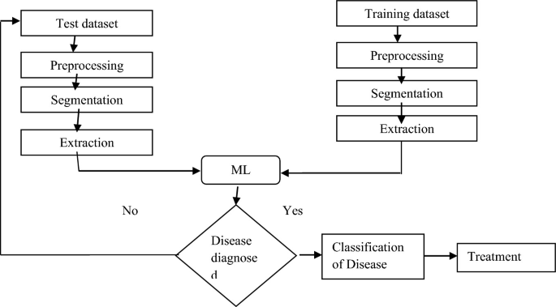
Block diagram
Department of Artificial Intelligence & Data Science

Slide 14
VIDYA JYOTHI INSTITUTE OF TECHNOLOGY (Autonomous)
THANK YOU
Department of Artificial Intelligence & Data Science

