Slide 1

AMCAT data - An Exploratory Data Analysis

Slide 2
About me
Hi there! I’m Ankitha Potu [IN1240206], a 23-year-old data enthusiast. Sure, I might be fresh, but I'm your one-stop shop for unlocking insights from numbers.
Feel free to reach out! I'm always down to connect with you all. ☺
https://github.com/Ankitha26/Ankitha26

Slide 3
Objective
To find the insights and decode the patterns on how the salary pay scale is impacted based on various parameters like academic achievements, AMCAT scores, Age, Years of Work Experiences etc..

Slide 4
Summary of the Dataset
There are total of 38 columns that are used to find their individual impacts on salary.
With 4000 data points that make our analysis to the optimal insights with all the required information.

Slide 5
DATA CLEANING AND MANIPULATION:
We can see the DOJ,DOL,DOB are given in timestamp format
Job city column contains -1 values which are NaN equivalents.
10 board column contain 0 value which is missing value
12 board column contain 0 value which is missing value
college state column contain 'union teritory' which is not a specific state
Graduation year column contain 0 which is a missing value
Domain column contain -1 which is a missing values

Slide 6
Univariate Analysis

Slide 7
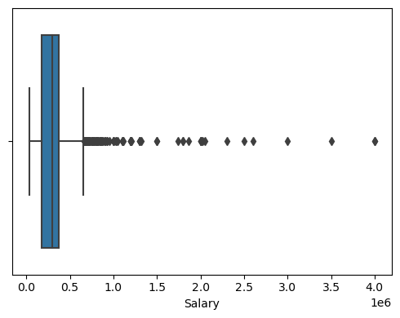
The Average of Salary: 300000.0 The Maximum of Salary: 4000000 The Minimum of Salary: 35000
Salary:
Box plot: There are so many data points with high salaries
Getty Images

Slide 8
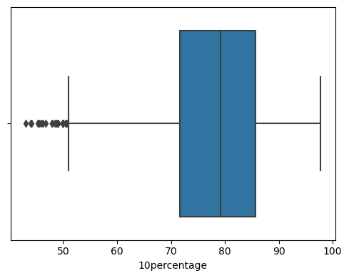
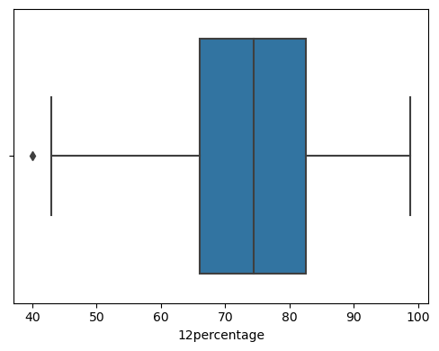
The Average of 10percentage: 79.15
The Maximum of 10percentage: 97.76
The Minimum of 10percentage: 43.0
Observation
Box plot: There are some outliers evident from the plot.
The Average of 12percentage: 74.4
The Maximum of 12percentage: 98.7
Observation
Box plot: There is only one data point has extreme low score.The Minimum of 12percentage: 40.0

Slide 9
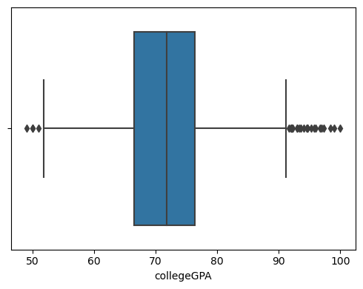
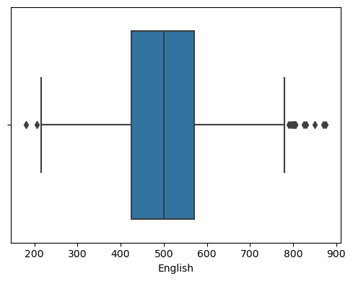
Observation
Box plot: we can see that outliers with in the dataset.
Observation
Box plot: Both lower and higher extreme values are evident from the distribution representation.

Slide 10
BI-Variate Analysis

Slide 11
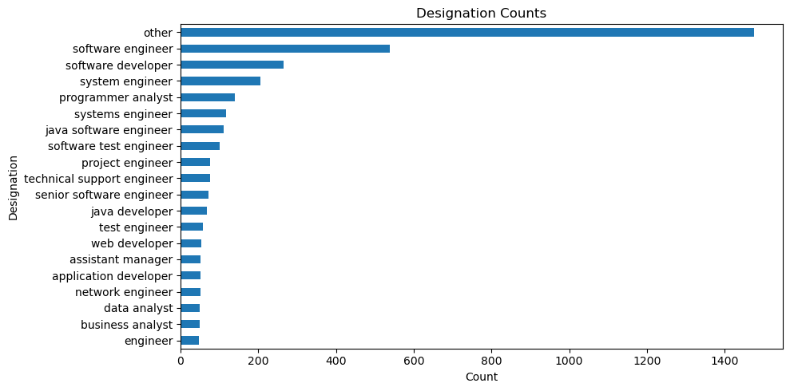
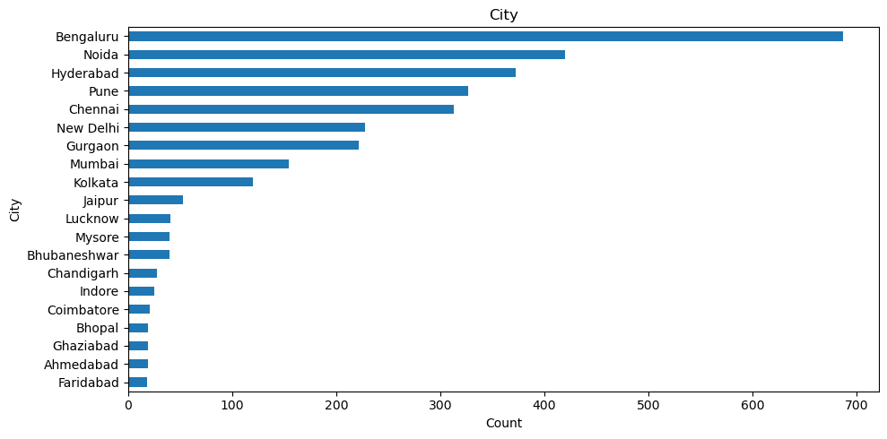
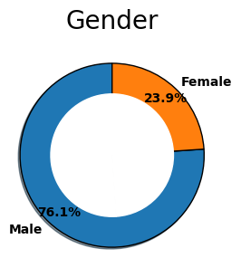
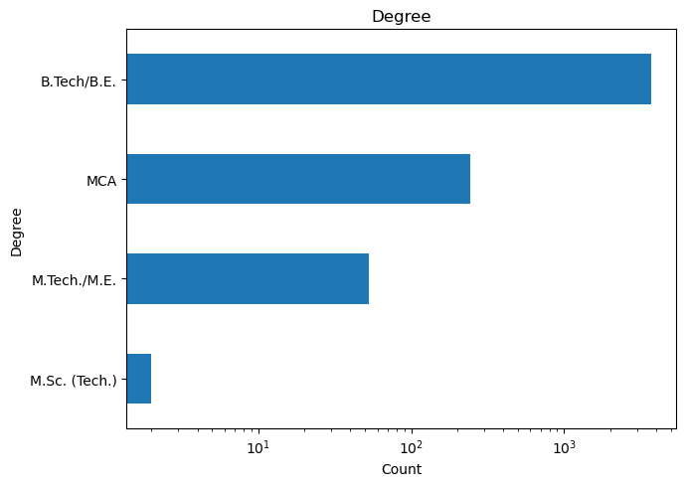
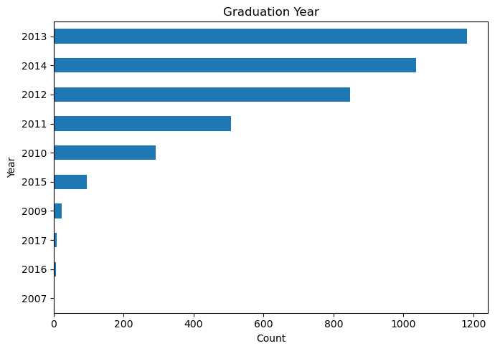
Designation:
Software engineers is the most common designation of all followed by system engineer and software developer
CITY:
The most favourite city for job placements is Banglore,followed by Nodia,Hyderabad,Pune and Mumbai and Kolkata being least favourable
Graduation Year:
Maximum Number of students were graduated in 2013,followed by the 2014 and 2012
Degree:
Most of the students done their graduation in B.Tech and there are very less students from M.sc(tech)
Gender:
The data set is not balanced in terms of gender

Slide 12
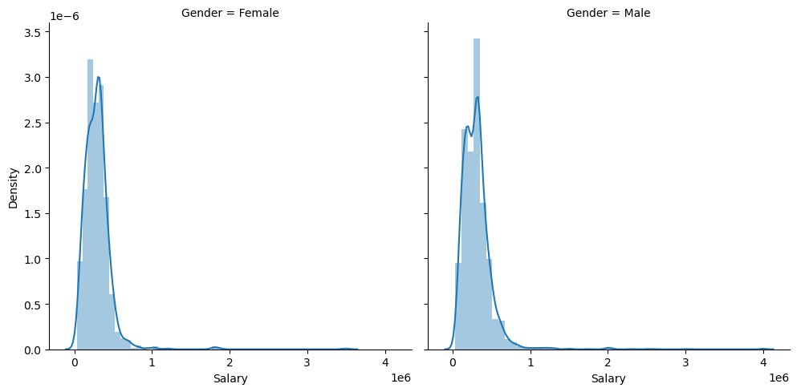
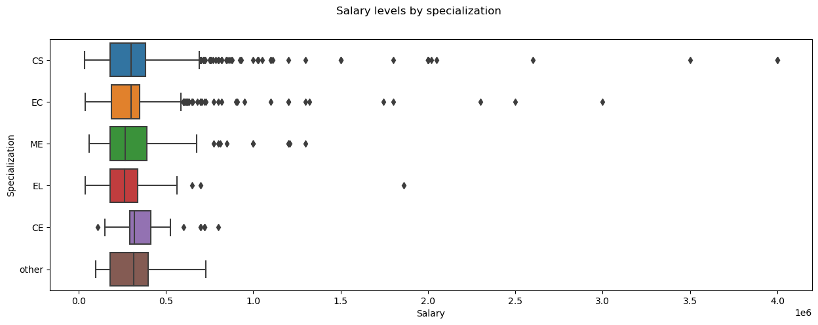
Observations:
We can observe that the salary data is right skewed.
n also see that the distributions are quite similar for male and female in the range below 10lakhs.
Observations:
Median salary of people from all specializations are nearly similar.
We can see there are more people getting higher pays who have specialization in CS/EC compared to others.

Slide 13
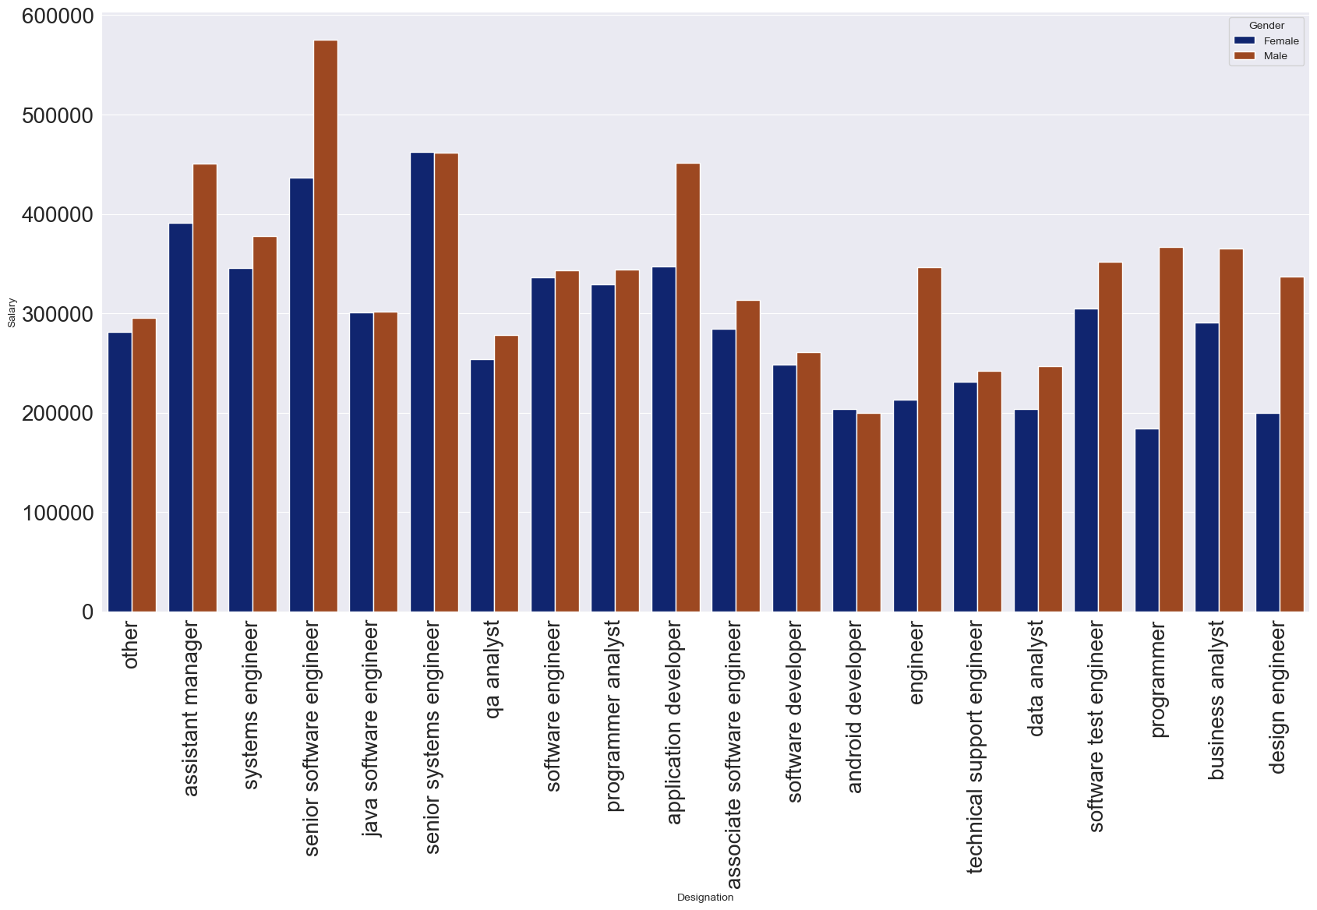
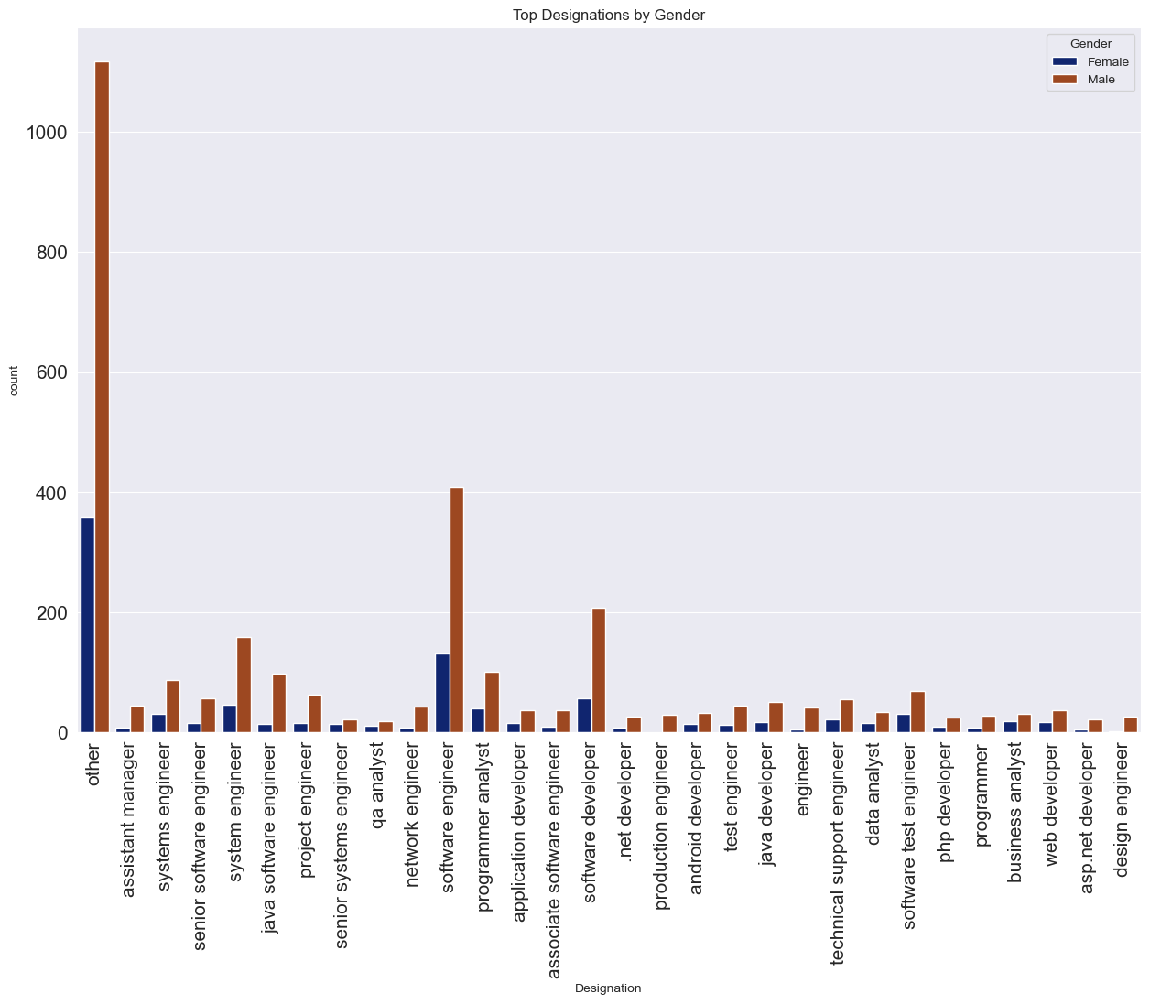
Observation for Designation,Salary and Gender:
1.In all domains men category dominates the women category
Senior software engineer has highest paying and least paid in web developer in male category.
2.For Test Engineer role female Category pay higher the male.
3.For System Engineer role both categories paid similar.
4.Among these top Designations the most data points are in Software Engineering.
5.In all designations male category dominates female.

Slide 14
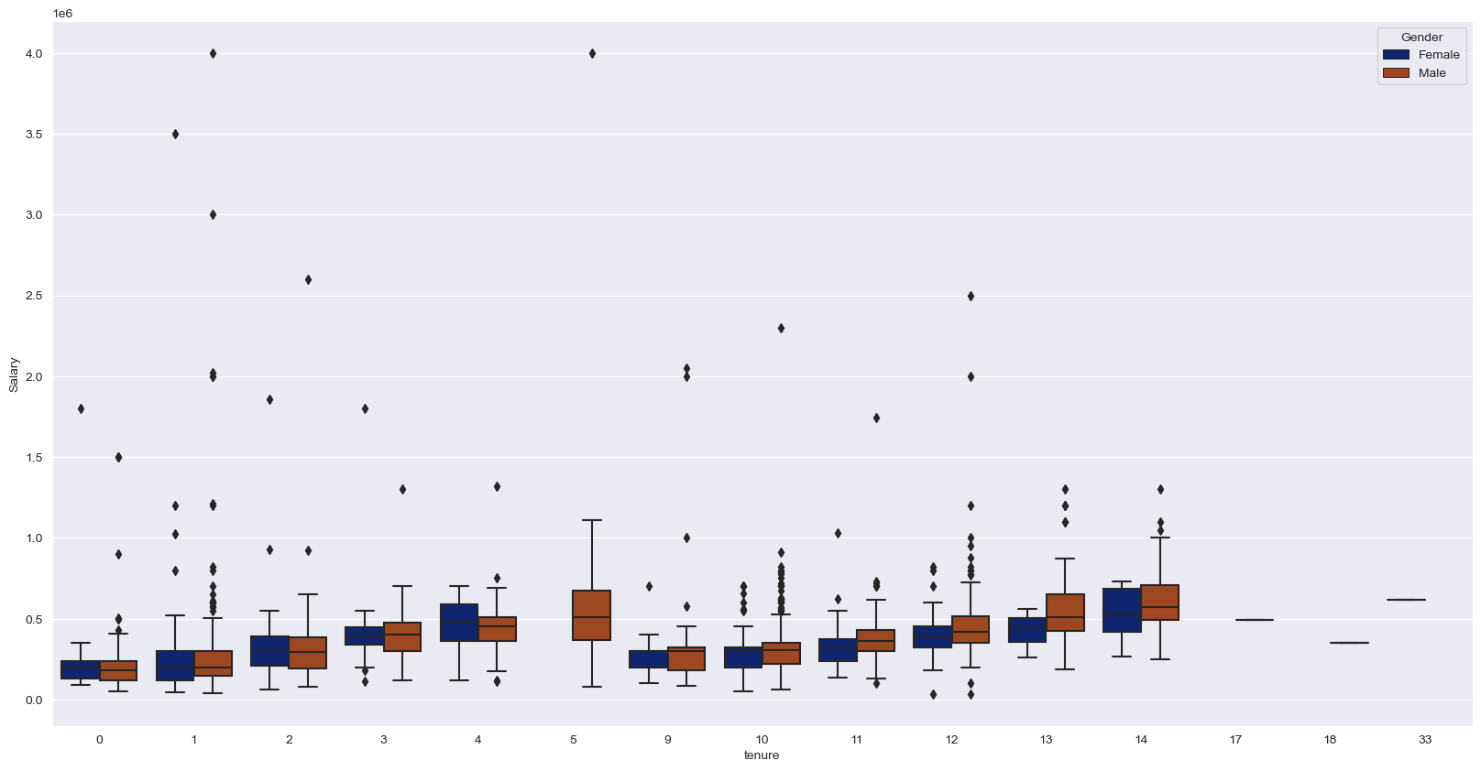
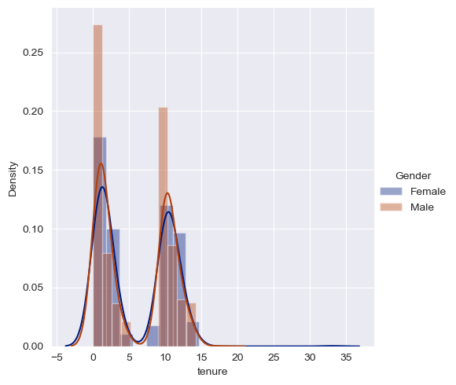
Observation for Gender ,Salary and Tenure
1.It is a Bi-Modal Distribution.
2.Average Experience of male is around 5years and for women it is around 4 and half years.
3.Median salary of both males and females have increased slightly with exp for first five years and Decreased suddenly on the 6th year and then same pattern for the following years.
4.We can see that men and women having same experience are paid nearly equally around 3.5-5 lakhs.

Slide 15
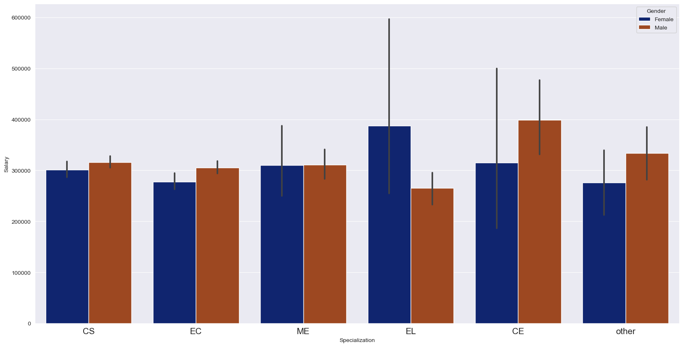
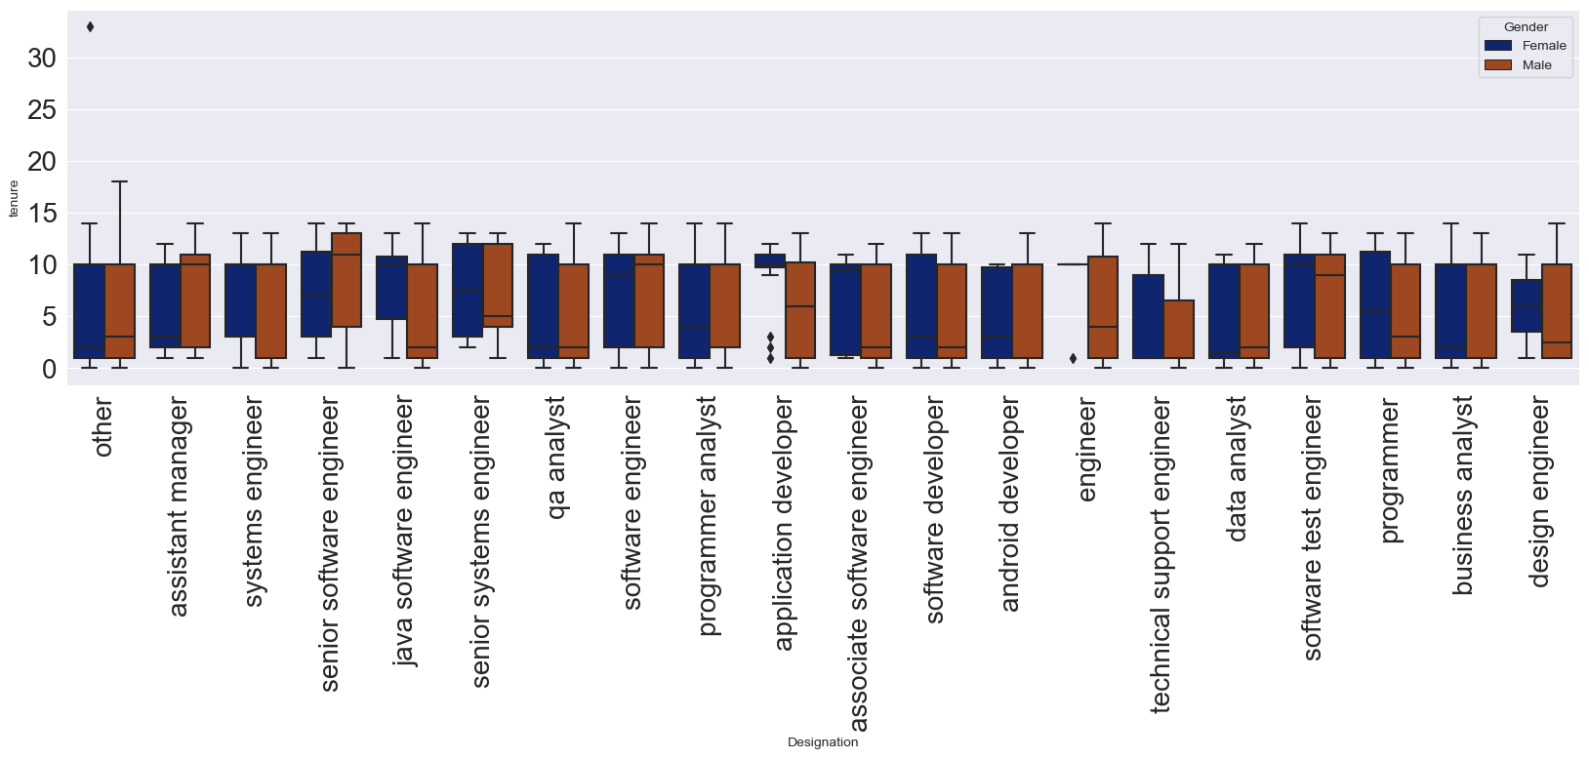
Observation
The tenure distribution for maximum number of Designations is skewed and this tells us every designation have people with both high and low experience
We can see there is difference in median experience of male and female in every designation.
But it is not a strong evidence to conclude salary difference for women is due to experience because of the fact that in some roles even women having higher experience are paid less and viceversa for men.
Observation
Men from CS,EC,CE Earn slightly greater than women from this specialization.
Women from the EL specialization Earns way more than men from same specialization.

Slide 16
Conclusion:
1.Most of Amcat Aspirants are male working in IT domain with an experience of around 5years with degree in B.tech and specialization in Computer Science/Information Technology from tier-2 college in Uttar Pradesh with an average salary around 300k.
2.Highpaying jobs taken up by Amcat aspirants are mostly from 'IT' Domain. 3.Software Engineer and Software Developer are the most aimed profession for Amcat aspirants.

Slide 17

THANK YOU

