Slide 1

Malnad College of Engineering,Hassan-573202
Department of Computer Science and Engineering
Real time sign language to text conversion with emergency assistance

Slide 2
Dr. Keerthi Kumar H M
Department of Computer Science and Engineering
Malnad College of Engineering
Hassan, India
hmk@mcehassan.ac.in
Ankitha K N
Department of Computer Science and Engineering
Malnad College of Engineering
Hassan, India
knankitha73@gmail.com
Ashwini D M
Department of Computer Science and Engineering
Malnad College of Engineering
Hassan, India
dmashwini40@gmail.com
Preksha H S
Department of Computer Science and Engineering
Malnad College of Engineering
Hassan, India
prekshahs03@gmail.com
Vikas B
Department of Computer Science and Engineering
Malnad College of Engineering
Hassan, India
vikasb.kadlaji.24@gmai.com

Slide 3
Agenda
Abstract
Objectives
Introduction
Challenges
Methodology
Datasets & Evaluation
Conclusion

Slide 4
Abstract
The paper surveys recent advances in real-time Indian Sign Language (ISL) systems that convert hand gestures to text, add transformer-based NLP for fluent sentence generation, and incorporate emergency-gesture detection that can trigger instant SMS alerts. It highlights BiLSTM/MediaPipe pipelines exceeding 98 % recognition accuracy, T5-based language modules reaching BLEU 0.81, and YOLOv5-driven emergency detectors achieving mAP up to 99.6 %, while noting persistent gaps such as signer variability, limited public datasets, and the scarcity of fully integrated, hardware-efficient solutions.

Slide 5
Objective
To review recent advancements in real-time Indian Sign Language (ISL) to text conversion systems.
To analyze various deep learning models (e.g., BiLSTM, GRU, CNN, YOLOv5) used for gesture recognition and emergency detection.
To highlight the role of Natural Language Processing (NLP), especially transformer models like T5, in generating grammatically accurate sentences from recognized gestures.
To evaluate the integration of emergency alert systems such as Fast2SMS with ISL recognition frameworks.
To identify existing challenges such as signer variability, dataset limitations, and the lack of end-to-end real-time systems.
To suggest future directions for building robust, inclusive, and scalable ISL recognition and emergency assistance technologies.

Slide 6
Introduction
Indian Sign Language (ISL) is a vital communication medium for the deaf and hard-of-hearing community in India.
Real-time ISL to text conversion systems bridge communication gaps and enhance accessibility.
Recent advancements leverage deep learning and computer vision techniques for accurate gesture recognition.
Integration of emergency detection and alert systems increases the practical utility of ISL recognition technologies.
Despite progress, challenges remain in creating fully automated, real-time, and user-adaptive systems.

Slide 7
Challenges
Signer Variability: Many models trained on small datasets (e.g., Rashmi & Lalita [2], Kothadiya et al. [14]) show reduced accuracy when tested on unseen users with different signing styles or hand shapes.
Dataset Gaps: Studies like Adithya & Rajesh [13] and Padmaja et al. [10] use small or domain-specific datasets that lack diversity, continuous sentence gestures, or emergency scenarios.
Real-Time Constraints: Systems using BiLSTM or YOLOv5 (e.g., Aradhana et al. [1], Qazi et al. [4]) face challenges running efficiently on mid-range hardware with low latency.
Pipeline Fragmentation: Some works (e.g., Aradhana et al. [1] for recognition, Rashmi & Lalita [2] for NLP, Shreya et al. [3] for emergency alerts) focus on isolated components, lacking end-to-end integration.
Weak NLP Integration: Few studies (notably Rashmi & Lalita [2]) incorporate advanced sentence prediction; others rely on word-level outputs, limiting contextual fluency.
Emergency System Limits: Alerting systems (Shreya et al. [3], Areeb & Nadeem [5]) depend on SMS APIs like Fast2SMS, which may fail under weak network conditions and have minimal real-world deployment testing.
Environment Sensitivity: Works like Buckley et al. [9] and Areeb & Nadeem [5] report significant accuracy drops due to poor lighting, cluttered backgrounds, or partial occlusion.
Privacy & Ethics: Continuous video recording raises concerns over user privacy and data handling—rarely discussed in the reviewed papers but critical for real-world adoption.

Slide 8
Methodology
Data Acquisition:
Collection of ISL gesture datasets using cameras and sensors.
Preprocessing:
Image and video frame normalization, noise reduction, and hand region segmentation.
Feature Extraction:
Use of convolutional neural networks (CNNs) and pose estimation models to extract hand and finger movement features.
Modeling:
Implementation of deep learning models such as BiLSTM, GRU, CNN, and YOLOv5 for gesture recognition.
Sentence Generation:
Application of Natural Language Processing (NLP) transformer models (e.g., T5) to convert recognized gestures into grammatically accurate text.
Emergency Alert Integration:
Linking recognized emergency gestures with SMS-based alert systems like Fast2SMS for real-time notifications.
Evaluation:
Performance testing using accuracy, precision, recall, and F1-score metrics on benchmark datasets.

Slide 9
BLOCK DIAGRAM
ISL Gesture Input
◄── (MediaPipe, CNN, Pose Estimation)
Preprocessing
◄── (Frame extraction, normalization)
Feature Extraction
◄── (MediaPipe, CNN, Pose Estimation)
Gesture Model
◄── (BiLSTM / GRU / YOLOv5)
NLP Sentence Build
◄── (T5 Transformer)
Emergency Gesture Check
◄── (Conditional Branch)
SMS Alert via Fast2SMS
Output Sentence/Tex
◄── (User Interface / TTS Option)

Slide 10
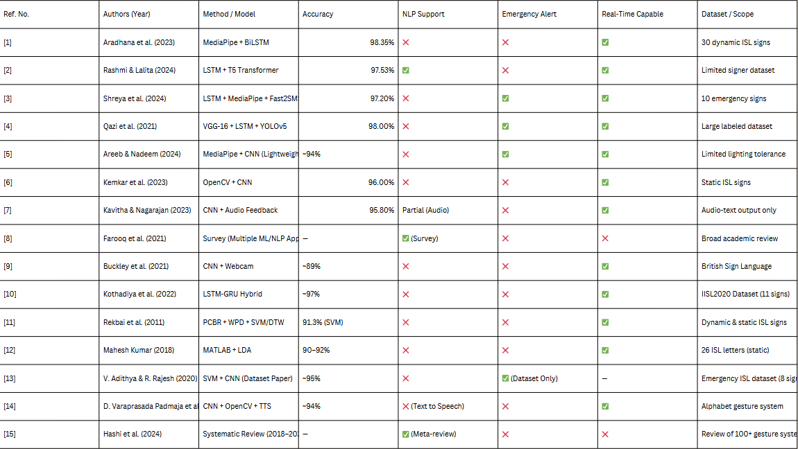
Datasets & Evaluation

Slide 11
Conclusion
This review shows that combining MediaPipe-based hand-landmark extraction with BiLSTM or hybrid CNN-RNN architectures can push ISL gesture-recognition accuracy beyond 97 percent, while transformer-driven NLP modules such as T5 markedly improve fluency by converting isolated signs into coherent sentences. Integrating real-time emergency detection—typically via YOLOv5 and SMS services like Fast2SMS—adds critical safety value, yet few systems deliver all three capabilities in a single, lightweight pipeline. Persistent obstacles include signer diversity, limited datasets, heavy computational loads, and fragmented vision-NLP-alert workflows. Future work should focus on advancing real-time ISL to text conversion systems, improving deep learning and NLP models for accurate gesture recognition and sentence generation, and enhancing emergency alert integration to develop robust, inclusive, and scalable ISL communication and assistance platforms.

Slide 12
THANK YOU

