Slide 1
Laptop Request Catalog Item
SlideMake.com

Slide 2

Laptop Request Catalog Item Overview
The Laptop Request Catalog Item is a standardized form used to request new or replacement laptops within an organization.
It ensures that all requests are documented, tracked, and processed efficiently.
This item helps streamline the procurement process and maintains inventory control.
Notes:
Image source: https://www.slidemake.com

Slide 3
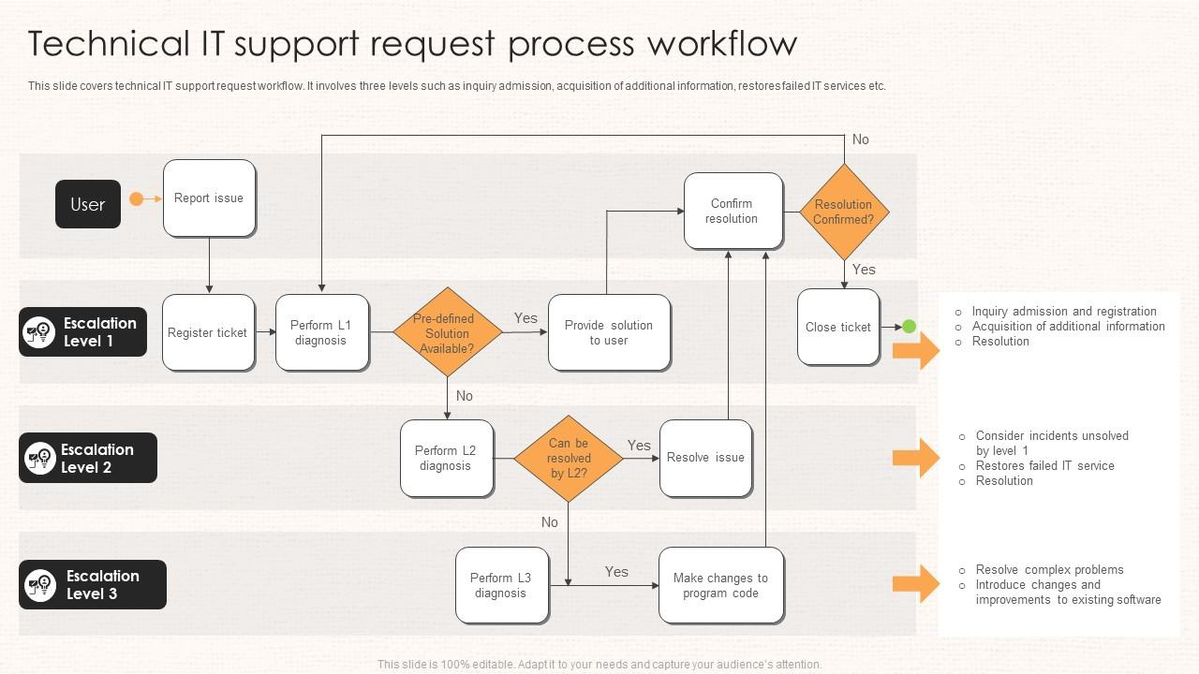
Purpose and Benefits
The primary purpose is to facilitate consistent and authorized laptop procurement requests.
It helps departments obtain necessary equipment quickly to support their operations.
The catalog item improves transparency and accountability in the equipment request process.
Notes:
Image source: https://www.slideteam.net

Slide 4
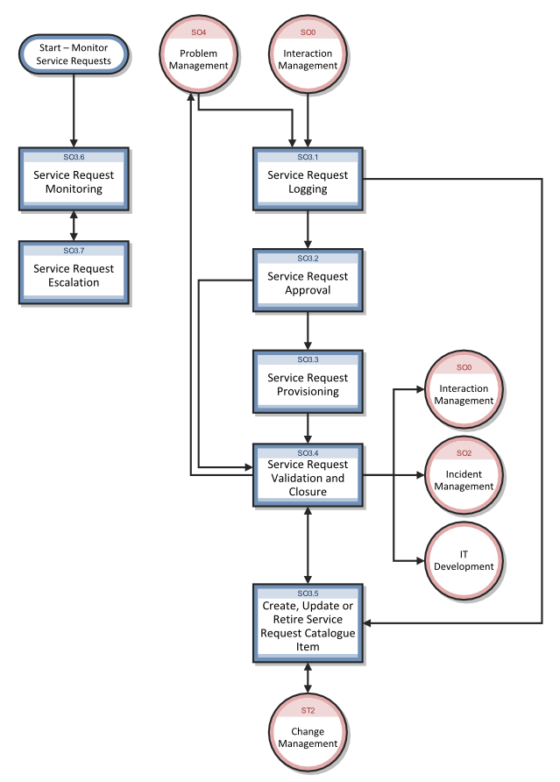
Request Submission Process
Users submit a Laptop Request Catalog Item through an online portal or designated system.
Required information includes user details, laptop specifications, and justification for the request.
Submissions are reviewed by the IT or procurement team for approval before processing.
Notes:
Image source: https://docs.microfocus.com

Slide 5
Essential Information Included
The catalog item captures details such as model preferences, operating system, and hardware specifications.
It also includes the purpose of the laptop, such as new hire or upgrade.
Additional information like department, cost center, and urgency level may also be documented.
Notes:
Image source: https://www.researchgate.net

Slide 6
Approval Workflow
Requests typically go through a tiered approval process based on cost or strategic importance.
Approvers may include department managers, IT administrators, or procurement officers.
Once approved, the request moves to the procurement stage for fulfillment.
Notes:
Image source: https://docs.microfocus.com

Slide 7
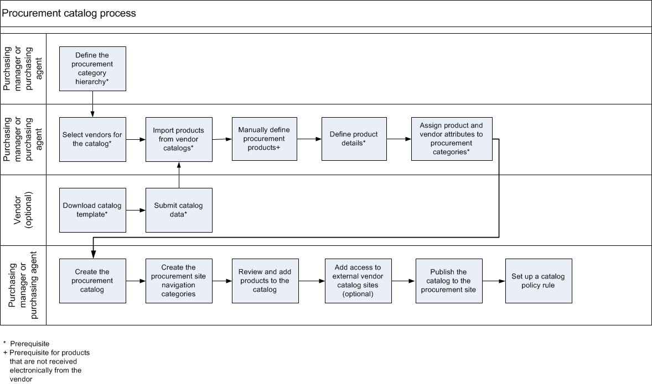
Benefits of Using a Catalog Item System
It standardizes requests, reducing errors and omissions in procurement.
It provides a clear audit trail for accountability and future reference.
The system enables better inventory management and planning for future needs.
Notes:
Image source: https://learn.microsoft.com

Slide 8
Common Challenges and Solutions
Delays can occur if requests lack complete information; providing detailed forms mitigates this.
Overrequesting or unnecessary upgrades can strain resources; clear guidelines help manage expectations.
Regular training on the request process ensures users understand how to submit accurate requests efficiently.
Notes:
Image source: https://docs.microfocus.com

Slide 9
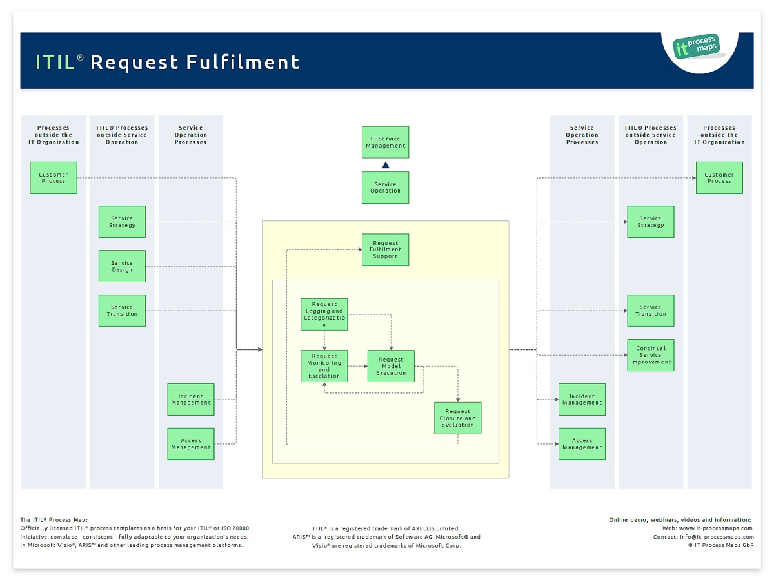
Summary and Best Practices
Always ensure that requests are detailed and justified to facilitate quick approval.
Follow the organization's established process for submitting and tracking requests.
Continuously review and update the catalog item criteria to adapt to evolving technology needs.
Notes:
Image source: https://wiki.en.it-processmaps.com

Slide 10
References
Organization’s IT Procurement Policies (2023).
Laptop Request Workflow Documentation (2023).
Industry best practices for hardware procurement processes.

