Slide 1
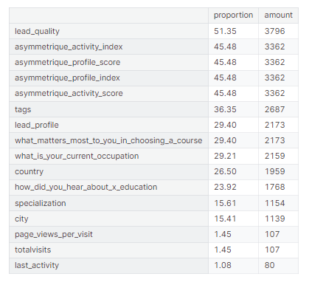
Explore Missing Values
Missing values in certain columns, often requiring employee input, might stem from uncategorized leads. Streamlining lead management can improve data collection, inform decision-making, and optimize lead conversion strategies. Further investigation is necessary to confirm this hypothesis.

Slide 2
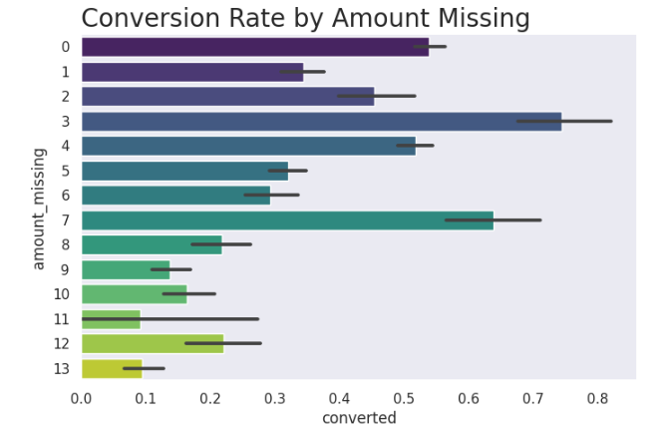
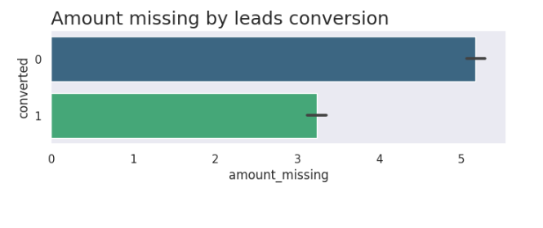
How much of the missing values belong to the same people?

Slide 3
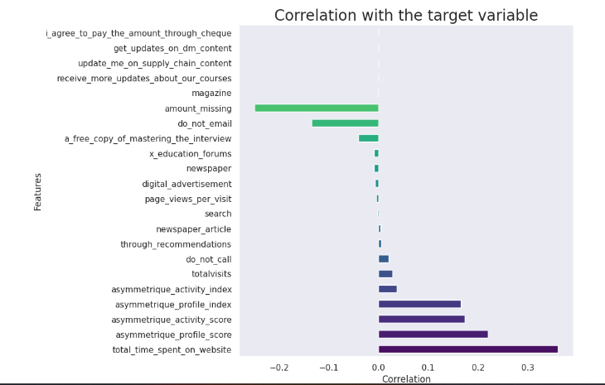
There's a negative correlation between missing lead data and the conversion rate. Higher instances of missing data might signify incomplete or poorly managed lead information, leading to potential difficulties in accurately categorizing and nurturing leads.
Notably, there's one column, "Total Time Spent On Website," which has a stronger correlation with the target variable than the number of missing values columns. This suggests that it might be a better potential predictor than most of the other features.

Slide 4
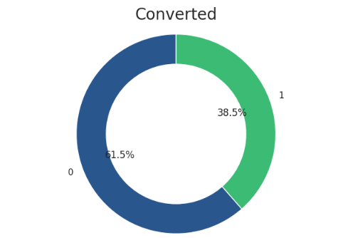

Exploratory Data Analysis

Slide 5
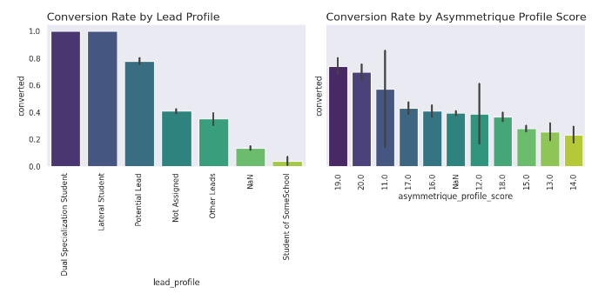


Slide 6
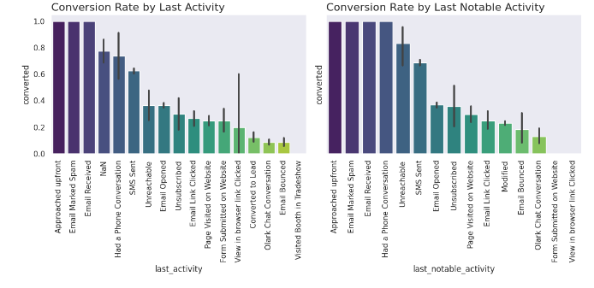
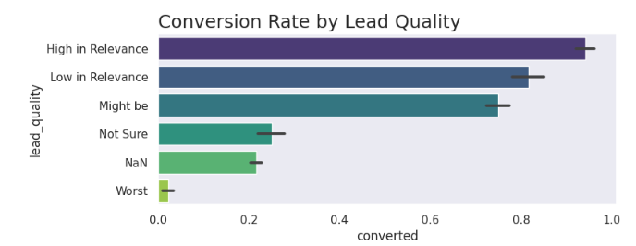

Slide 7
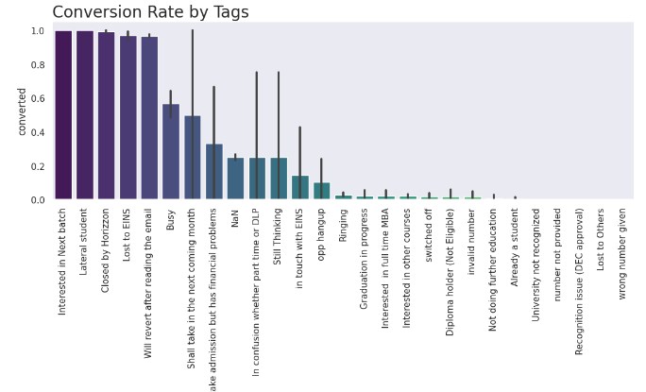
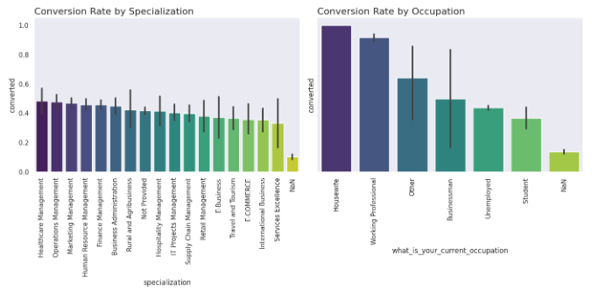

Slide 8
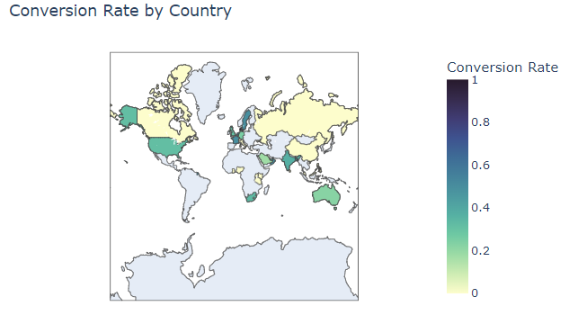
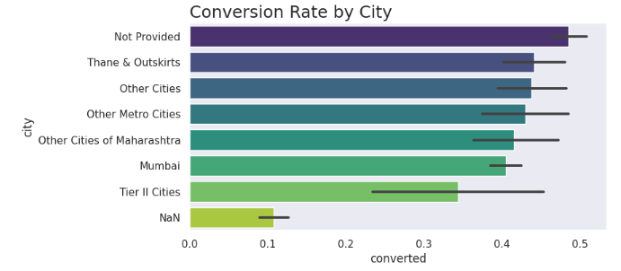

Slide 9
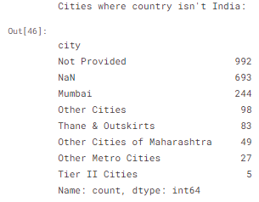
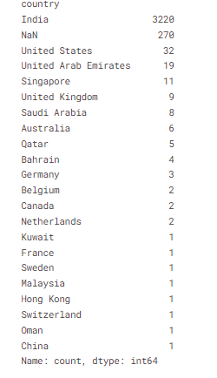
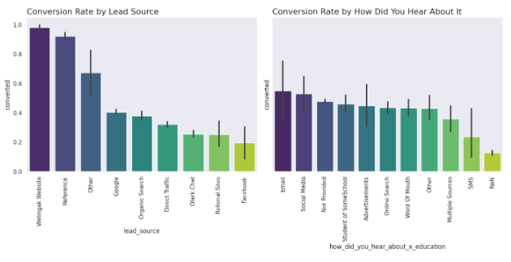

Slide 10
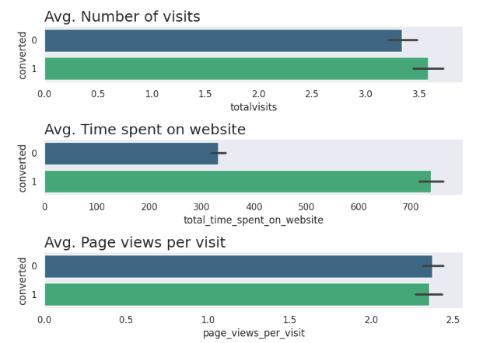
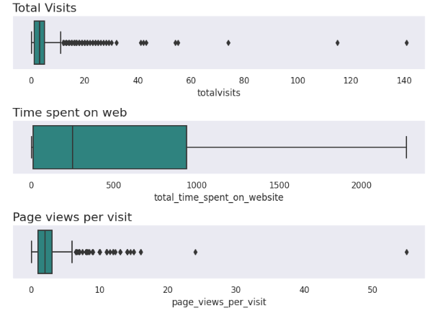

Slide 11
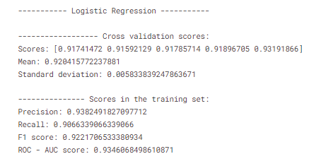
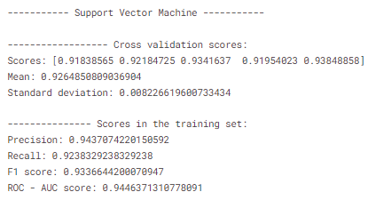
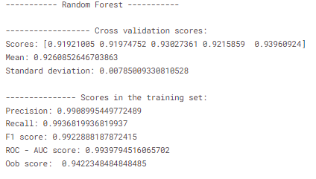
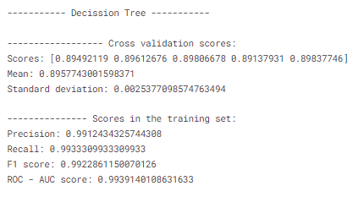
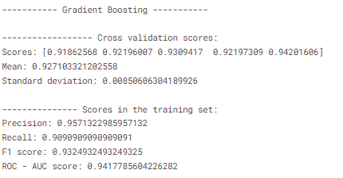

Slide 12
