Slide 1

UE20CS302: Machine Intelligence
Project Phase – 1
Project Title : Gender Bias Detection using Sentiment Analysis
Project ID :
Project Team : Titans

Slide 2
Abstract and Scope
In the entire world, women only make 77 cents for every dollar that men make. We suggest conducting a comprehensive research into the identification of gender bias using sentiment analysis in the context of workplaces utilising tweets, keeping this as the crux of the story.
With input from tweets, Sentimental Analysis is employed as the main principle and is carried out using machine learning to ensure security.This emotive examination of tweets raises public awareness and permits women to publicly express their feelings. We have relied heavily on Twitter to further our research and go through the viewpoints of others around us.

Slide 3
Literature Survey
Measuring gender bias in word embeddings across domains and discovering new gender bias word categories
Reducing gender bias in abusive language detection
An analysis of WordNet's coverage of gender identity using Twitter and the National Transgender Discrimination Survey
Stroke survivors on twitter: sentiment and topic analysis from a gender perspective
Exploring sentiment analysis on twitter data
Twitter sentiments analysis using machine learning methods
Mitigating gender bias in natural language processing: Literature review

Slide 4
Gender bias in sentiment analysis
Biasfinder: Metamorphic test generation to uncover bias for sentiment analysis systems

Slide 5
Design Approach
Why use tweets as a dataset?
Twitter sentiment analysis allows you to keep track of what's being said about your product or service on social media, and can help you detect angry customers or negative mentions before they they escalate.
Why use sentiment analysis?
Sentiment analysis tools are essential to detect and understand audiences feelings. Companies that use these tools to understand how customers feel can use it to improve CX. It might just be the perfect supplement for our problem statement.
What are the drawbacks of using nlp based sentiment analysis?
The target opinion and accuracy of the emotion might not be captured correctly.

Slide 6
Design Constraints, Assumptions & Dependencies
Sentiment analysis is the process of studying people’s opinions and emotions, generally using language clues. At first glance, it’s just a text classification problem, but if we dive deeper, we will find out that there are a lot of challenging problems which seriously affect sentiment analysis accuracy.
Irony and sarcasm, Types of negations, Word ambiguity and Multipolarity do affect the model accuracy.
So assumptions that our dataset is ideal and does not contain these edge cases is an assumption we make which is also a design constraint.

Slide 7
Proposed Methodology / Approach
We propose to use web-scraping using the twitter api on various issues that target our problem statement and create an extensive and exclusive dataset for our research.
The dataset will be passed through a set of models (TBA) and will be pre-processed in a unique way to extract the opionistic statements and create an inclusive bag of words using various NLP techniques.

Slide 8
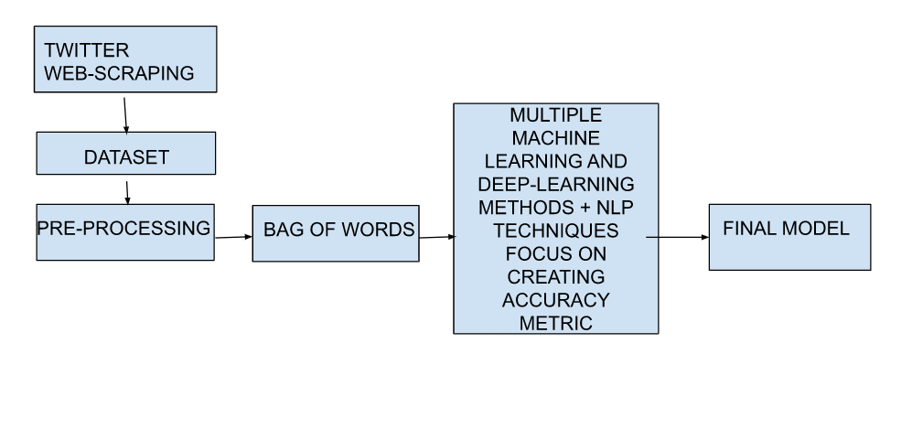
Architecture

Slide 9
Technologies Used
panda
numpy
scikit-learn
spacy
nltk
Open-source sentimental analysis Python libraries are used.

Slide 10
References
Chaloner, Kaytlin, and Alfredo Maldonado. "Measuring gender bias in word embeddings across domains and discovering new gender bias word categories." In Proceedings of the First Workshop on Gender Bias in Natural Language Processing, pp. 25-32. 2019
Park, Ji Ho, Jamin Shin, and Pascale Fung. "Reducing gender bias in abusive language detection." arXiv preprint arXiv:1808.07231 (2018).
Hicks, Amanda, Michael Rutherford, Christiane Fellbaum, and Jiang Bian. "An analysis of WordNet’s coverage of gender identity using Twitter and the National Transgender Discrimination Survey." In Proceedings of the 8th Global WordNet Conference (GWC), pp. 123-130. 2016.

Slide 11
Garcia-Rudolph, Alejandro, Sara Laxe, Joan Saurí, and Montserrat Bernabeu Guitart. "Stroke survivors on twitter: sentiment and topic analysis from a gender perspective." Journal of medical Internet research 21, no. 8 (2019): e14077.
Venugopalan, Manju, and Deepa Gupta. "Exploring sentiment analysis on twitter data." In 2015 eighth international conference on contemporary computing (IC3), pp. 241-247. IEEE, 2015.
Mandloi, Lokesh, and Ruchi Patel. "Twitter sentiments analysis using machine learninig methods." In 2020 International Conference for Emerging Technology (INCET), pp. 1-5. IEEE, 2020.
Sun, Tony, Andrew Gaut, Shirlyn Tang, Yuxin Huang, Mai ElSherief, Jieyu Zhao, Diba Mirza, Elizabeth Belding, Kai-Wei Chang, and William Yang Wang. "Mitigating gender bias in natural language processing: Literature review." arXiv preprint arXiv:1906.08976 (2019).

Slide 12
Thelwall, Mike. "Gender bias in sentiment analysis." Online Information Review (2018).
Asyrofi, Muhammad Hilmi, Zhou Yang, Imam Nur Bani Yusuf, Hong Jin Kang, Ferdian Thung, and David Lo. "Biasfinder: Metamorphic test generation to uncover bias for sentiment analysis systems." IEEE Transactions on Software Engineering (2021).

Slide 13
SL. NO | Paper titled | Year of publication | Methodology | Drawback | Comments
1 | Measuring Gender Bias in Word Embeddings across Domains and Discovering New Gender Bias Word Categories | 2019 | WEAT bias detection | Ambiguity to distinguish between harmless gender-associated words and harmful gender-biased words | Novel method of discovering gender-associated word categories by clustering and embeddings validated through WEAT hypothesis testing mechanism
2 | Reducing Gender Bias in Abusive Language Detection | 2016 | Debiased Word Embeddings, Gender Swap, Bias fine-tuning | Classification performance drop happens when mitigation methods used for CNN, GRU and alpha-GRU models | Effectively reduce gender bias by 90-98%. Future scope of evaluating NLP systems in different directions, not merely focusing on performance metrics like accuracy or AUC. Three bias mitigation methods: 1.debiased word embeddings, 2.gender swap data augmentation, and 3.fine-tuning with a larger corpus
3 | An Analysis of WordNet’s Coverage of Gender Identity Using Twitter and The National Transgender Discrimination Survey | 2016 | Language Analysis of Twitter and NTDS Data, Coverage Analysis of Twitter Words and WordNet | Due to significant variation of words used between these contexts, there was some overlap | Coverage analysis of trans words taken from two different contexts, Twitter and the National Transgender Discrimination Survey Assessment of WordNet’s coverage of trans identity

Slide 14
4 | Stroke Survivors on Twitter: Sentiment and Topic Analysis From a Gender Perspective | 2019 | Sentiment analysis based on a state-of-the-art lexicon (National Research Council) with syuzhet R package | Data collection relies on Twitter’s streaming API, which prevents collection of tweets from private Twitter accounts. Hence, findings may not represent individuals with private accounts. | Women express positive emotions and happiness much more than men. From a gender perspective, this study examined emotional expressivity for eight distinct types of emotions and discovered 20 key areas of interest in Twitter posts from stroke patients.
5 | Exploring sentiment analysis on twitter data | 2015 | Data Retrieval Module, Subjective tweets extraction, Tweet Classification module | Analysis of how brand affinity varies across regions as the tweets contain geographic information also. | A hybrid tweet sentiment classification model incorporating domain oriented lexicons, unigrams and tweet specific features using machine learning techniques. Extraction of consumer sentiment towards popular smartphone brands over the past few years
6 | Twitter Sentiments Analysis Using Machine Learning Methods | 2020 | Naïve Bayes, SVM and maximum entropy classification | More work in future is needed to improve the performance measures | Because of the limited number of characters(280) in tweets, it becomes easy for sentiment analysis. Naïve Bayes has the highest accuracy 86%.
7 | Mitigating Gender Bias in Natural Language Processing: Literature Review | 2019 | Debiasing Training Corpora, Debiasing Gender in Word Embeddings, Debiasing by Adjusting Algorithms (NLP) | Harmonization of single, modular processes together to form an ideally unbiased system. Certain debiasing techniques may introduce noise into a NLP model, causing performance degradation.hand-craft debiasing approaches may unintentionally encode the implicit bias of the developers | Review on contemporary studies on recognizing and mitigating gender bias in NLP. Mitigating Gender Bias in Languages Beyond English, Non-Binary Gender Bias, Interdisciplinary Collaboration

Slide 15
8 | Gender bias in sentiment analysis | 2018 | Lexical sentiment analysis algorithms | Male sentiment is harder to detect because it is less explicit. Only one lexical sentiment analysis algorithm was used | Biases in lexical sentiment analysis accuracy between reviews authored by males and females. More likely to detect more strong positive and negative sentiment from females than from males.
9 | BiasFinder: Metamorphic Test Generation to Uncover Bias for Sentiment Analysis Systems | 2021 | Metamorphic Testing for Fairness, NLP techniques, Bias finder- mutant and template generation engine with failure detection engine | Evaluate BiasFinder to determine if it generalizes to other NLP tasks beyond sentiment analysis | BiasFinder, a metamorphic testing framework for creating test cases to uncover bias in Sentiment Analysis (SA) systems. Human annotators consistently consider mutants generated by BiasFinder are more fluent than mutants generated by MT-NLP

Slide 16
Any other information
We wish to continue the research and publish a paper.

Slide 17

THANK YOU
Thank You

