Slide 1

MUSIC STORE DATA ANALYSIS

Slide 2
About us
Group member 1:
D. Sai Siddharth Varma, B. Tech in CSE
ID: , Batch: 448
Group member 2:
K. Ankith Kumar, B. Tech in CSE
ID: , Batch: 448

Slide 3
Objective of the Project
The objective of this project is to analyze key business questions to uncover customer purchasing patterns, identify top-performing genres and artists, and support data-driven decision-making related to revenue, customer engagement, and market trends. Using MySQL concepts, queries were developed to extract meaningful insights from a set of systematically connected database tables. These tables were pre-created and populated using CSV files, enabling efficient and accurate data analysis.

Slide 4
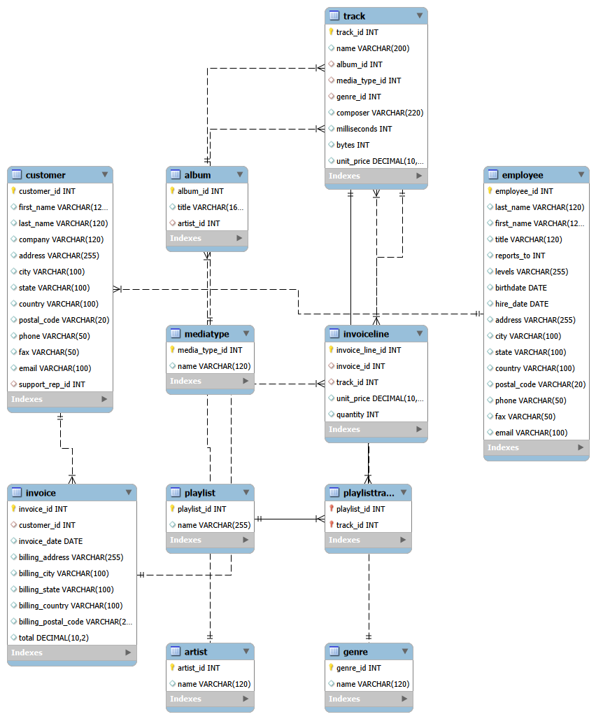
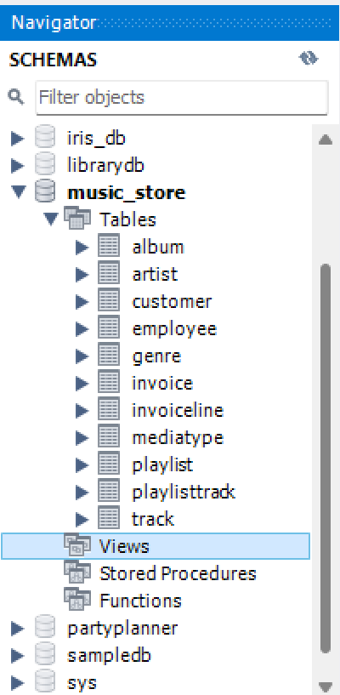
ER Diagram and schema explanation

Slide 5
Key analysis questions
The questions were centered around
Employee Hierarchy Analysis.
Geographical Invoice Distribution.
High-Value Transactions.
Revenue by City.
Best Customer Identification.
Genre-Based Customer Preferences (Rock Listeners).
Top Rock Artists by Track Count.
Track Duration Analysis.
Customer Spending by Artist.
Most Popular Genre by Country.
Top-Spending Customer by Country.

Slide 6
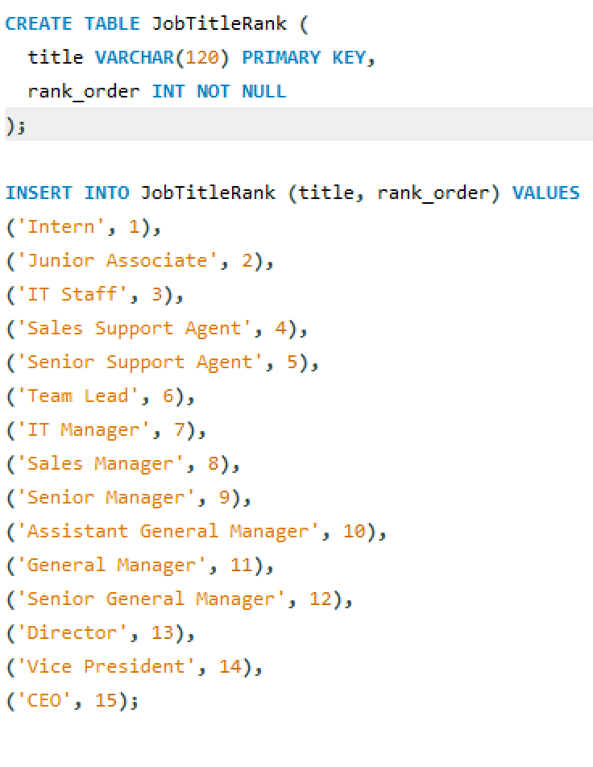
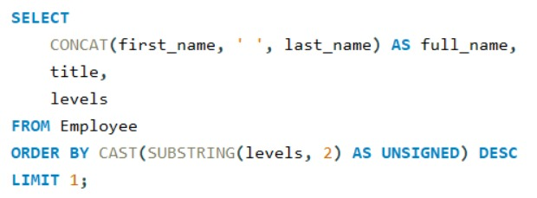
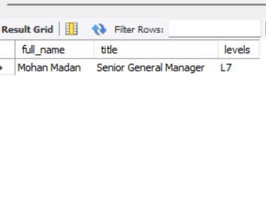
SQL query results with screenshots or summaries
1. Who is the senior most employee based on job title?

Slide 7
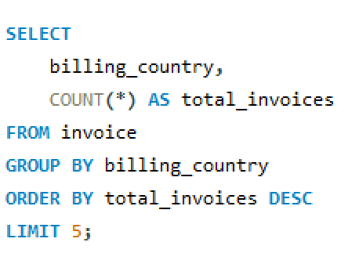
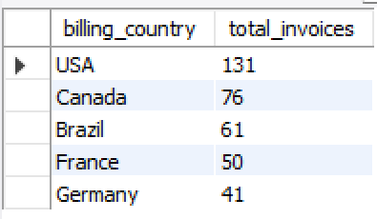
2. Which countries have the most Invoices?

Slide 8
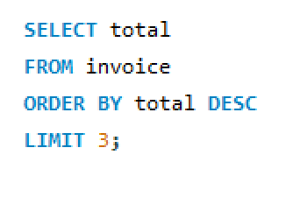
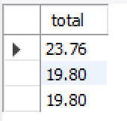
3. What are the top 3 values of total invoice?

Slide 9
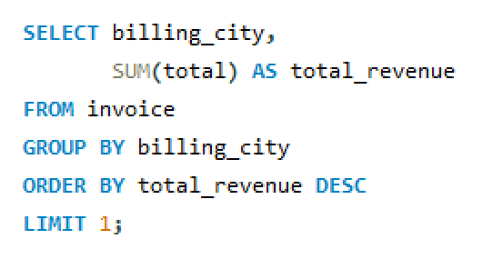
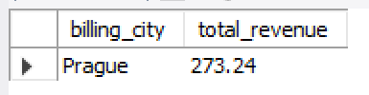
4. Which city has the best customers? - We would like to throw a promotional Music Festival in the city we made the most money. Write a query that returns one city that has the highest sum of invoice totals. Return both the city name & sum of all invoice totals.

Slide 10
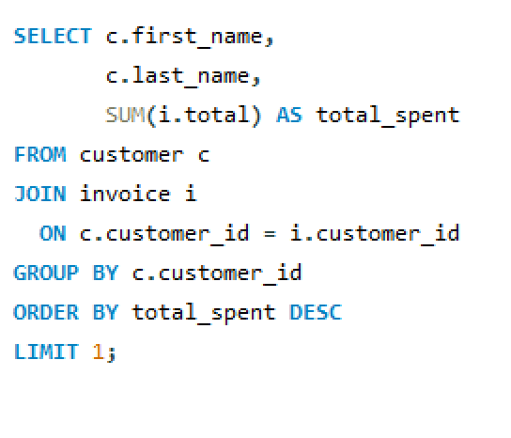

5. Who is the best customer? - The customer who has spent the most money will be declared the best customer. Write a query that returns the person who has spent the most money.

Slide 11
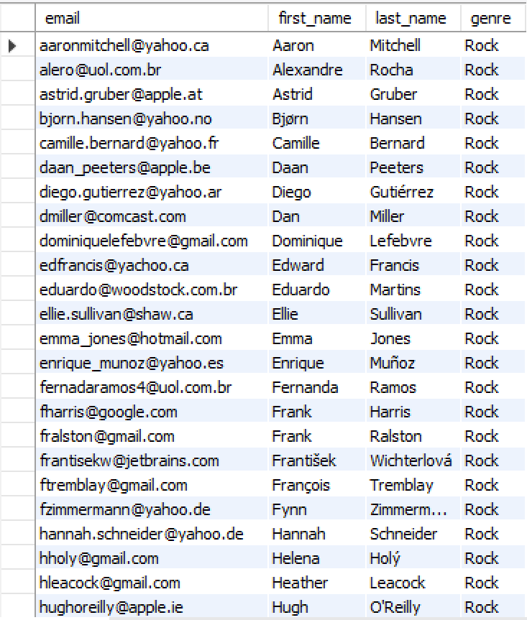
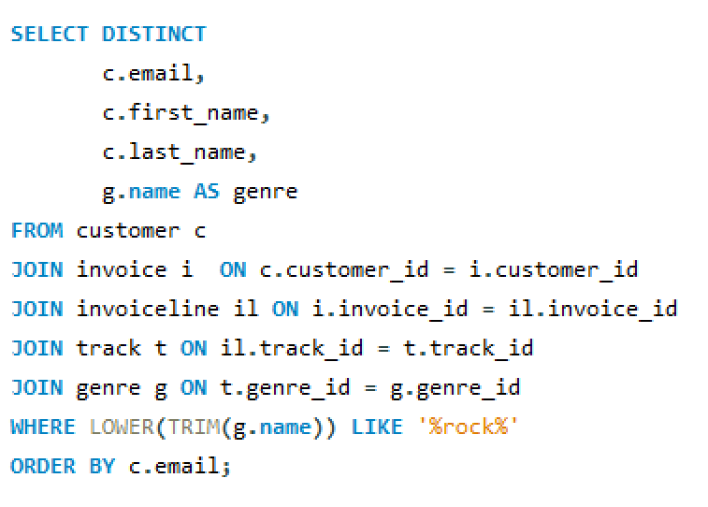
6. Write a query to return the email, first name, last name, & Genre of all Rock Music listeners. Return your list ordered alphabetically by email starting with A.

Slide 12
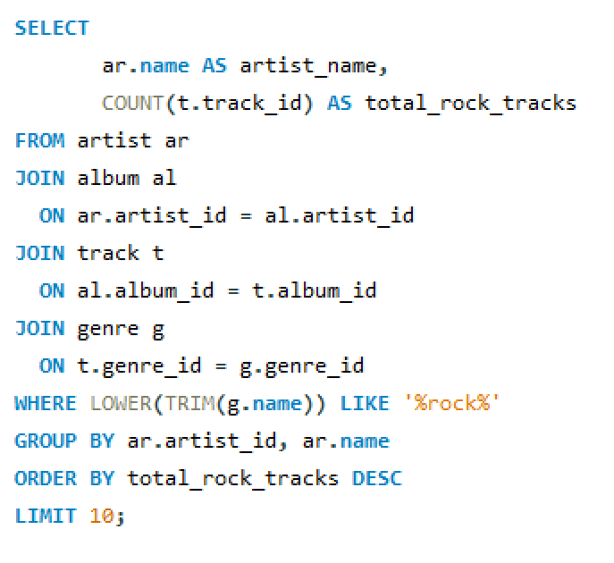
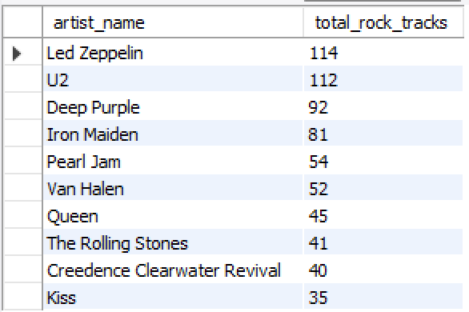
7. Let's invite the artists who have written the most rock music in our dataset. Write a query that returns the Artist name and total track count of the top 10 rock bands.

Slide 13
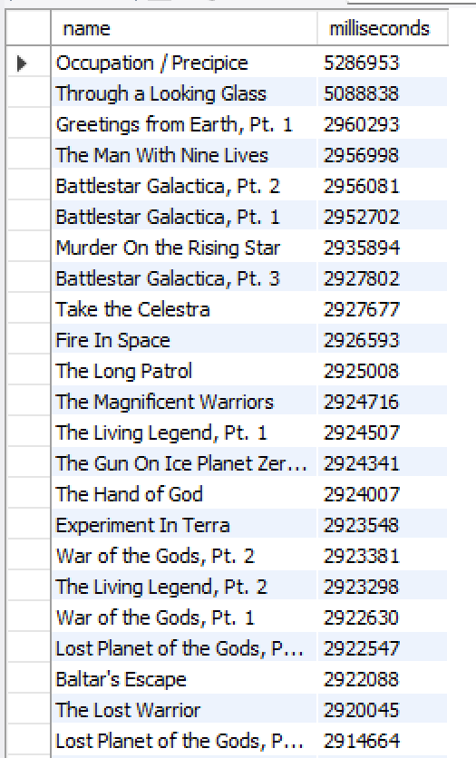
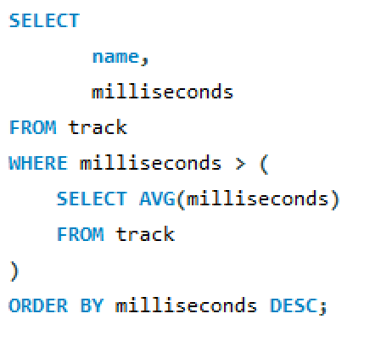
8. Return all the track names that have a song length longer than the average song length.- Return the Name and Milliseconds for each track. Order by the song length, with the longest songs listed first.

Slide 14
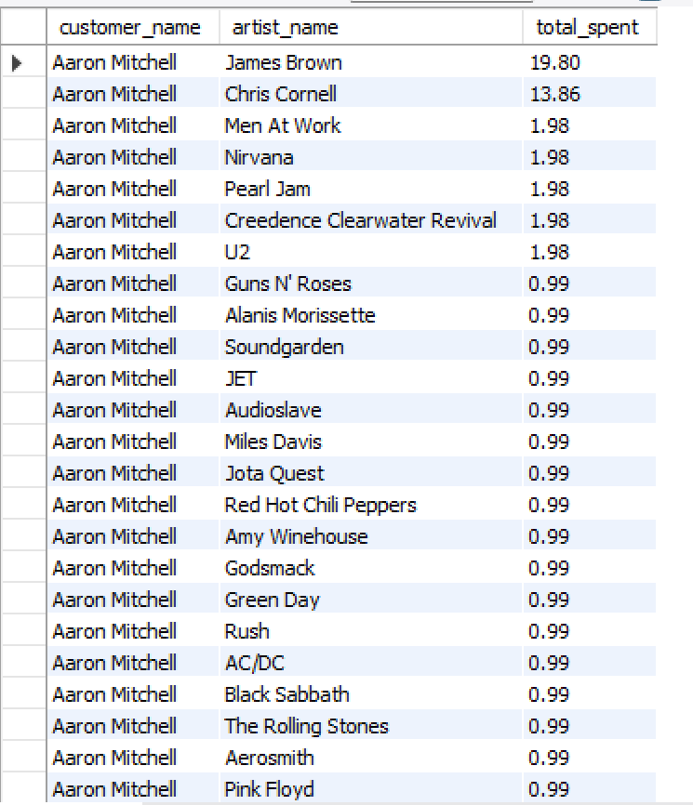
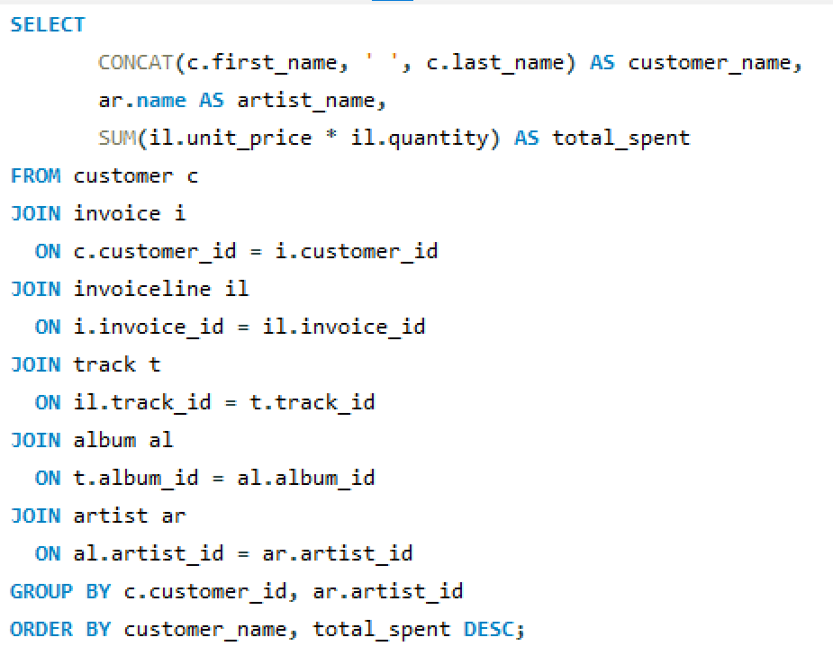
9. Find how much amount is spent by each customer on artists? Write a query to return customer name, artist name and total spent

Slide 15
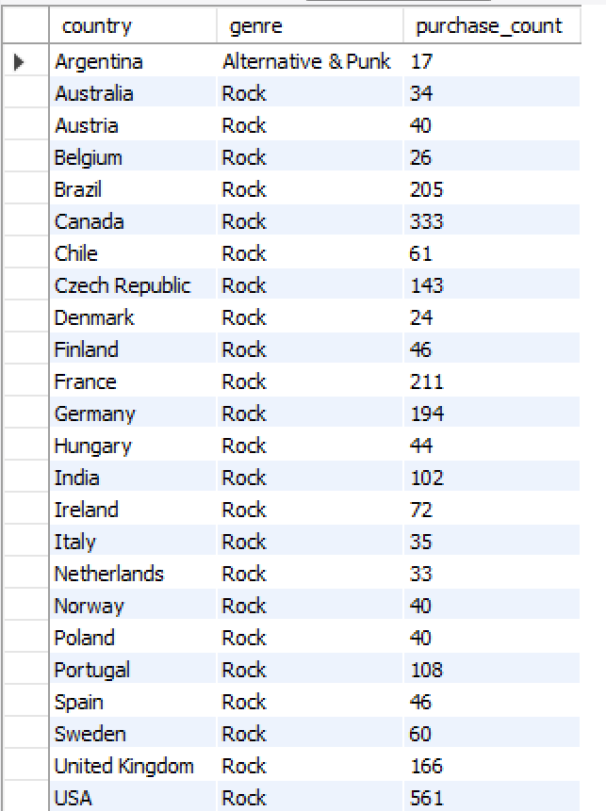
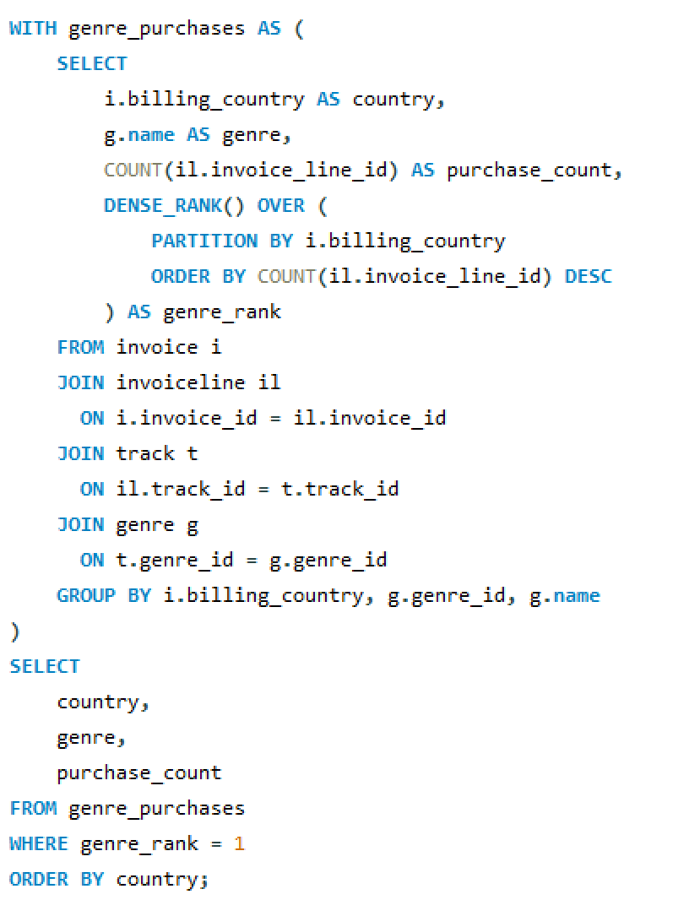
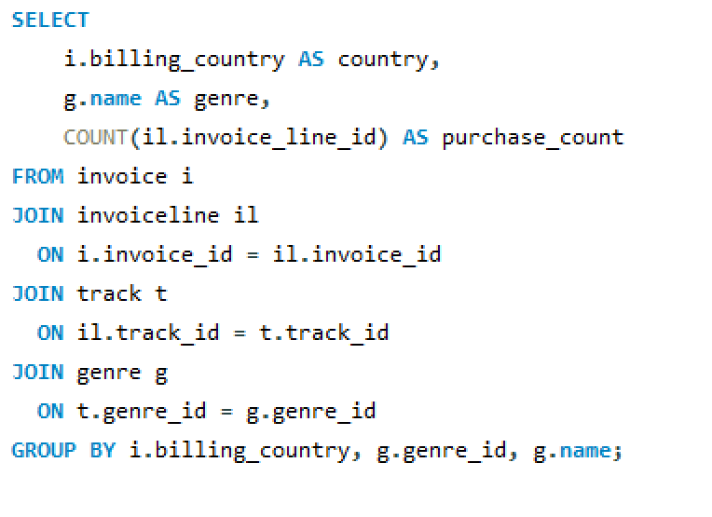
10. We want to find out the most popular music Genre for each country. We determine the most -- popular genre as the genre with the highest number of purchases. Write a query that returns each country along with the top Genre. For countries where the maximum number of purchases is shared, return all Genres

Slide 16
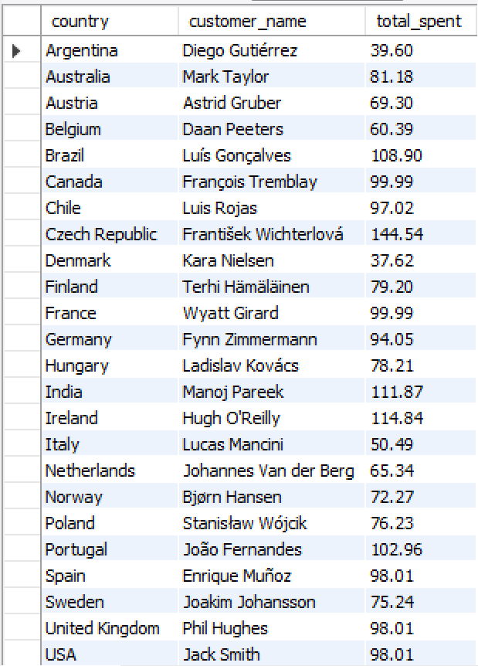
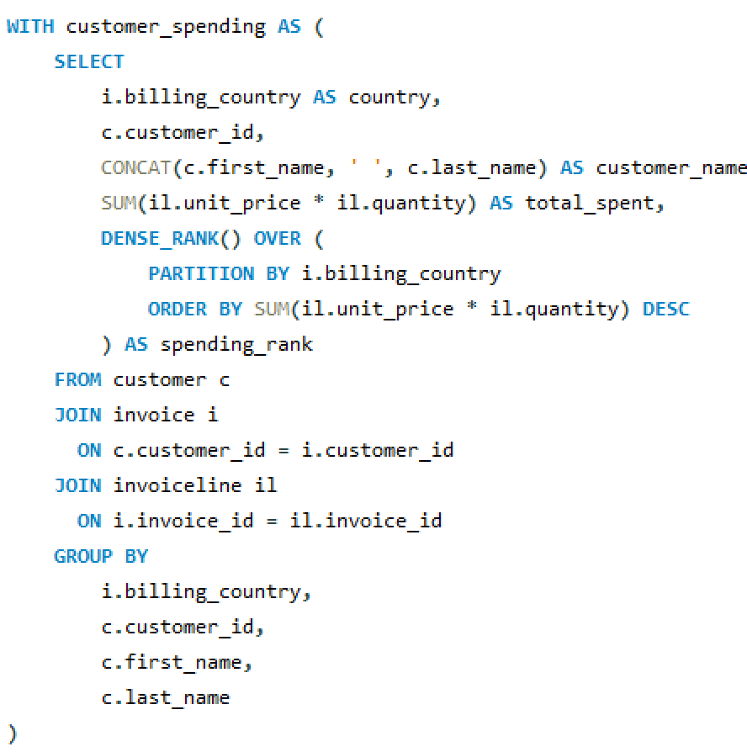
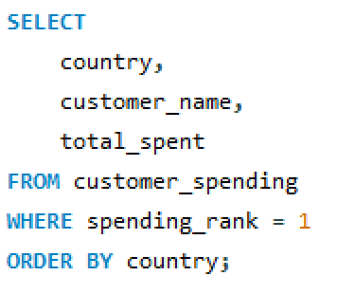
11. Write a query that determines the customer that has spent the most on music for each country. Write a query that returns the country along with the top customer and how much they spent. For countries where the top amount spent is shared, provide all customers who spent this amount

Slide 17
Final business insights and recommendations
Key Business Insights
Rock is one of the most popular genres, with high customer engagement.
A small group of top customers contributes a large share of revenue.
Certain cities and countries generate higher invoice totals, indicating strong regional markets.
A few artists and albums drive most of the purchases, especially in Rock music.
Customers tend to spend more on longer tracks and popular genres.
Business Recommendations
Focus marketing campaigns on top-performing genres (Rock).
Organize music festivals or promotions in high-revenue cities.
Provide loyalty rewards to high-spending customers.
Promote top artists and albums to increase sales.
Use regional insights to plan country-specific offers.

Slide 18
Conclusion (Key finding overall)
Customer purchasing behavior varies significantly by genre, city, and country.
Rock music dominates in terms of popularity and revenue contribution.
A limited number of customers and artists drive maximum business value.
SQL-based analysis helped convert raw data into actionable business insights.
The project demonstrates how data-driven decisions can improve revenue and customer engagement.

Slide 19
Q&A Slide
We would be happy to answer any questions related to:
Database design & relationships
SQL queries and logic used
Business insights derived from the data
Challenges faced during the project

Slide 20
Our Experience/Challenges working on SQL – Data Analysis Project.
Our Experience
Gained hands-on experience in SQL queries, joins, and aggregations.
Learned to solve real-world business problems using data analysis.
Improved ability to convert SQL results into business insights.
Challenges Faced
Managing foreign key constraints while loading multiple datasets.
Handling secure_file_priv and LOAD DATA INFILE errors in MySQL.
Writing and understanding complex joins across multiple tables.
Outcome
Successfully completed the project with accurate results.
Strengthened both technical and analytical skills.

Slide 21

THANK YOU

