Slide 1


PROJECT
PRESENTATION
By Ankit Meena

Slide 2

TITLE
Title: Stock Price Prediction Using LSTM Model
Name: Ankit Meena
Email: 21je0126@iitism.ac.in
Profile: AI Engineer
Project Github-Link: LINK

Slide 3


BACKGROUND
IMPORTANCE
Stock prices reflect the economic health and performance of a company.
Accurate predictions enable investors to make informed decisions, maximizing profits.
CHALLENGES
Stock prices are influenced by numerous factors (market trends, news, macroeconomics).
High volatility and noise in stock prices make predictions complex.
Need for sophisticated models capable of capturing long-term dependencies in time-series data.

Slide 4
DATA ANALYSIS RESULTS
Dataset Overview: NTT stock data including columns like Date, Close Price, Open Price, High Price, Low Price, Volume, and Change%.
Key Findings:
Time-series trends: Identified general upward/downward trends in the stock price.
Seasonality and patterns: Detected recurring patterns, indicating periodic behavior.
Correlation analysis: Correlations between features such as Volume and Close prices were found.
Outliers: Identified anomalies in the dataset that may influence prediction accuracy.
Issues:
Presence of noise and missing data points.
Challenges in capturing sudden stock price jumps (volatility).

Slide 5
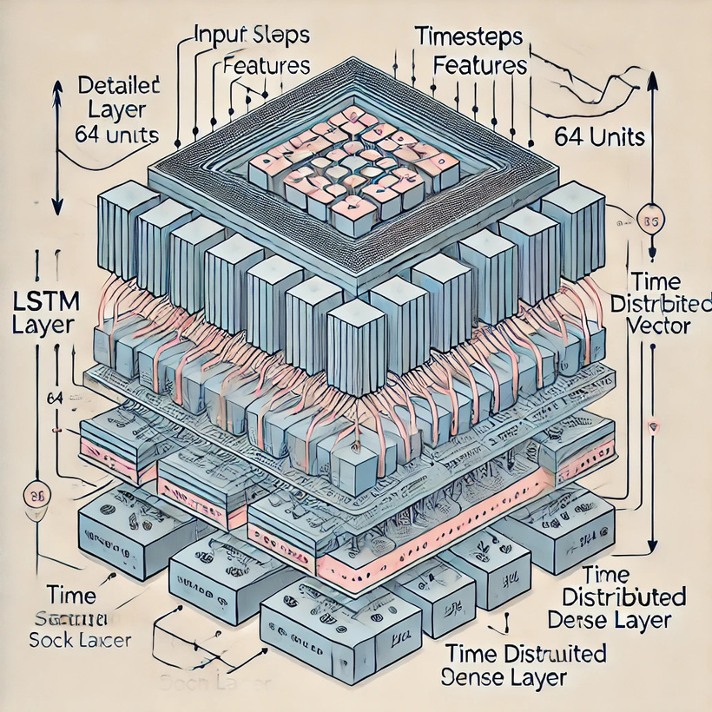
TECHNOLOGY OVERVIEW
Model Selection:
LSTM (Long Short-Term Memory) chosen due to its ability to capture long-term dependencies and patterns in time-series data.
LSTM networks handle vanishing gradients effectively, making them suitable for sequential data like stock prices.
Feature Engineering:
Scaled Features: Used MinMaxScaler to normalize stock price values, ensuring the model converges faster.
Technical Indicators: Generated rolling averages and exponential moving averages (EMA) to capture price trends and smooth out volatility.
Rationale:
The LSTM model is widely used in financial time-series prediction due to its performance in sequential data.
Feature engineering with indicators helps the model understand short- and long-term price movements.
Architecture diagram of the LSTM model.

Slide 6
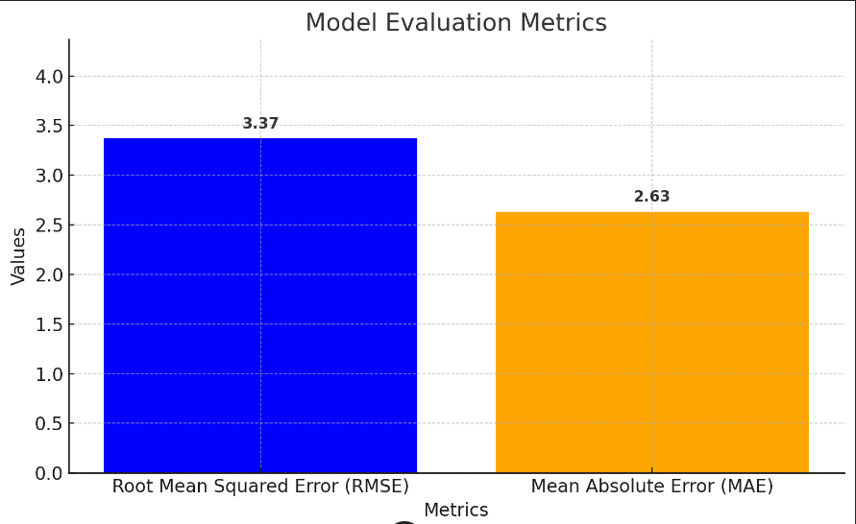
EVALUATION INDICATORS
Root Mean Squared Error (RMSE):
Chosen to evaluate prediction accuracy by measuring the average error magnitude between predicted and actual prices.
Formula: RMSE = √(Σ(y_pred - y_actual)² / n)
Lower RMSE indicates better model performance.
Visualizations:
Plotted actual vs predicted stock prices to visually compare how well the model fits the data.
Results:
RMSE of the model during training: 3.369737871874968
Mean Absolute Error (MAE) during training: 2.631829564106861

Slide 7
VERIFICATION CONTENT (HYPOTHESES)
Improvement Hypotheses Tested:
Hypothesis 1: Increasing LSTM model complexity (more layers/units) will improve performance.
Action: Added additional LSTM layers to better capture the complexity of the time-series.
Hypothesis 2: Feature engineering by adding technical indicators will improve prediction accuracy.
Action: Integrated moving averages and exponential moving averages to provide additional context to the model about price trends.
Objective:
Test these hypotheses to find areas of improvement and adjust the model accordingly.

Slide 8

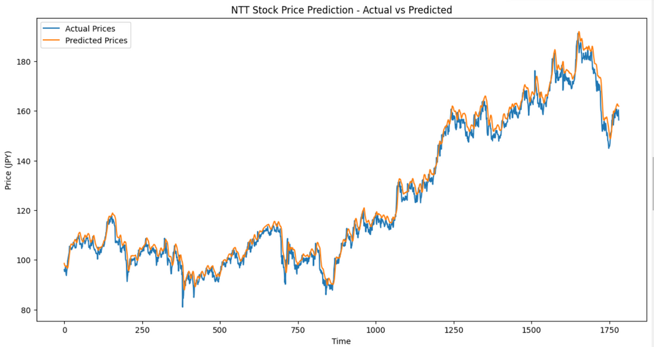
VERIFICATION RESULT 1 (HYPOTHESIS 1)
Approach:
Added more LSTM layers and increased the number of LSTM units in each layer.
Trained the model with the same number of epochs (20 epochs).
Results:
Slight reduction in RMSE: 3.369737871874968
Improved ability to capture longer-term dependencies but increased training time.
Consideration:
Adding complexity improved accuracy, but only marginally.
Trade-off: More complex models increase computational cost and risk overfitting.

Slide 9
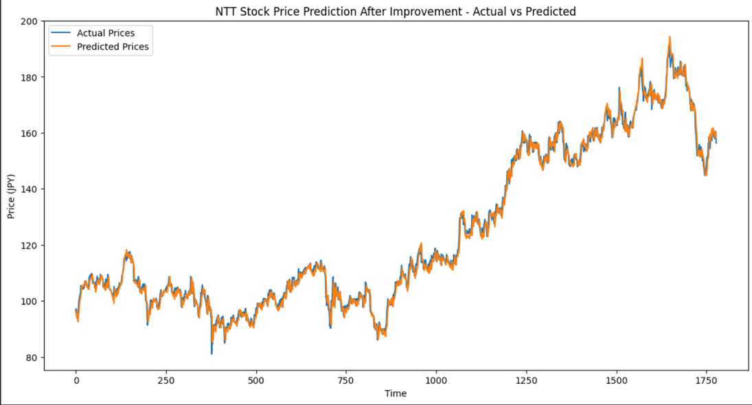
VERIFICATION RESULT 2 (HYPOTHESIS 2)
Approach:
Added 20-day rolling averages and exponential moving averages (EMA) as features.
Increase the number of epochs (150 epoch)
Results:
Slight improvement in prediction accuracy, particularly in capturing trends and reducing noise.
RMSE after adding indicators: 2.280825792571175
Consideration:
The technical indicators helped smooth out short-term fluctuations, improving model predictions.
Observation: Predictive performance during volatile periods remained challenging, indicating a need for further model refinement.

Slide 10
SUMMARY OF RESULTS
RESULTS
FUTURE OUTLOOK
LSTM successfully predicted stock prices with moderate accuracy.
Feature engineering with rolling averages and EMAs improved the model's ability to track trends.
Model performance was assessed using RMSE and visual inspection of predicted vs actual prices.
Possible Improvements:
Incorporate external factors (e.g., economic data, news sentiment) as additional features.
Experiment with other models like GRU (Gated Recurrent Units) or hybrid models combining ARIMA and LSTM.
Application:
Fine-tuned models could be applied for portfolio management or algorithmic trading strategies.

Slide 11
QUESTIONS
?

Slide 12
THANK YOU

