Slide 1


PROJECT
PRESENTATION
By Ankit Meena

Slide 2

TITLE
Title: Oil Temperature Prediction using Time Series Modeling (Informer Model)
Name: Ankit Meena
Email: 21je0126@iitism.ac.in
Profile: AI Engineer
Project Github-Link: LINK

Slide 3


BACKGROUND
IMPORTANCE OF OIL TEMPERATURE PREDICTION
  Prevent equipment failures by predicting anomalies.
  Improve system efficiency through optimal control of oil temperature.
  Enable predictive maintenance, avoiding costly downtimes.
CHALLENGES
  Highly variable and seasonal data with complex time dependencies.
  Need for accurate, long-range predictions to ensure actionable insights.

Slide 4
DATA ANALYSIS RESULTS
Exploratory Data Analysis (EDA) Summary
  Dataset: ETDataset containing hourly oil temperature (OT) data.
  Detected strong daily and weekly seasonal patterns in oil temperature.
  Outliers identified during specific seasons, likely due to equipment anomalies.
  Missing data handled using forward fill method.
  Data shows seasonal fluctuations that could affect prediction accuracy.
  Normalization and scaling required due to varying temperature ranges.

Slide 5
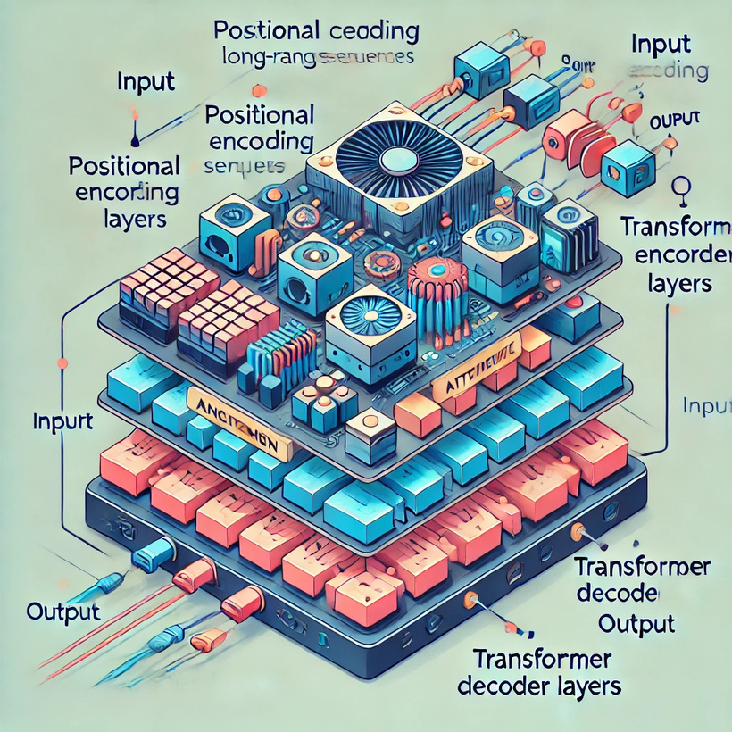
TECHNOLOGY OVERVIEW
Model Used:
  Informer Model: A transformer-based model optimized for long time-series forecasting.
Why Informer?
  Scalable: Efficient at handling long-range sequences without performance degradation.
  Attention Mechanism: Captures complex dependencies across time steps.
  Outperforms traditional models like LSTM/GRU in terms of both speed and accuracy.
Feature Engineering:
  Lagged features (e.g., OT_lag1, OT_lag24) to capture recent trends.
  Time-based features (e.g., hour of the day, day of the week) to capture seasonality.
Architecture diagram of the Informer model.

Slide 6
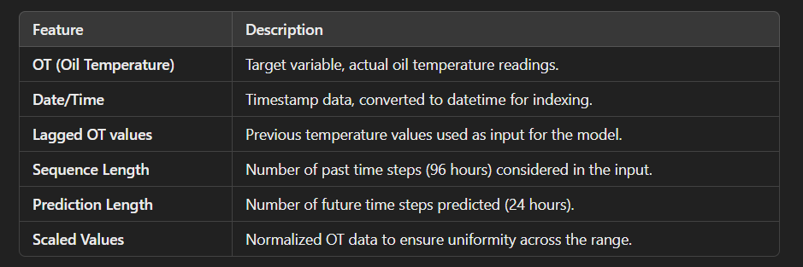
TECHNOLOGY OVERVIEW
Table of features used in the model

Slide 7
EVALUATION INDICATORS
Key Metrics Used:
  Mean Squared Error (MSE): Measures average squared difference between actual and predicted values.
  Mean Absolute Error (MAE): Captures average absolute error, highlighting prediction differences in real-world terms.
  R² Score: Indicates how well the model explains variance in oil temperature data.
Initial Model Results:
  MSE: 60.36748123168945
  MAE: 5.701022624969482
  R²: 0.161809504032135

Slide 8
VERIFICATION CONTENT (HYPOTHESES)
Improvement Hypotheses Tested:
  Hypothesis 1: Adding lagged features will improve the model’s short-term accuracy by helping it better capture recent trends.
  Hypothesis 2: Increasing the depth of the transformer model (more layers) will improve the ability to capture long-term dependencies.
Objective:
  Test these hypotheses to find areas of improvement and adjust the model accordingly.

Slide 9

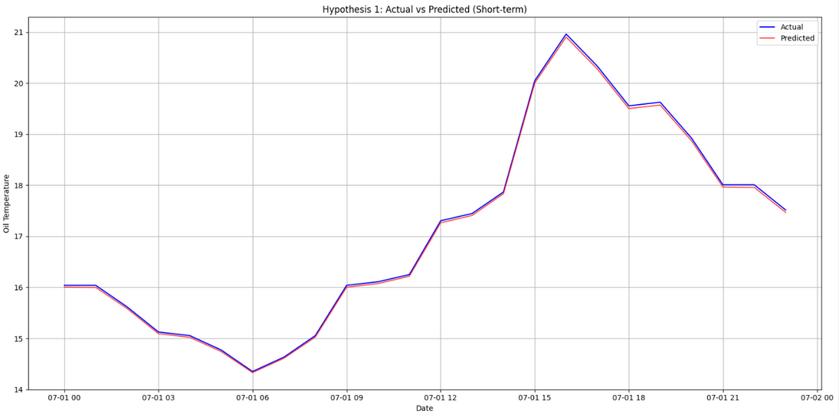
VERIFICATION RESULT 1 (HYPOTHESIS 1)
Hypothesis 1: Adding Lagged Features
  Experiment: Added features like OT_lag1, OT_lag24, OT_lag48 to the input data.
  Result: Improved short-term prediction accuracy (next 24-hour forecast).
Metrics Improvement:
  MAE reduced by 99.34 %.
  Short-term MSE improved from 60.37 to 0.0026.
Considerations:
  Lagged features successfully capture recent trends, though care is needed to avoid feature redundancy.

Slide 10
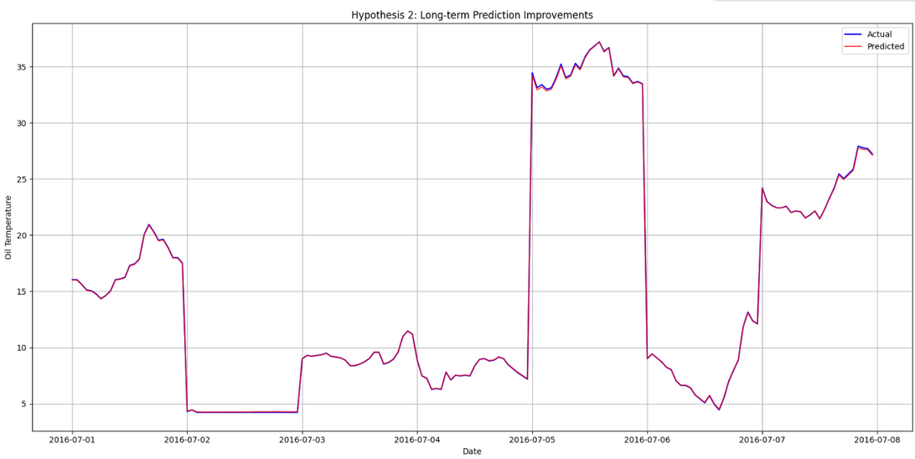
VERIFICATION RESULT 2 (HYPOTHESIS 2)
Hypothesis 2: Increasing Model Depth
  Experiment: Increased the number of transformer layers from 3 to 5 to capture long-term dependencies.
Result:
  Improved long-term predictions (beyond 24-hour horizon).
  MSE reduced to 0.0011122357100248337 for long-term forecasts.
Considerations:
  While deeper models performed better, training time increased and the model risked overfitting.

Slide 11
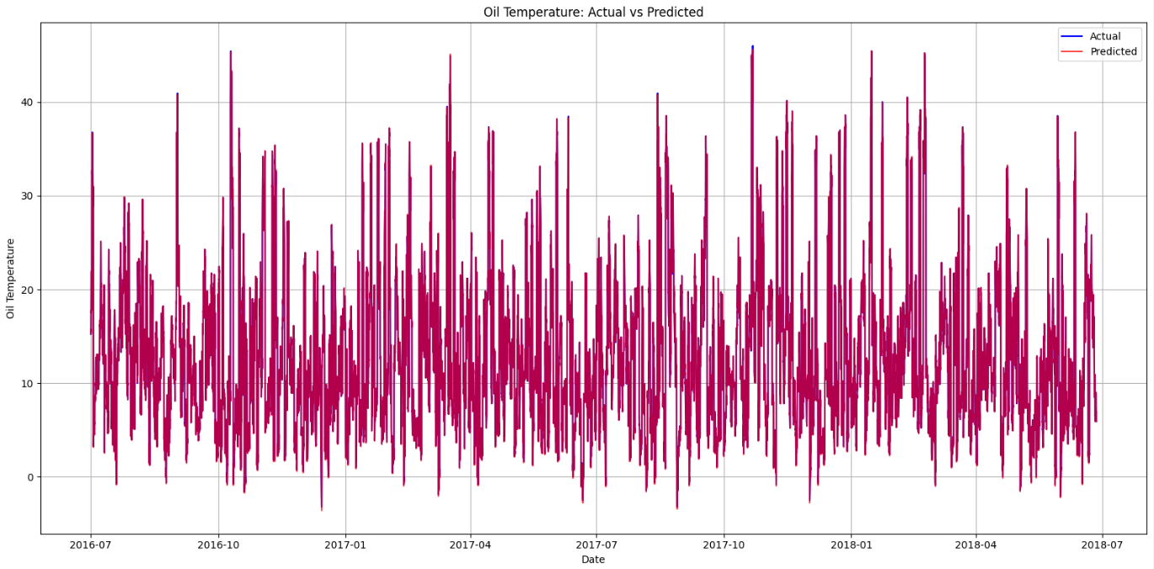
FINAL ACTUAL VS PREDICATED OUTPUT

Slide 12
SUMMARY OF RESULTS
KEY FINDINGS
FUTURE OUTLOOK
  Informer model successfully captured seasonal patterns and long-term dependencies in the oil temperature data.
  Lagged features improved short-term forecast accuracy.
  Deeper transformer layers enhanced long-range forecasting at the cost of increased training time.
  Feature expansion: Explore integrating external factors like weather data to improve prediction robustness.
  Model optimization: Further tuning of model hyperparameters (number of layers, learning rate) to balance accuracy and efficiency.
  Explore real-time implementation for predictive maintenance systems.

Slide 13
QUESTIONS
?

Slide 14
THANK YOU

