Slide 1
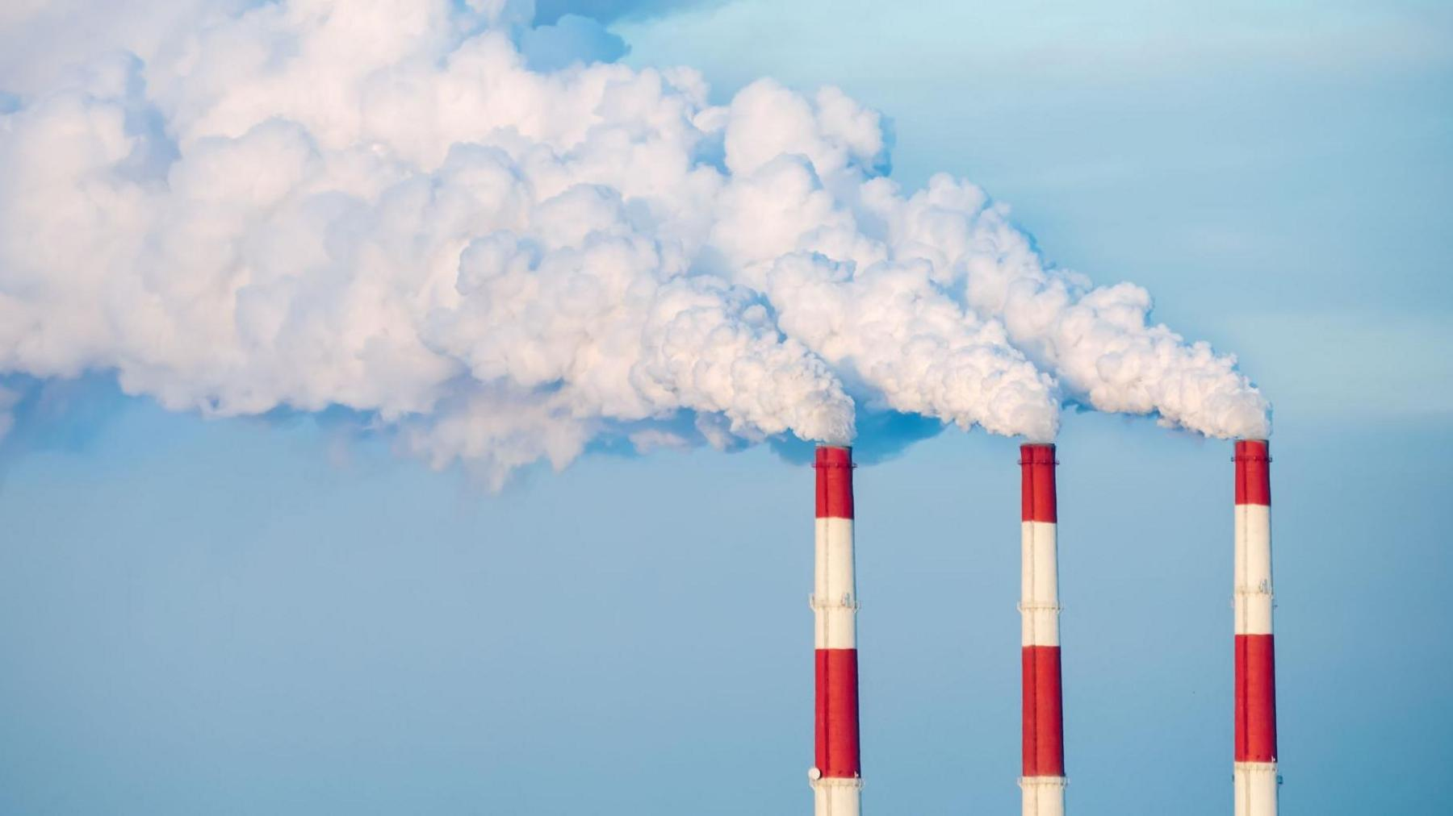

Analysing Factors Affecting Nitrogen Oxides (NOx) Emissions of Gas Turbine
Submitted To :
Prof. Devlina Chatterjee
HOD-DoMS, IIT Kanpur
Group 13
Sr. No | Students Name | Enroll. No
1) | Ankit Kumar | 251140002
2) | Nikhil D. Madankar | 251140014
3) | Sameer Saurav | 251140021
4) | Subodh Singh | 251140024
Course Title : Statistical Modeling for Business Analytics
Course Code : MBA652

Slide 2
Contents
Objective & Background
Data Source & Variables
Descriptive Statistics & Outlier Removal
Scatterplot Analysis
Correlation Matrix
Full Model & Multicollinearity (VIF)
Model Comparison (Backward Elimination)
Final Model & Interpretation
Conclusion

Slide 3
Objective & Background
Objective
Background
To analyze operational and environmental factors affecting NOx emissions of an industrial gas turbine, and build a multiple linear regression model to predict emission levels for environmental compliance and process optimization.
Peak combustion flame temperatures trigger thermal NOx formation — a pollutant under strict emission ceilings.
Predicting NOx from standard sensor telemetry supports continuous compliance verification, combustion-anomaly detection, and a computational proxy when physical CEMS units are under maintenance.
NOx escapes into the sky and creates smog and acid rain, Coughing .

Slide 4
Data Source & Variables
Dataset: Gas Turbine CO and NOx Emission Data Set (2011-2015), UCI ML Repository
Source: Operating cogeneration gas turbine, north-western Turkey (SCADA logging)
Contact: heydarkaya@nku.edu.tr, ptufekci@nku.edu.tr, euzun@nku.edu.tr
Sample: 36,733 hourly records → 35,347 after z-score outlier removal (|z| ≤ 3)
Variable | Description | Unit
NOx (Y) | Nitrogen oxides emissions | mg/m³
AT | Ambient temperature | °C
AP | Ambient pressure | mbar
AH | Ambient relative humidity | %
AFDP | Air filter differential pressure | mbar
GTEP | Gas turbine exhaust pressure | mbar
TIT | Turbine inlet temperature | °C
TAT | Turbine after temperature | °C
TEY | Turbine energy yield (power output) | MWh
CDP | Compressor discharge pressure | mbar

Slide 5
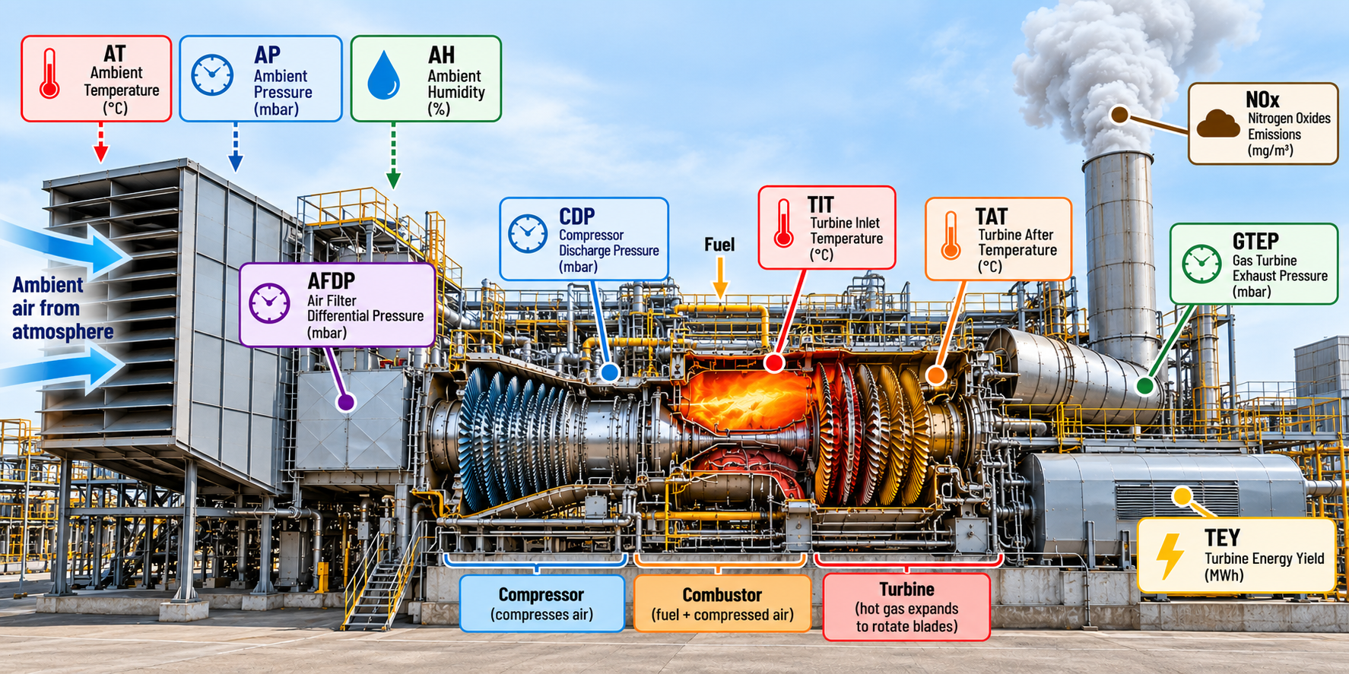
Industrial Gas Turbine Components
AI Generated Picture for Better Understanding of Variables

Slide 6
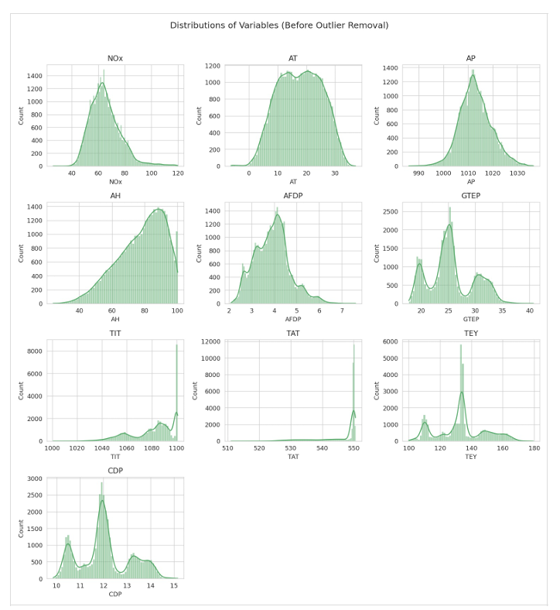
Descriptive Statistics

Slide 7
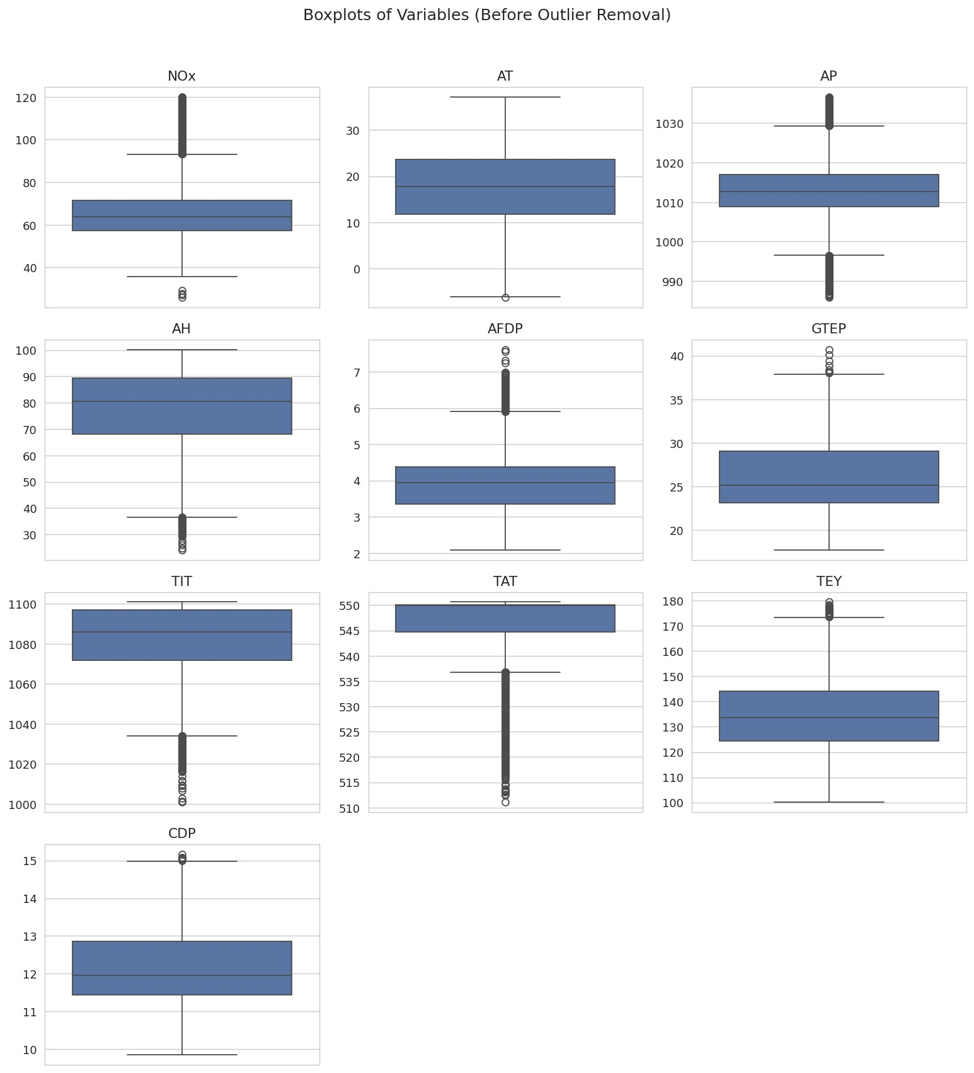
Descriptive Statistics & Outlier Removal
Method:
Standardized z-score, observation dropped if any of 10 variables had |z| > 3
N before: 36,733 → N removed: 1,386 → N after: 35,347
NOx std dev falls from 11.68 to 10.43 without materially shifting the mean (65.3 → 64.55).
TIT and TAT cluster near their upper limits — turbine spends most of its time near full-load operating temperatures.

Slide 8
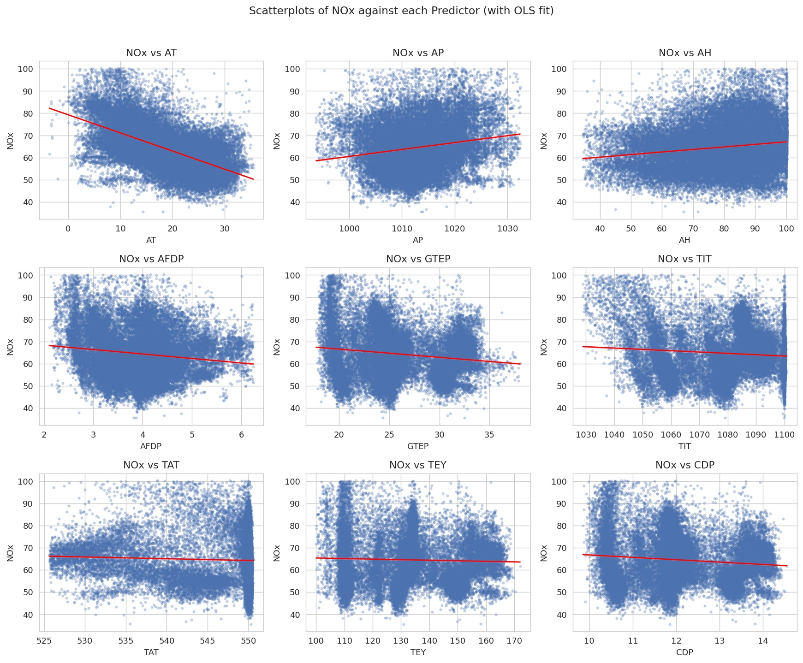
Scatterplot Analysis
NOx and Ambient temperature (AT) has strongly negative relation
NOx vs Ambient Pressure (AP) Relationship: Weak positive
NOx vs Ambient Humidity (AH) Relationship: Weak positive
TIT and TEY doesn't show a strong linear relationship with NOx
Why the NOx emission decreases with increase in AT ?
When the outside air becomes hotter . Hot air is less dense. That changes the amount of air the compressor can ingest for a given operating condition and affects turbine performance, load, air–fuel ratio, compressor operation, etc.

Slide 9
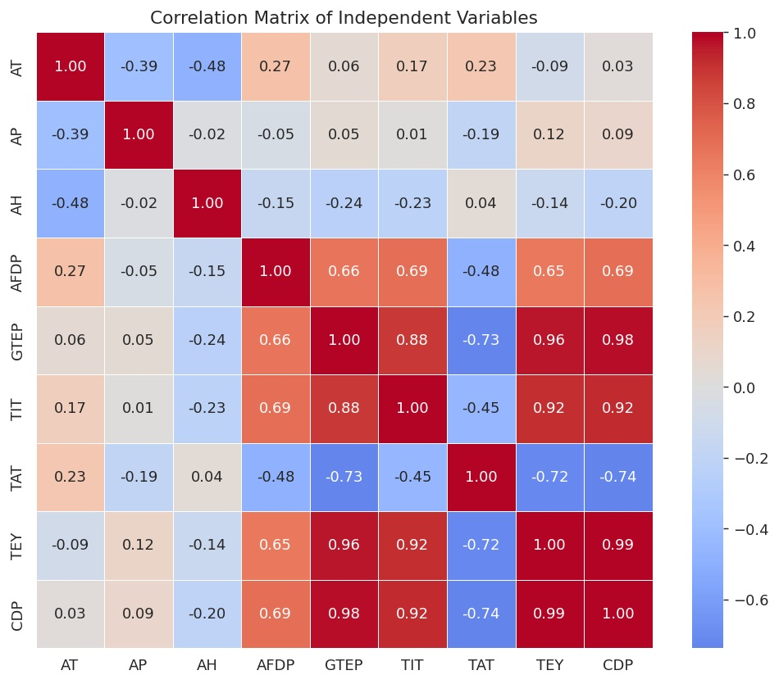
Correlation Matrix
Pair | Correlation
GTEP – TIT | 0.88
GTEP – TEY | 0.96
GTEP – CDP | 0.98
TIT – TEY | 0.92
TIT – CDP | 0.92
TEY – CDP | 0.99
TAT – TEY | −0.72
TAT – CDP | −0.74
Implication: This is preliminary evidence of severe multicollinearity — confirmed formally via VIF (Variance Inflation Factor)

Slide 10
Full Model (9 Predictors) & Multicollinearity
Model 1 : NOx = β₀ + β₁AT + β₂AP + β₃AH + β₄AFDP + β₅GTEP + β₆TIT + β₇TAT + β₈TEY + β₉CDP + ε
R² = 0.551 Adj. R² = 0.546 , p < 0.001
Predictor | Coef | p-value | VIF
AT | -1.671 | <0.001 | 8.3
AP | -0.225 | <0.001 | 1.5
AH | -0.214 | <0.001 | 1.6
AFDP | 0.908 | <0.001 | 2.4
GTEP | 0.082 | 0.094 | 28.5
TIT | 1.418 | <0.001 | 35.1
TAT | -1.348 | <0.001 | 9.0
TEY | -1.571 | <0.001 | 246.6
CDP | -6.419 | <0.001 | 238.1
The full model explains about 55.1% of the variation in NOx emissions
However, severe multicollinearity exists among turbine-load variables, especially TEY (VIF 246.6) and CDP (VIF 238.1) are essentially redundant , while GTEP is insignificant (p = 0.094)
A VIF above 10 is commonly considered an indication of serious multicollinearity

Slide 11
Model Comparison (Backward Elimination)
Model | Variables Included | Dropped | Reason | R² | Adj. R²
Model 1 | All 9 predictors | None | Full baseline | 0.551 | 0.546
Model 2 | 8 (drop TEY) | TEY | Severe Collinearity ( VIF = 246.6 ) | 0.5308 | 0.5303
Model 3 | 7 (drop CDP) | CDP | Severe Collinearity ( VIF = 87.2 ) | 0.3709 | 0.3708
Model 4 | 6 (drop GTEP) | GTEP | Insignificant ( p = 0.094 & VIF = 13.2 ) | 0.3708 | 0.3707
NOx= −176.13−1.67AT−0.225AP−0.214AH+0.908AFDP+0.082GTEP+1.418TIT−1.348TAT−1.571TEY−6.419CDP
NOx= 51.501−1.158AT−0.136AP−0.209AH+1.186AFDP−0.342GTEP+1.167TIT−1.429TAT−23.995CDP
NOx= 173.252−1.118AT−0.224AP−0.214AH+1.258AFDP−2.835GTEP+0.464TIT−0.511TAT
NOx= 90.089−1.120AT−0.146AP−0.155AH+1.861AFDP−0.013TIT+0.295TAT
Model 4 is retained as final:
- TEY, CDP and GTEP were removed due to high multicollinearity and/or insignificance.
- After removing them, all VIF values fell below 2.4, indicating no serious multicollinearity.

Slide 12
Final Model & Interpretation
NOx = 90.09 − 1.12·AT − 0.146·AP − 0.155·AH + 1.861·AFDP − 0.013·TIT + 0.295·TAT
R² = 0.3708 Adj. R² = 0.3707 , p < 0.001 | All VIF < 2.4 (no multicollinearity)
AT (−1.12)
Higher ambient temperature is associated with lower NOx emissions.
AH (−0.15)
Humidity dilutes combustion, lowering peak flame temperature — suppresses NOx.
AFDP (+1.86)
Largest-magnitude effect. Higher air-filter pressure is associated with higher NOx emissions.
TAT (+0.30)
Hotter exhaust-side temperature, holding inlet fixed, indexes a hotter combustion cycle.

Slide 13

Implications & Practical Applications for Regulators (India)
Localized Microclimate Mitigation & Urban Greening:
  Since ambient temperature ($\text{AT}$) heavily influences $NO_{x}$emissions and thermal dynamics, mandatory green-belt policies and urban forestry around industrial clusters should be implemented to mitigate the Urban Heat Island (UHI) effect.
Dynamic Environmental Compliance & Temperature-Based Standards:
  Environmental regulators should consider shifting from static emission norms to dynamic standards that account for seasonal ambient temperature fluctuations, which alter thermal efficiency and emission behaviors.

Slide 14
Conclusion
1
Ambient temperature (AT) is the strong predictor of NOx and explaining large of its variance.
2
The turbine “load” process variables (GTEP, TIT, TAT, TEY, CDP) are severely inter-correlated (|r| up to 0.99); dropping TEY, CDP and GTEP resolves it.
3
Forward selection and VIF-driven elimination independently converge on the same 6-variable model: AT, AP, AH, AFDP, TIT, TAT.
The final model explains 37.1% of NOx variance (Adj. R²), with inference accounting for confirmed heteroskedasticity .
4
5
Cooler, drier ambient air and a hotter restricted combustion process are all associated with higher NOx emissions.

Slide 15
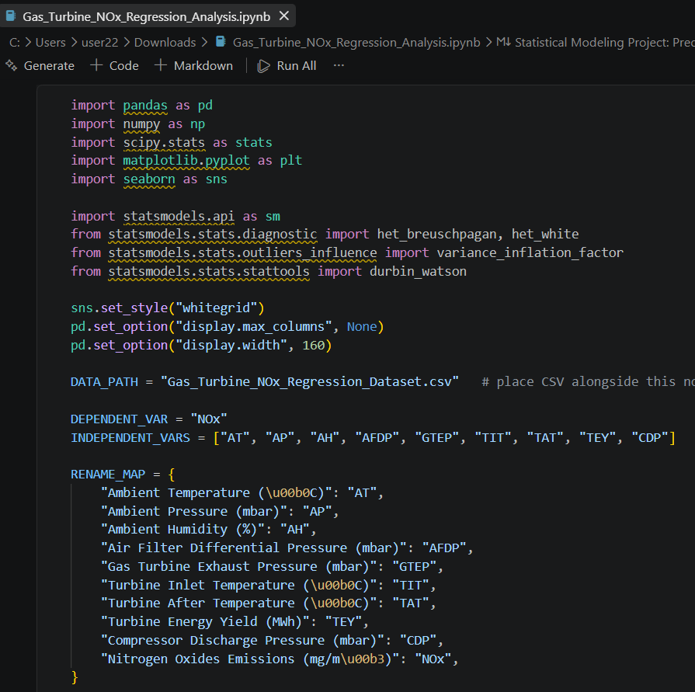
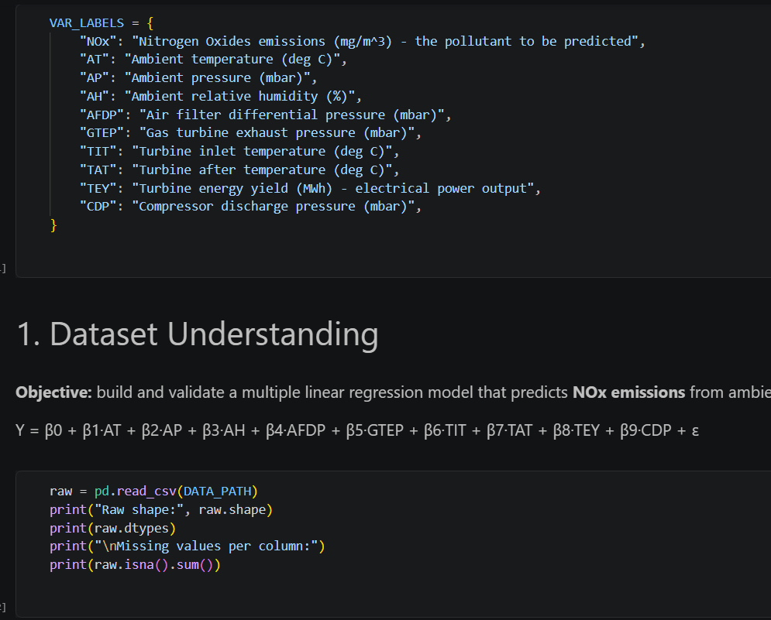
Appendix

Slide 16
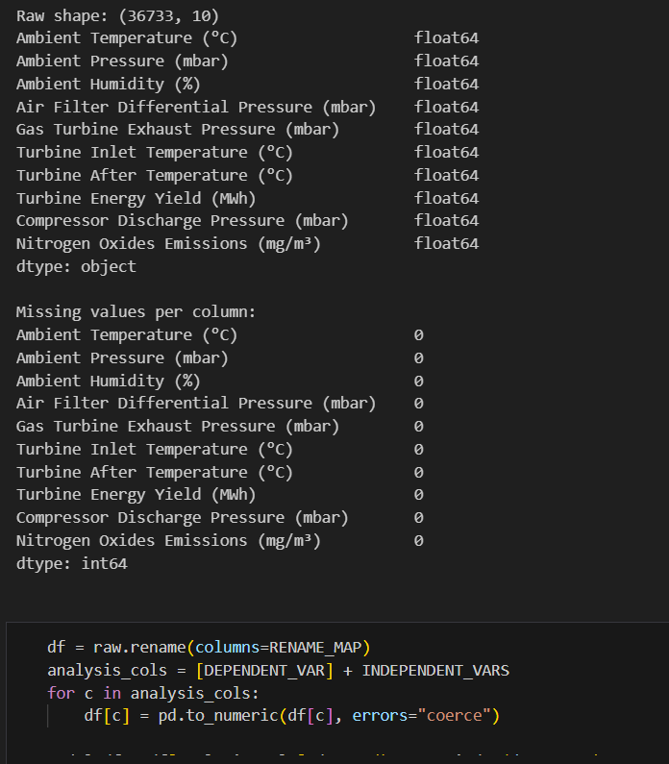
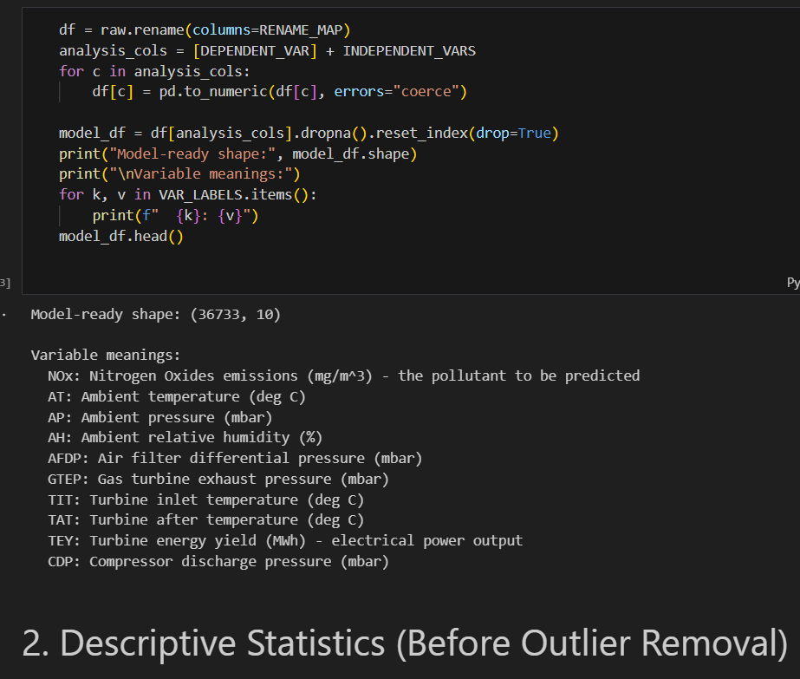
Appendix

Slide 17
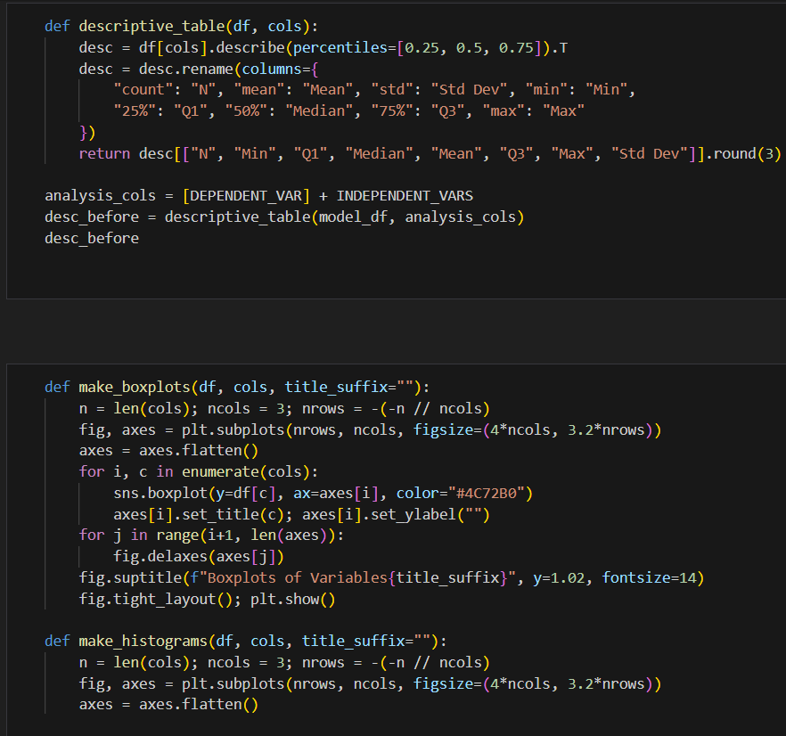
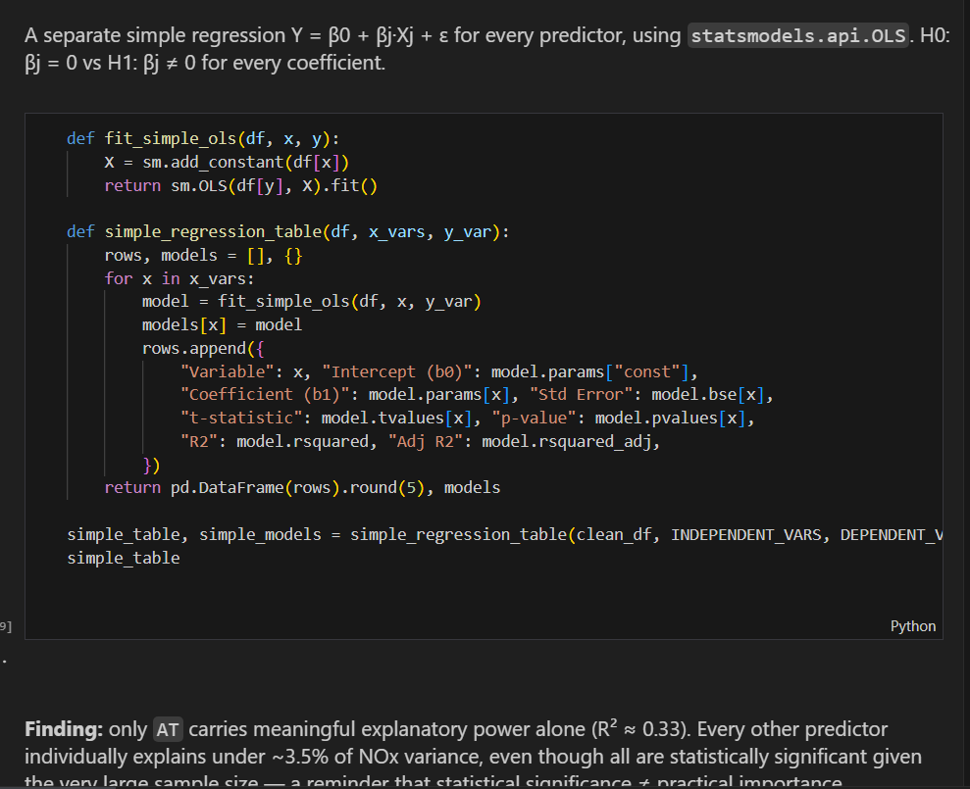
Appendix

Slide 18
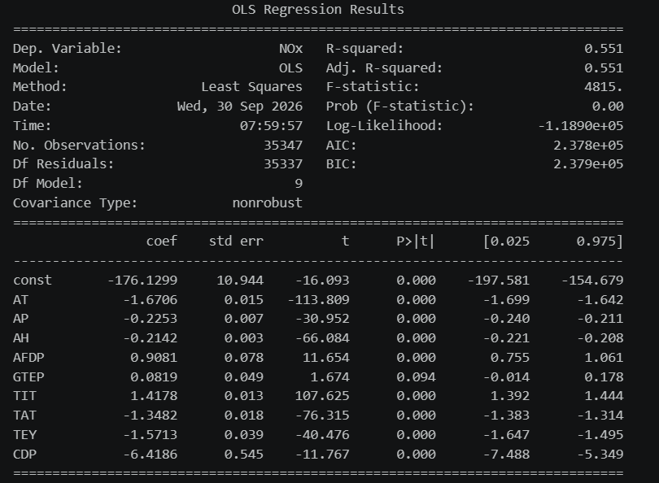
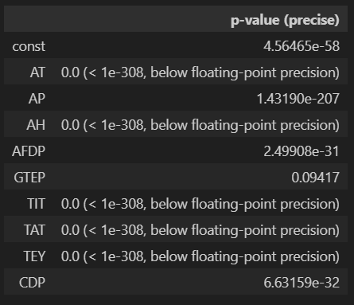
OLS Regression Results

Slide 19
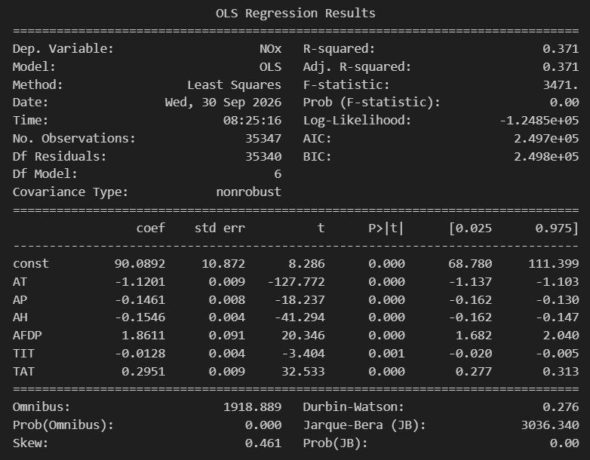
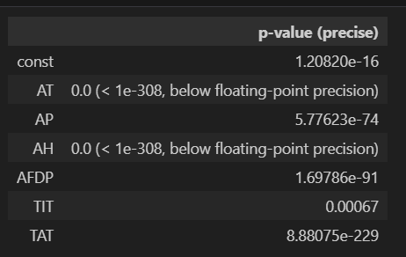
OLS Regression Results

Slide 20
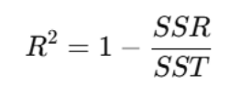
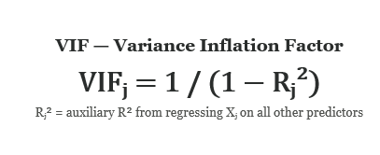
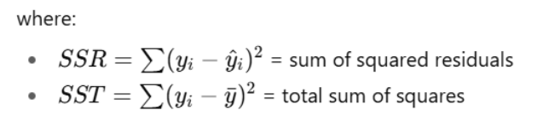
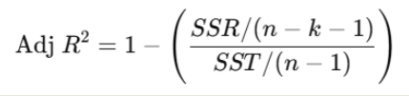
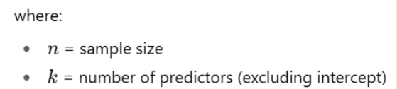
Key Formulas

Slide 21
Thank You!

