Slide 1
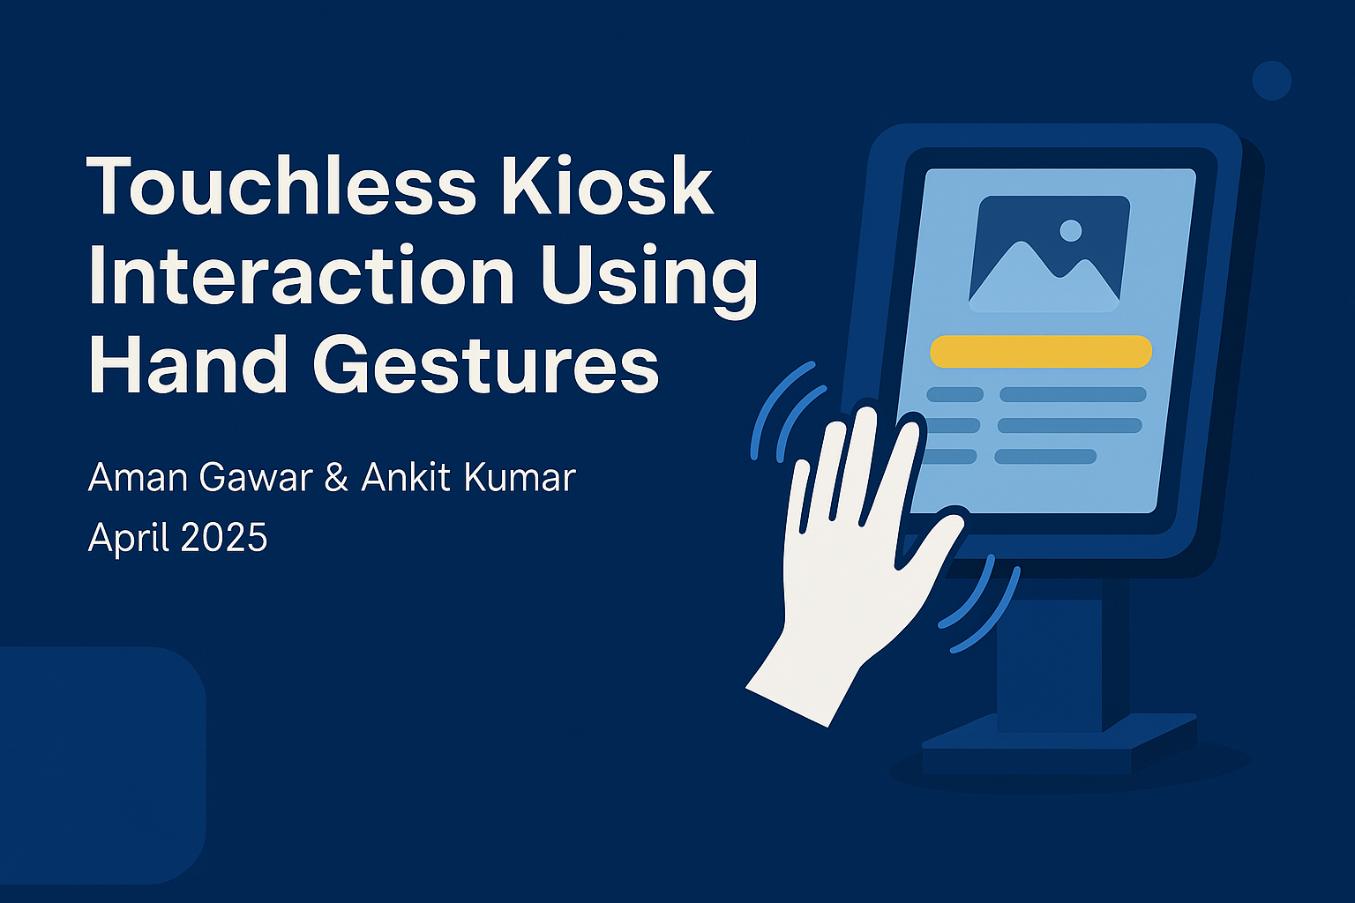
Touchless Kiosk Interaction Using Hand Gestures
By Aman Gawar & Ankit Kumar
April 2025

Slide 2
Introduction
- Kiosks are widely used in public places (airports, malls, etc.)
- COVID-19 emphasized the need for contactless interaction
- The project enables interaction using real-time hand gestures
- Benefits: Hygienic, Accessible, Intuitive

Slide 3
Problem Statement
- Hygiene risks from shared surfaces
- Inaccessible to people with disabilities
- High maintenance costs for touchscreens
- Touchscreens feel outdated in modern tech environments

Slide 4
System Overview
- Gesture Detection Module: MediaPipe + OpenCV
- Gesture Classification Module: Rules based on hand landmark geometry
- Interactive GUI Module: Tkinter-based display interface
- Real-time detection + GUI updates

Slide 5
Technology Stack
- Language: Python
- Libraries:
• OpenCV (video processing)
• MediaPipe (hand detection)
• Tkinter (GUI)
• Pillow (image display)
• NumPy (gesture math)

Slide 6
Algorithms & Logic Used
- Landmark-based gesture classification:
• Thumbs Up/Down: Y-coordinates of thumb tip
• Swipe Left/Right: X movement of wrist
• Help: Distance between fingers
- Geometry-based logic = fast & light

Slide 7
System Architecture
- Webcam → OpenCV → MediaPipe → Gesture Classifier
- → Tkinter GUI + OpenCV Feedback
- Modular design: Easy to extend

Slide 8
Results & Evaluation
- Accuracy: 89–94% across all gestures
- Latency: ~28–30ms per frame
- FPS: ~35 (smooth real-time experience)
- User feedback: 8.5/10 usability
- Tested in varying lighting, hand sizes, and angles

Slide 9
Applications & Future Scope
- Applications:
• Retail, Healthcare, Transportation, Education
- Future Additions:
• Machine Learning for gestures
• Voice & face integration
• Support for low-power devices
• Personalized gesture sets

Slide 10
Conclusion
- Effective alternative to touch-based kiosks
- High accuracy, low latency
- Scalable and hygienic solution
- Ready for real-world applications
- Room for intelligent and multimodal enhancements

