Slide 1
MODULO SMART HOME SYSTEM
MODULO 1
Presented By : Ann Martin (1317157)
Ankit Kumar (1317188)
Keerthana.T (1317191)
Department of Computer Science and Engineering
Guide : Bijeesh T V
2016-2017-March

Slide 2
Introduction First Module “DAD”
“DAD” – Door Alert System For Deaf People
How it Works?
    This module is wireless
    Two Devices will be implemented
    One for sensor
    Other for vibration
Sensor Device- Sense the object and data is stored in microcontroller after that data is transmitted to the receiver device using RF circuits
Receiver Device- Receiver device is small pocket size device which will receive transmitted data from sensor device

Slide 3
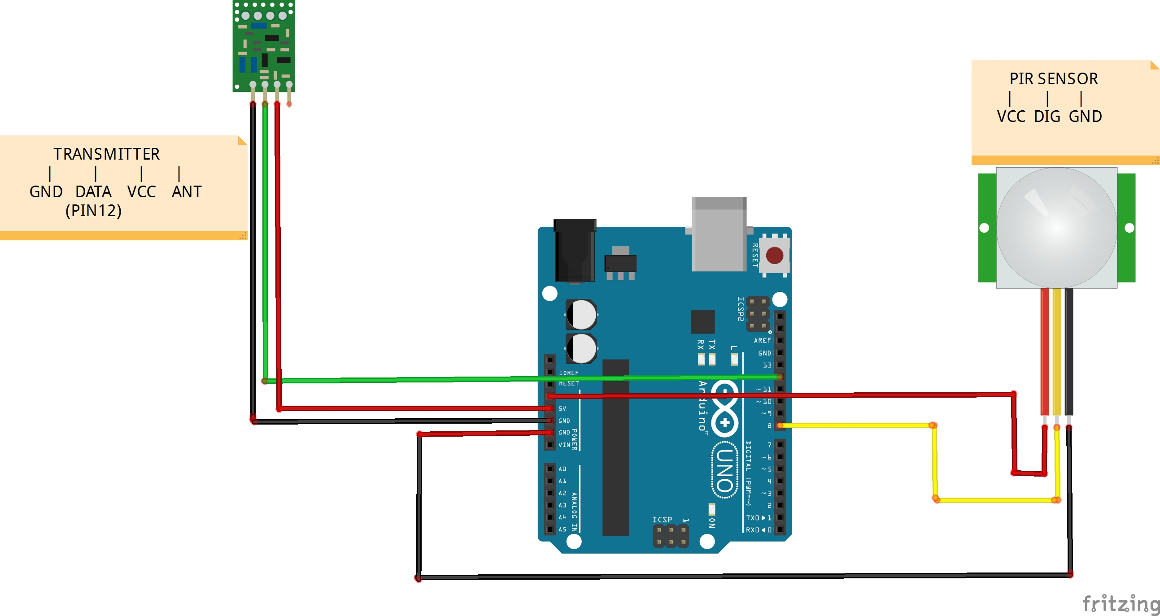
Design Modules
1. Sensor Device

Slide 4
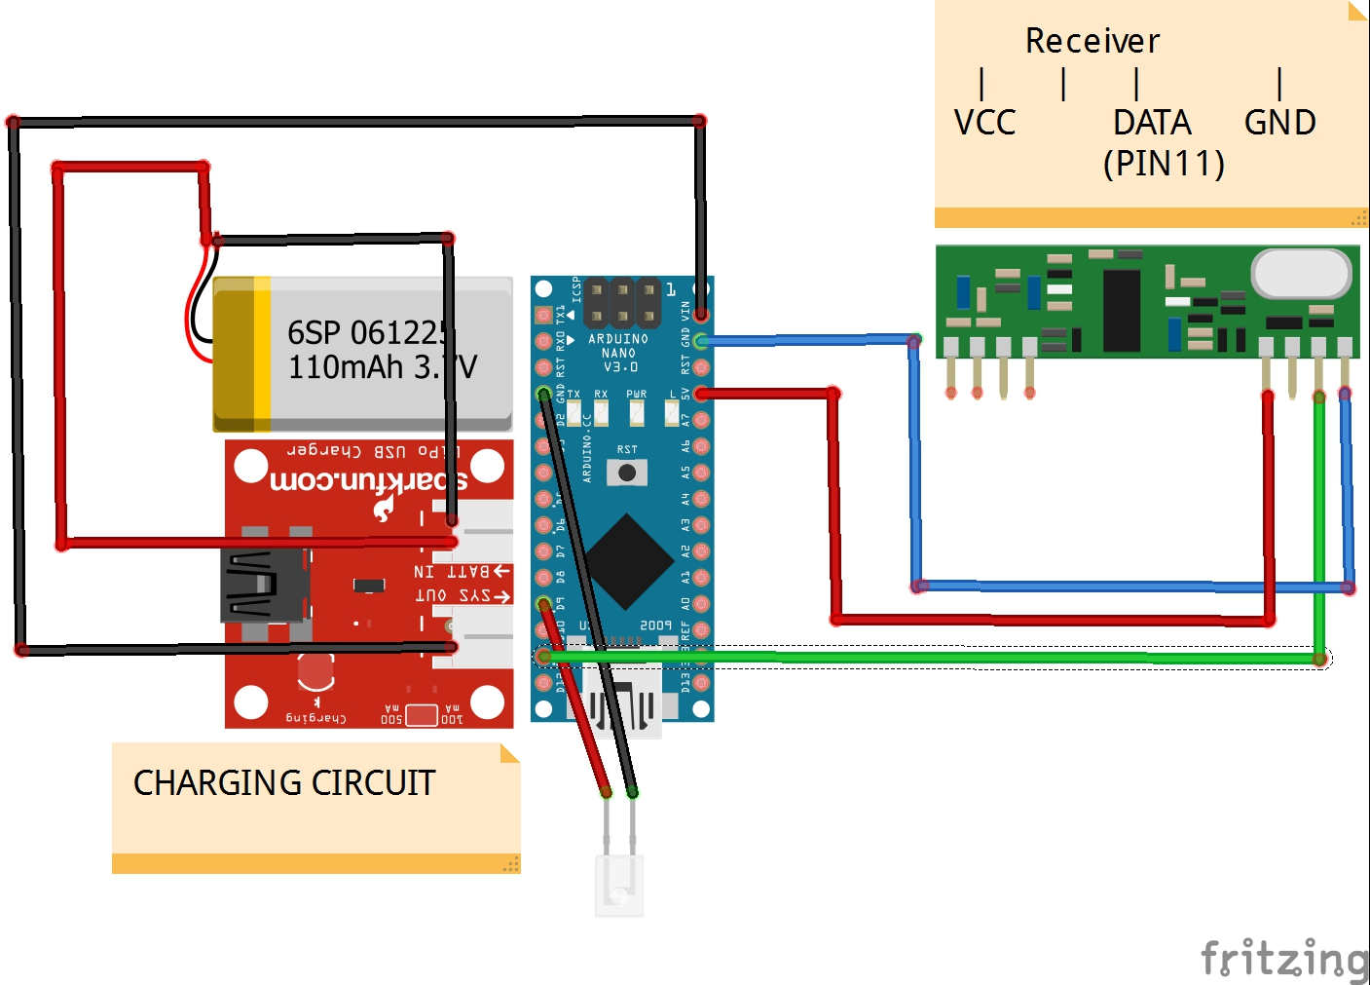
Design Modules
1. Receiver Device

Slide 5
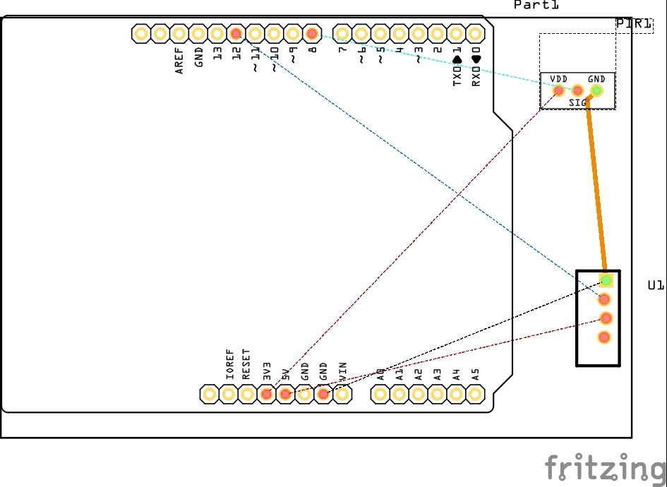
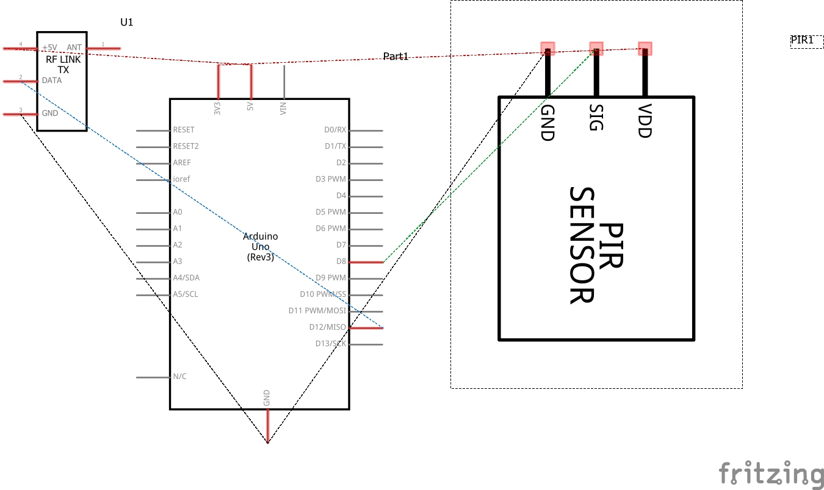
Circuit Design
Sensor Device
Schematic Design PCB Design

Slide 6
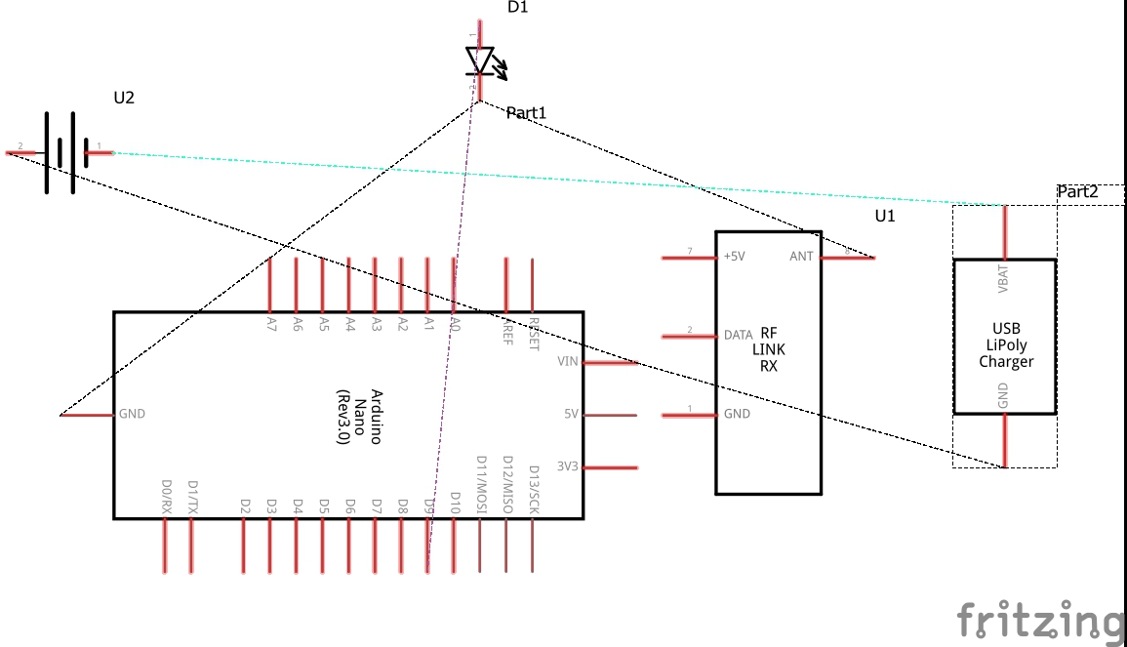
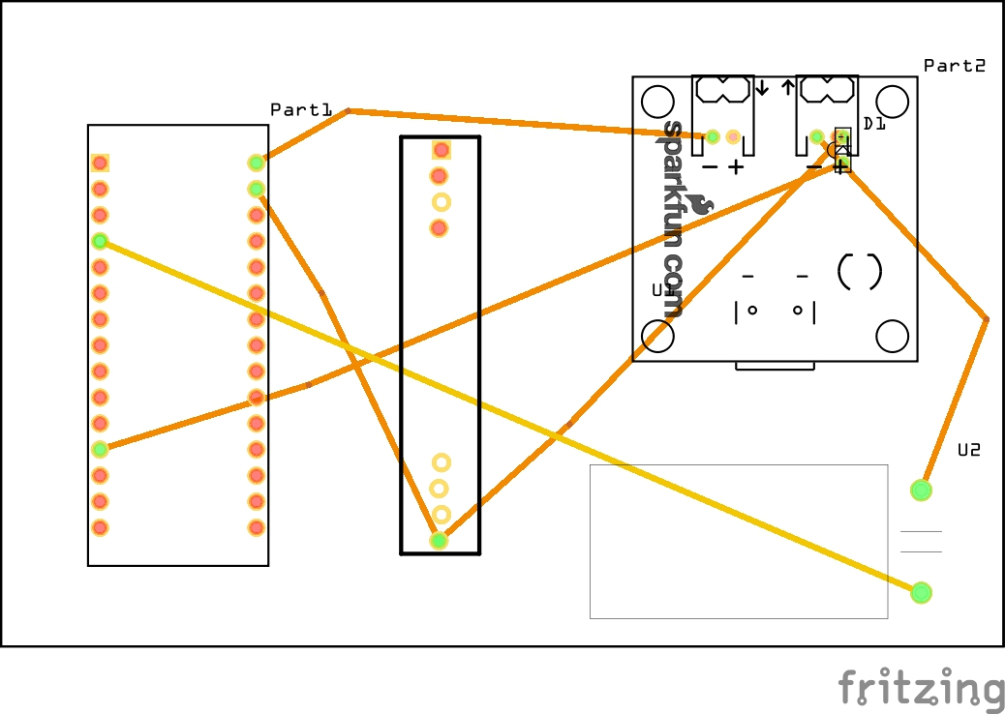
Circuit Design
Receiver Device
Schematic Design PCB Design

Slide 7

Computational Model (implementation model)

Slide 8
Experimental Result
The first module – using RF module
Board used: Arduino/ Genuino Uno
The transmitter sends signal to the receiver, and the message is displayed in the computer screen
Modification required: Code Bugs, circuit implementation with proper model.

Slide 9
Requirements
1. Arduino Compiler
2. Arduino Uno board
3. Arduino Nano board
4. RF module
5. PIR sensor
6. USB cable
7. PCB board
8. Light Emitting Diode

Slide 10
Future Plan
Module 2: Adding pulse sensor-detecting pulse and wrist band.

Slide 11
Conclusion
We have to assemble all component

Slide 12
References
Youtube.com
Arduino official website
http://homeautomationserver.com/
http://randomnerdtutorials.com/nrf24l01-2-4ghz-rf-transceiver-module-with-arduino/
R. I. Damper, M. D. Evans - “A Multifunction Domestic Alert System for the Deaf-Blind”- IEEE Transactions on Rehabilitation Engineering, Volume: 3, Issue: 4, Dec 1995 .
K. Vidyasagar, G. Balaji, K. Narendra Reddy- “Android Phone Enabled Home Automation”- Journal of Academia and Industrial Research (JAIR), Volume 4, Issue 2, July 2015.
Bilal Ghazal, Khalid Al-Khatib-“Smart Home Automation System for Elderly, and Handicapped People using Xbee” - International Journal of Smart Home, Vol. 9, No. 4 (2015).

