Slide 1
Installation
of Python
in Windows

Slide 2

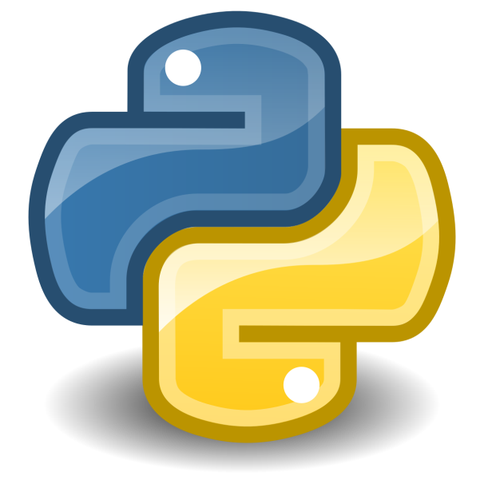
Guido van Rossum

Slide 3
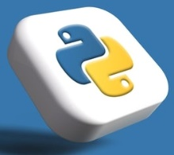
Python
Python is an interpreted, object-oriented, high-level programming language
It was released in 1991
Useful in scripting language
Used by -
Google, Yahoo!
Many Linux distribution
Games and apps

Slide 4
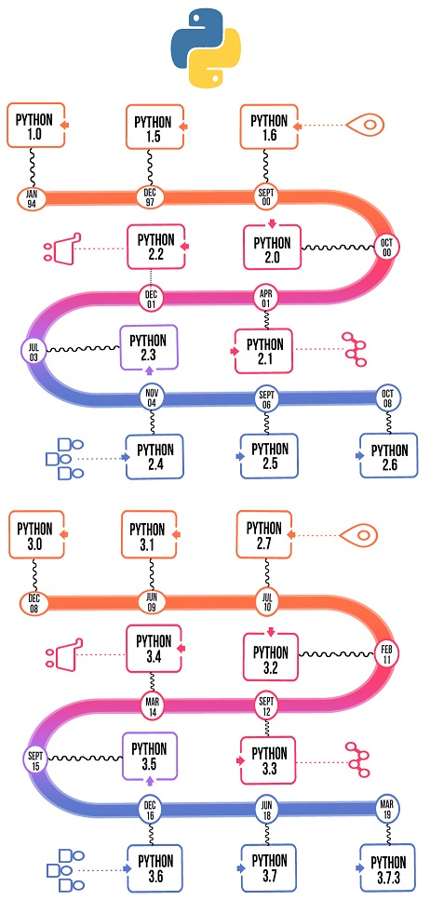
Different versions of Python

Slide 5
Interpreted Language
Interpreted
Not compiled like Java
Code is written and then directly executed by an interpreter
Type commands into interpreter and see immediate results
Java:
Code
Compiler
Runtime
Environment
Computer
Python:
Code
Interpreter
Computer

Slide 6
Python Features
Easy to Learn and Use
Object-Oriented Language
GUI Programming Support
Expressive Language

Slide 7
How to Install Python
Windows:
Download Python from https://www.python.org/
Install Python.
Run Idle from the Start Menu.

Slide 8

Print Command in Python
Python does not have a main method like Java
Python statements do not end with semicolons

Slide 9
Basic Python Syntax

Slide 10
Variables in Python
No need to tell data type in python
X=10
Y= “Hello”
Z= ‘‘‘Hello ’’’
A=1.020; // Semicolon in optional

Slide 11

Input in Python
# Python program showing
# a use of input()
val = input("Enter your value: ")
print(val)

