Slide 1

Open source
Presented by anyun

Slide 2
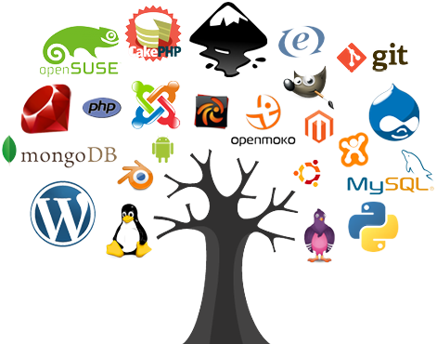
1. History of open source -From 70s to now 2. OSD-compliances 3. open source vs close source
Agenda

Slide 3
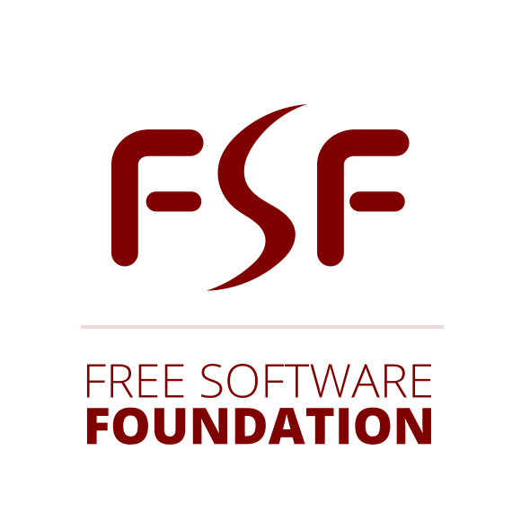
History of open sources (70s ,80s)
70s
In 1974, software became copyrightable, but that didn’t have a big impact because many companies had already stopped to distribute source code to prevent copying their software.
80s
In 1983, Richard Stallman created the GNU project. The GNU project contained open-source rewrites of closed-source software Stallman used.
In 1985 Stallman founded the Free Software Foundation (FSF), a foundation to support the free software movement.

Slide 4



History of open sources (90s)
The term open-source was readily adopted at the end of the 90s by the Linux, Perl, and Python community, but also by companies like, Netscape and Red Hat.
In 1998, the non-profit Open Source Initiative was founded, inspired by Netscape which had just open-sourced their web browser Netscape Communicator (which later became Firefox).
In 1999, a group of developers of the Apache web server realized their methodology could be applied to other open-source projects as well. They proceeded to found the non-profit Apache Software Foundation.
In 1999, Sourceforge.com was launched which allowed developers to easily share and develop source code.

Slide 5

History of open source ( 2000s)
2000
In 2000, the Linux Foundation was founded. It became on of the biggest and most influential open-source software foundations with a $100 million in revenue.
2001
In 2001, the Python Software Foundation was founded. To this date, the foundation remains committed to developing Python in the open.
2005
In 2005, Linus Torvalds created the initial version of Git, an open-source version control system to speed up the distributed development of the Linux kernel.
2008
In 2008, GitHub.com was launched - a central platform for source code development based on Git.
2008
Also in 2008, Google released the first version of Android, today’s most used mobile operating system.

Slide 6


History of open source ( 2010s)
2010s
Since 2017, Microsoft is one of the biggest open-source contributors in the world. In 2018, Microsoft acquired GitHub, the largest open-source development platform to this date.
The Free Software Foundation (FSF), the Apache Software Foundation (ASF), and the Linux Foundation became the largest foundations for open-source software. Even companies which fought open-source for decades started embracing open-source.
Open-Source Software clearly has conquered the world.

Slide 7
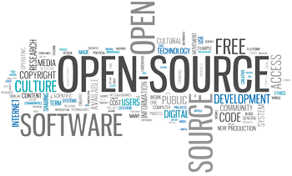
OSD-COMPINCES
The distribution terms of open-source software must comply with the following criteria:
1.Free redistribution: The license shall not restrict any party from selling or giving away the software as a component of an aggregate software distribution containing programs from several different sources.
2. Source code: The program must include source code and must allow distribution in source code as well as compiled form.
3. Derived works: The license must allow modifications and derived works and must allow them to be distributed under the same terms as the license of the original software.

Slide 8

OSD-COMPINCES
4. Integrity of the author's source code:
The license may restrict source-code from being distributed in modified form only if the license allows the distribution of "patch files" with the source code for the purpose of modifying the program at build time.
5. No discrimination against persons or groups
6. No discrimination against fields of endeavour:
The license must not restrict anyone from making use of the program in a specific field of endeavour.

Slide 9

OSD-COMPLINCES
7. Distribution of license:
The rights attached to the program must apply to all to whom the program is redistributed without the need for execution of an additional license by those parties.
8. License must not be specific to a product:
If the program is extracted from that distribution and used or distributed within the terms of the program's license, all parties to whom the program is redistributed should have the same rights as those that are granted in conjunction with the original software distribution.
9. License must not restrict other software.
10. License must be technology-neutral

Slide 10
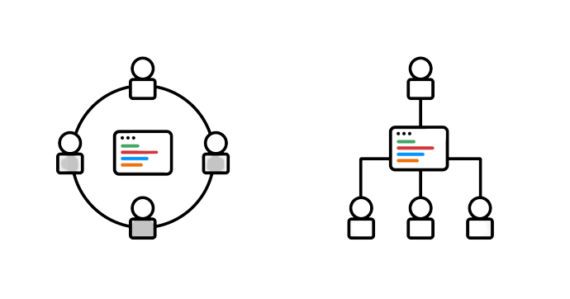
OPEN SOURCE VS CLOSE SOURCE
OPEN SOURCE
Open source software refers to the computer software which source is open means the general public can access and use. In short it is referred as OSS. The source code of open source software is public. It uses the code freely available on the Internet. This code can be modified by other users and organizations means that the source code is available for anyone to look at. The price of open source software is very less and there is no so much restrictions on users based on usability and modification of software.
Some examples of open source software are Firefox, OpenOffice, Gimp, Alfresco, Android, Zimbra, Thunderbird, MySQL, Mailman, Moodle, TeX, Samba, Perl, PHP, KDE etc.

Slide 11
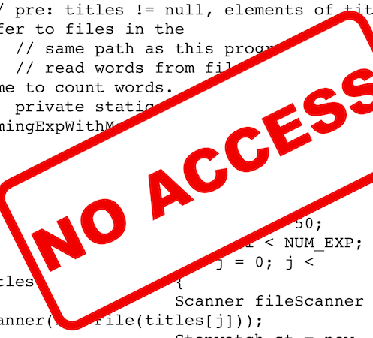
OPEN SOURCE VS CLOSE SOURCE
CLOSE SOURCE
Closed source software refers to the computer software which source code is closes means public is not given access to the source code. In short it is referred as CSS. In closed source software the source code is protected. The only individual or organization who has created the software can only change it. The price of closed source software is high and users need to have valid and authenticated license to use the software. As is issues an authenticated license so it also put a lot restrictions on users based on usability and modification of software.
Some examples of closed source software are Skype, Google earth, Java, Adobe Flash, Virtual Box, Adobe Reader, Microsoft office, Microsoft Windows, WinRAR, mac OS, Adobe Flash Player etc.

