Slide 1
KIET Group of Institutions, Delhi-NCR, Ghaziabad
Affiliated to Dr. A.P.J. Abdul Kalam Technical University (AKTU), Lucknow
Suggest an AI-Based Solution to Enable Ease of Grievance Lodging and Tracking for Citizens Across Multiple Departments
Project ID
Project Classification
Presentation
Date of Presentation
PCS-27-10
Application
First
07-08-2026
B.Tech (CS) Final Year Project Presentation
DEPARTMENT OF COMPUTER SCIENCE
Student Names: Abhay Pratap, Anubhav Mittal, Ankit Modi, Anshuman Rai
Guide: Mr. Vivek Kr. Sharma (Assistant Professor)

Slide 2
Problem Statement
1
Manual Submission & Routing
2
Time-Consuming Process
A citizen files a grievance, which is manually reviewed by a person and then forwarded to the concerned department.
Manual forwarding delays resolution and creates bottlenecks in the redressal cycle.
3
High Human Resource Cost
4
Poor Tracking
Significant manpower is required just to read and route grievances to the right department.
Citizens have limited visibility into where their grievance stands once it is forwarded.
AI-based Grievance Lodging & Tracking System
2

Slide 3
Proposed Solution
An AI-powered chatbot that understands citizen input and automatically decides how it should be handled — eliminating manual reading and forwarding.
Normal Query
Answered directly by chatbot
Citizen Query
(via Chatbot)
AI Classification
Model
Grievance
Auto-routed to the correct department
Concerned
Department
No manual reading of every submission
Faster routing, faster resolution
Reduced human resource dependency
AI-based Grievance Lodging & Tracking System
3

Slide 4
System Flow (MVP)
1
2
3
4
5
User Login
Chatbot
Classification
Auto-Routing
Admin Panel
Access user details securely
User asks a query in natural language
Model detects query vs. grievance
Grievance sent to correct department
Status updated: Resolved / Pending
Admin Panel Capabilities
View all grievances routed to the department
Update status — Resolved or Pending
Send a status/progress message back to the citizen
Frontend and backend for this flow are built; classification & routing model is functional.
AI-based Grievance Lodging & Tracking System
4

Slide 5
System Architecture
A layered architecture separates concerns cleanly — each layer can be developed, tested, and scaled independently.
Presentation Layer
React, HTML, JavaScript — Chatbot UI, Citizen Dashboard, Admin Panel
Application Layer
Node.js REST API — Authentication, Session Handling, Request Routing
AI / ML Layer
Text Preprocessing → TF-IDF Feature Extraction → Department & Priority Classifiers → Confidence Gating
Data Layer
PostgreSQL — Grievances, Users, Status Logs, Routing History
AI-based Grievance Lodging & Tracking System
5

Slide 6
Data Flow Diagram
How a single citizen query moves through the system end-to-end, including the confidence-based safety check.
Citizen submits query
Backend API receives & logs
ML model classifies text
Normal Query:
Chatbot answers directly
Grievance or
Normal Query?
Grievance:
Predict Department + Priority
Confidence ≥ 0.6 ?
Yes → Auto-route to
concerned department
No → Flag for
human review
Admin updates status (Resolved / Pending) → Citizen sees live status in tracking dashboard
AI-based Grievance Lodging & Tracking System
6

Slide 7
Methodology
The classification model was built following a standard supervised ML pipeline, adapted for multilingual text.
1
2
3
Data Collection & Curation
Text Preprocessing
Feature Engineering
Multilingual grievance text gathered and labeled with department + priority
Whitespace normalization, script-aware cleaning (Latin + Devanagari), de-duplication
TF-IDF: word bigrams + character 3–5-grams to handle Hinglish code-switching
4
5
6
Model Training
Evaluation
Confidence-Gated Deployment
Logistic Regression classifiers, one head each for department and priority
Stratified 85/15 train-test split, scored with macro-F1 per target
Low-confidence predictions routed to human review instead of auto-routing
AI-based Grievance Lodging & Tracking System
7

Slide 8
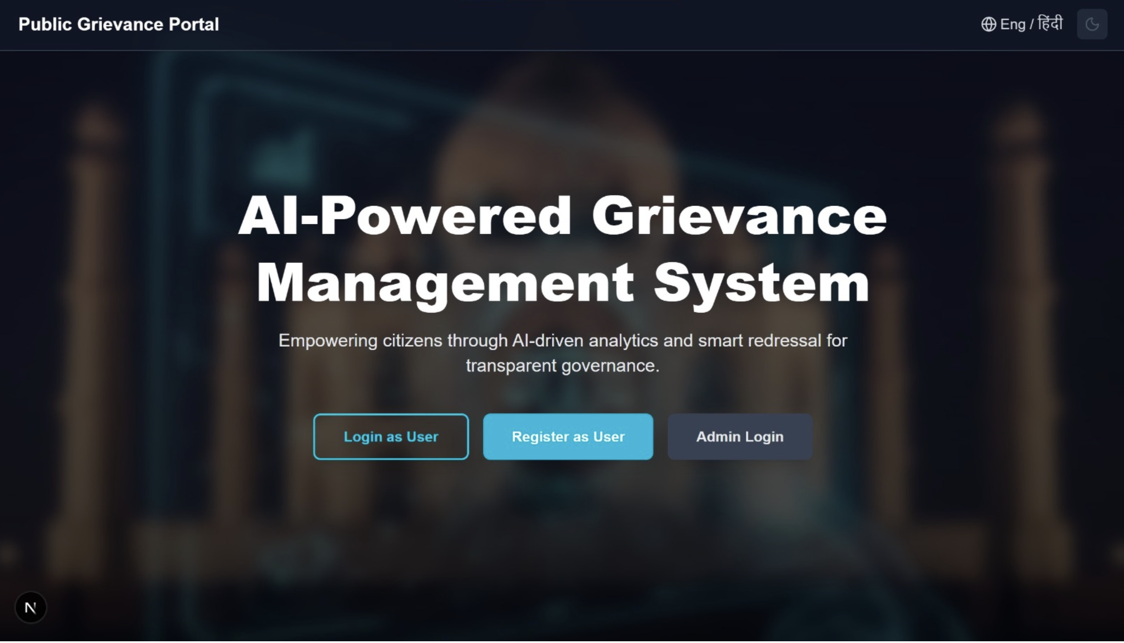
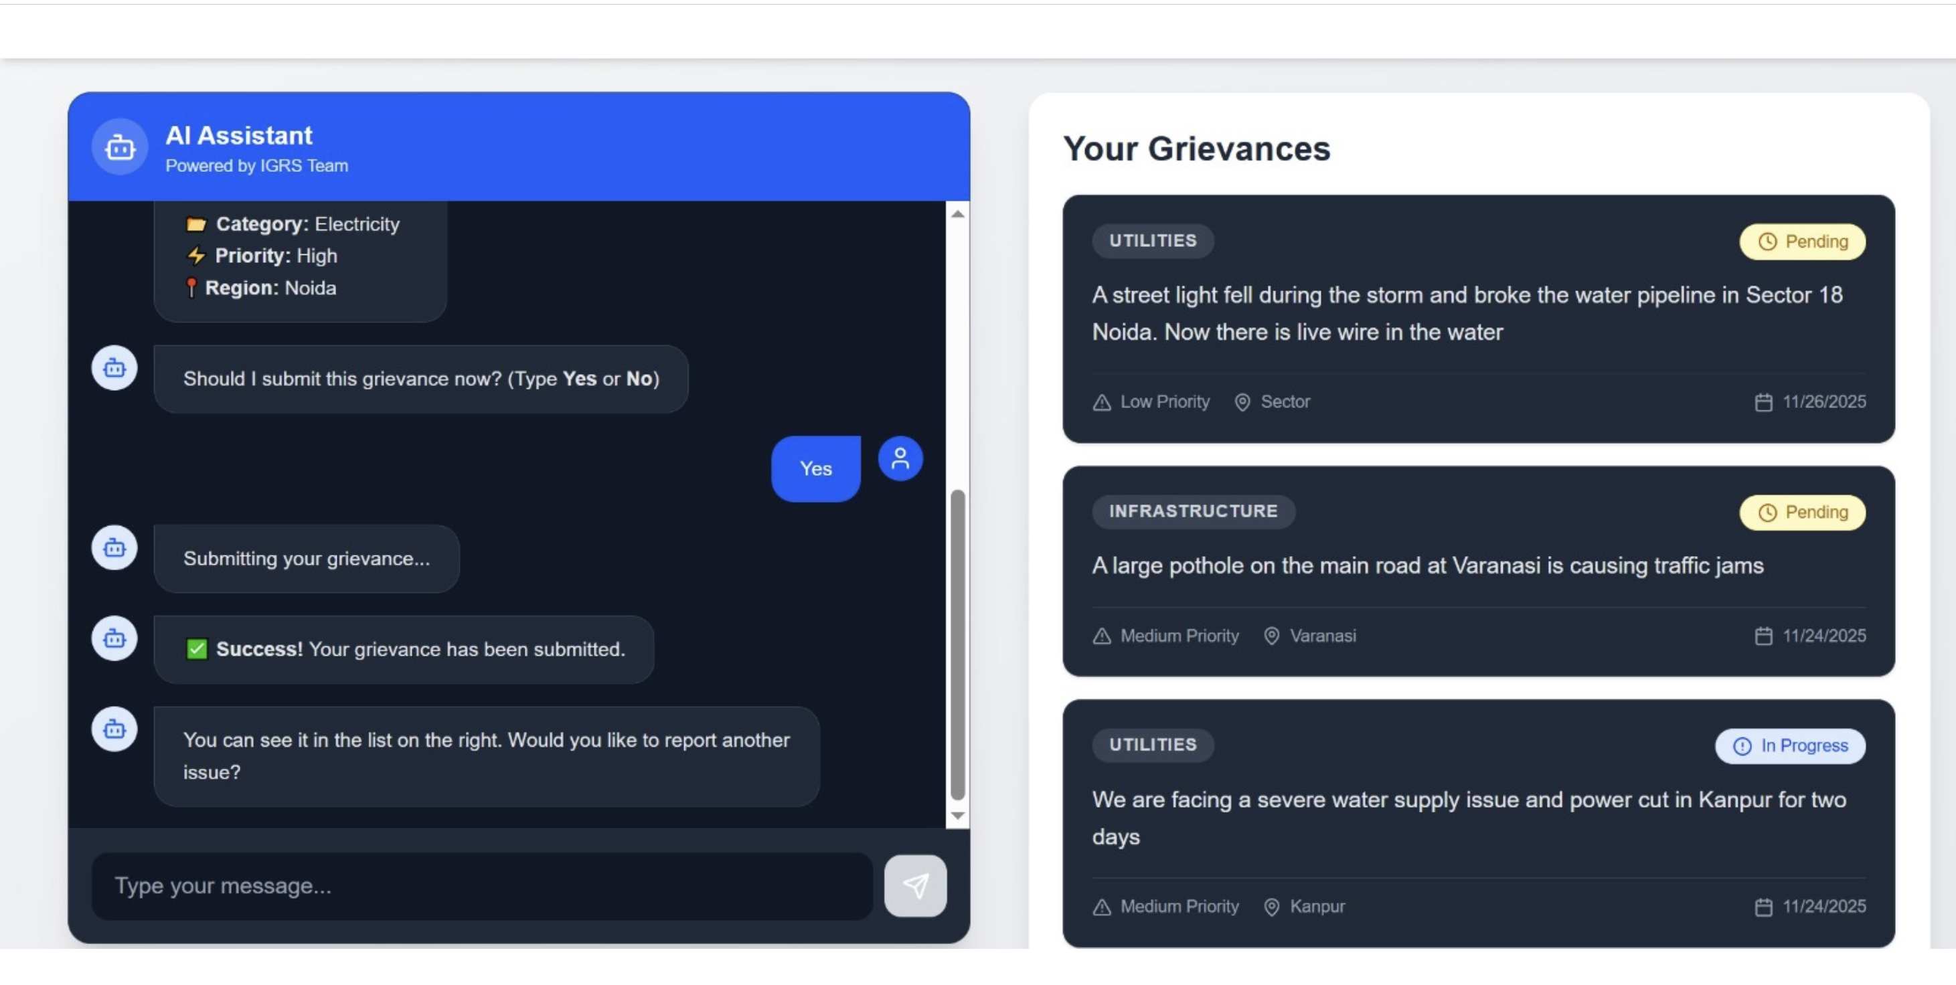
Live Application Preview
Screenshots of the working prototype — landing page and the AI chatbot submitting a real grievance.
Landing Page
AI Chatbot — Grievance Submission & Tracking
AI-based Grievance Lodging & Tracking System
8

Slide 9
Research & Existing System Study
Before starting development, relevant research papers were studied and the existing government platform CPGRAMS was analyzed for gaps.
Studied Platform: CPGRAMS — Centralized Public Grievance Redress and Monitoring System
Gaps Identified in CPGRAMS
Routing Accuracy
Misclassification
Duplicate Grievances
Grievances are not always directed to the right department reliably.
Genuine grievance text is sometimes treated as a normal query instead.
No robust mechanism to detect and remove duplicate submissions.
Our system directly targets these three gaps through automated, model-driven classification and routing.
AI-based Grievance Lodging & Tracking System
9

Slide 10
Dataset
A custom dataset was curated and used to train the grievance classification and routing model.
8,000
16
ROWS (FULL CURATED SET)
COLUMNS
Dataset is used to train the model that classifies incoming text as a normal query or a grievance, and predicts the relevant department.
Prototype Training Sample (this presentation's demo model)
3,996 labeled grievance rows across 8 departments (street_lights, water_supply, drainage, sanitation, roads, electricity, health_safety, public_services)
Multilingual text: English, Hindi, and Hinglish (romanized Hindi) complaints
AI-based Grievance Lodging & Tracking System
10

Slide 11
Classification Model — Approach & Results
Baseline model trained and evaluated on the sample dataset: TF-IDF (word + character n-grams) features feeding two linear classifiers — one for department, one for priority.
Why character n-grams
They capture sub-word patterns that work across English, Hindi, and Hinglish code-switching — without needing separate per-language pipelines.
Confidence-gated routing
Predictions below a 0.6 confidence threshold are flagged “needs_review” and sent to a human instead of being auto-routed — a safety net against silent misrouting.
Sample Predictions
Complaint (excerpt) | Department | Confidence | Status
“Ward 12 mein paani ki supply nahi aa rahi...” | water_supply | 97.6% | Auto-routed
“...chauraha me light ki problem he” | street_lights | 44.3% | Needs review
AI-based Grievance Lodging & Tracking System
11

Slide 12
Technology Stack
1
2
3
4
Frontend
Backend
Database
AI / Query Handling
React, HTML, JavaScript
Node.js
PostgreSQL
Groq API
A modern full-stack architecture combining a responsive React frontend, a scalable Node.js backend, a relational PostgreSQL database, and Groq's fast inference API for AI-driven query handling.
AI-based Grievance Lodging & Tracking System
12

Slide 13
Current Progress
Completed
In Progress / Pending
✓
Frontend
…
Advanced Model Building
Developed using React, HTML, JavaScript
Pending
✓
Backend
…
Multi-Language Support
Developed using Node.js
Pending
✓
Classification & Routing Model
Built — classifies input and routes grievances
AI-based Grievance Lodging & Tracking System
13

Slide 14
Future Scope
Grievance Analytics Dashboard
Analyze grievance data to identify which areas generate the most grievances and which categories are most common — enabling departments to focus resources where they are needed most.
A
By Area
C
By Category
F
Focused Action
Identify regions/localities with high grievance volume
Identify which grievance categories are most frequent
Direct resources toward high-need areas and categories
AI-based Grievance Lodging & Tracking System
14

Slide 15
References
R
Research Papers
Reviewed prior research on AI-based grievance classification and routing systems.
View compiled research papers →
D
Dataset Collection
Custom dataset (8,000 rows x 16 columns) compiled for model training (source link — to be added).
C
CPGRAMS
Centralized Public Grievance Redress and Monitoring System — pgportal.gov.in, studied as the existing benchmark system.
AI-based Grievance Lodging & Tracking System
15

Slide 16
Thank You
AI-based Grievance Lodging & Tracking System

