Slide 1
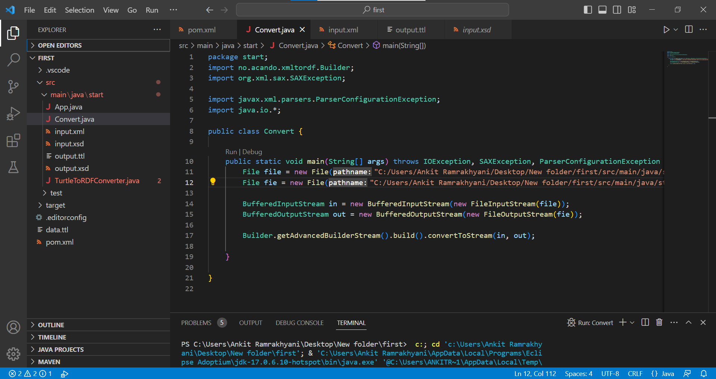
CODE SNIPPET:-
The Following Code Covert The XML Document into the Equivalent TURTLE Format.
TURTLE(Terse RDF Triple Language)
In computing, Terse RDF Triple Language (Turtle) is a syntax and file format for expressing data in the Resource Description Framework (RDF) data model.
A Turtle document allows writing down an RDF graph in a compact textual form. An RDF graph is made up of triples consisting of a subject, predicate and object.`

Slide 2
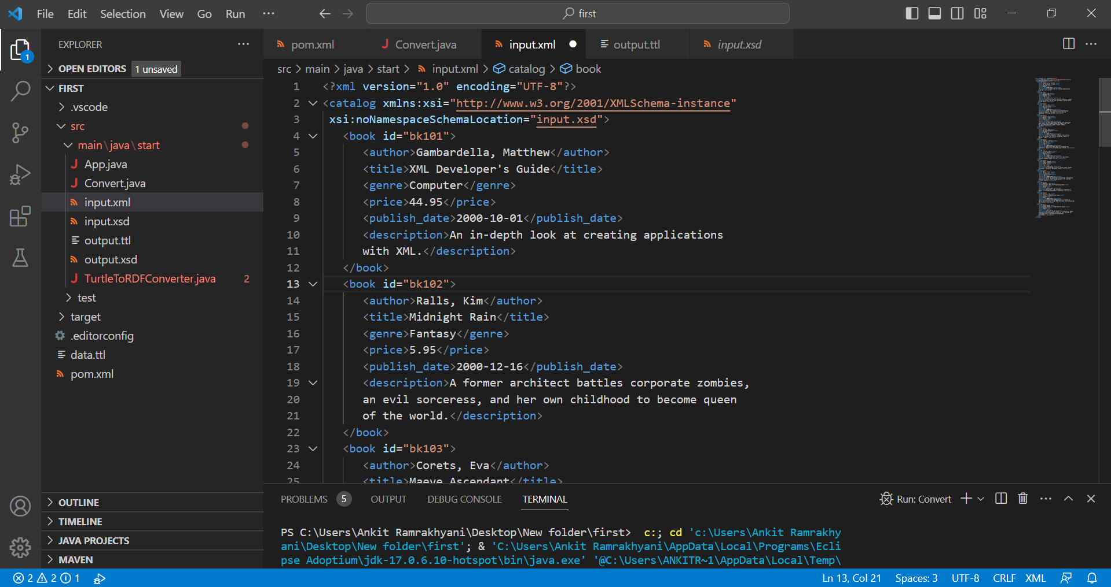
INPUT FILE:-

Slide 3
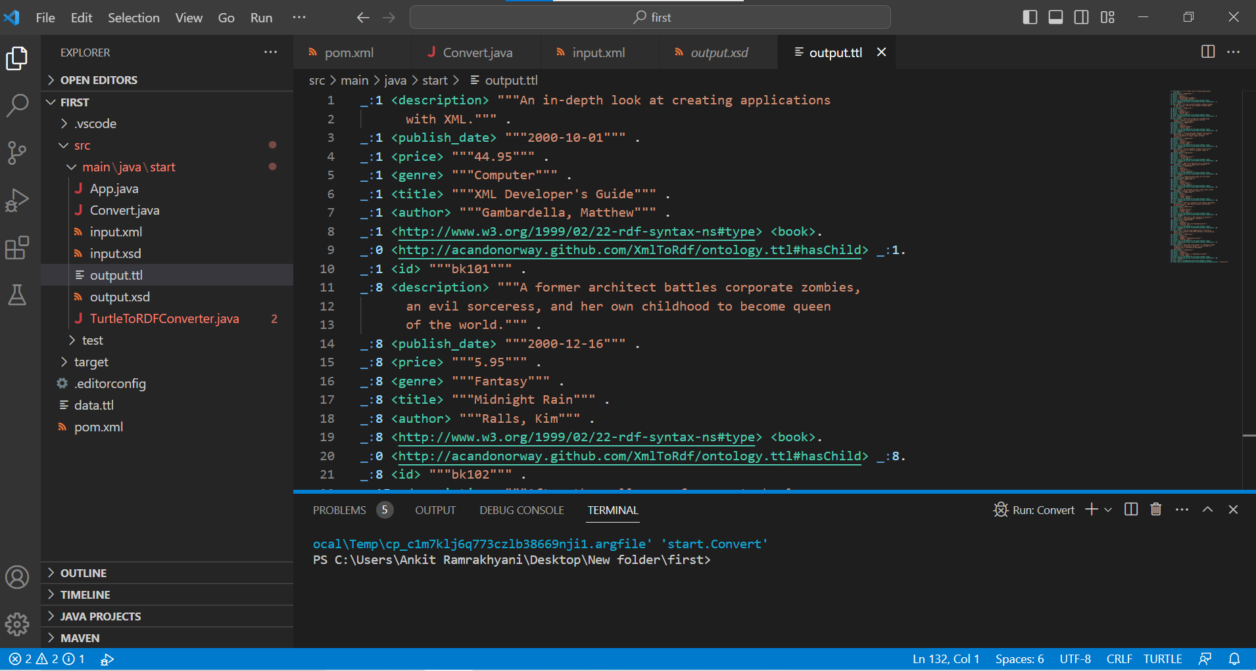
OUTPUT FILE(In TURTLE FORMAT):-

Slide 4
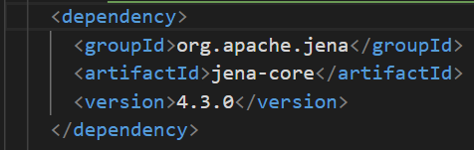
TECHNICAL DIFFICULTIES:-
As we used the JINA Framework, but it was initially difficult to load all JAR files, we could add whole framework but instead we made our project in MAVEN and added the following dependency in pom.xml File.

Slide 5
GITHUB LINK:-

