Slide 1

CECS 571 Fundamentals of Semantic Web Technologies
COMPUTER ENGINEERING AND COMPUTER SCIENCE
By:-
Sai Vardhan Kondapaka
Ankit Ramrakhyani
Sai Mallesh Goud Dabbeti
Sri Ram Prasad
Pavan Sai Reddy Atla
Project 3: Semantic Data Retrieval
Under guidance of:-
Dr. Bo Fu
GIT link- https://github.com/Ankitr0908/WebSemantics_Project3

Slide 2
Content:-
Dataset Description
Technical Approach
Queries and Description
Visualization of OWL dataset
Technical Challenges Faced
References and GitHub Link
Owl Samples
Code and UI Samples

Slide 3
Dataset-
The following dataset has been used in this project-
Ecology and Endangered Species-
The ontology includes classes for different types of animals, such as mammals, birds, and reptiles, and provides information about their characteristics, habitats, conservation status, and more. For example, each animal class has properties that describe its size, diet, and geographic range. The ontology also includes classes for different types of habitats, such as forests, deserts, and freshwater environments, and provides information about the species that live in each habitat.
The ontology is designed to be extensible, allowing new animal classes and properties to be added as needed. It can be used to represent information about animals in a variety of contexts, such as biodiversity research, conservation efforts, and education. The ontology also includes information about various plant species, and as their taxonomy, growth habits, and habitats.
Link- https://drive.google.com/file/d/1SZ-vrET7AEfIrqpgfowOLrZ44KHe4kCB/view

Slide 4
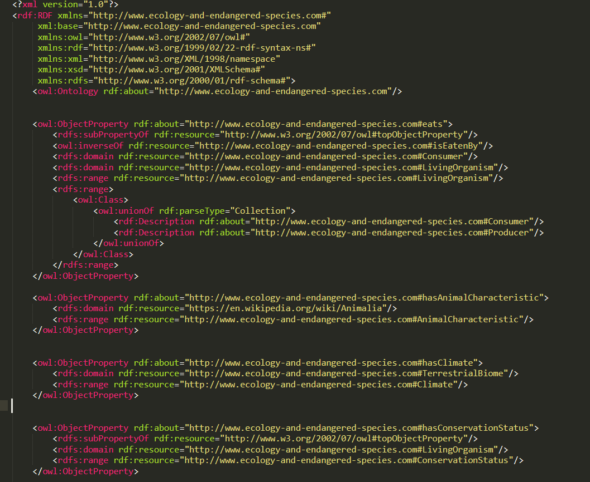
Owl File Screenshot1

Slide 5
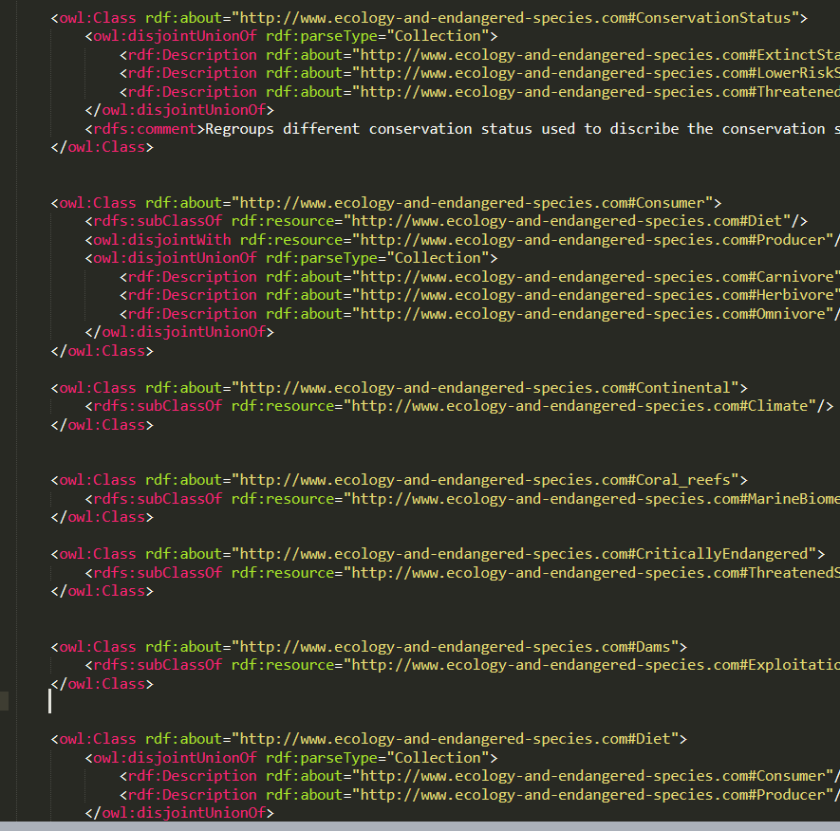
Owl File Screenshot2

Slide 6
Technical Approach: Overview
Step 1 : User Interface Design and Development.
Step 2 : Creation of SPARQL Queries.
Step 3 : Read OWL file and giving desired prefixes and namespace.
Step 4: Execute the queries using Apache Jena.
Step 5: Integrate the final code.
Step 6: Perform required operations (read, upload, display) in GUI.

Slide 7
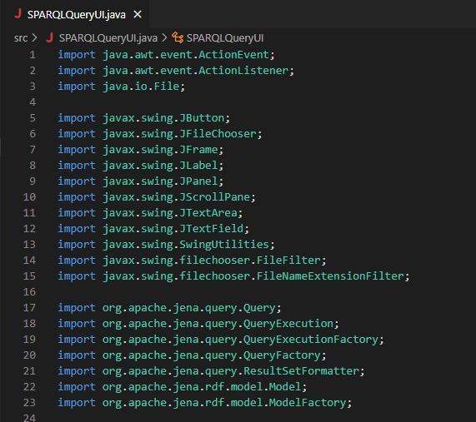
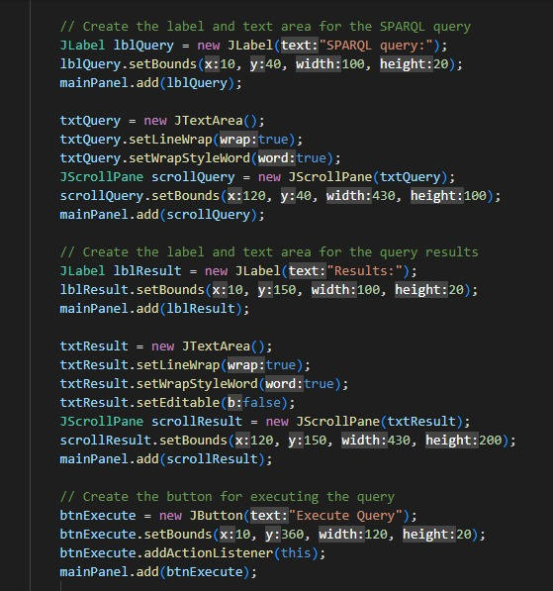
Code Snippets

Slide 8
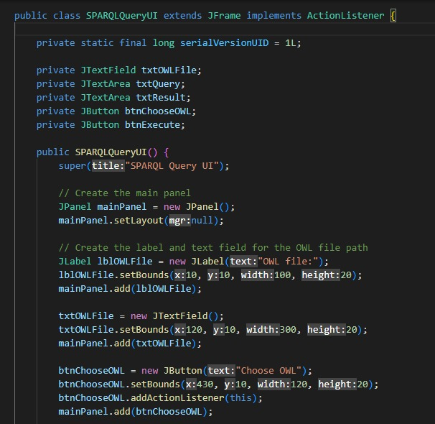
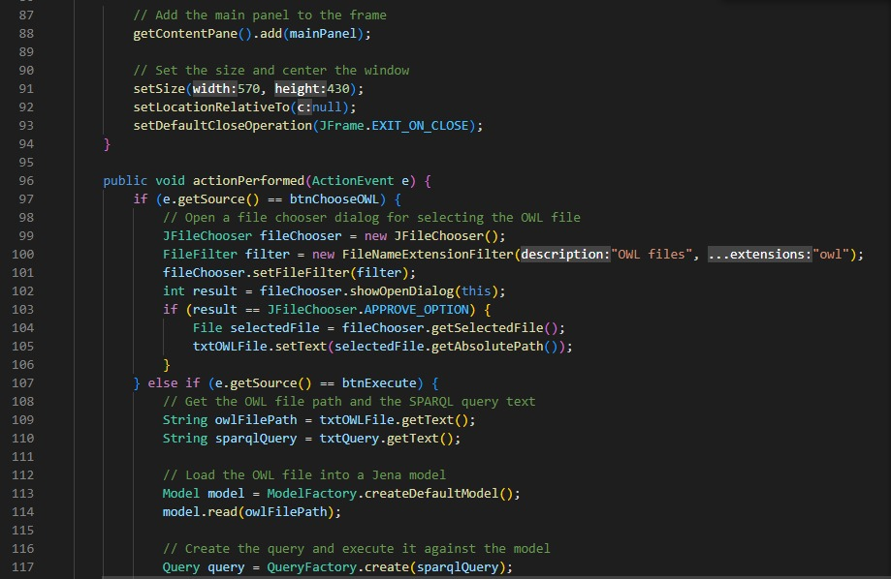
Code Snippets

Slide 9
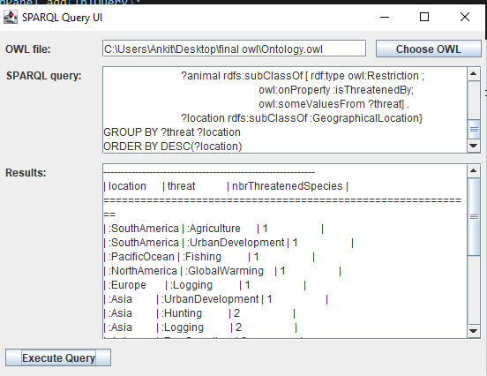
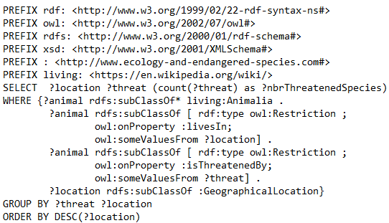
Query 1:-
What are the locations and the types of threats faced by the endangered animal species, and how many species are threatened in each location?

Slide 10
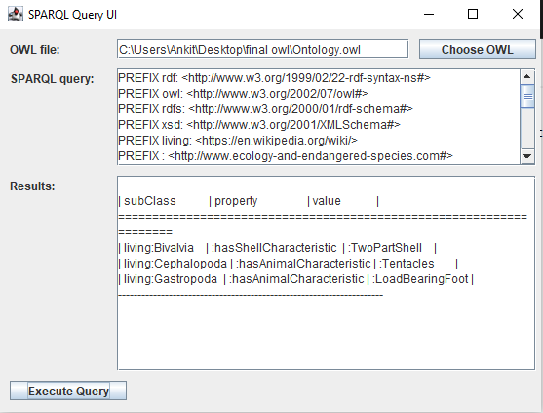
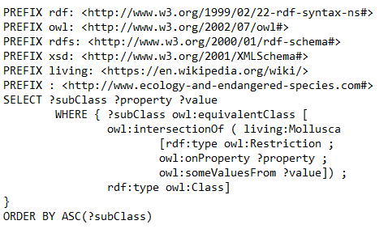
Query 2:-
What are the properties and their corresponding values that define the subclasses of the class equivalent to living:Mollusca?

Slide 11
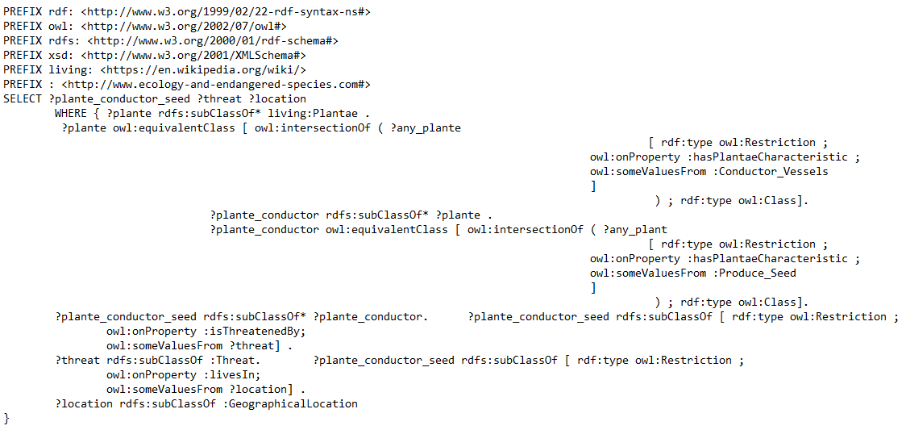
Query 3:-
What are the locations and types of threats faced by the plant species that have both conductor vessels and produce seeds, and how are these species further classified based on their plantae characteristics?

Slide 12
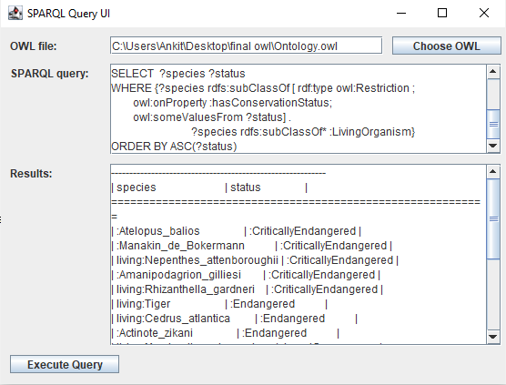
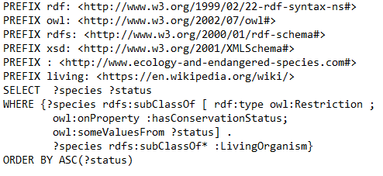
Query 4:-
What are the living organisms and their corresponding conservation statuses?

Slide 13
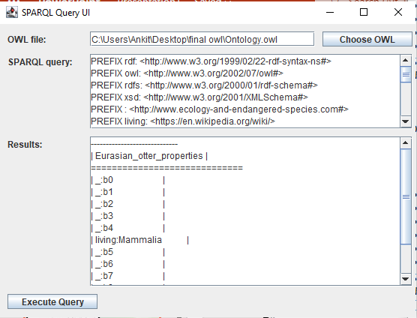
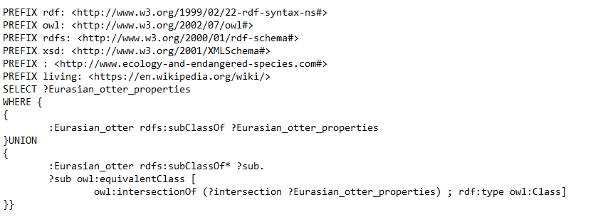
Query 5:-
Query to retrieve all the subclasses and equivalent classes of the Eurasian otter class and returns their properties.

Slide 14
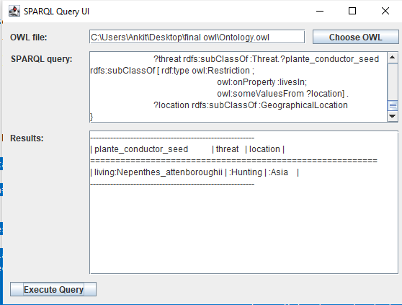
UI Screenshot
The UI has three components-
OWL File- It is to choose the OWL file input from user locally.
SPARQL query- Input Area where user can write queries, for execution on the selected dataset.
Results – Output box of the desired query result.

Slide 15
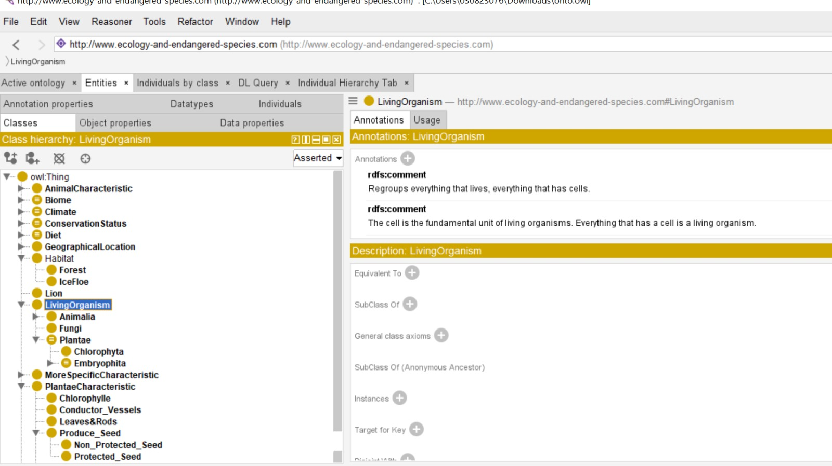
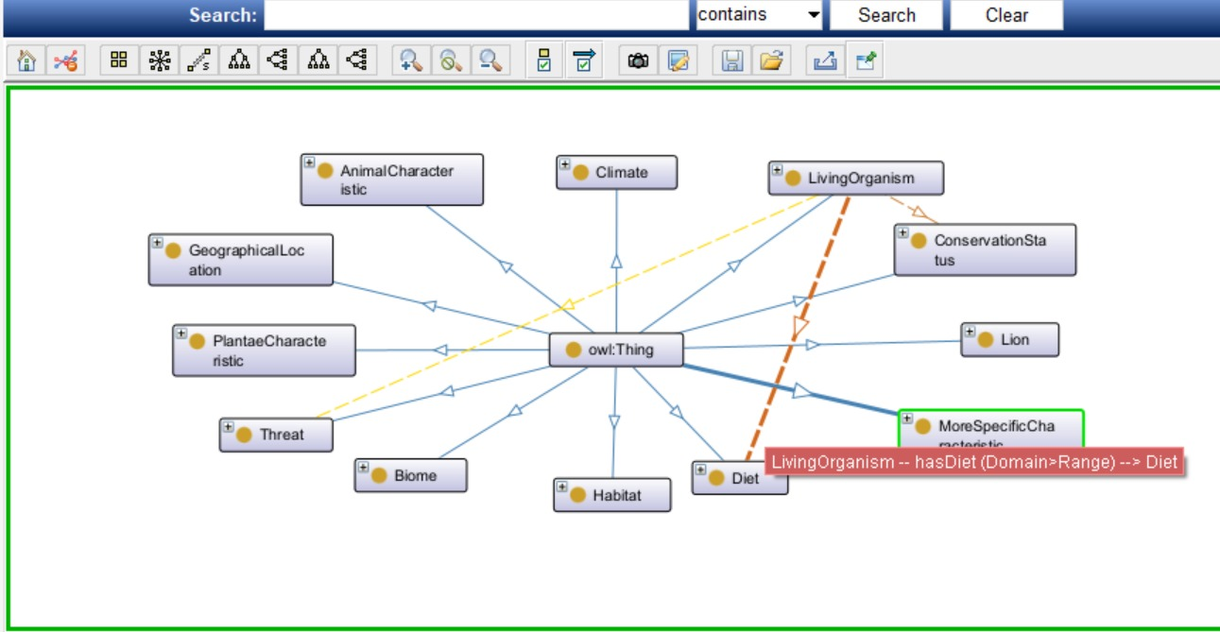
OWL Visualization

Slide 16
Technical Difficulties:-
Choosing The Dataset-
Initially Choosing of Project 1 Dataset
Changed the dataset to get Complex Queries.
Auto Refresh of The Application-
Use Timer class to schedule a task that updates the text field periodically.
Or, using DefaultTableModel, which provide automatic refresh functionality when data is added, removed, or updated.
SPARQL and OWL Syntax-
Understanding and working on SPARQL queries syntax and handling it to output the desired results.
Integrating Apache Jena-
Working with and using Apache Jena in the project which is a Semantic Web framework for Java, for executing the queries and interpreting the owl input files.
Appendix –
-> Making sure system runs without error.
-> Making the code self-contained. (Apache Jena exception)
-> Adding informative comments such that people not involved can get a vague understanding about the project and its objective.

Slide 17
References-
Jena - https://jena.apache.org/tutorials/rdf_api.html
Sparql -https://medium.com/wallscope/constructing-sparql-queries-ca63b8b9ac02
OWL -https://www.w3.org/TR/owl-guide/
GIT Link- https://github.com/Ankitr0908/WebSemantics_Project3

Slide 18


