Slide 1

Smart waste Collection & recycling management system
By Ankitraj jha

Slide 2
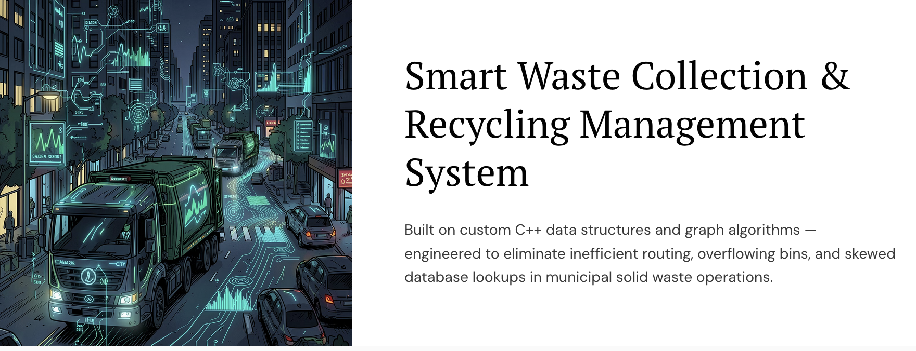

Slide 3
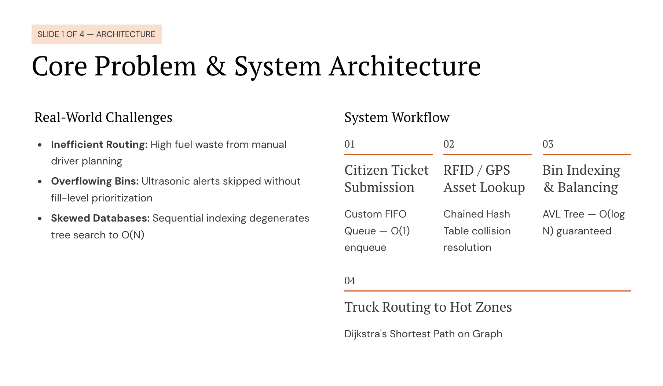

Slide 4
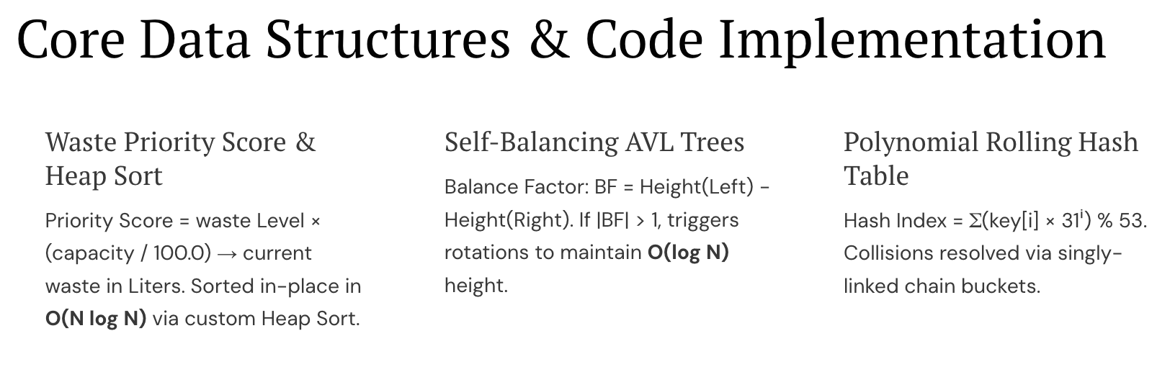

Slide 5
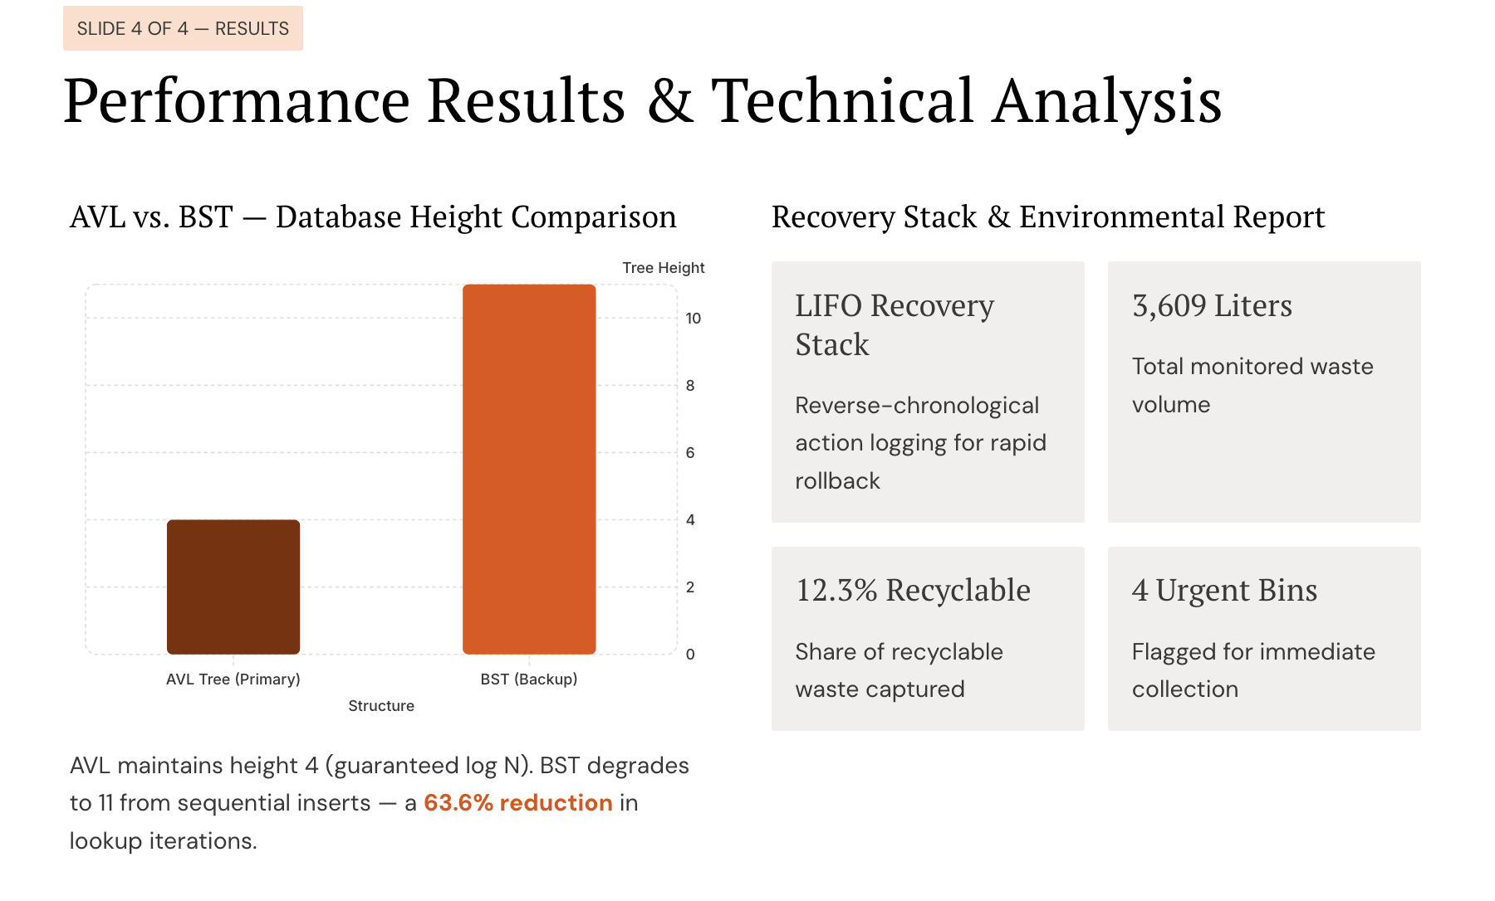

Slide 6
Thank You

