Slide 1

Weather Forecast Simulation(C++)
By Ankitraj Jha

Slide 2
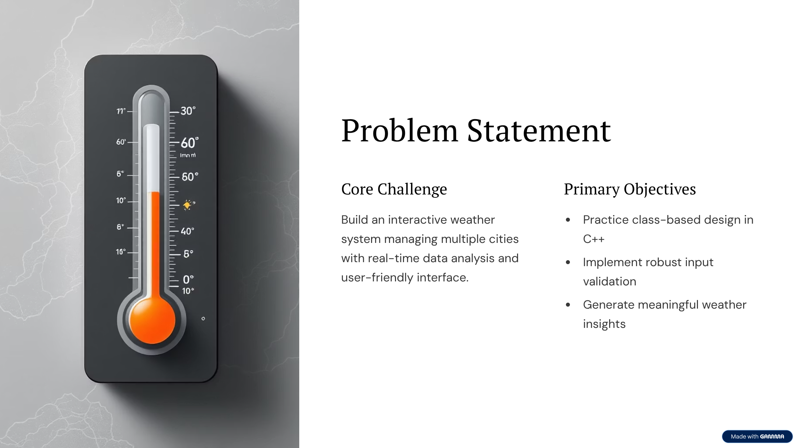


Slide 3
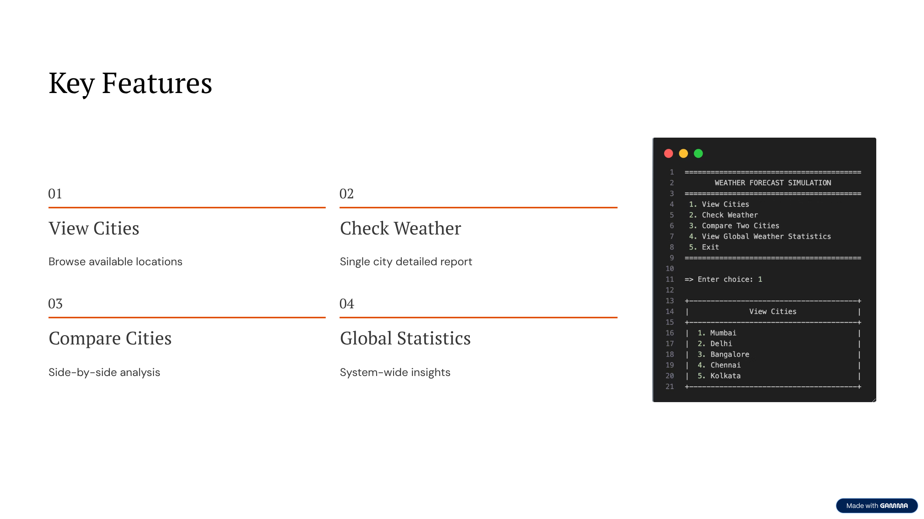

Slide 4
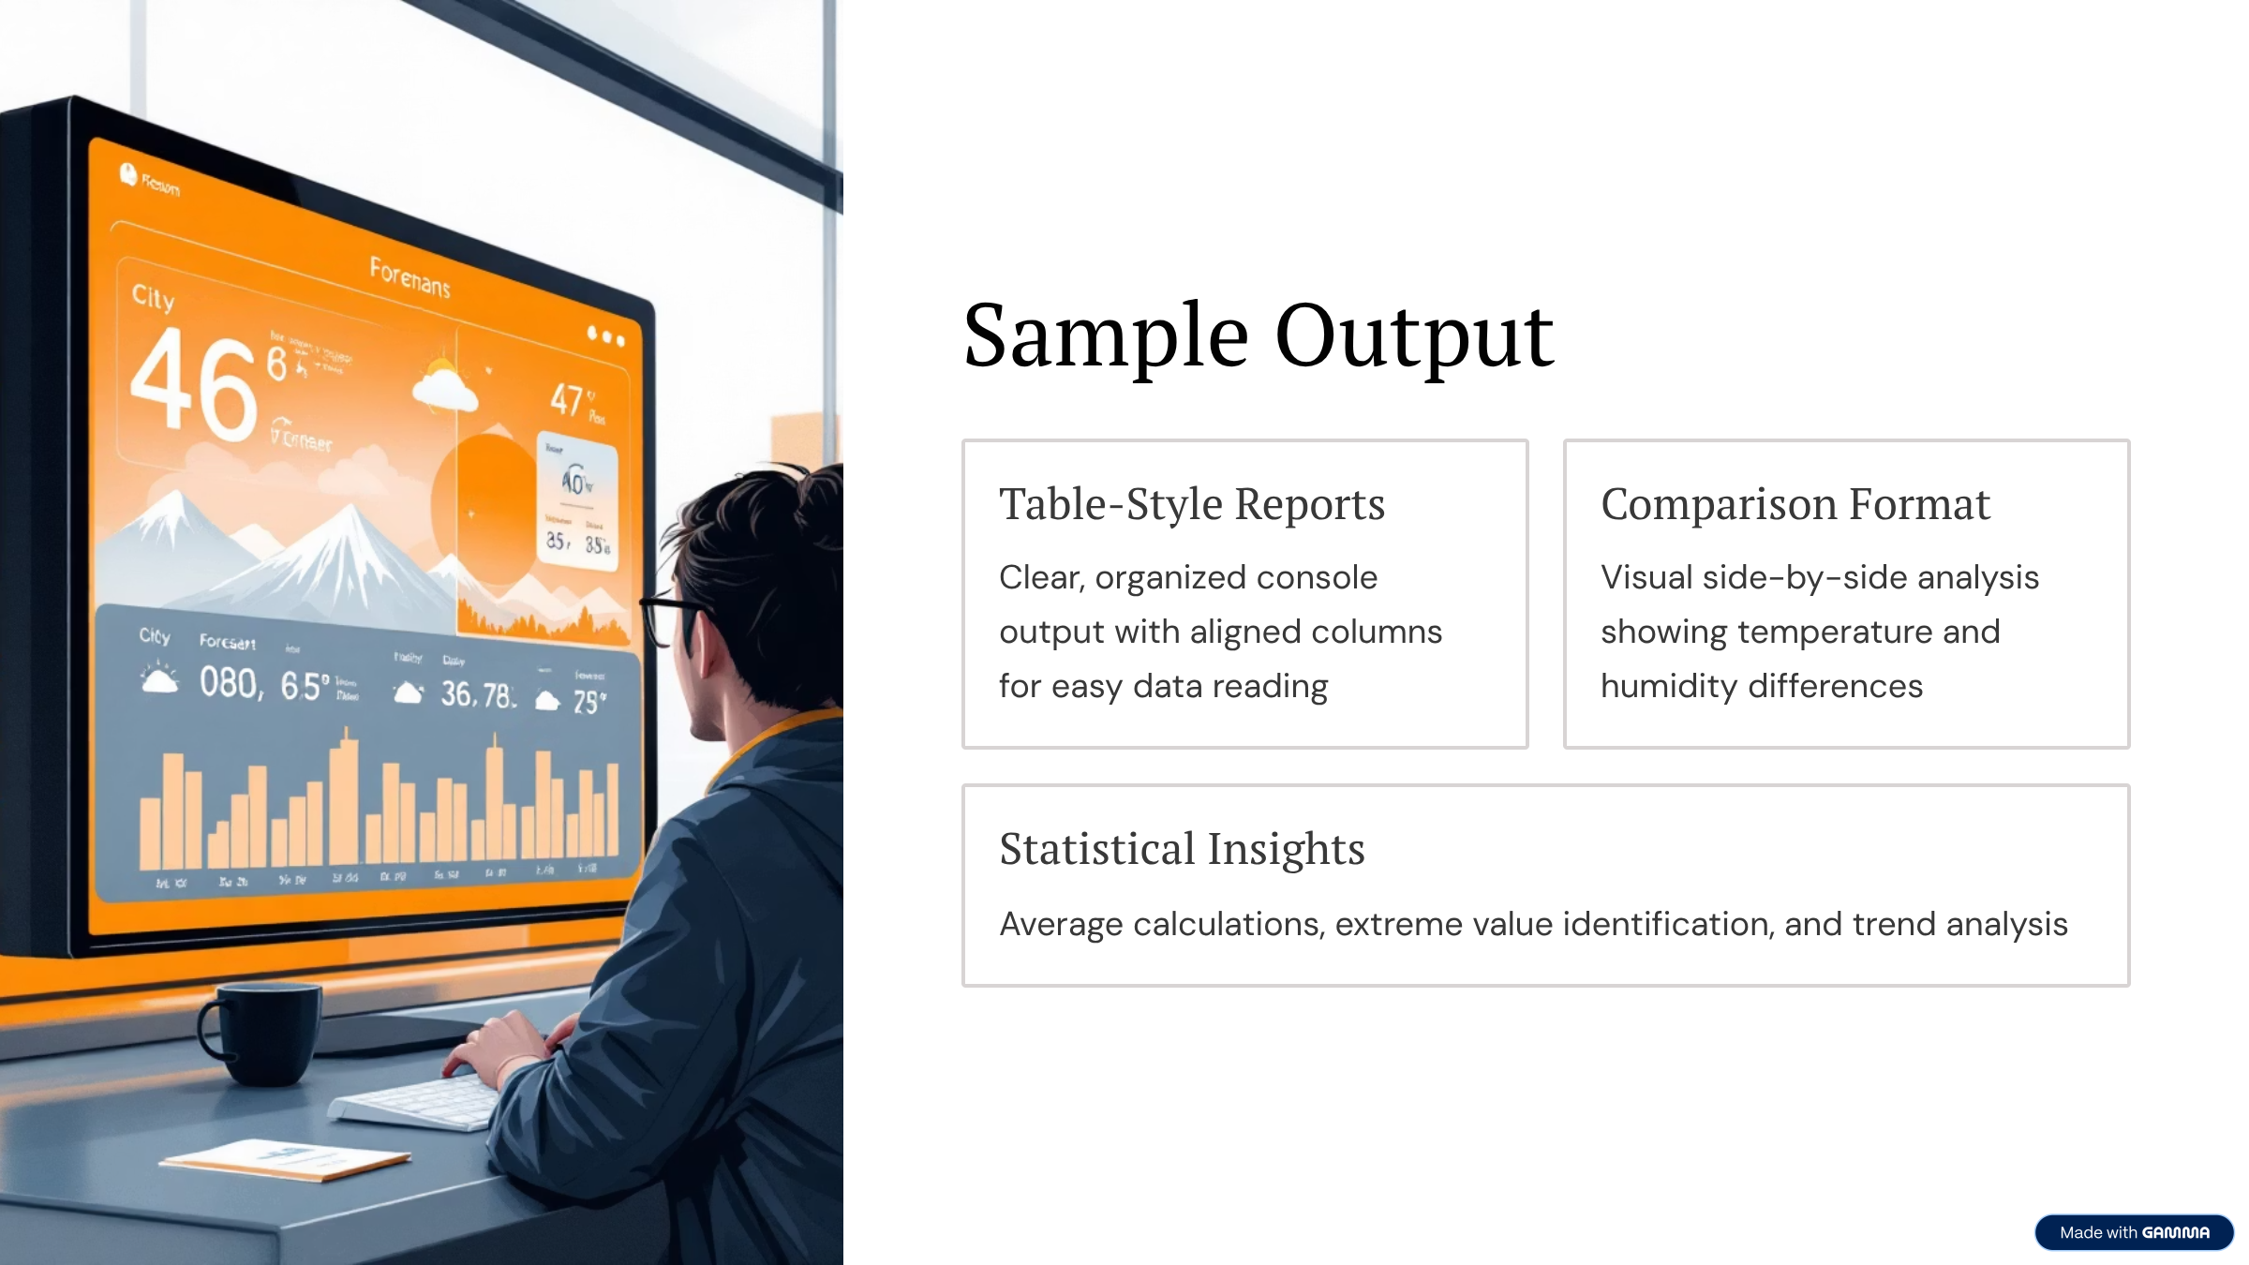

Slide 5
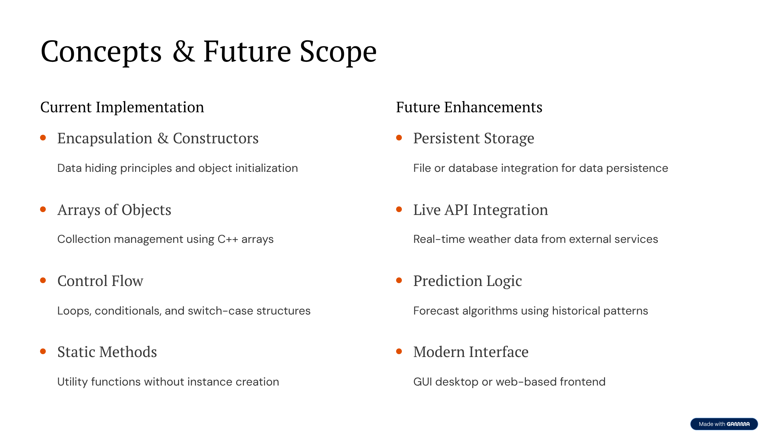

Slide 6
Thank You

