Slide 1

Weather Forecast Simulation(C++)
By Ankitraj Jha

Slide 2
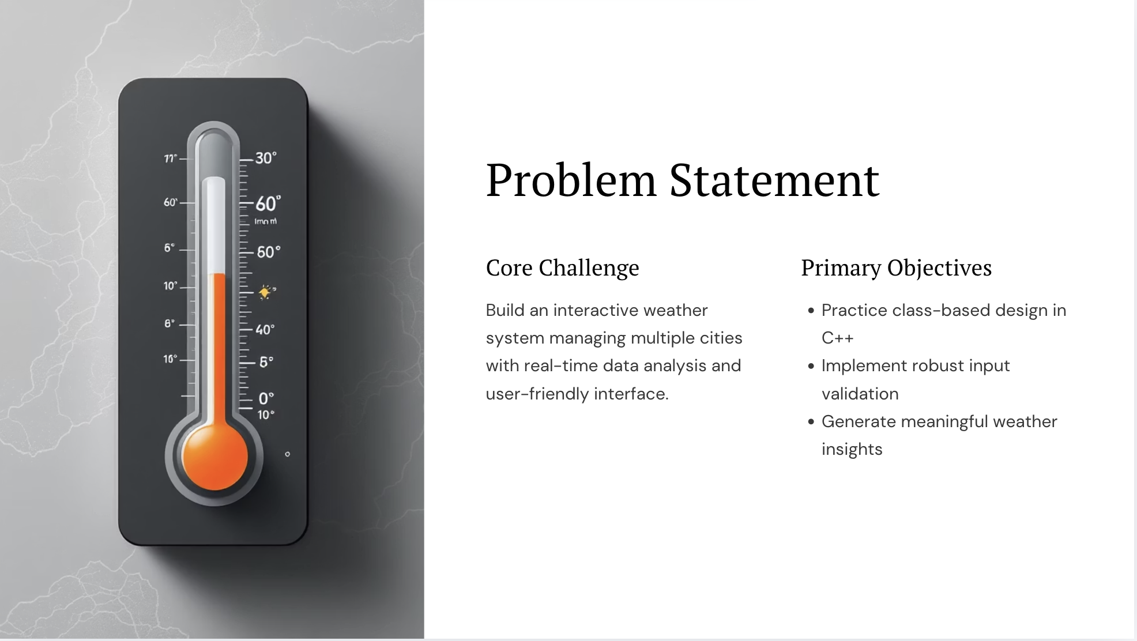

.

Slide 3
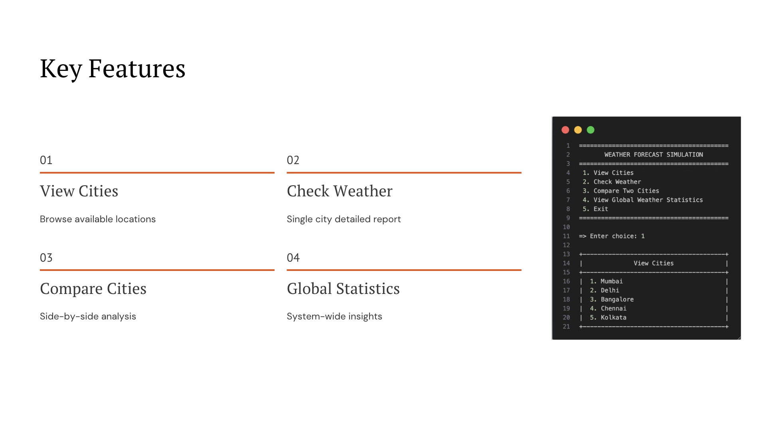
.

Slide 4
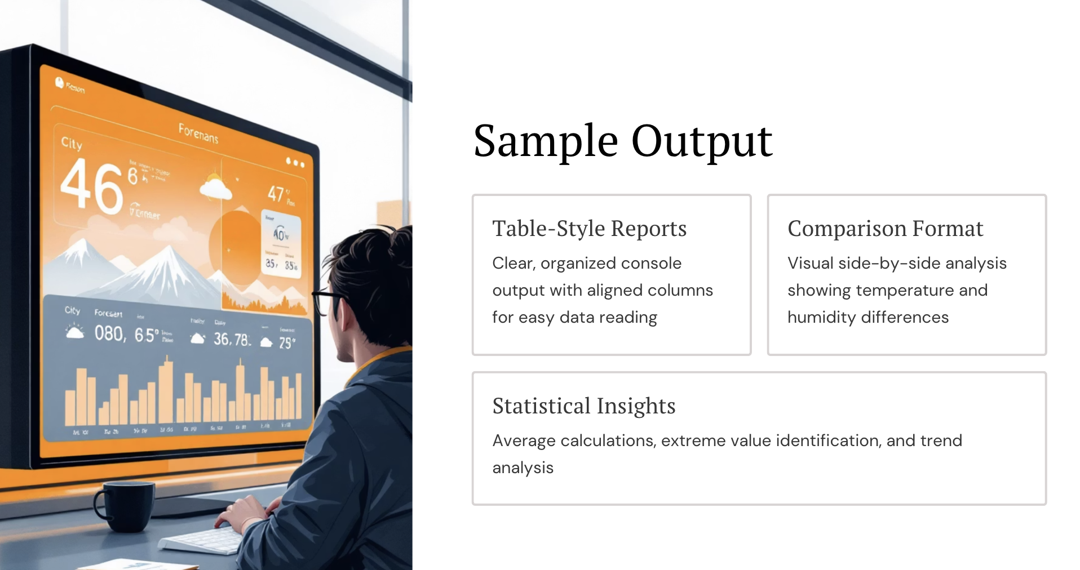

Slide 5
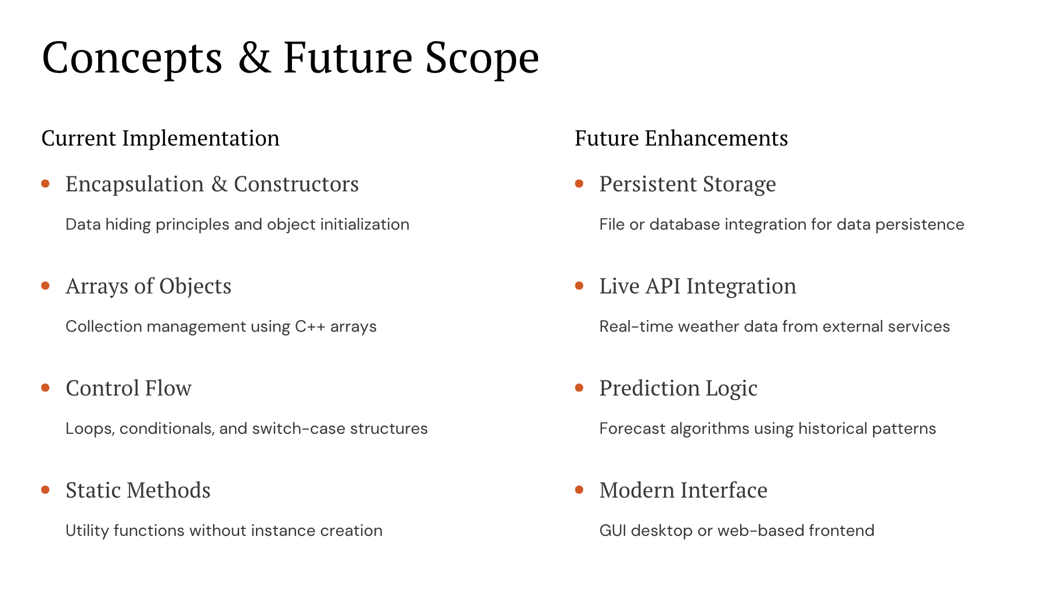
.

Slide 6
Thank You

