Slide 1

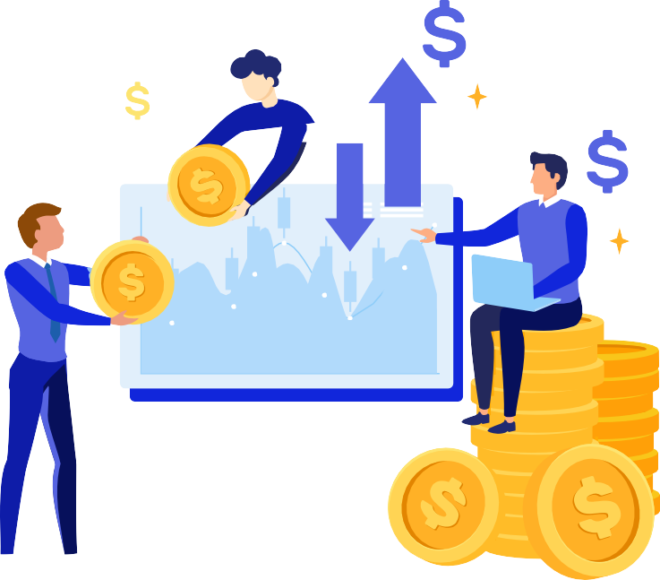

Driving User Acquisition, Retention and Revenue Growth

Slide 2

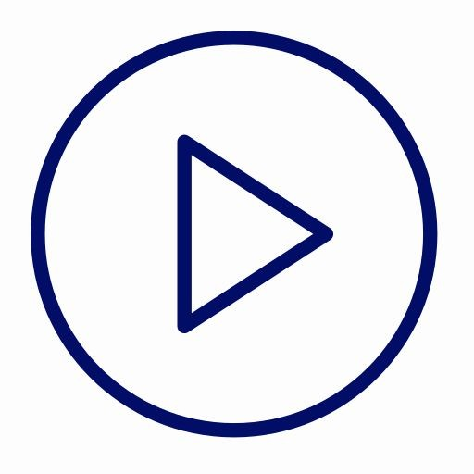

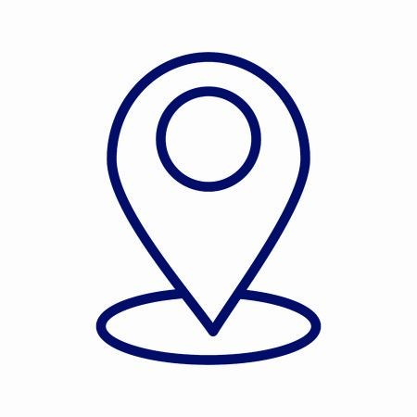



About 3.14
Founded in 2013 ; Provides programmatic ad solutions with a unique DSP - Radian
2200+
Campaigns as of Q4’21
110+
Countries engaged with ads each month
Oﬃces in Delhi, London, Jakarta (Indonesia)
Integrated with the largest ad exchanges to provide with the most resourceful inventories
170+
GEOs
3.5B+
Users across apps
Focus on Fraud Prevention, Transparency, Scale and delivering ROI
Strengths
High value user acquisition Maximise retention rate and ROAS Down funnel events optimisation 100% transparency
AI-based Targeting, Look-alike audience creation, A/B Testing, Creative Analysis and much more

Slide 3









Pros of Programmatic
Features of Programmatic Buying
Programmatic Buying:s using
Target potential useralgorithms and machine learning
Bidding Model: RTB (Automated)
Connected with 40+ major Ad exchanges in the world: AppLovin, Mopub, AdColony, Unity, Chartboost etc.
Diﬀerence with aﬃliates:
Aﬃliates connect with publishers via SDK/API - giving limited control over campaign performance
With programmatic buying, 3dot14 can provide full control over campaign performance
REACH
TRANSPARENCY
REAL TIME REPORTING
TARGETING BEYOND CTR
PERSONIFIED TARGETING
FRAUD PROOF
RELEVANCE
DATA INSIGHTS

Slide 4
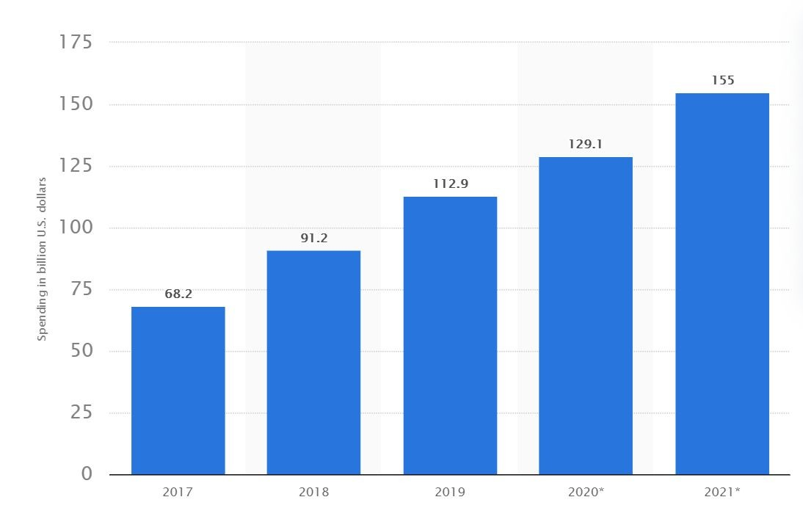
What is the industry doing?
According to recent estimates, programmatically sold advertising was worth 129.1 billion U.S. dollars in 2020. The ﬁgure is expected to reach 155 billion by the end of 2021.
*Source: https://www.statista.com/statistics/275806/programmatic-spending-worldwide/

Slide 5




Solutions
User Acquisition
Retargeting
Re–engagement
Branding

Slide 6
DSP Overview
Our DSP - Radian aims to provide a comprehensive solution
Dynamic Real-time Targeting
We connect with every single user individually to make the most out of your budget.
Placement Optimization
Advertising lives through its delivery. We leverage inventory sources granularly based on performance.
CPA & CPI Prediction
Every single impression decides both conversion success and ROI. We have made it our science to leverage
deep-learning algorithms for bid optimisation on all funnel stages to reach the most valuable users.

Slide 7



Filters fraudulent/suspicious bid requests and blocks accidental clicks
Machine Learning
Enhances bid request data to develop extensive user proﬁles - helps understand the user we bid on
Extracts Post-install Behavior of users to measure in-app interaction and spend
Our predictive Machine Learning model is created using unbiased historical proprietary data to ﬁnd the best users for your app and estimate the likelihood of their actions to serve them the most suitable ads at the most relevant
time.
User interest and activities are measured and quantiﬁed using frequency, recency and monetization
Retargets previously active and loyal users to reactivate and retain high quality users

Slide 8
Fraud-free programmatic campaigns
Filtering Bad Bid Requests
Suspicious or fraudulent traﬃc is ﬁltered out throughout the process
Post-install optimization
To further ﬁlter false users, campaigns are optimized for post-install engagements
Availability of a fraud-free database
A large database of approximately 2 bn fraud-free, veriﬁed devices ensuring ads are shown to real, quality users

Slide 9





Ad formats and Creatives A/B Testing
Deliver scaled performance by supporting all ad formats for mobile programmatic: banners, video, native, interstitials and playable ads
We track impression-to-installs and in-app events, thus indicating the real conversions
Performance of each creative is available on the DSP which helps to identify the optimum creative type
The best in-market experimentation platform for conducting creative tests and scaling high-performance creatives
Multiple variations of the creatives are tested and optimized to maximise performance
Our AI-powered media optimization ensures that
advertisements are personalized across platforms

Slide 10

Why choose 3.14?
A DSP with a unique algorithm working on a dCPM model
Ensured 100% transparency and access to all data
Option of self-service / managed service platform
Integrations with more than 40+ major ad exchanges to oﬀer the best inventories
Complete Creative Analysis from experts
All leading ad formats supported including playable ads
Fraud prevention and access to real-time reports
AI based targeting, Look-alike audience creation and A/B Testing for complete optimisation
A scaled increase in quality user base with an assurance of meeting KPIs like Install-to-registration, Registration to First Deposit and many more.
Email communications and weekly calls with our optimization analyst to get the best understanding of the plan ahead

Slide 11
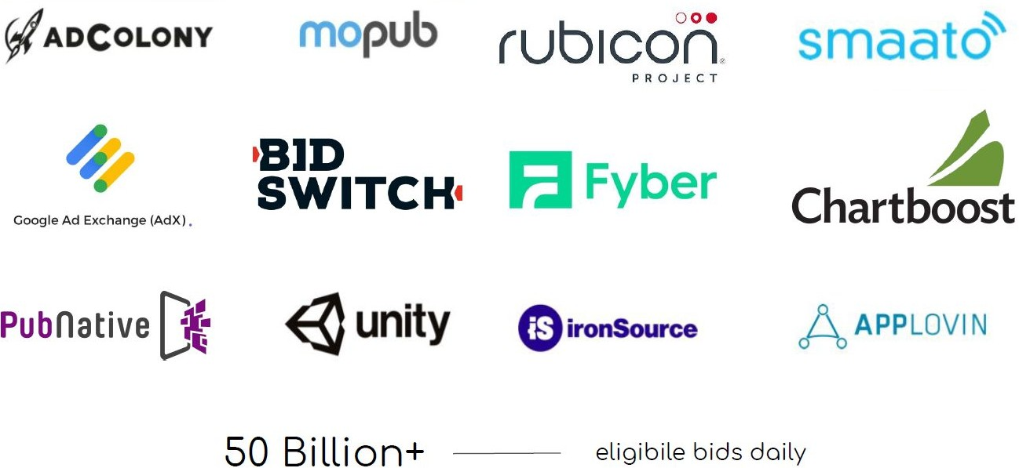
A multitude of Ad Exchanges Integrated
So that our clients can reach any type of user they wish

Slide 12
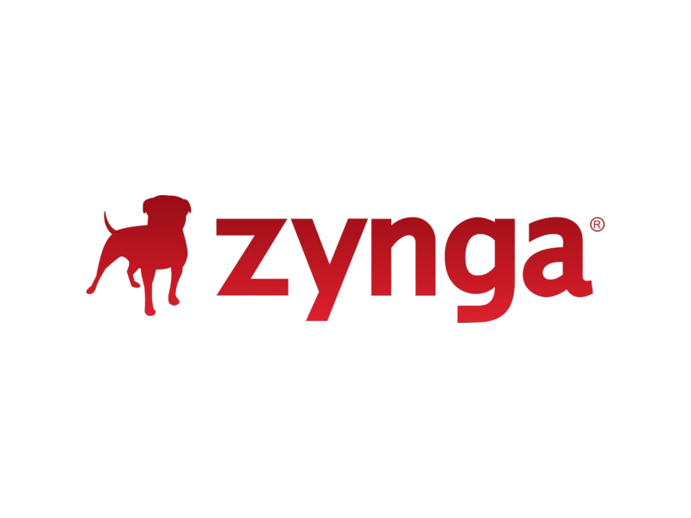


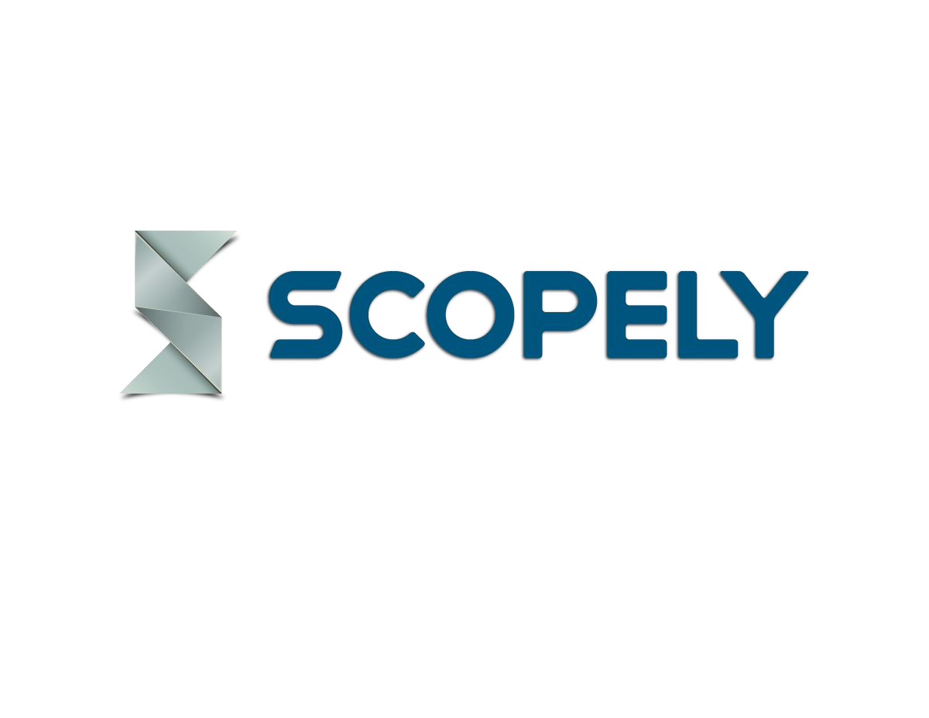




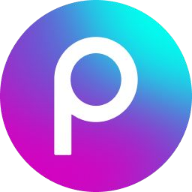
Get featured on top publishers

Slide 13


Success Stories

Slide 14






DCX is a Singapore-based company that
RESULTS
specializes in crypto-enabled ﬁnancial services.
DCX is bringing a revolution with its
crypto-based products by developing
60%
Install-to-
registration
35%
Decrease in CPA
borderless ﬁnancial services that ensure a
faster, simpler, and uninterrupted ﬂow of capital.
17%
Increased First-time Deposits (FTDs)
OBJECTIVE
Increase post-install events (signup and ﬁrst-time deposits)

Slide 15




Gojek is a Super App. It's one app for ordering food, commuting, digital payments, shopping, hyper-local delivery, and over a dozen services. The company operates across South East Asia namely Thailand, Singapore, Thailand and Vietnam.
RESULTS
14000+
Bookings placed
monthly
40000+
Installs per month
16.5%
Month-on-month increase in
install-to-booking ratio
OBJECTIVE
Acquire new quality mobile users.
Increase the install-to-order ratio.

Slide 16

Mobile Premier league popularly known as MPL is an online gaming platform that consists of numerous games, quiz, virtual sports and more. This gaming app oﬀers real cash prizes for playing your favourite mobile games.
RESULTS
21%
Month-on-month
Install growth
82%
Install-to-sign-up
40%
Sign-up to Cash Play Daily Average User
OBJECTIVE
Acquire new quality mobile users.
Increase the install-to-order ratio.

Slide 17








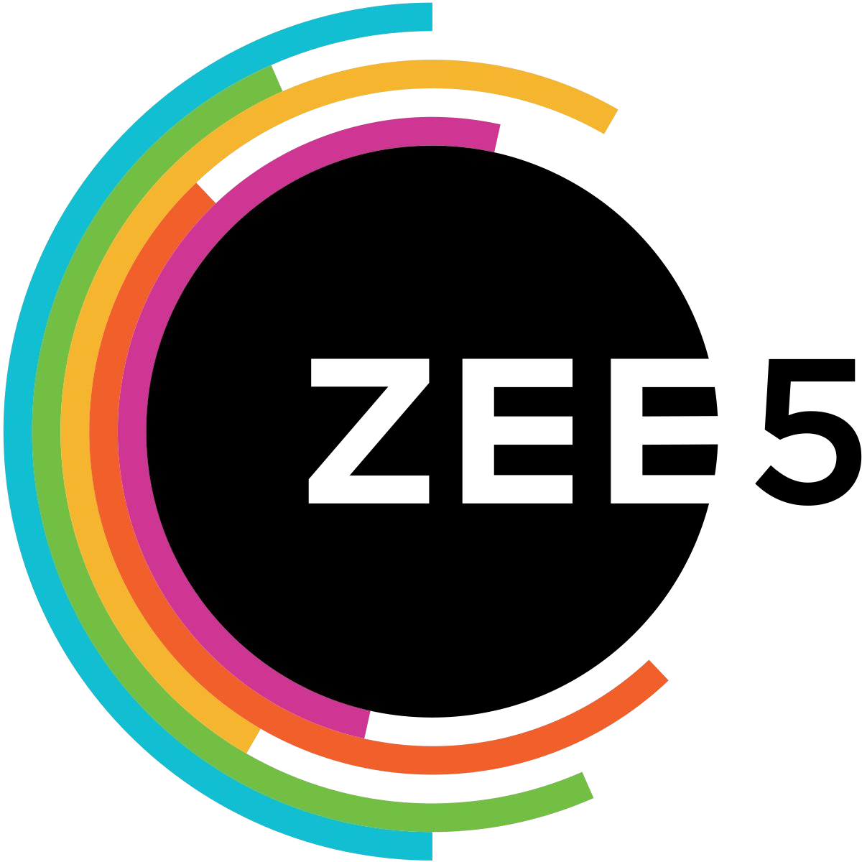
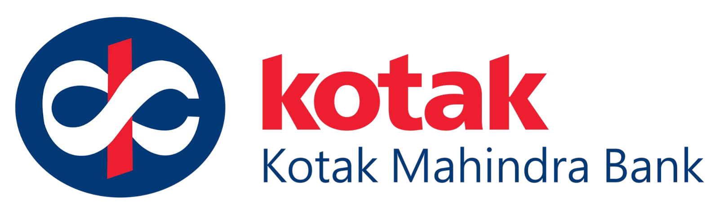

Our Partners
& many more...

Slide 18
All that’s required to get started!
Suppression List
₀₁ So we don’t target old users who
already installed your app.
03
View-through Attribution (VTA) enabled
So we can have a more complete picture of your ad’s performance.
02
All Events Postback
So we don’t target users acquired by other channels.
04
Creative Flexibility
So we can freely choose the size and type of creative for optimisation.

Slide 19
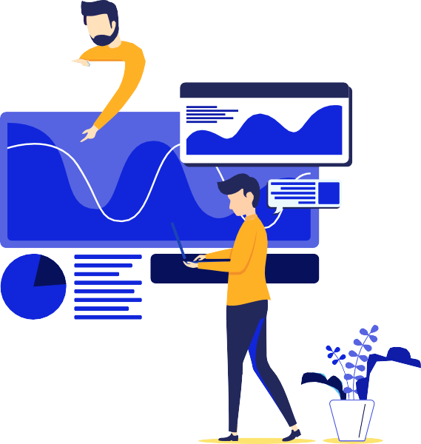






Grow your app’s user base at scale!
3.14 can help you exceed your advertising potential!
Know more:
www.3dot14.co
Get in Touch: programmatic@3dot14.co deepak.baghel@3dot14.co muskan.agarwal@3dot14.co

Slide 20
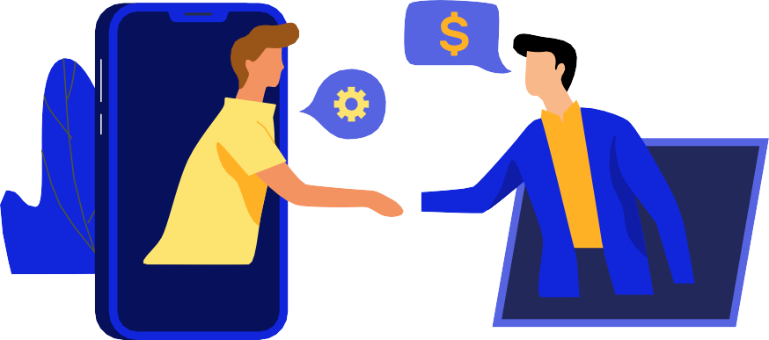

Thank you!

