Slide 1
Multilevel Sense Amplifier
Group Number: 12
Group Members : Aman Rupain (MT24172) Ankit Sharma (MT25099) Drashi Jain (MT25114)
Course: Memory Design And Test
Prof.: Dr Anuj Grover

Slide 2
Problem Statement
This sense amplifier should have multiple outputs for different values of bit line voltage.
The offset should be 50 mV at 0.9 V supply, with a response time of 150 ps at the output latch.
Perform 3σ Monte Carlo analysis for robustness verification.
Compare normal and common-centroid layout implementations.

Slide 3
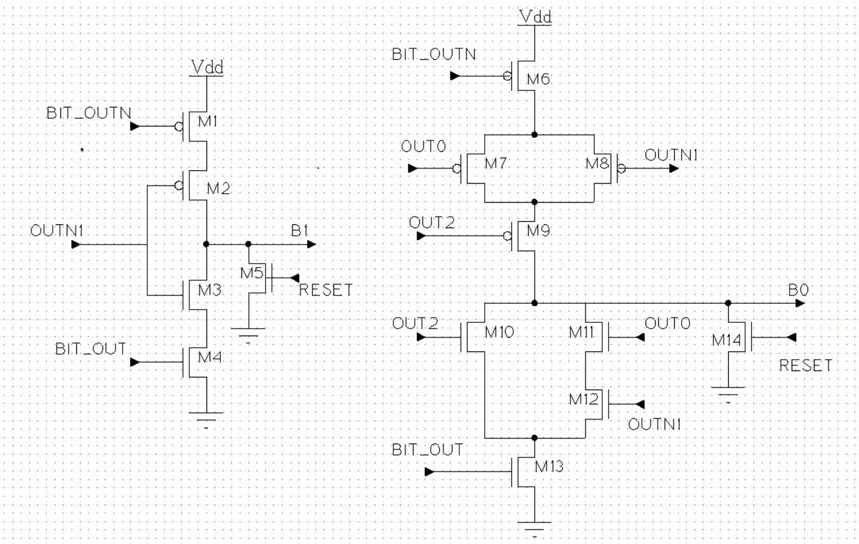
Schematic
Decoder Design

Slide 4
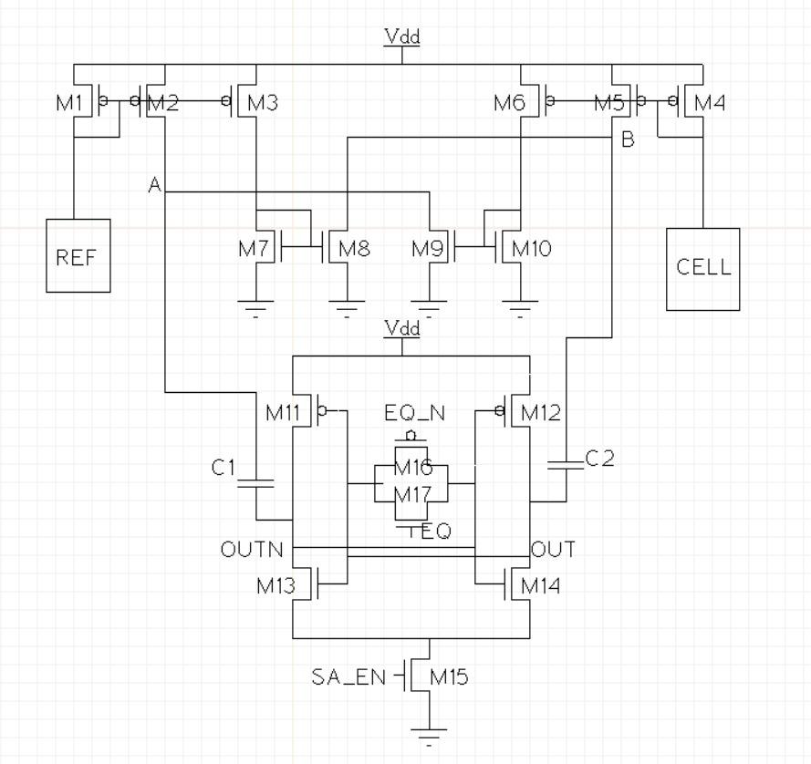
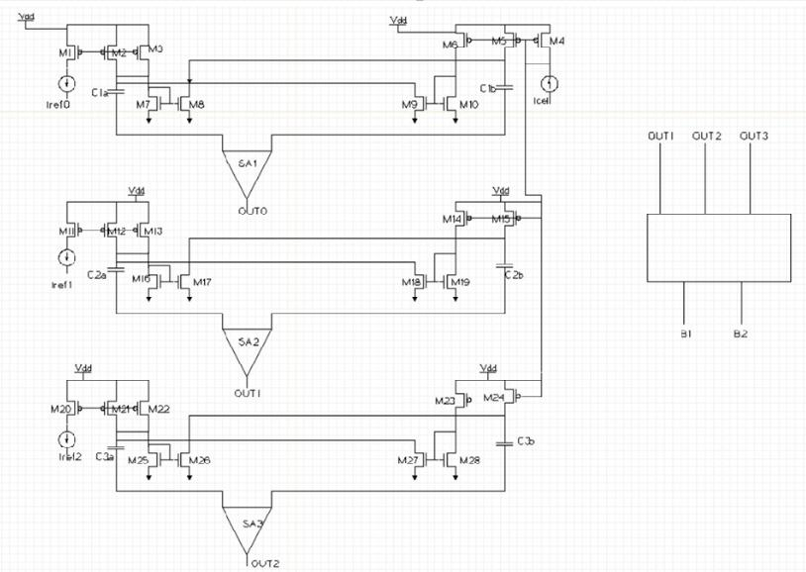
Schematic

Slide 5
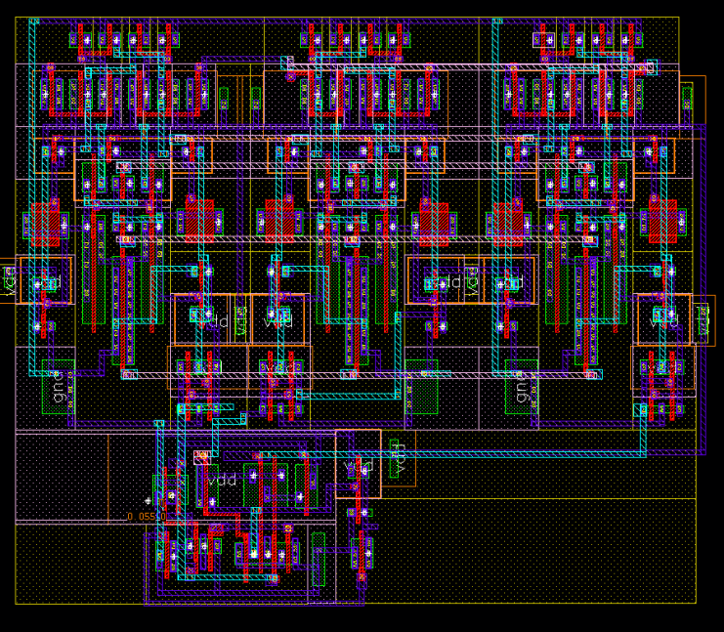
Layout

Slide 6
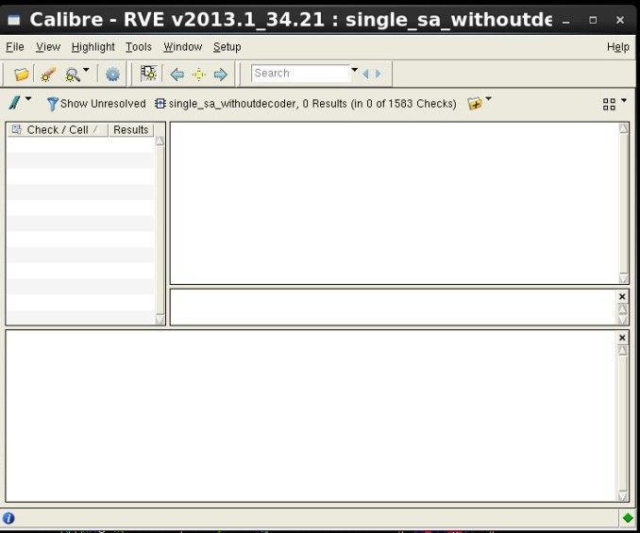
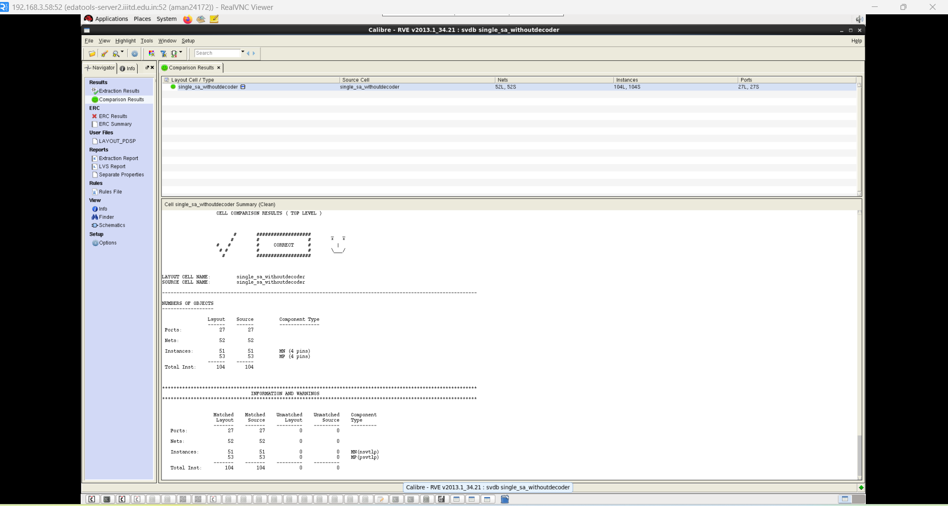
DRC/LVS

Slide 7
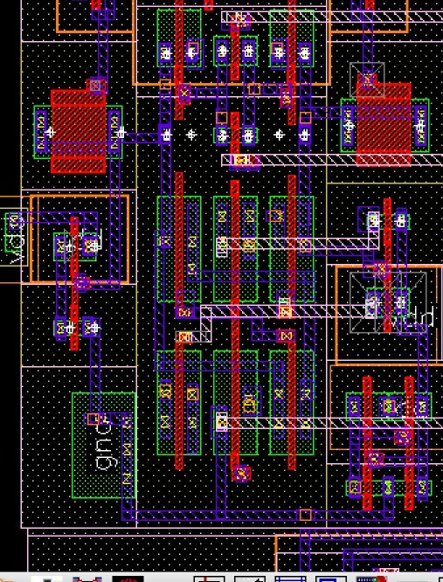
Common Centroid Layout

Slide 8
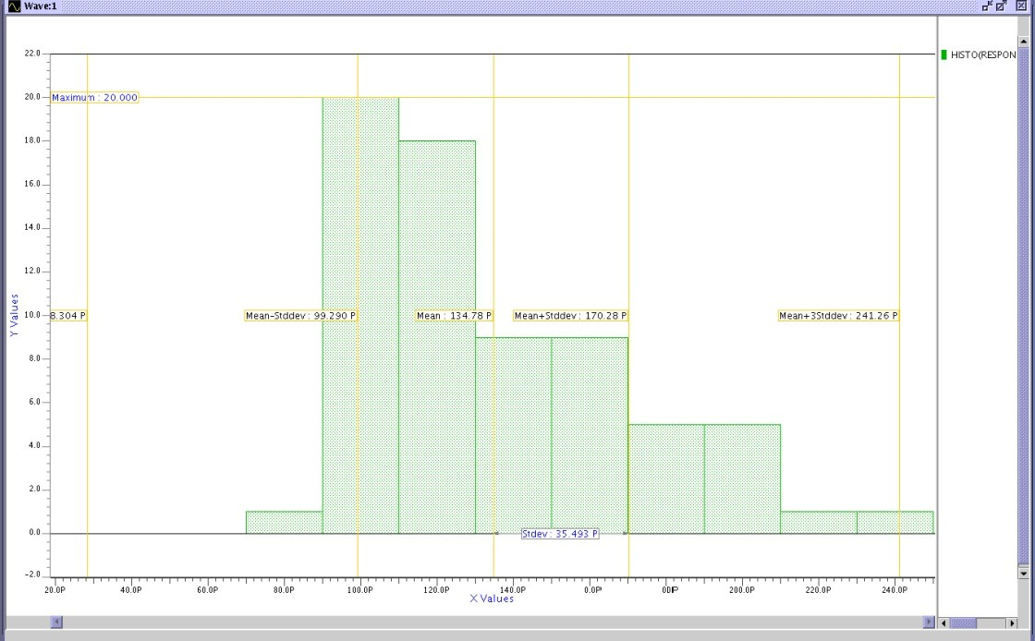
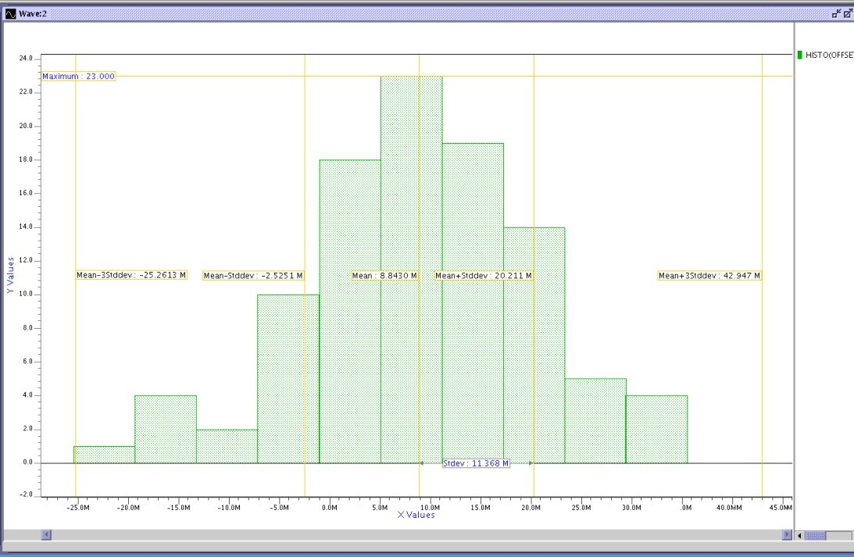
Results
1.2 v response time
1.2 offset voltage

Slide 9
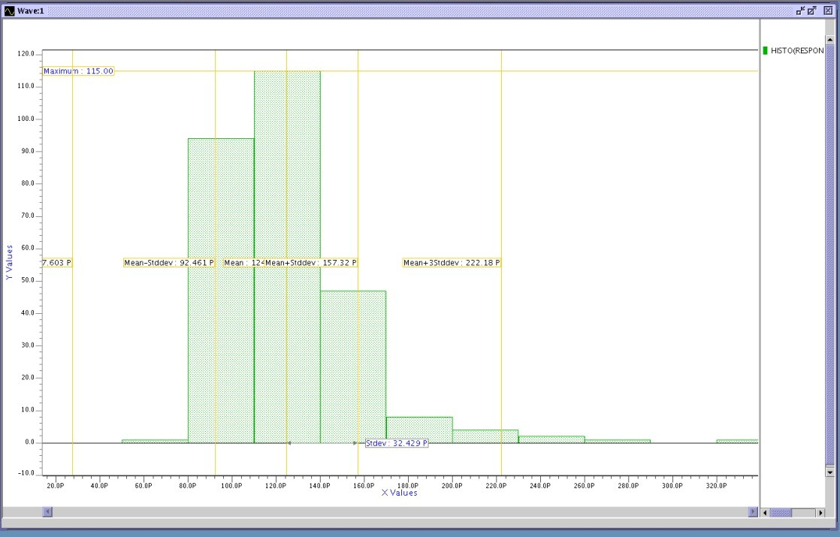
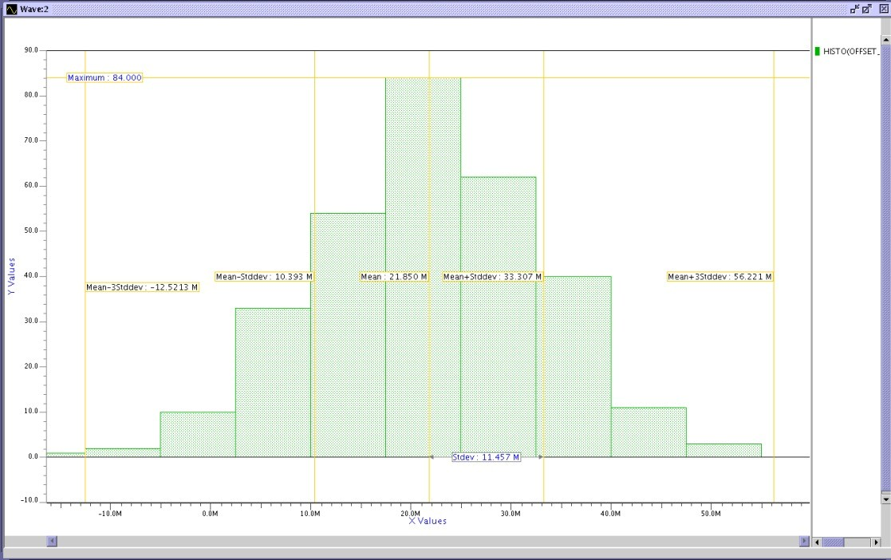
Results
OFFSET VOLTAGE SS-40 FRO SA1
Mean-21.850p
Sd-11.457p
RESPONSE TIME 1.2 V SS-40 SA1
Mean-124p
Sd- 32.429p

Slide 10
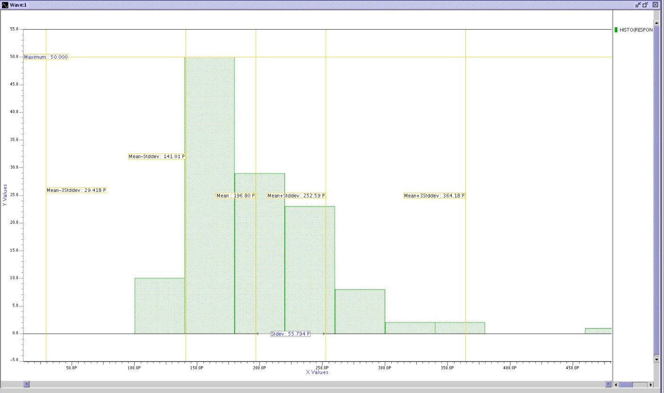
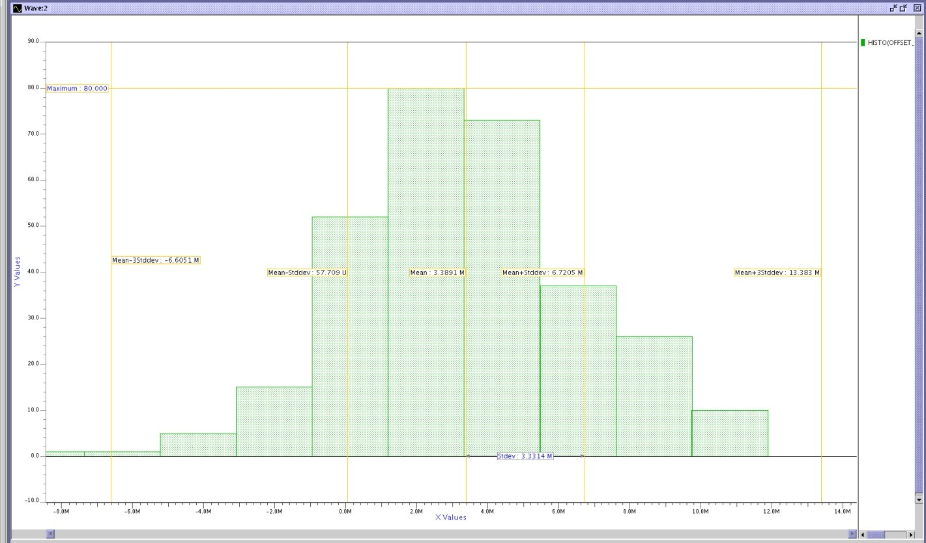
Results
RESPONSE TIME SA3
mean-196.8p
Sd-55.794p
OFFSET VOLTAGE SA3
mean-3.3891m
Sd-3.3314m

Slide 11
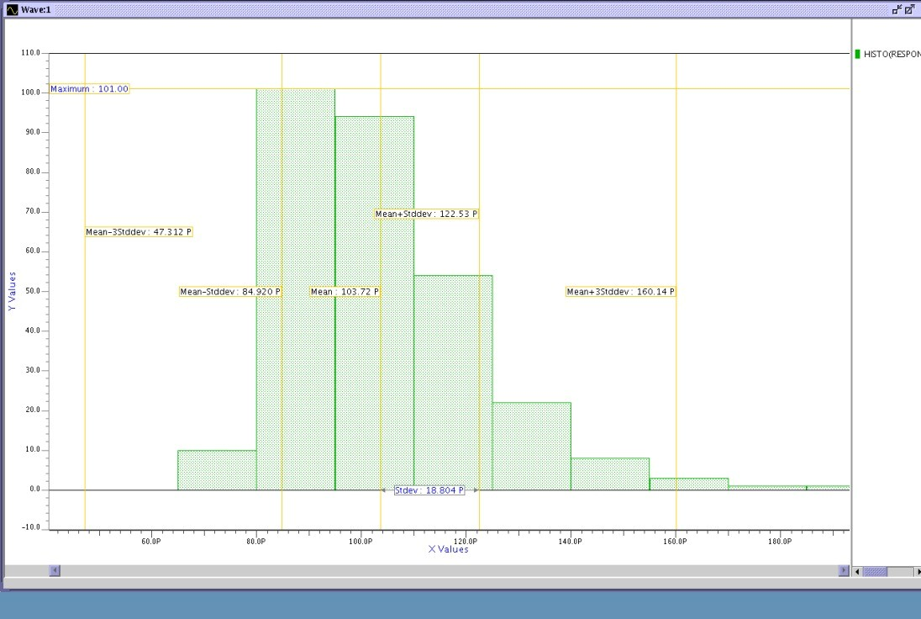
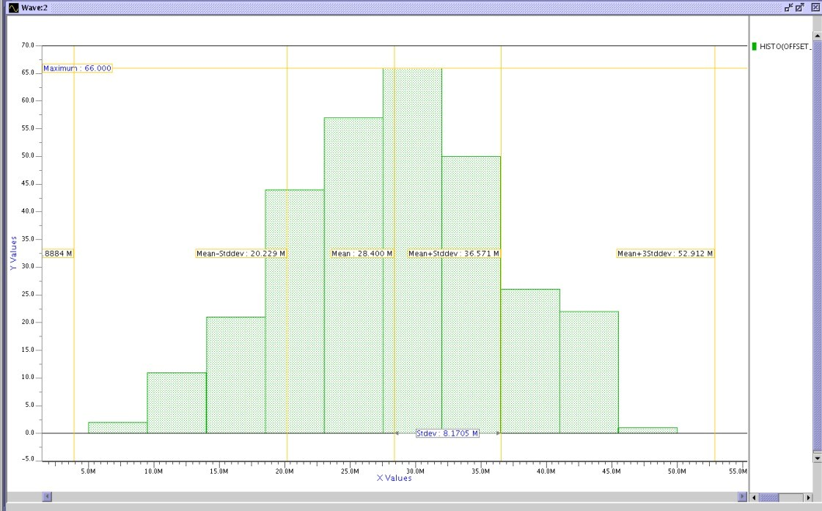
Results
SA2 response time at 1.2v
Mean-103.72p
Sd-18.804p
SA2 offset voltage 1.2 v
Mean-28.4m
Sd-8.1705m

Slide 12
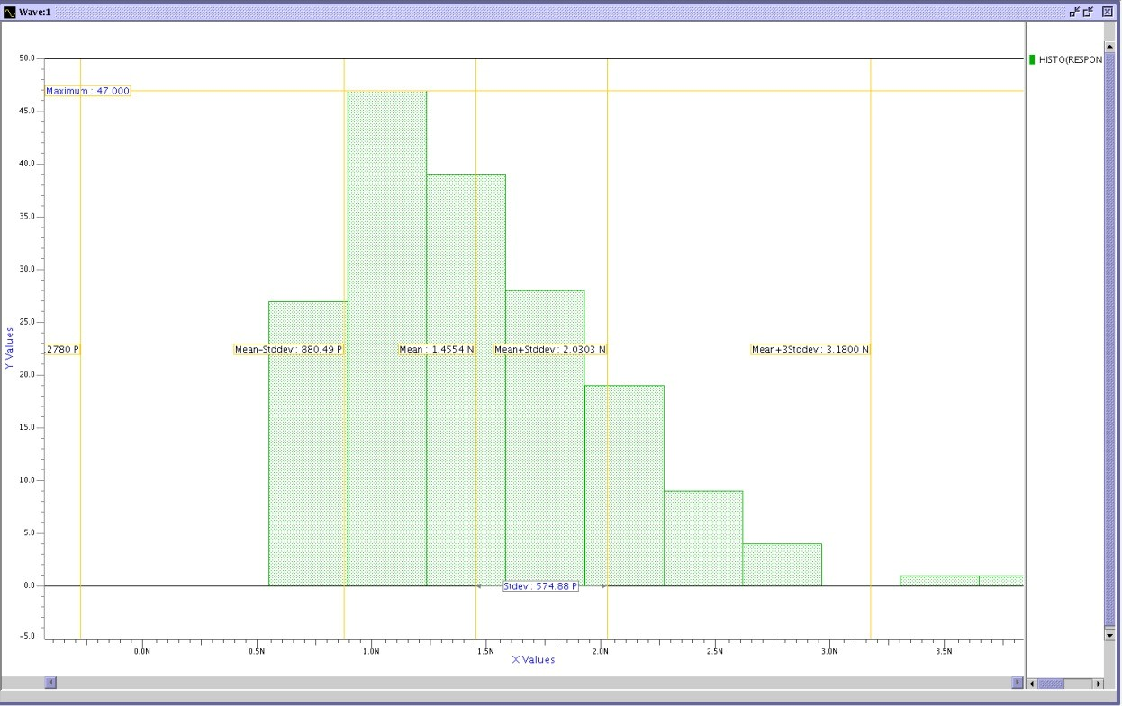
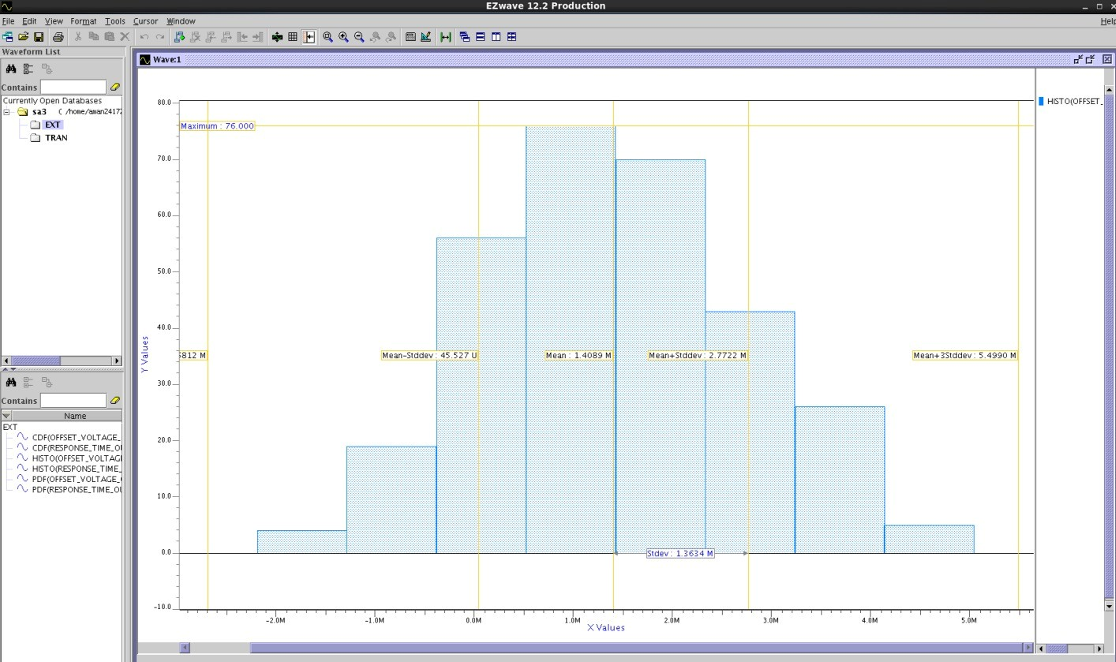
Results
SA3 at 0.9V SS Mean – 1.4554n St. – 574.88P
offset at 0.9 SA3 mean-1.4089m
Sd-1.3634m

Slide 13
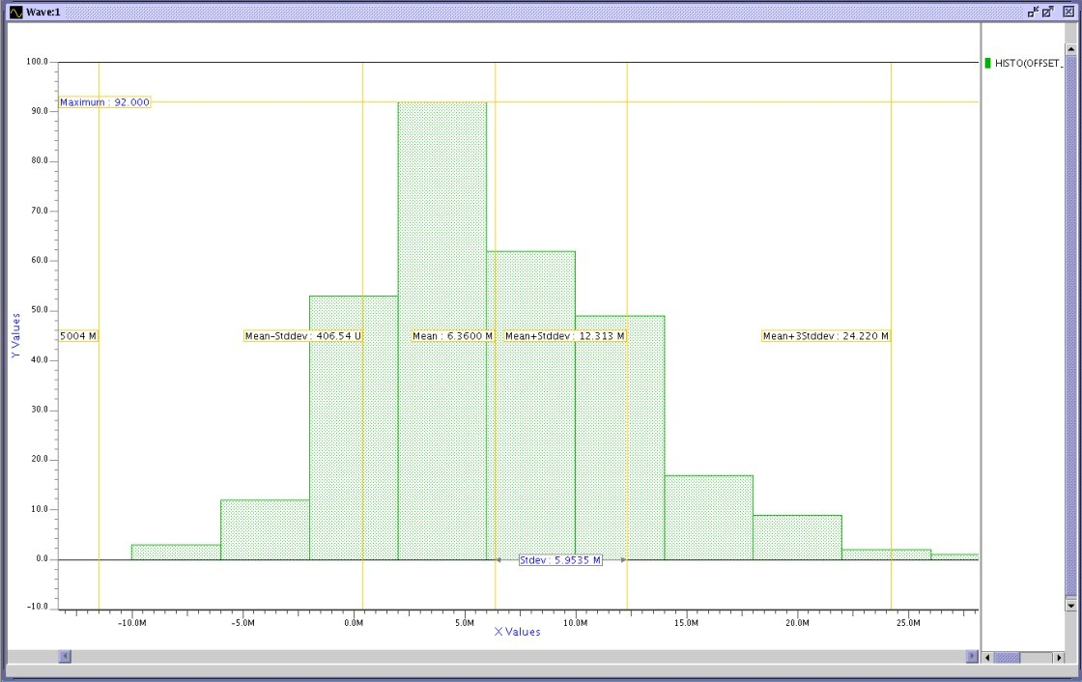
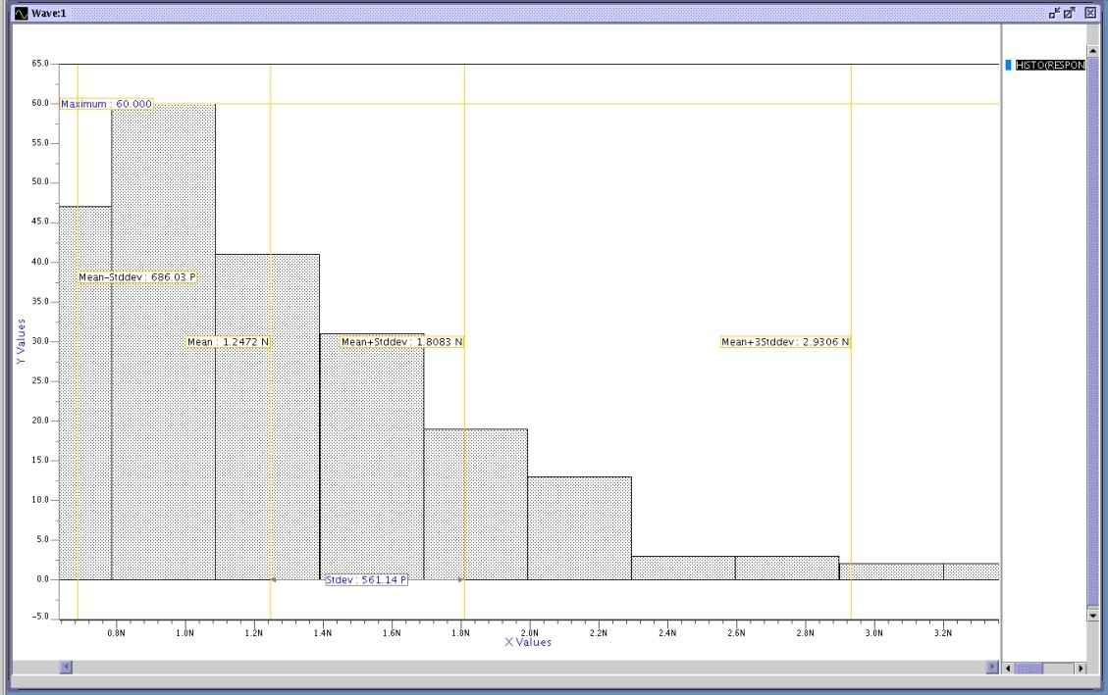
OFFSET AT 0.9 SA1
Mean-6.36m
Sd-5.9535m
SA1 RESPONSE AT 0.9V
Mean-1.2472n
Sd-561.14P

Slide 14
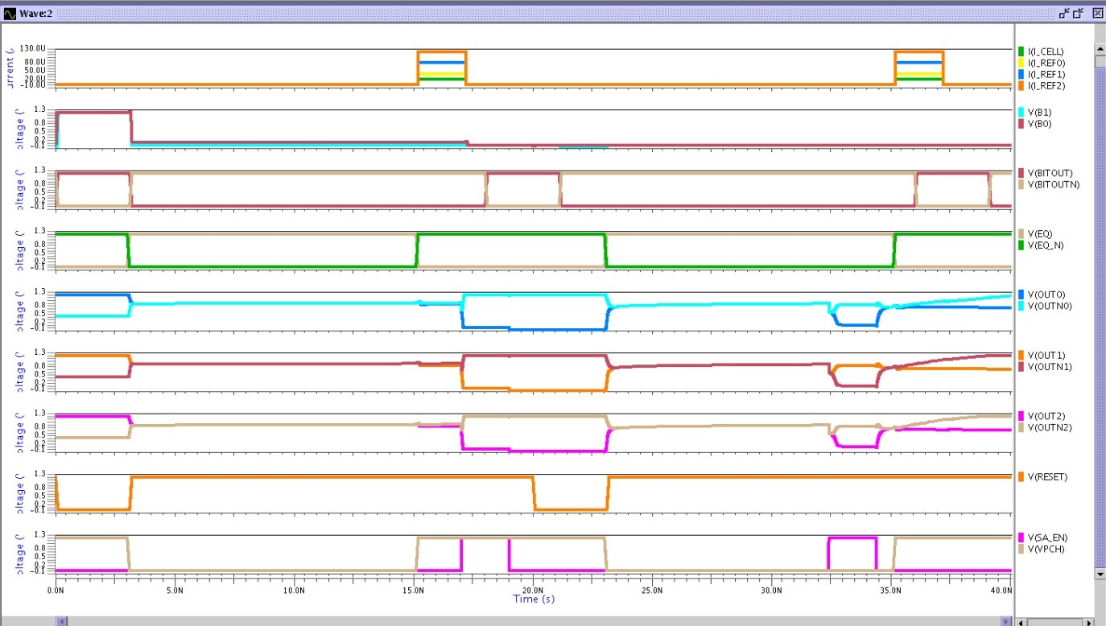
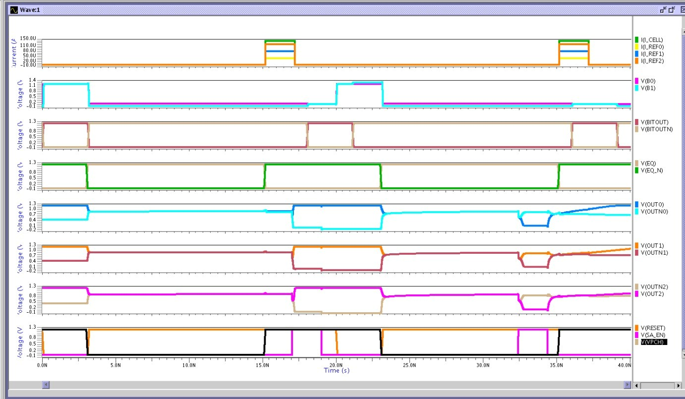
Results
b00
b11

Slide 15
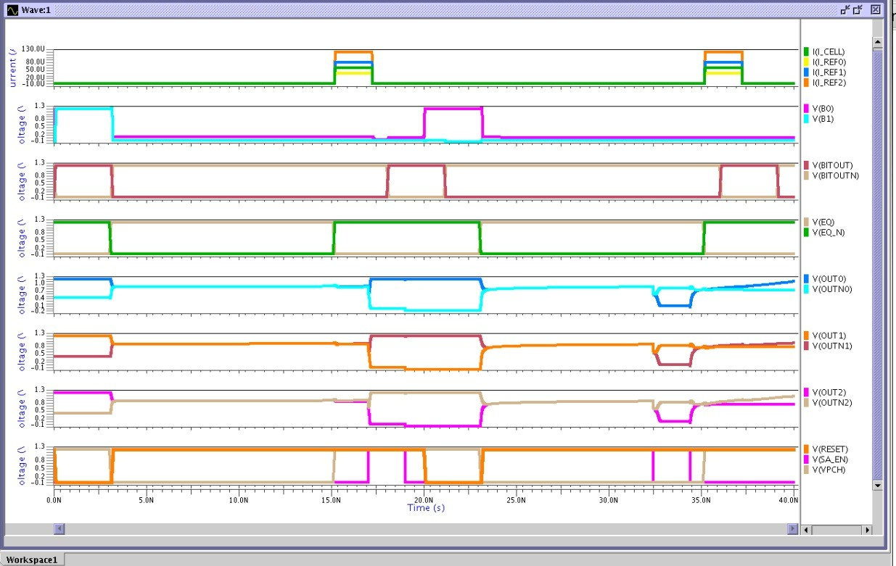
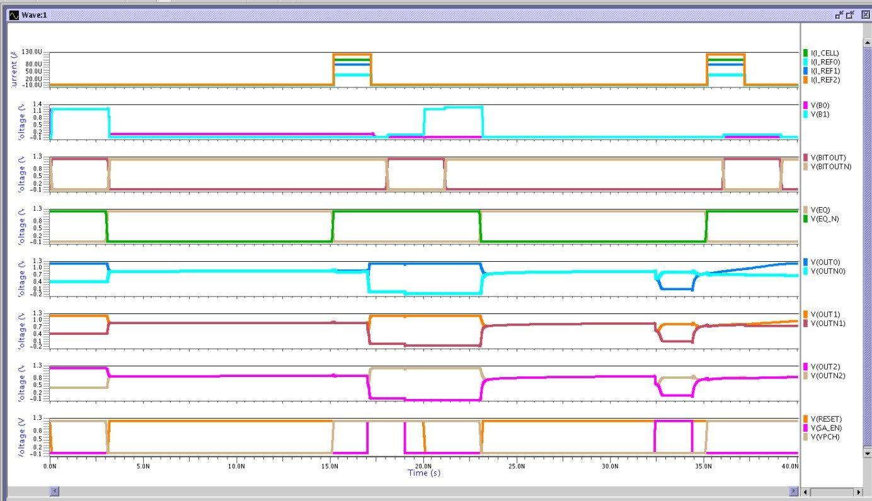
Results
b01
b10

Slide 16
Work Distribution
Work Distribution: Schematic, functionality, layout, postlayout - Aman Rupain X-circuit, layout, prelayout simulation - Ankit Sharma Schematic, X-circuit, layout, prelayout simulation - Drashi Jain
References: F. Husain, B. Iqbal, and A. Grover, “A 0.4 μA Offset, 6 ns Sensing-time Multi-level Sense Amplifier for Resistive Non-Volatile Memories in 65 nm LSTP Technology,” in Proc. 34th Int. Conf. VLSI Design and 20th Int. Conf. Embedded Systems (VLSID), 2021, pp. 76–81, doi: 10.1109/VLSID51830.2021.00018.

Slide 17
Thank you

