Slide 1
Receipt and Invoice Digitizer- OCR Model

Slide 2
Problem Statement
Manual extraction of data from receipts and invoices is time-consuming and inefficient
High probability of human errors during data entry
Difficulty in storing, searching, and analyzing physical documents
Lack of automation in handling unstructured document formats

Slide 3
Introduction to OCR
Optical Character Recognition (OCR) is a technology used to convert text within images into machine-readable format
Enables automated extraction of textual data from scanned documents
Widely used in domains such as banking, retail billing, and document management
Forms the foundation for intelligent document processing systems

Slide 4
Role of LLM
Large Language Models (LLMs) enable intelligent understanding of unstructured text
Google Gemini is used to interpret OCR-extracted text
Identifies key entities such as:
Invoice number
Dates
Vendor details
Total amount
Improves accuracy compared to rule-based extraction
Handles variations in document formats effectively
Reduces dependency on complex regex patterns

Slide 5
Technologies Used
Python – Core programming language
pytesseract – Interface for Tesseract OCR engine
Pillow (PIL) – Image processing and handling
pdf2image – Conversion of PDF pages into images
Regular Expressions (Regex) – Pattern-based data extraction
JSON – Structured data representation

Slide 6
System Setup & Installation
Install Python environment
Install Tesseract OCR engine and configure system path
Install required Python libraries using pip
Ensure proper handling of dependencies for PDF processing
Command:
pip install pytesseract pillow pdf2image

Slide 7
Input Handling
The system accepts file paths as input through command-line arguments
Supports multiple file formats:
Image files (.jpg, .png)
PDF documents
Automatically determines file type based on extension
Routes input to the appropriate processing pipeline

Slide 8
Text Extraction Process
Images are processed using the Pillow library
OCR is applied using pytesseract to extract textual content
For PDF files:
Each page is converted into an image
OCR is applied sequentially to all pages
Extracted text is stored as raw unstructured data

Slide 9
Document Type Classification
The system distinguishes between receipts and invoices
Classification is based on keyword detection and scoring
Invoice indicators:
“Invoice”, “GSTIN”, “Due Date”
Receipt indicators:
“Receipt”, “Transaction ID”, “Thank You”
Enables context-specific data extraction

Slide 10
Invoice Data Extraction
Extracts structured fields including:
Invoice Number and Date
Vendor and Customer Details
Tax Information (CGST, SGST, IGST)
Payment Terms and Due Date
Total Amount and Balance Due
Utilizes regex-based pattern matching for accurate extraction

Slide 11
Receipt Data Extraction
Extracts key transactional information:
Store Name and Address
Receipt Number and Transaction ID
Date and Time of purchase
Items purchased
Total Amount and Payment Method
Designed to handle varying receipt formats

Slide 12
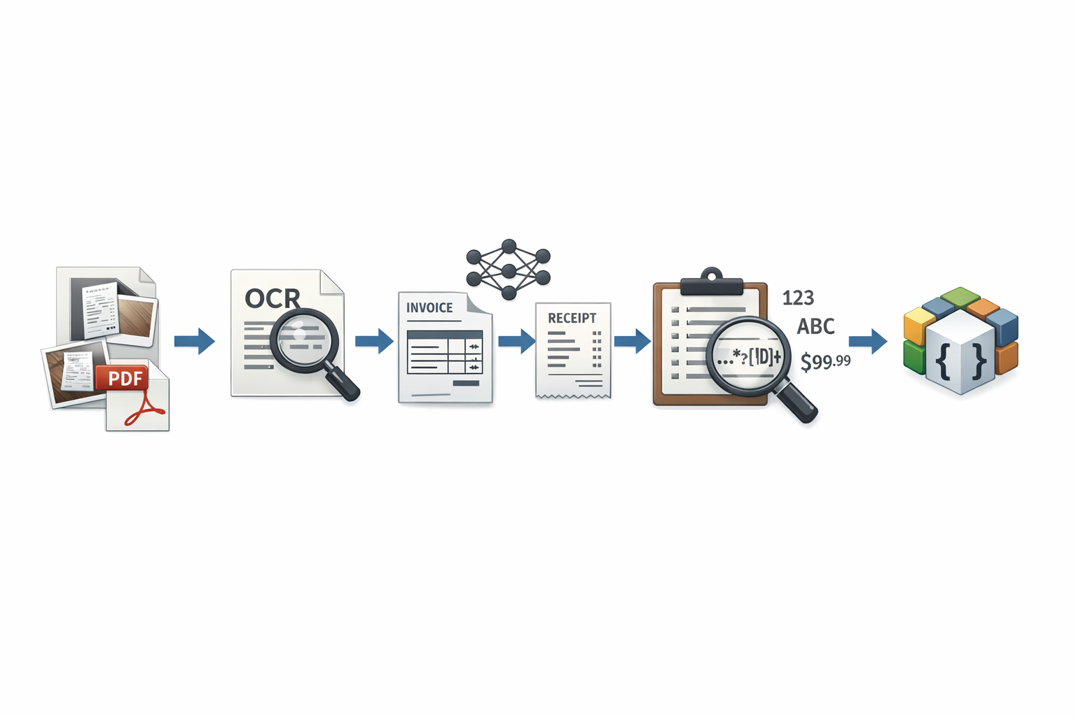
System Workflow
The system begins with uploading a document (image or PDF)
Optical Character Recognition (OCR) extracts raw text from the document
Extracted text is processed using an LLM (Gemini) for intelligent understanding
Structured invoice data is generated and validated
The processed data is stored in a database for future access
The stored record is returned to the user or application

Slide 13
Line Item Extraction
Identifies individual items within the document
Extracted attributes include:
Product description
Quantity
Unit price
Total price
Uses multi-pattern matching to handle structured and semi-structured formats

Slide 14
Data Processing & Normalization
Cleans extracted values by removing symbols and formatting inconsistencies
Detects currency types (INR, USD, EUR, GBP)
Standardizes field names for consistency
Merges invoice and receipt outputs into a unified schema

Slide 15
Output Format
Final output is generated in JSON format
Ensures structured and machine-readable data representation
Facilitates integration with databases and applications

