Slide 1
Blinkit Sales Dashboard Analysis
Power BI Data Analytics Project

Slide 2
Project Overview
This project analyzes Blinkit's sales performance using an interactive Power BI dashboard.
It focuses on sales trends, outlet performance, item categories, and customer ratings.

Slide 3
Key Metrics Highlighted
- Total Sales: $1.20M
- Number of Items: 9K
- Average Sales: 141
- Average Rating: 4.0

Slide 4
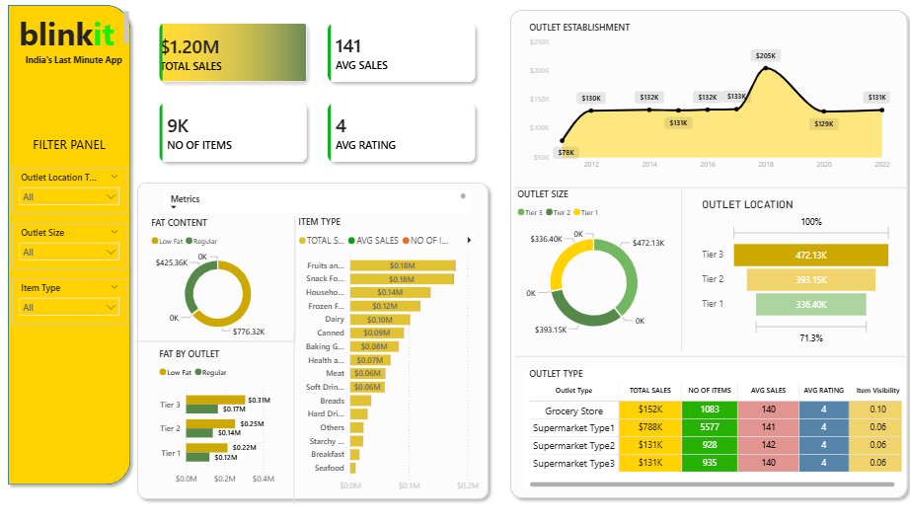
Dashboard Overview

Slide 5
Key Insights
- Tier 3 outlets contribute the highest sales
- Low-fat items generate more revenue
- Supermarket Type 1 leads in total sales
- Fruits & Snacks are top-performing categories

Slide 6
Tools & Skills Used
- Power BI
- Data Cleaning & Modeling
- DAX Measures
- Data Visualization & Business Insights

