Slide 1

IILM UNIVERSITY
STUDENT CREDENTIALS
GREATER NOIDA, UTTAR PRADESH
Ankit Kumar
Enrollment / Roll No.
Program & Batch
2410031474
B.Tech (CSE)
CISCO NETWORKING ACADEMY · VERIFIED INTERNSHIP
Network Technician
Career Path
An Internship Presentation Report
HOST ORGANIZATION
Cisco Networking Academy
INTERNSHIP DURATION
Delivered through IILM University
April 2026 – June 2026

Slide 2


Candidate & Program Overview
Candidate Details
Internship Profile
Student Name: ANKIT KUMAR
Program Name: Cisco Networking Academy Verified Path
Roll Number: 2410031474
Specialization Domain: Network Technician / Computer Networking
Degree: B.Tech (Computer Science & Engineering)
Duration: April 2026 – June 2026
Academic Batch: 2024-2028
Issued On: June 16, 2026
University: IILM University, Greater Noida, U.P.
Delivered Via: School of Computer Science & Engineering, IILM
02

Slide 3




Organization Profile: Cisco Networking Academy
Cisco Networking Academy is Cisco Systems’ global IT skills and career-building program, delivered in partnership with academic institutions worldwide to build industry-ready networking talent.
IILM Collaboration: Delivered through the School of Computer Science and Engineering, IILM University, empowering student networking talent.
Program Snapshot
3
Industry Alignment: Follows Cisco's globally recognized curriculum, bridging academic learning and real-world network-technician skills.
Courses completed
100%
Core Focus Domains: Networking Fundamentals, Ethernet Switching, IP Addressing, Wireless Configuration, and Network Security.
Verified credential
Jun 2026
Issued & verified
03

Slide 4


Problem Statement & Program Context
The Skills Gap
The Program's Scope
While engineering curricula extensively cover networking theory, students often lack hands-on exposure to configuring, securing, and troubleshooting real network devices.
This internship addresses the full scope of entry-level network technician tasks — standards, switching, addressing, wireless, routing, and troubleshooting.
Understanding protocols and addressing on paper is only one part of network literacy; diagnosing connectivity issues and securing access is rarely practiced.
Mastering Cisco Packet Tracer simulation to transform classroom concepts into configured, secured, and diagnosable network environments.
04

Slide 5




Core Project Objectives
Standards & Protocols
Ethernet & Switching
Wireless Configuration
Secure Access
Explain the importance of standards and protocols in network communications.
Explain how communication and Ethernet operate within a switched network.
Configure an integrated wireless router and client to connect securely to the internet.
Configure secure user access and apply effective troubleshooting methodology.
05

Slide 6




Technologies & Networking Toolkit
Simulation & Design
Addressing & Routing
Services & Transport
Security & Support
Environment: Cisco Packet Tracer
Schemes: IPv4 and IPv6
Services: DNS, DHCP
Access: Secure user configuration
Design: Topology building & testing
Routing: Network-layer protocols
Transport: TCP/UDP fundamentals
Support: Help-desk troubleshooting
06

Slide 7

Network Architecture
Management Layer: Secure user access controls and structured troubleshooting/help-desk procedures.
End-Device Layer
↓
Services Layer: DNS and DHCP servers providing name resolution and automatic address assignment.
Access Layer (Switch / AP)
Transport Layer: Protocols governing reliable and best-effort end-to-end host communication.
↓
Network Layer (Router)
Network Layer: Routers using routing services and protocols for end-to-end connectivity.
↓
Transport Layer
Access Layer: Switches provide Ethernet connectivity; a wireless router/AP provides secure access.
↓
Services Layer (DNS/DHCP)
07

Slide 8
Program Journey (Methodology)
Phase 1
Phase 3
Networking Essentials
Career Path Capstone
Foundational concepts: standards, protocols, Ethernet communication, IPv4/IPv6 addressing.
Switched networks, wireless config, routing, troubleshooting & secure access — the verified credential.
Phase 2
Exploring with Packet Tracer
Hands-on simulation to build, configure and test small network topologies.
Each phase concluded with assessments; the capstone required demonstrating practical skills before the Cisco-verified credential was issued.
08

Slide 9

Key Skills & Demonstrated Competencies
Network Standards & Protocols: Explained the importance of standards and protocols governing network communications.
Switched Network Operation: Demonstrated how Ethernet and switching operate within a functioning switched network.
IPv4/IPv6 Addressing & Routing: Applied addressing schemes and configured routers for end-to-end connectivity.
Wireless & Secure Access: Configured an integrated wireless router/client and secured user access on the network.
Troubleshooting & Help Desk: Applied structured troubleshooting methodology and help-desk best practices to resolve DNS/DHCP-based connectivity issues.
09

Slide 10
Certification & Official Verification
Verification Metric | Official Record / Credential Details
Credential Title | Network Technician Career Path (Verified)
Issuing Organization | Cisco Networking Academy
Academic Partnership | IILM University, Greater Noida, U.P.
Supporting Courses | Networking Essentials; Exploring Networking with Cisco Packet Tracer
Issued On | June 16, 2026
Verified By | Lynn Bloomer, Director, Cisco Networking Academy
10

Slide 11
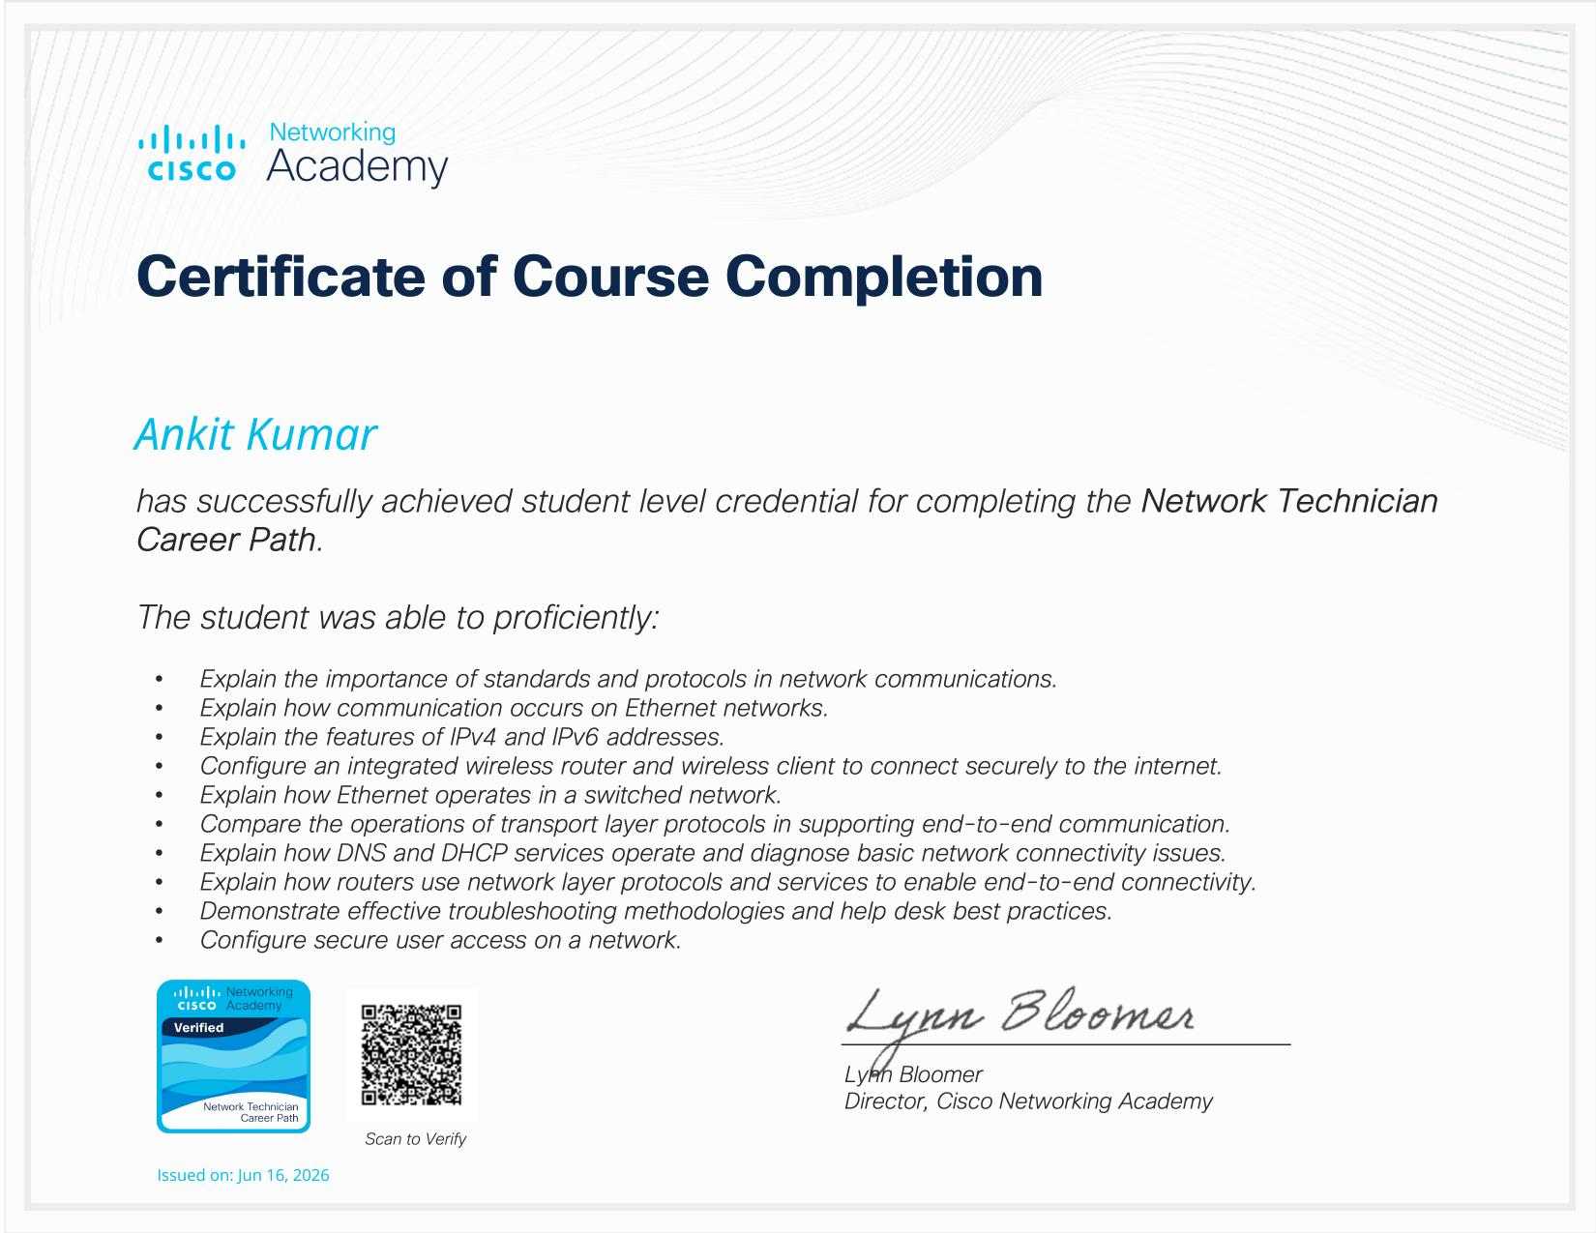
Certificate of Completion
11

Slide 12
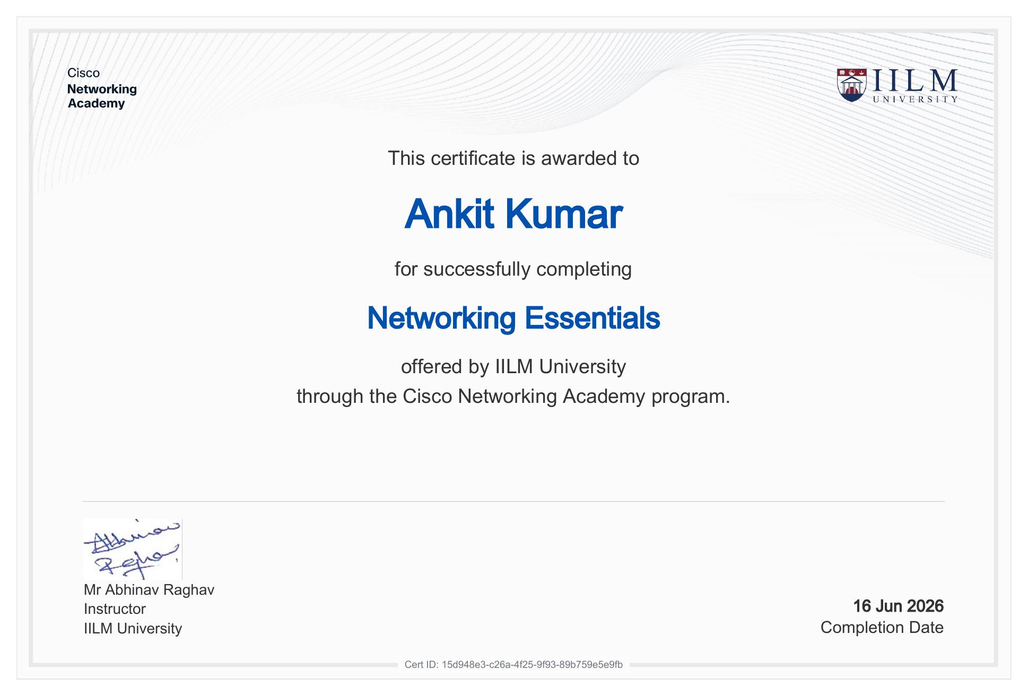
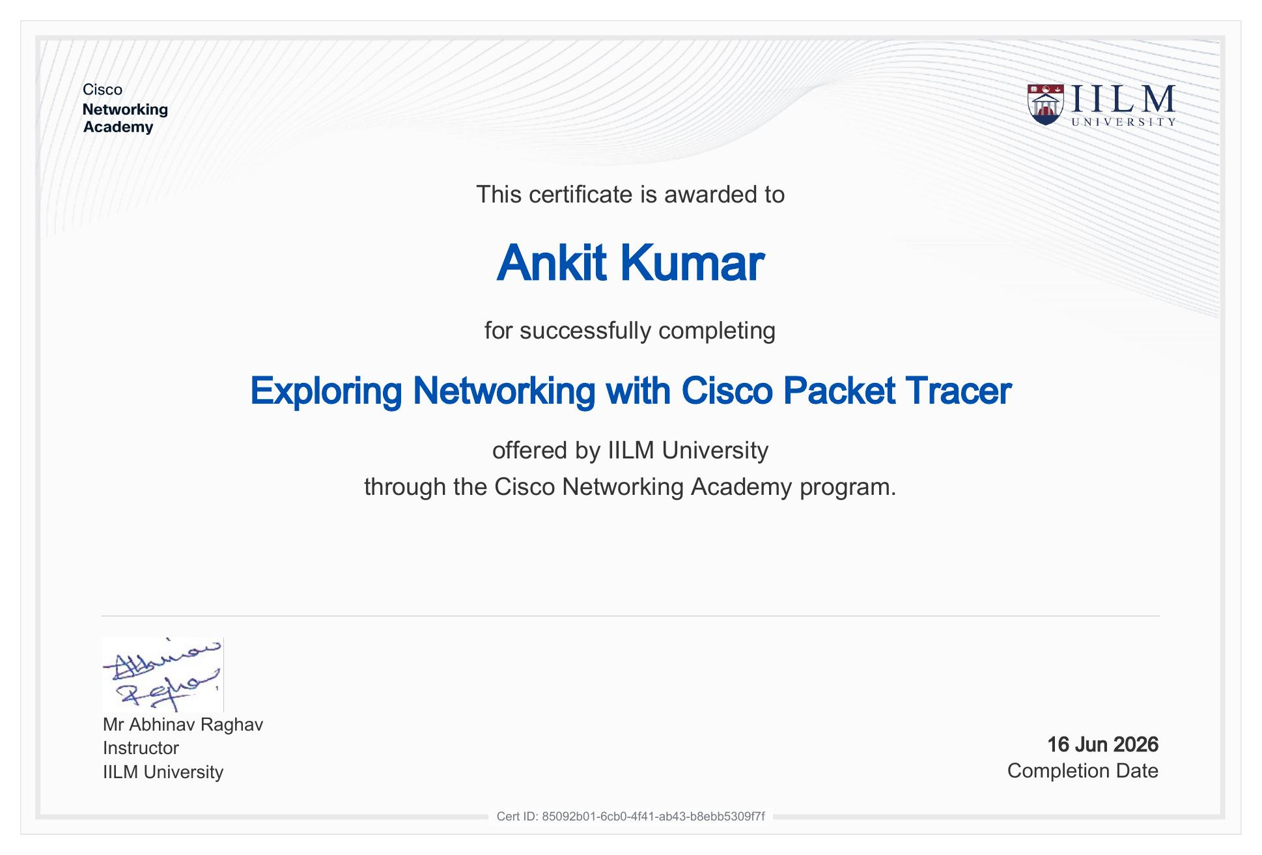
Supporting Course Certificates
12

Slide 13
Thank You!
Ankit Kumar
School of Computer Science & Engineering
Roll No: 2410031474
IILM University, Greater Noida, U.P.

