Slide 1
Introduction
To Market_metrics

Slide 2
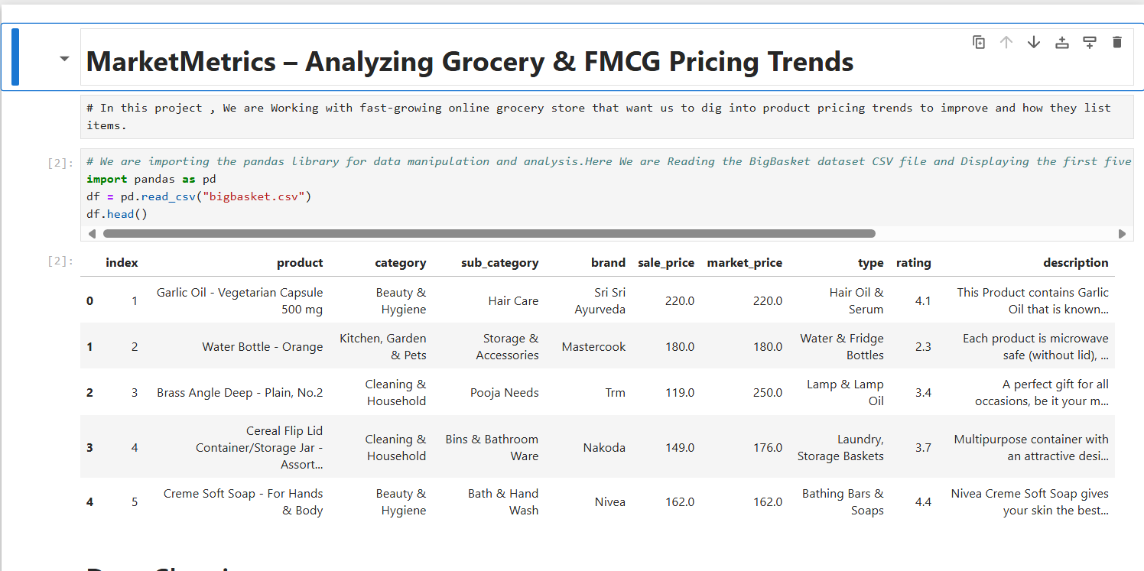

Slide 3
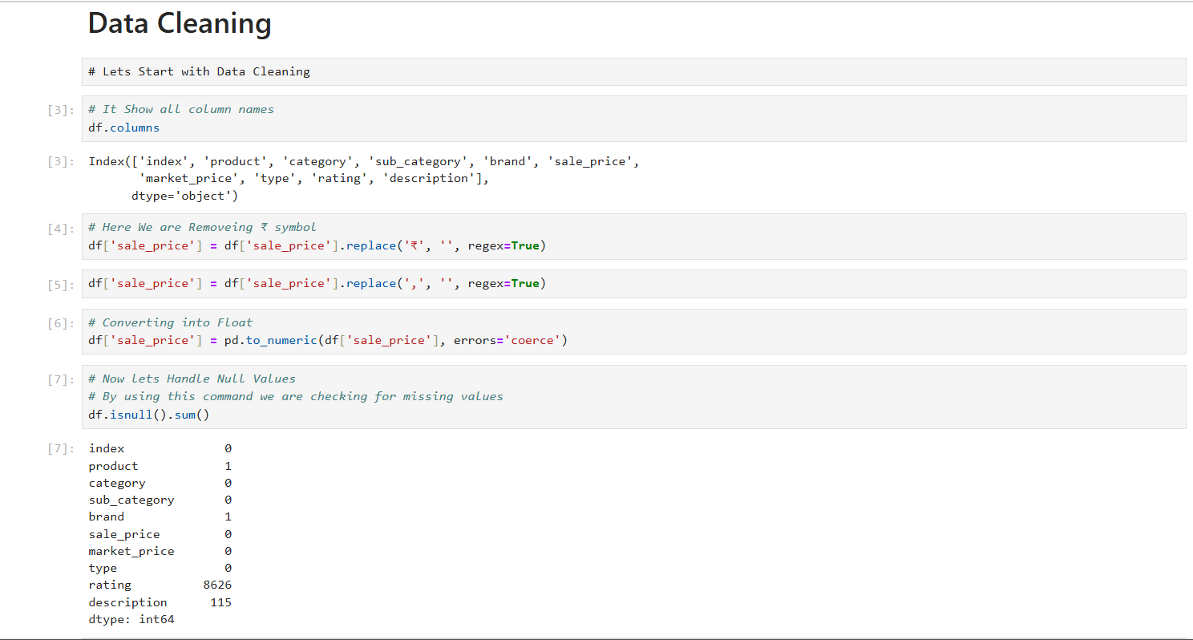
Displayed all column names to understand the dataset's structure and attributes before cleaning.
Data Cleaning
Displayed all column names to understand the dataset's structure and attributes before cleaning.
Removed currency symbols (₹) and commas from the sale_price column.

Slide 4
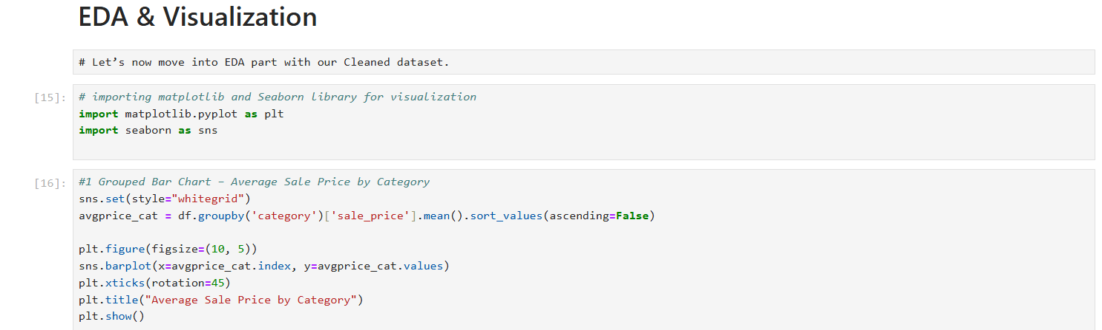
EDA & Visualization
It shows how the average sale price varies across different product categories.
Categories are sorted from highest to lowest average price.
Great for identifying premium or low-cost product segments.

Slide 5
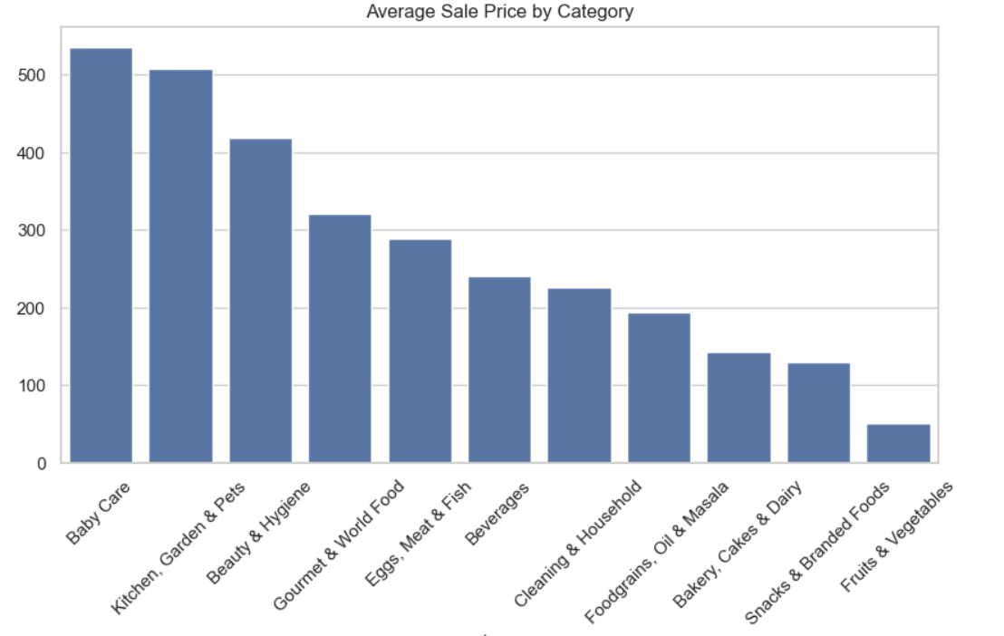
Grouped Bar Chart
Baby Care, Kitchen, and Beauty products have the highest average prices.
Fruits & Vegetables have the lowest average sale price among all categories.

Slide 6
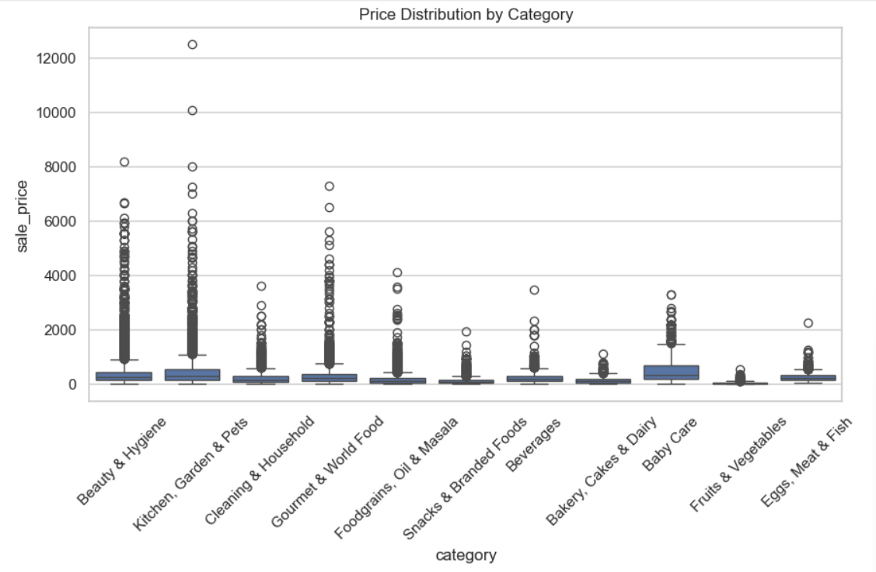
Box Plot
Most categories have a wide range of sale prices with significant outliers.
Beauty & Hygiene and Kitchen categories show high price variability.

Slide 7
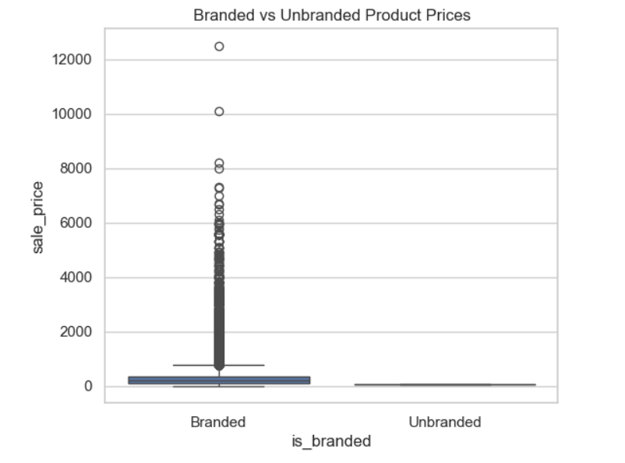
Branded vs. Unbranded Product Prices
Branded products have much higher and more variable prices than unbranded ones.
Unbranded product prices are tightly clustered at the lower end.

Slide 8
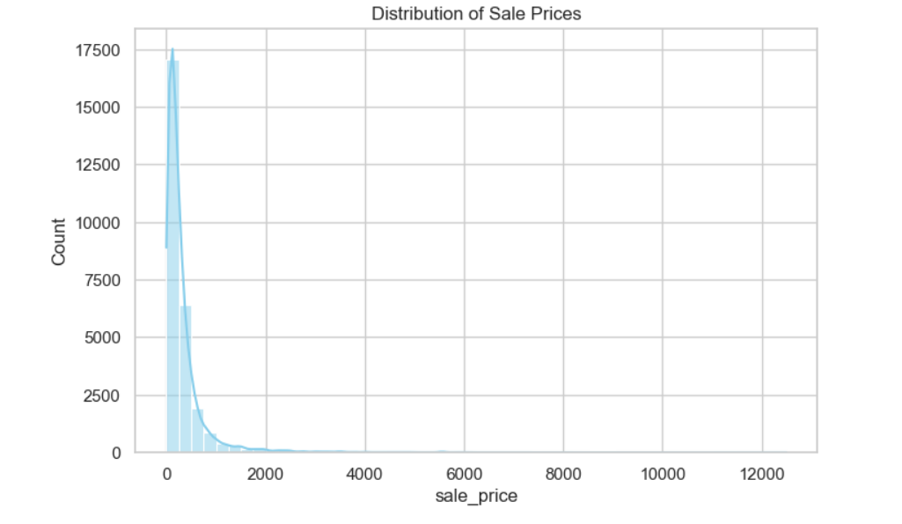
Histplot
Sale prices are right-skewed, with most products priced under ₹1000.
A few products are priced much higher, creating a long tail.

Slide 9
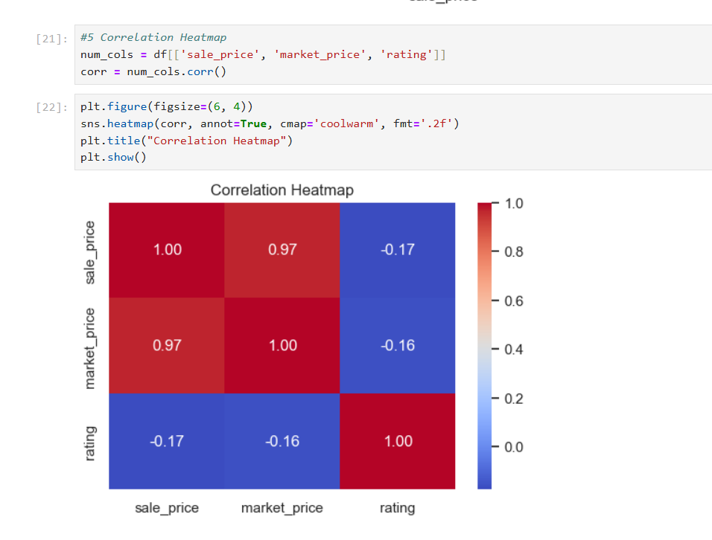
Correlation Heatmap
Sale price and market price are highly positively correlated (0.97).
Ratings have a very weak negative correlation with prices.

