Slide 1
Online Advertising Campaign Analysis
Performance Insights for Company X
(Apr–Jun 2020)
By Ankit
1

Slide 2
Introduction
Objective: Analyze the performance of online advertising campaigns to optimize ROI.
Dataset:
15,400 records from April 1, 2020, to June 30, 2020.
Key metrics: displays, cost, clicks, revenue,
post_click_conversions, post_click_sales_amount.
2

Slide 3
Data Cleaning
Missing Values: Filled with median for numeric columns
(e.g., cost, clicks).
Categorical Columns: Trimmed extra spaces
(e.g., campaign_number, user_engagement).
Date Column: Created from month and day columns for time-series analysis.
3

Slide 4
Key Findings
Top Placements: "mno" and "ghi" drove the highest displays and clicks
Banner Impact: Larger banners (e.g., 240x400) generated 3x more clicks than smaller ones.
Cost-Revenue Relationship: Moderate correlation (e.g., 0.6).
Best Campaign: "High Engagement" campaigns had a 15% conversion rate.
Average Revenue per Click: $2.50.
Post-Click Sales: Peaked in mid-May, driven by high-performing placements.
4

Slide 5
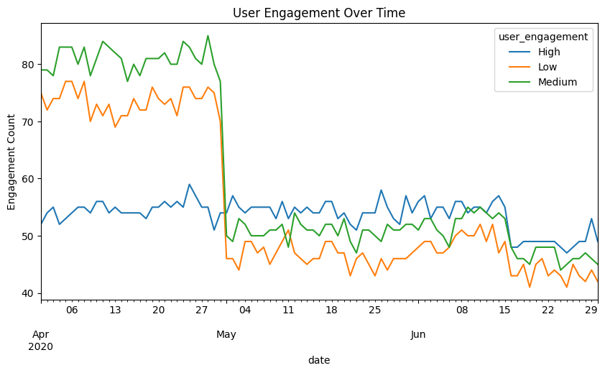
Visualizations
Graph 1: User Engagement Over Time
5

Slide 6
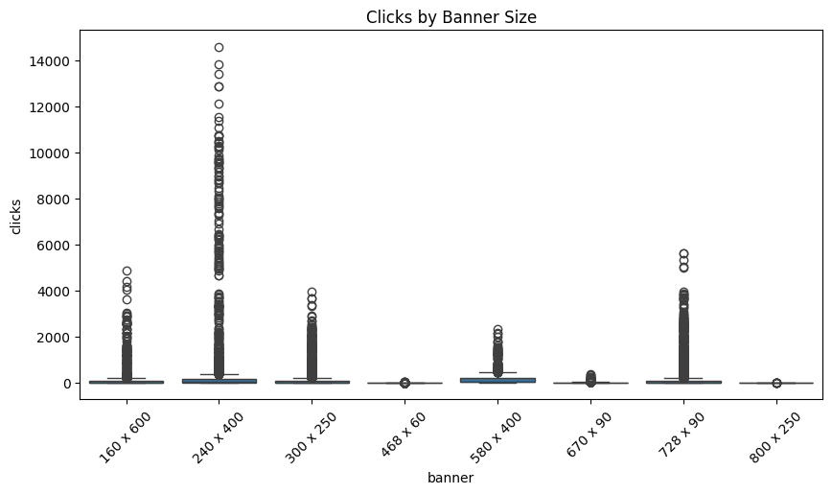
Graph 2: Clicks by Banner Size
6

Slide 7
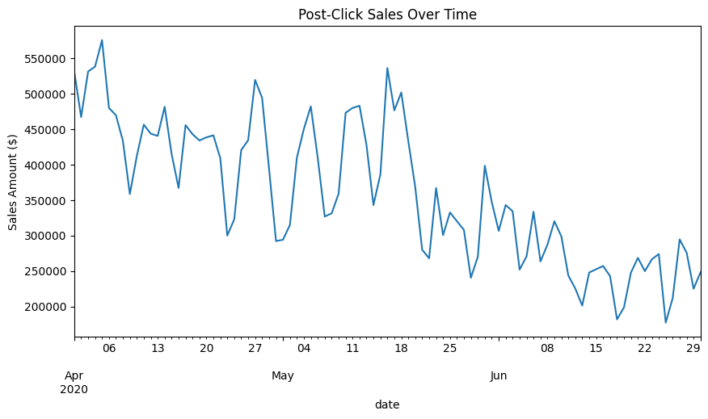
Graph 3: Post-Click Sales Over Time
7

Slide 8
Additional Insights
User Engagement by Banner Size: Larger banners (240x400) had the highest engagement.
Cost Per Click (CPC): Varied significantly across campaigns, with "camp1" being the most cost-effective.
Post-Click Conversions: Highest on weekdays (Tuesday and Wednesday).
Outliers: A few campaigns had unusually high costs but low revenue, warranting further investigation.
8

Slide 9
Recommendations
Budget Allocation: Prioritize placements like "mno" and "ghi".
Banner Strategy: Use larger sizes (240x400, 300x250) for better engagement.
Campaign Focus: Target "High Engagement" users for higher conversions.
Cost Optimization: Monitor campaigns with low ROI and reallocate budgets.
Seasonal Trends: Increase ad spend during peak engagement periods (e.g., mid-May).
9

Slide 10
Thank you
10

