Slide 1
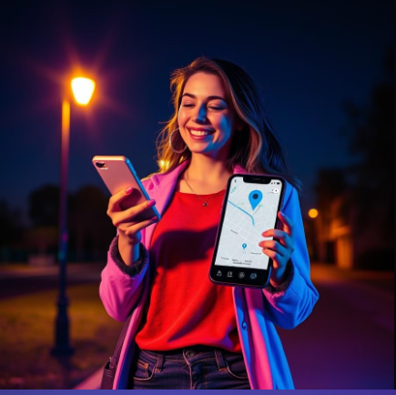
DEVELOPATHON : 2025 SMART SHIELD YOUR SAFETY ONE TAP AWAY!
Empowering individuals with real-time safety solutions through a user-friendly mobile app, Designed to leverage environmental and behavioral data for personalized risk detection, ensuring peace of mind in a world that's constantly changing.
BY - Team TECH TRIBES
RITIKA MEHRA
MANAN SINGH BHANDARI
ANKIT KUMAR PANDIT
TANISHQ SINGH
TEAM ID: DTD004

Slide 2
Smart Shield App keeps you safe by analyzing your environment and behaviour to detect threats. It sends immediate alerts and potential information to your contacts and authorities, ensuring you're always protected. Stay secure and connected with Smart Shield App.
Problem
Individuals, especially women, students, and people working alone, are increasingly vulnerable to various threats in everyday situations. Current safety solutions are primarily reactive, failing to provide real-time, proactive protection that can swiftly detect and respond to emerging dangers
Solution
This app aims to empower individuals by providing immediate alerts to trusted contacts, utilizing a multi-layered approach that combines real-time environmental detection, user behavior analysis, and customizable safety features.

Slide 3
Leveraging Technology for Proactive Safety
Behaviour Monitoring
Detects sudden changes in movement patterns, like rapid running or entering unsafe areas, triggering immediate alerts to predefined contacts.
Automatic Alerts
Sends real-time location-based emergency notifications when potential threats are detected, based on user behavior and environmental analysis.
Geo-fencing
Sets pre-defined safe zones and alerts contacts if the user unexpectedly leaves these zones, providing an additional layer of protection.

Slide 4
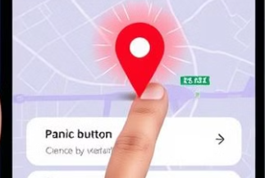
Empowering Users with Control and Choice
Panic Button
Provides a direct, manual trigger for sending emergency alerts to contacts,
giving users instant control in urgent situations.
Voice Activation
Responds to simple voice commands, such as "Help me," to activate
emergency actions like sending alerts or sharing location details.
Live Location Sharing
Enables users to share their real-time GPS location with selected
contacts or authorities, providing critical information during an emergency.

Slide 5
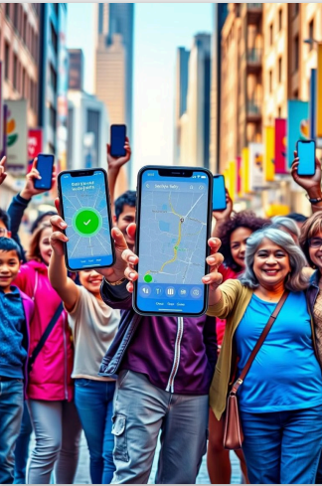
Building a Future of Safer Communities
User-Centric Design
Focusing on creating a user-friendly, intuitive, and accessible app that
empowers individuals to take control of their safety.
Data Security and Privacy
Implementing robust measures to protect user data and ensure privacy,
learning user trust and fostering a sense of security.
Community Engagement
Collaborating with local communities, organizations, and authorities to raise awareness and integrate the app into existing safety initiatives.

Slide 6

BY-
Team TECH TRIBES

