Slide 1
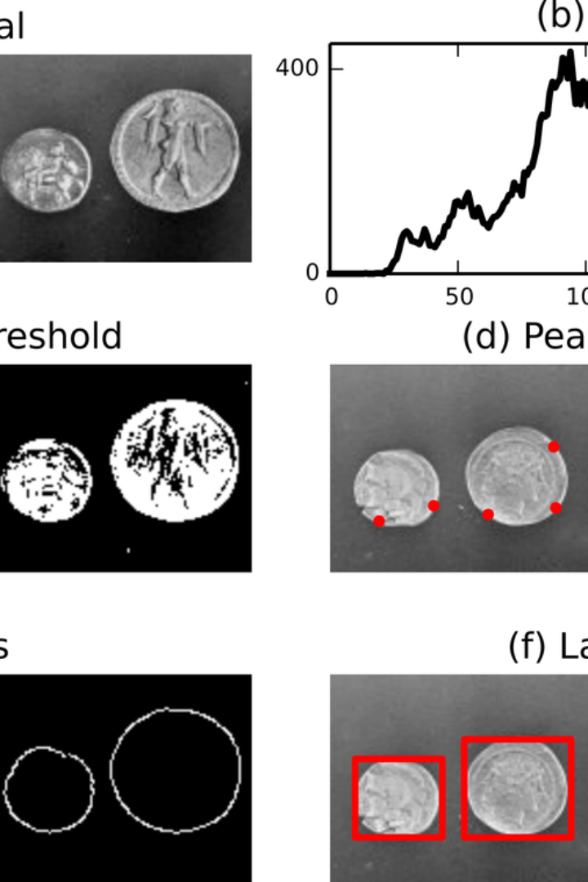


Coin Counter Project
The "Coin Counter" project is a computer vision-powered system designed to analyse live video input for the detection and identification of various coins, along with their respective values. The project utilizes functions from openCV, cvzone, and numpy libraries to preprocess the images for accurate analysis. Notably, functions such as GaussianBlur, Canny, Dilate, morphologyEx, and resize are employed to process the images effectively. It's important to highlight that the system achieves these objectives without the use of any machine learning or deep learning algorithms.
by just_another 3d_object

Slide 2
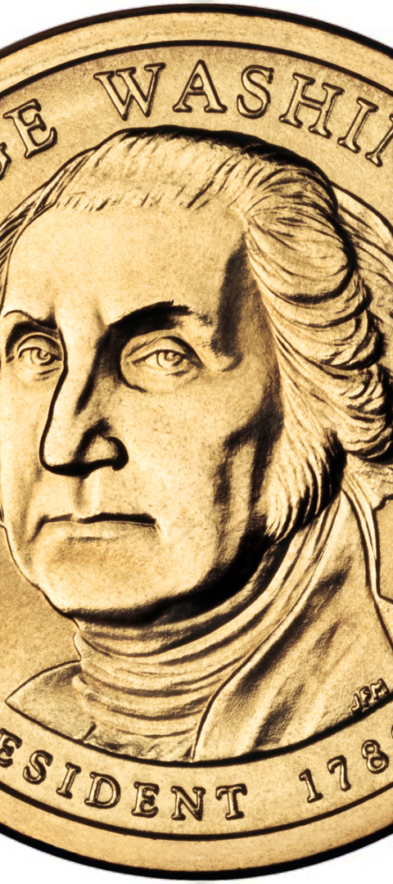
Surface Area and Color Analysis
1
Surface Area Calculation
The project actively computes the surface area of the coins in the frames to facilitate the accurate prediction of coin values. Improved surface area calculation enhances the precision and reliability of the coin identification process.
2
Color Recognition
Through the analysis of coin colors, the project is capable of predicting the values of the coins. Color analysis plays a pivotal role in recognizing and differentiating various coin denominations in the video frames.

Slide 3
Image Processing Techniques
GaussianBlur
Canny and Dilate
MorphologyEx and Resize
The GaussianBlur function is utilized to reduce noise and detail in the images, enabling better extraction of coin features for accurate assessment.
Functions like Canny and Dilate contribute to edge detection and expansion for enhanced image analysis, positively impacting the accuracy of coin identification.
Utilization of MorphologyEx and Resize functions further refines the images for optimal analysis, providing detailed insights into the coin attributes for precise value determination.

Slide 4



Leaders in Computer Vision
openCV
numpy
cvzone
An essential library for computer vision-related projects, providing extensive functionalities for image analysis and processing.
Highly regarded for numerical computing, numpy plays a significant role in the efficient manipulation of arrays for image representation.
A powerful library augmenting openCV, offering solutions for simplified and effective image processing and analysis.

Slide 5
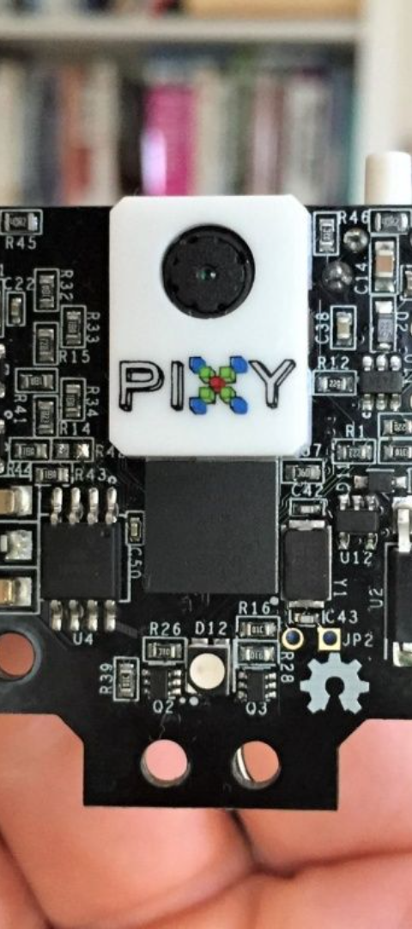
Smart Application of Tools
1
Efficient Preprocessing
2
Dynamic Analysis
Utilization of the proper techniques enables efficient preprocessing, ensuring images are well-suited for accurate coin identification.
The project leverages a dynamic approach to image analysis, enabling real-time assessment and accurate value prediction of the coins.
3
Seamless Integration
The seamless integration of different libraries facilitates a comprehensive and cohesive approach to coin value determination through computer vision.

Slide 6
Impressive Precision and Efficiency
Accurate Coin Identification
Real-time Value Display
Enhanced User Experience
The project excels in accurately identifying various coins and accurately predicting their values, showcasing impressive precision in coin analysis.
It successfully computes and displays the total value of the money in real-time, showcasing efficient and valuable computational capability.
The system contributes to an enhanced user experience through its efficient and precise coin identification and value prediction capabilities.

